Slide 1
Signature Forgery Detection
Submitted by:
Someindra Kumar Singh(13000214101)

Slide 2
Introduction
A recap of things done and discussed earlier
Different types of Forgeries namely simple, skilled and forged
Discussion on how we can use unsupervised learning to extract features by identifying clusters
Preprocessing the data and its importance
Different steps in preprocessing the data
Reshaping the data for the purpose of training
1

Slide 3
Work Flow and Network Models
Input 1
CNN
Preprocessing Module
Discriminator
Input 2
CNN
2

Slide 4
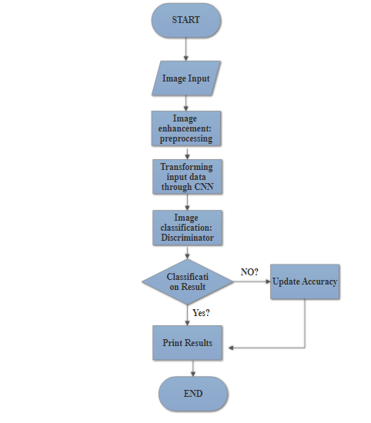
FLOWCHART:
3

Slide 5
Gray Image
Gray Image
Scale Image
Standard dimensions image
Reduce Noise
Denoised Image
Eliminate Background
B&W background eliminated image
Preprocessing and Standardizing the image
Steps
4

Slide 6
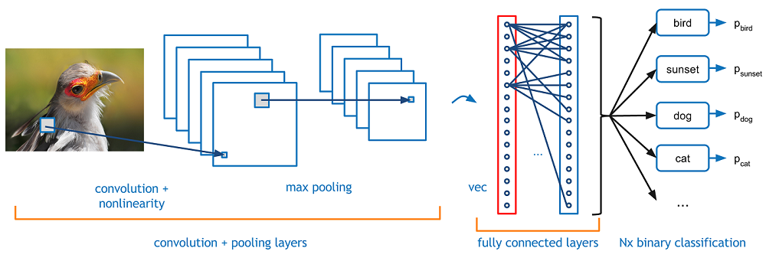
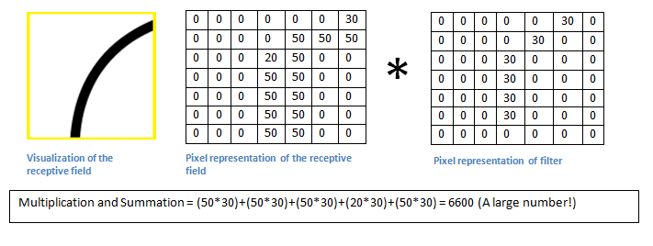
Feature Extraction, Convolution Neural Networks:
We use Convolutional Neural Networks with MaxPooling2D and fully connected layers.
CNN are very useful in extracting features from an image and have been proved to work in diverse backgrounds
6

Slide 7
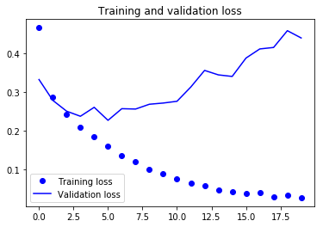
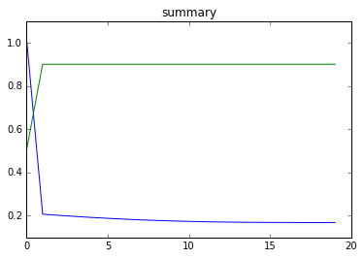
Tussle with Over-fitting: CNN
The training loss linearly decreased at the start and then started to increase and occasional downfalls. This suggests that the system tried to memorize the data and successfully did.
To avoid over fitting we added drop out to the network. Dropout randomly turns off a fraction of neurons during the training process, reducing the dependency on the training set by some amount. How many fractions of neurons you want to turn off is decided by a hyper parameter, which can be tuned accordingly. This way, turning off some neurons will not allow the network to memorize the training data since not all the neurons will be active at the same time and the inactive neurons will not be able to learn anything.
8

Slide 8
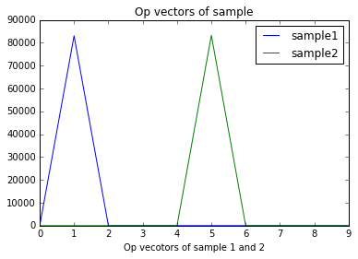
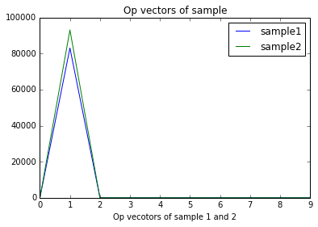
Visualization of outputs from CNN:
In figure 1, the outputs vector suggests that signature are from 2 different classes. It makes an appeal for random forgery. The difference in spikes may or may not be large.
In figure 2, we see that the 2 signatures belong to the same class. But the difference between the two is large enough. Which makes strong case for a forged signature
7

Slide 9
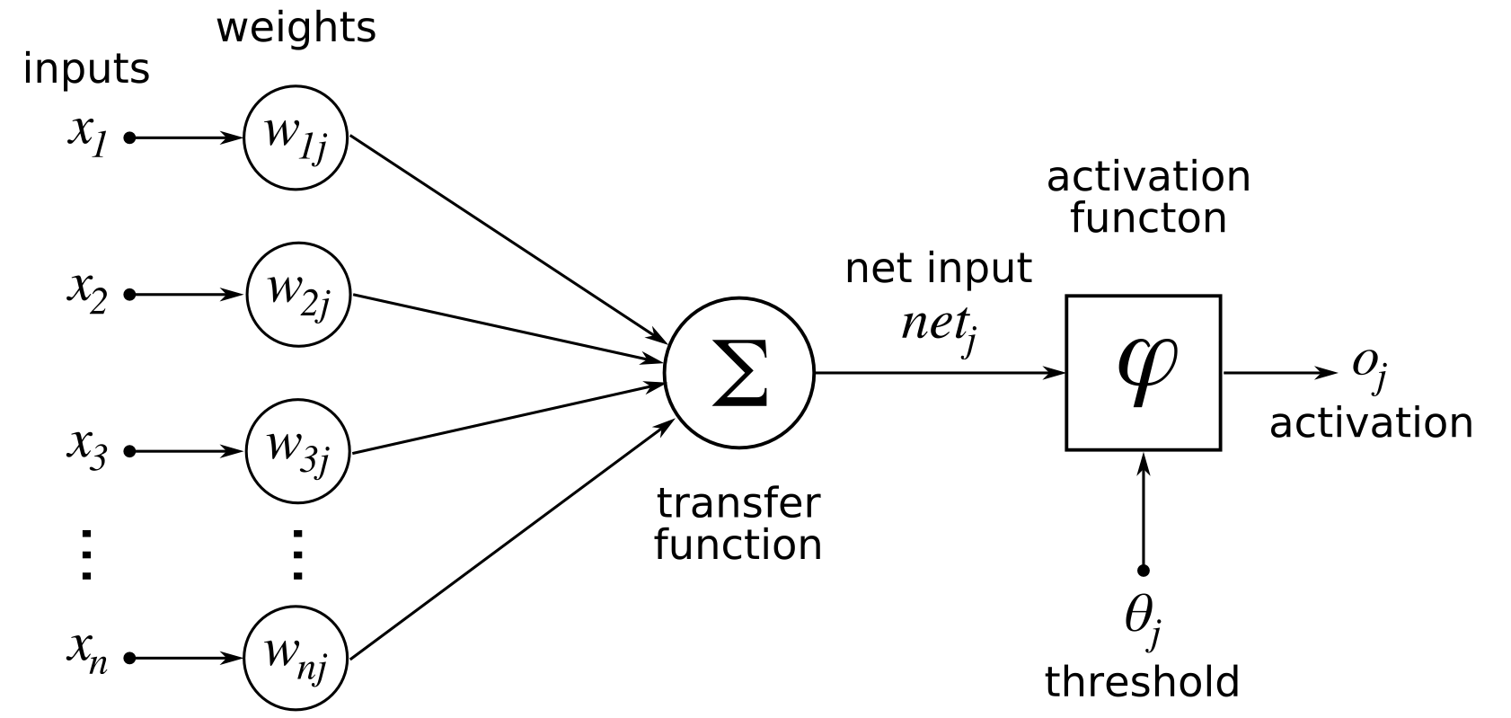
Learning through Differential: Discriminator
As we have seen that the task at hand is to predict the status of forgery. We have created a 2 -tuple information for that. If the signatures belong to the same class then what is required is to learn the differential to understand what swings can a person make while making its signature.
We use Sequential non-recurrent neural networks to make final classification
9

Slide 10

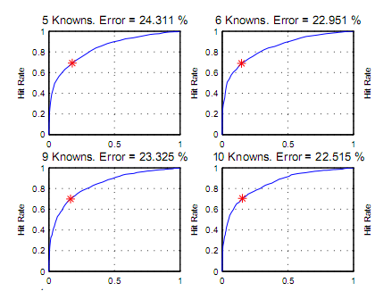
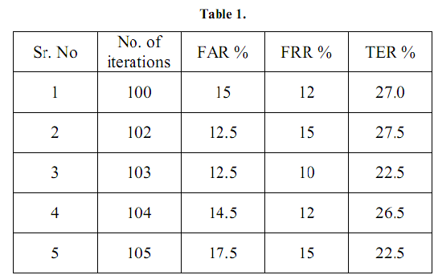
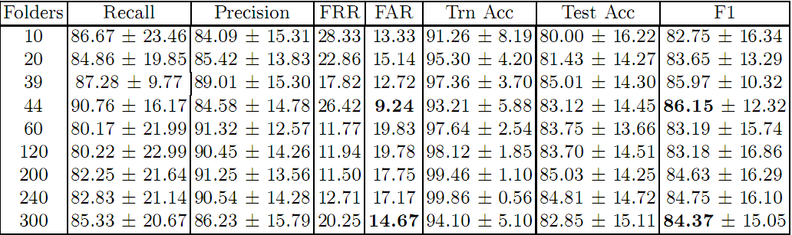
Results and Conclusion
10

Slide 11
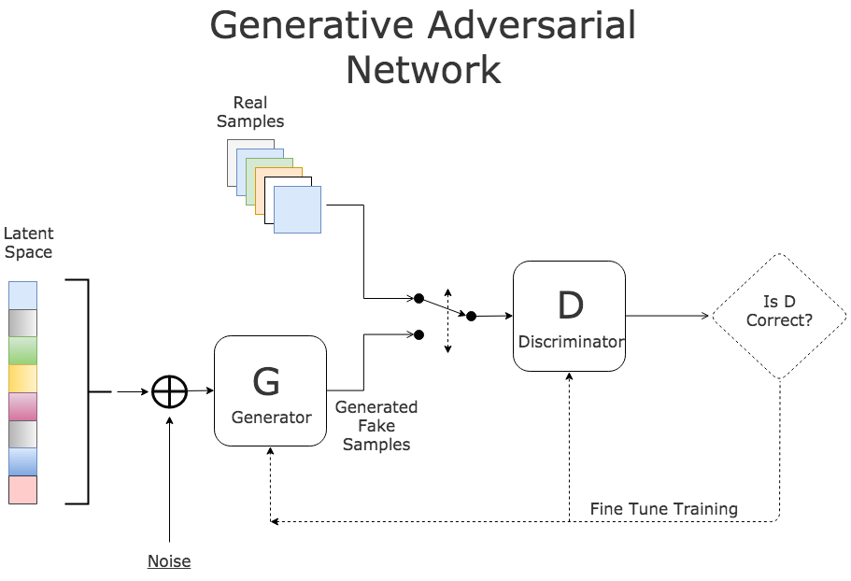
Further Enhancement
Use of generalized adversarial networks
11

Slide 12
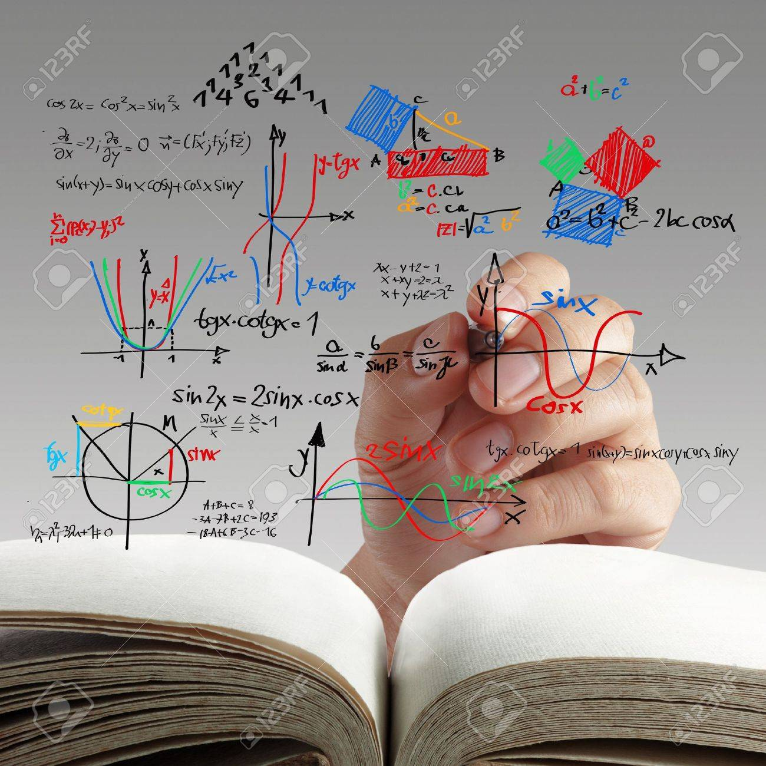
THANK YOU.!
I AM NOW OPEN TO QUESTIONS

