Slide 1
Not your daddy’s .NET
The workshop
#NYDDN

Slide 2
Index
Rules of engagement
Recap March 29
What's new
Setting up
.NET Core cli
.NET Standard
Giveaways
ASP.NET Core
EF Core
Wrap up and drinks

Slide 3
Rules of engagement
Ask anything, there are no stupid questions
Ask for help
Respect each other
Divert from plan and dive deeper
Learn and Teach
Have fun!

Slide 4
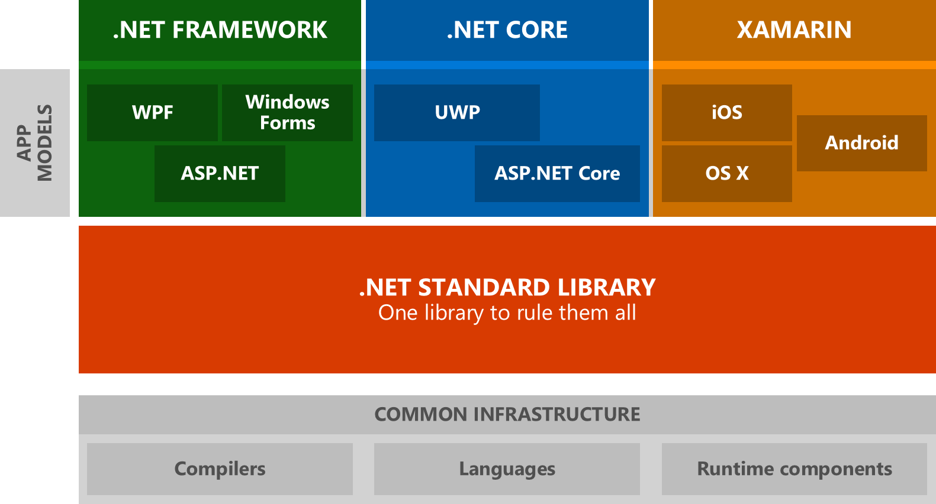
Recap
.NET Core - the basics
Why the reboot
.NET Standard
Tooling
EF Core
ASP.NET Core
ASP.NET Core – Web API
ASP.NET Core – MVC

Slide 5
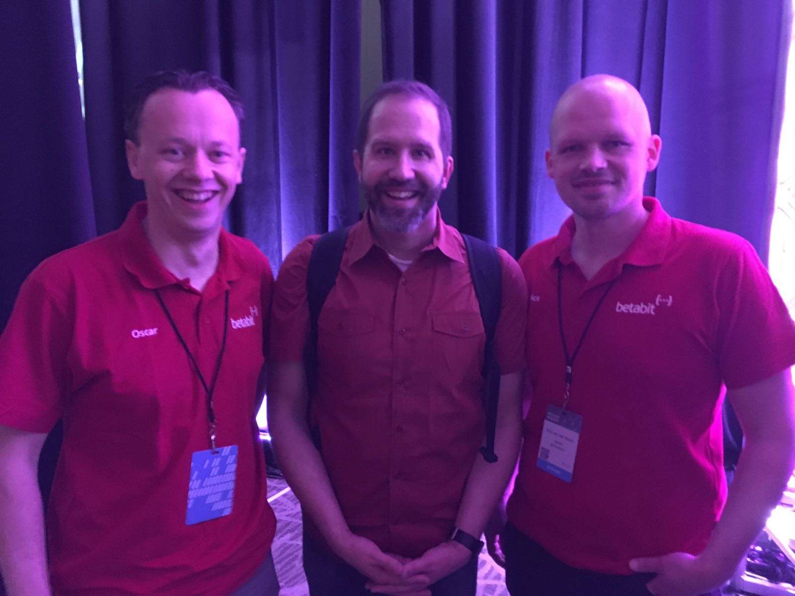
What’s new
.NET Core Previews
VS update 3 preview
ASP.net core
SignalR
EF Core
XAML Standard
Notes:
Core previews:
VS Update 3: Now available as side by side install
ASPNet Core: Razor Pages
SignalR: Core
EF Core: TODO..

Slide 6
Razor Pages
Page-focused (smaller) scenarios
ASP.NET Core 2.0.0 or later (VS2017.3 or later)
On by default
Convention
Notes:
Easier for beginners, scripters. More scripting like (ASP / PHP)
Pages folder
WebMatrix anyone?

Slide 7
SignalR
No more…
jQuery dependency
auto-reconnect with message replay
hub-state
multi-hub endpoints
single-model scale-out
multi-server ping-pong (now require sticky sessions)

Slide 8
SignalR
Supports binary data
Host-agnostic (enables non-HTTP transports)
All-new connectuion-level “Endpoints” API
Multiple protocols/formats support (JSON, protobuf, custom)
Support ‘pure’ WebSockets clients
Return results from client method invocations
TypeScript client
Flexible scale-out extensibility

Slide 9
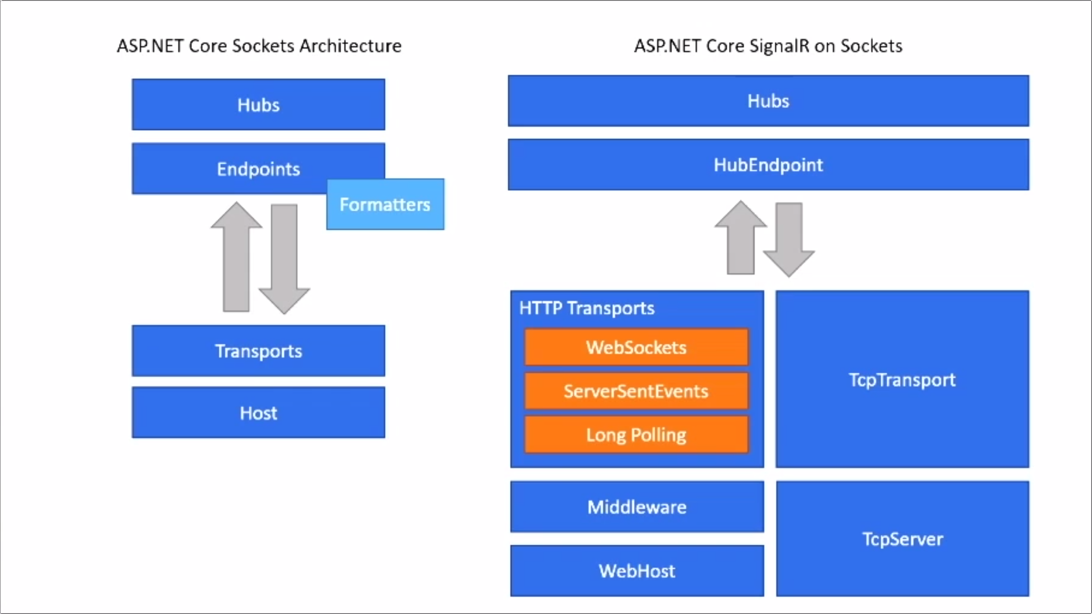
SignalR
Notes:
No more ForeverFrame!!

Slide 10
Setting up
Get the stuff you need via the links in the readme:
https://github.com/betabitnl/nyddn-ws
vs2017
Core 1.1
Localdb?
Optional:
Preview 3
Core 2.0

Slide 11
.NET Core cli
Create a hello world console app
DotNetCoreCli.Lab.HelloWorld/lab.md
Notes:
Quick start demo’s from command line

Slide 12
.NET Standard
Create a lib and use it from two frameworks
DotNetStandard.Lab.ShareLib.sln
Get both console apps in the solution to build and run
Add some real world scenario code and NuGet packages in there (daytime code?)

Slide 13
Giveaways
How many API’s are supported in .NET Standard 2.0?
https://github.com/dotnet/standard/tree/master/docs/versions​
32,638
Notes:
https://github.com/dotnet/standard/blob/master/docs/faq.md
2.0: 32,638
1.6: 13,501
1.3: 13,122

Slide 14
ASP.NET Core
TAG Helpers lab
AspNetCore.Lab.TagHelpers.sln
Dependency injection and middleware lab
AspNetCore.Lab.DiMw.sln
Pages lab (vs preview 3)
AspNetCore.Lab.Pages.sln

Slide 15
EF Core
From scratch lab (Code first) & In memory testing lab
EntityFrameworkCore.Lab.CfAndImt.sln
Scaffolding
Do you have an existing db? Try scaffolding it!
https://github.com/betabitnl/nyddn/
EF Core 2.0
Try running some new prerelease features from Rowan Miller's session at MSBuild17?
https://github.com/rowanmiller/Demo-EFCore
Notes:
OS

Slide 16

Wrap up and drinks

