Slide 1

The Albatrone
Simon Blom, Sameh Mikhail, Romy Schardam

Slide 2
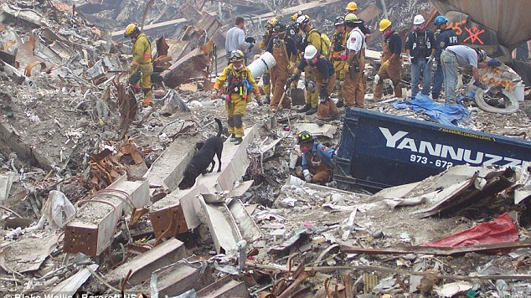
Introduction
Search and Rescue mission
Dogs
Police
Search parties
Natural disasters?
Minor missions?
Deze foto van Onbekende auteur is gelicentieerd onder CC BY-NC-ND
Notes:
Relevance and impact

Slide 3
Bio-Inspiration
Romy

Slide 4
Technical Details
Simon

Slide 5
Future improvements
Bigger

