Slide 1
Practice 11.
Perform simple tutorial on Git

Slide 2
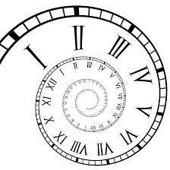
What is “version control”?
Version control is a system that records changes to a file or set of files over time so that you can recall specific versions later.
It allows you to revert selected files back to a previous state, revert the entire project back to a previous state, compare changes over time, see who last modified something that might be causing a problem, who introduced an issue and when, and more.
Notes:
A system called version control keeps track of changes made to a file or group of files over time so that you may retrieve certain versions at a later time.
It enables you to compare changes over time, identify who last edited anything that could be creating an issue, who originated an issue and when, and more. You can even roll back certain files or the entire project to a prior state.

Slide 3
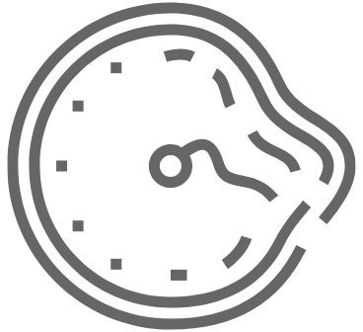
What is “version control”?
Using a VCS also generally means that if you screw things up or lose files, you can easily recover.
In addition, you get all this for very little overhead.
Notes:
Additionally, you can usually simply restore data if you make mistakes or lose them when using a VCS.
You also receive all of this for a very little overhead.

Slide 4

Version control issue
Many people’s version-control method of choice is to copy files into another directory (perhaps a time-stamped directory, if they’re clever).
This approach is very common because it is so simple, but it is also incredibly error prone. It is easy to forget which directory you’re in and accidentally write to the wrong file or copy over files you don’t mean to.
To deal with this issue, programmers long ago developed local VCSs that had a simple database that kept all the changes to files under revision control.
Notes:
A common approach to version control is for users to copy items to a different directory (maybe even a time-stamped directory, if they're really crafty).
Due to its simplicity, this method is widely used, yet it is also quite mistake prone. It is simple to inadvertently write to the incorrect file or copy over files you don't want to since you can easily forget which directory you are in.
Programmers created local revision control systems (VCSs) with a basic database that stored all file modifications under revision control ages ago in order to address this problem.

Slide 5
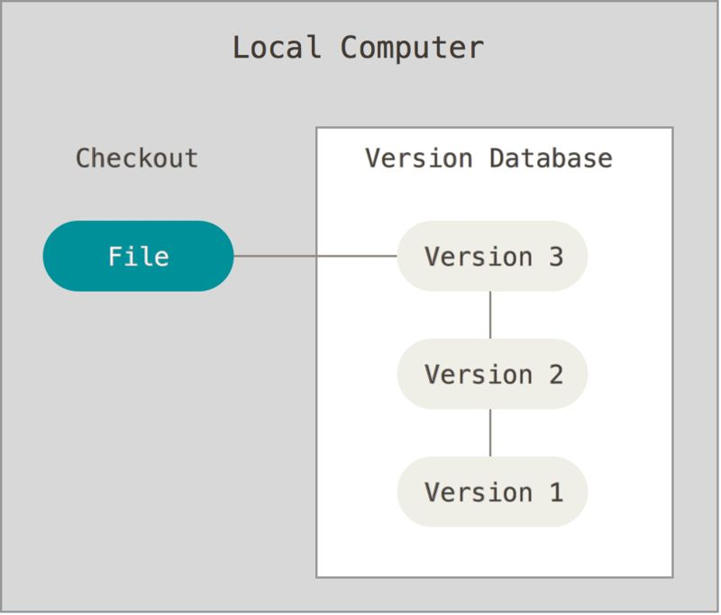
Local version control
One of the most popular VCS
tools was a system called RCS, which is still distributed with many computers today.
RCS works by keeping patch sets
(that is, the differences between files) in a special format on disk; it can then re-create what any file looked like at any point in time by adding up all the patches.
Notes:
An RCS system was one of the most widely used VCS tools; it is still included with many PCs today.
RCS operates by storing patch sets, or the variations between files, in a unique format on disk. By adding up all of the patches, it is then able to reconstruct the appearance of any file at any given moment.

Slide 6
Version control issue 2
The next major issue that people encounter is that they need to collaborate with developers on other systems. To deal with this problem, Centralized Version Control Systems (CVCSs) were developed.
These systems (such as CVS, Subversion, and Perforce) have a single server that contains all the versioned files, and a number of clients that check out files from that central place. For many years, this has been the standard for version control.
Notes:
The necessity of working with developers on other platforms is the next significant problem that individuals run across. Centralized Version Control Systems (CVCSs) were created as a solution to this issue.
These systems, which include Perforce, CVS, and Subversion, feature many clients that check out files from a single server that has all of the versioned files. This has been the accepted method of version control for a long time.

Slide 7
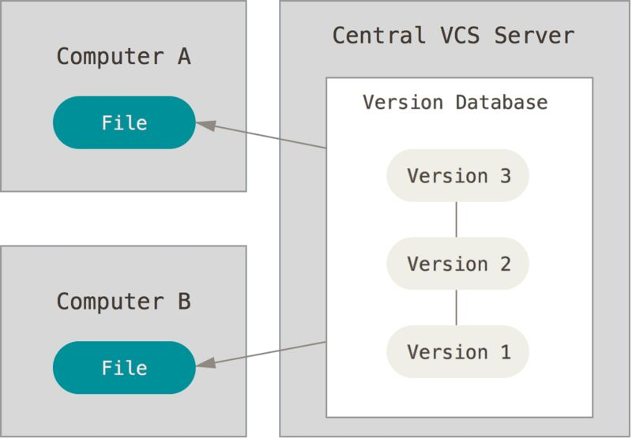
Centralized version control
This setup offers many
advantages, especially over local VCSs.
For example, everyone knows to a
certain degree what everyone else on the project is doing.
Administrators have fine-grained
control over who can do what, and it’s far easier to administer a CVCS than it is to deal with local databases on every client.
Notes:
In particular, this configuration has several benefits over local VCSs.
For instance, everyone on the project is somewhat aware of what everyone else is doing.
In addition to having far more control over who can do what, administrators find that managing a CVCS is significantly simpler than managing local databases for each client.

Slide 8

CVC’s downside
The most obvious is the single point of failure that the centralized server represents. If that server goes down for an hour, then during that hour nobody can collaborate at all or save versioned changes to anything they’re working on.
If the hard disk the central database is on becomes corrupted, and proper backups haven’t been kept, you lose absolutely everything — the entire history of the project except whatever single snapshots people happen to have on their local machines.
Notes:
The centralized server's role as a single point of failure is the most evident. Nobody will be able to communicate at all or save versioned changes to whatever they're working on if the server goes down for an hour.
All project history, with the exception of any individual snapshots that users may have on their local computers, is lost if the hard drive housing the central database gets damaged and adequate backups have not been maintained.

Slide 9


CVC vs. Local VCSs
- Local VCSs suffer from this same problem — whenever you have the entire history of the project in a single place, you risk losing everything.
Notes:
The similar issue affects local VCSs: having the complete project history in one location puts everything at danger of being lost.

Slide 10

Solution
This is where Distributed Version Control Systems (DVCSs) step in.
In a DVCS (such as Git, Mercurial, Bazaar or Darcs), clients don’t just check out the latest snapshot of the files; rather, they fully mirror the repository, including its full history.
Thus, if any server dies, and these systems were collaborating via that server, any of the client repositories can be copied back up to the server to restore it.
Every clone is really a full backup of all the data.
Notes:
Distributed Version Control Systems (DVCSs) come into play here.
Clients of a distributed version control system (DVCS), like Git, Mercurial, Bazaar, or Darcs, mirror the whole repository, including all of its past versions, rather than simply the most recent snapshot of the contents.
As a result, any client repository may be transferred back up to the server in order to recover it in the event that a server fails and these systems were cooperating through it.
In actuality, each clone is a whole backup of all the data.

Slide 11
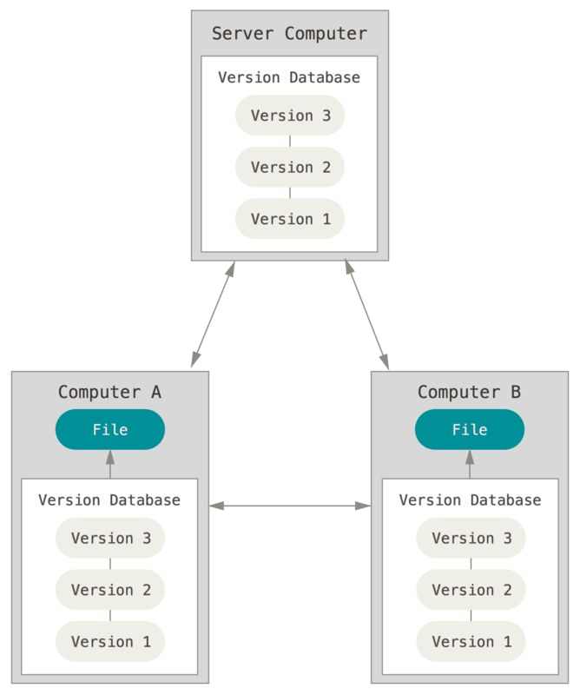
Distributed version control
Furthermore, many of these systems deal pretty well with having several remote repositories they can work with, so you can collaborate with different groups of people in different ways simultaneously within the same project.
This allows you to set up several types of workflows that aren’t possible in centralized systems, such as hierarchical models.
Notes:
Additionally, a lot of these platforms handle handling multiple remote repositories rather effectively, allowing you to concurrently communicate with many groups of people on the same project in various ways.
This enables you to set up a variety of operations, including hierarchical models, that aren't feasible in centralized systems.

Slide 12

So, what is Git in a nutshell?
This is an important section to absorb, because if you understand what Git is and the fundamentals of how it works, then using Git effectively will probably be much easier for you.
As you learn Git, try to clear your mind of the things you may know about other VCSs, such as CVS, Subversion or Perforce — doing so will help you avoid subtle confusion when using the tool.
Even though Git’s user interface is fairly similar to these other VCSs, Git stores and thinks about information in a very different way, and understanding these differences will help you avoid becoming confused while using it.
Notes:
This is a crucial section to read through since it will help you use Git more efficiently if you grasp its definition and the basic principles of how it operates.
Try to forget about any knowledge you may have of other version control systems (VCSs), such as CVS, Subversion, or Perforce, while you study Git. This will help you avoid subtle misunderstanding when using the tool.
Git stores and processes information considerably differently from these other VCSs, despite the fact that its UI is somewhat similar to theirs. Knowing these distinctions will help you use Git more effectively and prevent confusion.

Slide 13
Snapshots, Not Differences
The major difference between Git and any other VCS (Subversion and friends included) is the way Git thinks about its data.
Conceptually, most other systems store information as a list of file-based changes.
These other systems (CVS, Subversion, Perforce, Bazaar, and so on) think of the information they store as a set of files and the changes made to each file over time (this is commonly described
as delta-based version control).
Notes:
Git's approach to data management sets it apart from all other version control systems (VCS), including Subversion and its allies.
In theory, data is stored in most other systems as a list of file-based modifications.
The information that these other systems (such as CVS, Subversion, Perforce, Bazaar, and so on) hold is conceptualized as a collection of files and the modifications made to each file over time (a practice known as delta-based version control).

Slide 14
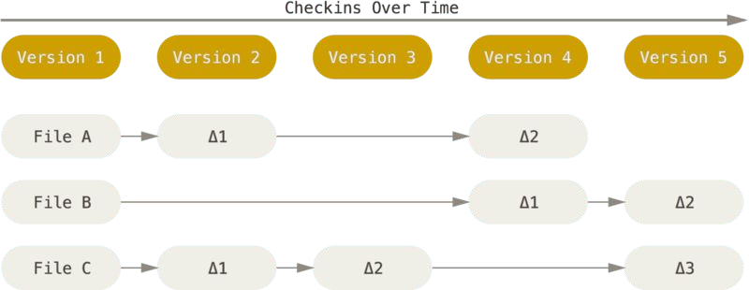
Storing data as changes to a base version of each file

Slide 15
Storing data as changes to a base version of each file
Git doesn’t think of or store its data this way.
Instead, Git thinks of its data more like a series of snapshots of a miniature filesystem.
With Git, every time you commit, or save the state of your project, Git basically takes a picture of what all your files look like at that moment and stores a reference to that snapshot.
To be efficient, if files have not changed, Git doesn’t store the file again, just a link to the previous identical file it has already stored.
Git thinks about its data more like a stream of snapshots.
Notes:
This is not how Git views or stores its data.
Rather, Git views its data more as a collection of snapshots taken from a small filesystem.
Git essentially takes a snapshot of all of your files at that exact instant and saves a reference to it each time you commit, or save the state of your project.
In order to save space, Git only saves a link to the same file that it has already saved in the event that a file has not changed.
Git views its data more as a continuous series of snapshots.

Slide 16
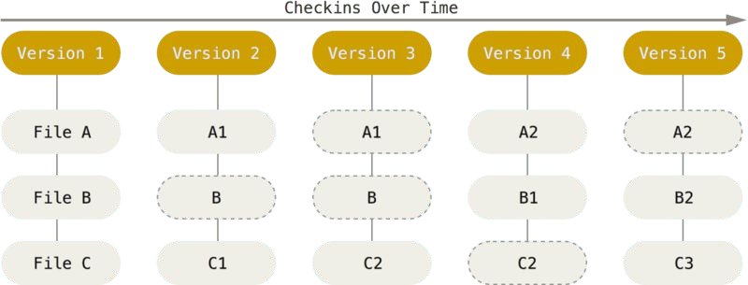
Storing data as snapshots of the project over time

Slide 17
Storing data as snapshots of the project over time
This is an important distinction between Git and nearly all other VCSs.
It makes Git reconsider almost every aspect of version control that most other systems copied from the previous generation.
This makes Git more like a mini filesystem with some incredibly powerful tools built on top of it, rather than simply a VCS.
We’ll explore some of the benefits you gain by thinking of your data this way when we cover Git branching in Git Branching.
Notes:
This is a crucial way that Git differs from almost every other VCS.
Nearly every facet of version control, which the majority of other systems imitated from the prior generation, is reexamined by Git.
This turns Git from being just a VCS into something more akin to a small filesystem with some really strong tools built on top of it.
When we discuss Git branching in Git Branching, we'll go over a few advantages of seeing your data in this manner.

Slide 18

Git Generally Only Adds Data
When you do actions in Git, nearly all of them only add data to the Git database.
It is hard to get the system to do anything that is not undoable or to make it erase data in any way.
As with any VCS, you can lose or mess up changes you haven’t committed yet, but after you commit a snapshot into Git, it is very difficult to lose, especially if you regularly push your database to another repository.
Notes:
Almost every operation you perform in Git adds information to the Git database.
It is difficult to make the system do something that cannot be reversed or to have it delete data in any manner.
Changes you haven't committed can be lost or messed up, just like with any other VCS. However, once you commit a snapshot into Git, it is very difficult to lose, especially if you push your database to a different repository on a frequent basis.

Slide 19
The Three States
- Pay attention now — here is the main thing to remember about Git if you want the rest of your learning process to go smoothly. Git has three main states that your files can reside in: modified, staged, and committed:
Notes:
Now pay attention—if you want the remainder of your learning process to go smoothly, this is the most important thing to know about Git. Your files can be in one of three basic states with Git: edited, staged, or committed.

Slide 20


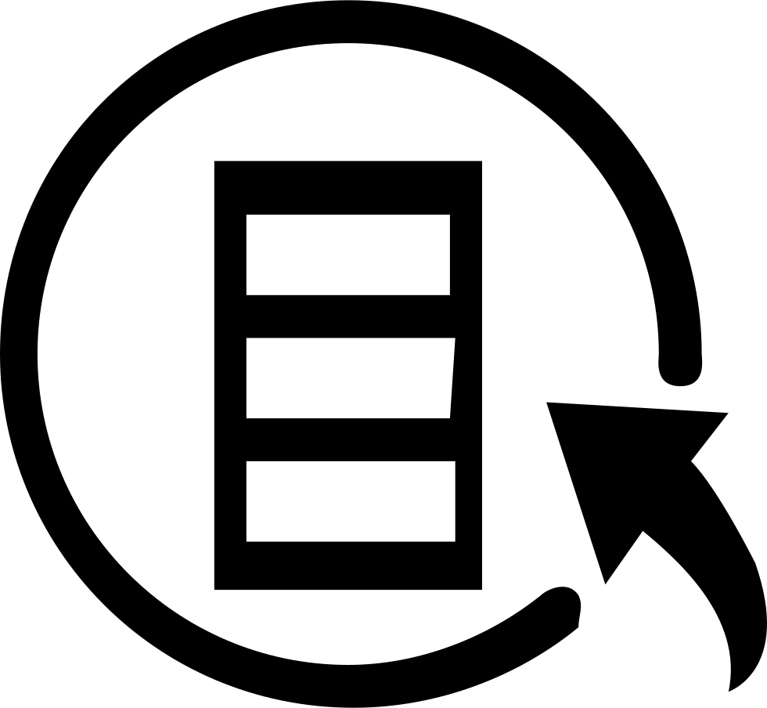
The Three States
Modified means that you have changed the file but have not committed it to your database yet.
Staged means that you have marked a modified file in its current version to go into your next commit snapshot.
Committed means that the data is safely stored in your local database.
Notes:
Modified denotes a modification that has been made to the file but has not yet been committed to your database.
When a file is designated as "staged," it indicates that it has been updated and should be included in your next commit snapshot.
When data is committed, it is kept securely in your local database.

Slide 21
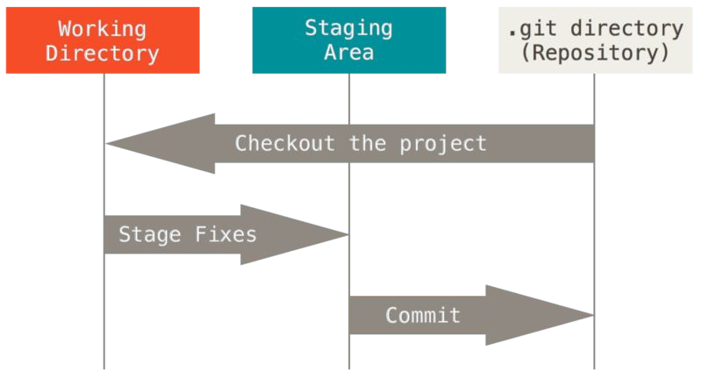
Three main sections
This leads us to sections of a Git project: the working tree, the staging area, and the Git directory.

Slide 22
Working tree
The working tree is a single checkout of one version of the project.
These files are pulled out of the compressed database in the Git directory and placed on disk for you to use or modify.
Notes:
A single checkout of a single project version makes up the working tree.
These files are extracted from the Git directory's compressed database and saved to disk so you may use or edit them.

Slide 23
Working tree
The staging area is a file, generally contained in your Git directory, that stores information about what will go into your next commit. Its technical name in Git parlance is the “index”, but the phrase “staging area” works just as well.
Notes:
Information about what will be included in your next commit is stored in a file called the staging area, which is usually located in your Git directory. In Git jargon, it's known technically as the "index," although "staging area" also does the trick.

Slide 24
Working tree
The Git directory is where Git stores the metadata and object database for your project.
This is the most important part of Git, and it is what is copied when you clone a repository from another computer.

Slide 25
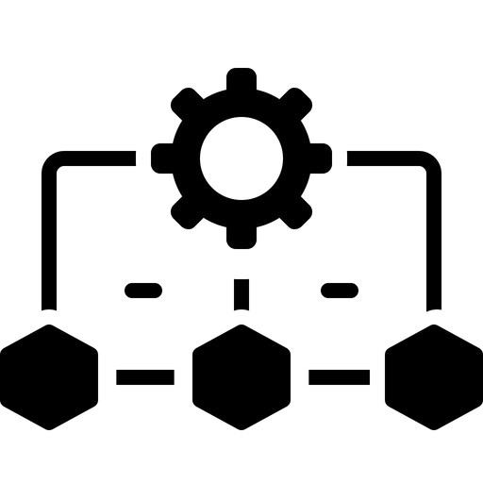
Git workflow
You modify files in your working tree.
You selectively stage just those changes you want to be part of your next commit, which adds only those changes to the staging area.
You do a commit, which takes the files as they are in the staging area and stores that snapshot permanently to your Git directory.
Notes:
The files within your working tree are altered.
You add only those modifications to the staging area by selectively staging the changes you wish to include in your next commit.
As soon as you commit, the files in the staging area are taken and permanently stored in your Git directory.

Slide 26
Git workflow
If a particular version of a file is in the Git directory, it’s
considered committed.
If it has been modified and was added to the staging area, it is staged.
And if it was changed since it was checked out but has not been staged, it is modified.
Notes:
A version of a file is deemed committed if it is present in the Git directory.
It is staged if it has been altered and added to the staging area.
Additionally, it is adjusted if something has changed after it was checked out but hasn't been staged.

