Slide 1
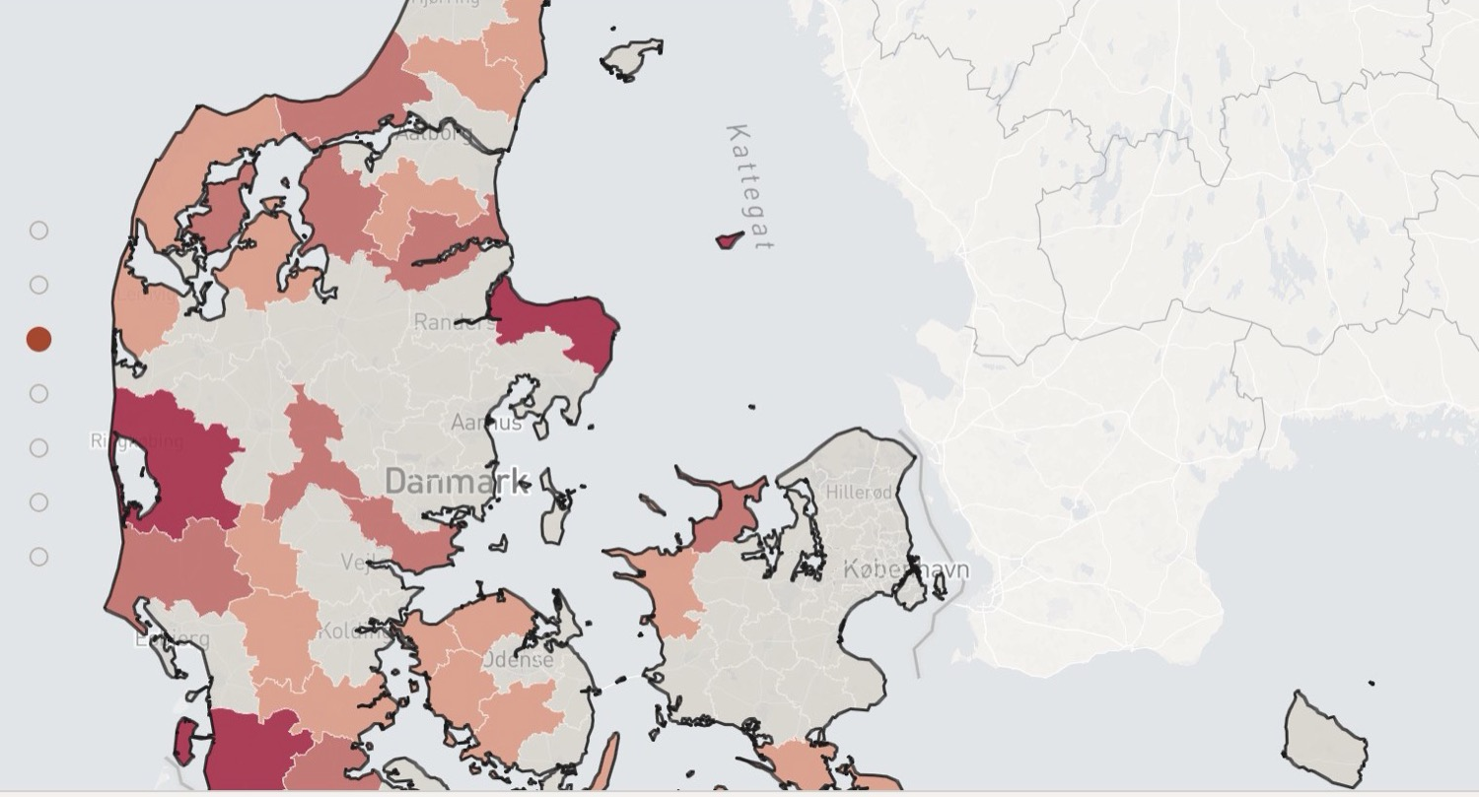
AN INTRODUCTION FOR DANISH MUNICIPALITIES
Danmarks
Mobilitetsatlas
One comparable A–G grade for how freely people can move, with and without a car.
Beta Mobility · Robert Martin · 9/9/2026
Notes:
Danmarks Mobilitetsatlas gives every place in Denmark one comparable A–G grade for mobility. Twenty minutes: what the grade measures, how we calculate it, and what it says about your municipality. The map behind me is the 29 municipalities graded E, F or G. Every figure in the deck is the published 0.4.0 edition of 22 August 2026, built on Rejseplanen GTFS (CC BY 4.0), OpenStreetMap and Danmarks Statistik. Full source list on mobilitetsatlas.dk/en/metode.

Slide 2
Denmark has the network. The question is what it reaches.
36,204
1,574
20
stops
routes
operators
That is the supply side, and it is the number most reports stop at.
A departure board is not access. What decides whether a car is a choice is how much of everyday life you can reach in a reasonable travel time: work, groceries, school, health, social.
Notes:
Denmark has a real public transport backbone. These are counted figures from the Rejseplanen feed, not estimates. But a stop outside your door is not the same as getting to work, school or the doctor. That gap is what the atlas measures.

Slide 3
One comparable grade, A to G
Mobility freedom, 0 to 100, for every place in Denmark. Then a letter.
A
B
C
D
E
F
G
high mobility freedom
low mobility freedom
mobility freedom = ½ public transport quality + ½ transport choice
Notes:
One comparable grade, built from two measured reaches. Public transport quality is how much of everyday life you reach without a car. Transport choice is how much further the car gets you. Their average is mobility freedom, 0 to 100, and that becomes the letter. People remember the letter. The score is the part you can move.

Slide 4
Nearly one municipality in three sits in E, F or G
E
F
G
A
B
C
D
29
1.15
19
of 98 municipalities
million people
per cent of the population
In the lowest bands, walking and public transport cover only a small part of everyday life. The car is in practice necessary, including for the people who cannot drive.
Notes:
Watch the scale: the three weakest bands step forward. Twenty-nine of the ninety-eight municipalities are graded E, F or G. That is 1.15 million people, about one Dane in five, living where the car is not really a choice. If your municipality is in that group, this is your slide. If it is not, some of your neighbours are.

Slide 5
Five kinds of municipality, five kinds of service
Public transport quality, population-weighted, by Statistics Denmark's municipal grouping.
The capital municipalities score 80.1. The rural municipalities score 25.2. A difference of 3.2 times.
A national average describes no municipality.
Public transport quality, 0–100 · population-weighted
Notes:
Grouped by Statistics Denmark's own municipal classification, public transport quality falls from 80 in the capital municipalities to 25 in the rural ones. A factor of 3.2, population-weighted, so this counts people rather than map area. No municipality chose this. It is what density and distance do. It does mean a national average is useless to you.

Slide 6
PART 2
How the grade is calculated
Same method, same sources, every municipality. That is what makes the comparison fair.
Notes:
Before any municipality accepts a letter grade, it wants to know how the letter was produced. Four steps, then the parts we do not yet capture.

Slide 7
From analysis to grade
1
2
3
4
Two measured reaches
Everyday destinations
Two scores
The grade
Rejseplanen timetables and the OpenStreetMap road network: what you reach by public transport, and by car. Trips over 90 minutes do not count.
Five kinds: workplaces, groceries, schools, health, social. The first destinations within reach count most.
Public transport quality is how much of everyday life you reach without a car. Transport choice is how much further the car gets you.
Their average is mobility freedom, and that determines the letter, A to G.
→ What the atlas does not capture (yet)
Notes:
About 75,000 points across all 98 municipalities, roughly every neighbourhood in the country. For each one we compute what is reachable twice, once by public transport and once by car. Over 20 billion journeys in total. Destinations score on a saturating curve, so the tenth supermarket adds less than the first. Click the box at the bottom if anyone asks what is missing. Someone always does, which is why it has its own slide.

Slide 8
What the atlas does not capture (yet)
Congestion
Flextrafik
The bicycle
Car times are computed without queues, so the car's advantage is overstated where congestion is worst.
Flextur and Plustur are not in the Rejseplanen feed, so sparsely populated municipalities get no credit for them.
Walking counts as access to the network; cycling is not yet a mode of its own. In Denmark that is the most noticeable omission.
Journey quality
Timetable, not reality
Supply, not behaviour
A seat, a safe interchange at night, a platform that works with a pram. We measure travel time and reach, not how it feels.
Delays and missed connections are not included. This is what the timetable promises.
What can be reached, not what people do. Two municipalities with the same grade can travel very differently.
← back to the method
Notes:
Say this one plainly. The two that matter most to a Danish municipality are Flextrafik and the bicycle. Both work against exactly the municipalities that score lowest. Press ← or click anywhere to go back.

Slide 9
The A–G scale, and where Denmark sits
Grade | Score | Municipalities | Population
A | 70–100 | 22 | 27%
B | 55–70 | 9 | 16%
C | 45–55 | 4 | 6%
D | 30–45 | 34 | 31%
E | 22–30 | 17 | 11%
F | 15–22 | 9 | 6%
G | 0–15 | 3 | 2%
WORKED EXAMPLE · ROSKILDE
70.7
Public transport quality
66.3
Transport choice
68.5
B
their average is mobility freedom
Notes:
The whole distribution on one slide. The shape is not a bell curve. Denmark is bimodal: a large A group, a large D group, very little in between. Roskilde on the right is the worked example from the method page. 70.7 and 66.3 average to 68.5, which is a B.

Slide 10
PART 3
What it looks like for your municipality
Every municipality has a page: the grade, the two pillars, the trend, the plans behind it.
Notes:
What this looks like for one municipality. Aarhus as the worked example, then the live site, then street level in København.

Slide 11
Aarhus, at municipal level
A
B
C
D
E
F
G
68.6
70.5
66.7
B
Public transport quality
Transport choice
No. 24 of 98 municipalities · high mobility freedom
The two pillars sit close together. Public transport competes with the car here. In most municipalities the second number is far larger than the first.
378,295 residents · 465.87 km²
1,174 DKK per resident for public transport (2025)
Transport authority: Midttrafik
Notes:
Aarhus scores 68.6, a B, twenty-fourth of ninety-eight. Read the two pillars as well as the letter: 70.5 for public transport quality against 66.7 for transport choice. That balance is unusual, and it is good news. Public transport competes with the car here. In most municipalities the second number is far larger than the first, and that gap is the car dependency.

Slide 12
Aarhus, live on the map
→ How to read A–G
mobilitetsatlas.dk/en/kommune/aarhus · CC BY-SA 4.0
Notes:
This map is live in the slide. Drag it, zoom, toggle the routes and the frequency. Three things to point at: the detailed map with cell-level grades, the five-year trend from Statistics Denmark, and "Ask about mobility", which answers from your own municipal and regional plans with the source documents linked. All of it CC BY-SA: screenshot it, quote it, put it in your own papers.

Slide 13
How to read A–G
A
Walking and public transport cover practically as much of everyday life as the car.
B
Walking and public transport cover most of everyday life, close to what the car does.
C
Walking and public transport cover a large part of everyday life, helped by short distances.
D
Walking and public transport cover part of everyday life, but far from what the car reaches.
E
Walking and public transport cover only a smaller part; the car reaches clearly further.
F
Walking and public transport cover few everyday journeys; the car is in practice necessary.
G
Walking and public transport cover almost none of everyday life; the car is the only real option.
← back
Notes:
The band descriptions come out of the published league table itself, so they cannot drift from the thresholds.

Slide 14
Compare municipalities
r = −0.664
n = 98 municipalities
Each dot is one municipality, coloured by its grade. Vertical: mobility freedom. Horizontal: the share of families with a car.
Where public transport reaches less, more families keep a car. The spread at any given level is wide, and that spread is where policy lives.
A pattern between two numbers is not a cause.
→ Every measure on the site
Families with a car (%) → · ↑ mobility freedom
Notes:
Every municipality, one dot, coloured by grade. Horizontally the share of families owning a car, from Statistics Denmark. Vertically mobility freedom. The correlation is minus 0.66 across all 98, and the spread at any given level of car ownership is the interesting part. Say the caveat out loud: a pattern between two numbers is not a cause. Click through for the live version, where the horizontal axis is a dropdown.

Slide 15
Explore, live
mobilitetsatlas.dk/en/udforsk · hover a dot for the municipality · ← back
Notes:
The chart itself, live, so hovering a dot names the municipality. The horizontal axis is a dropdown: spending per resident, car ownership, population density, road casualties. The table underneath sorts on both measures. Worth opening in a browser tab when the room starts asking about one specific number.

Slide 16
København, at street level
Live, and already at street level. Drag it, and the day's scheduled services keep moving across the buildings.
staging.mobilitetsatlas.dk
planned timetable · not live vehicles
Notes:
The last zoom level: København, street by street. Press Byvisning on any of the four largest municipalities and the map tilts into the buildings, with the day's scheduled services moving across it. Planned timetable, not live vehicles, and the panel says so. The green wash on the massing is the same A–G scale as the rest of the deck, now at building resolution. This is where a planner stops nodding at a national average and starts pointing at a street.

Slide 17
What moves the grade
Shorter travel times
Fewer or faster interchanges
to everyday destinations. The most direct lever there is.
a connection saved counts twice: once each way.
Service where there was none
Stops closer to housing
the largest gains are at the bottom of the scale.
the walk to the stop is part of the journey time.
Housing near destinations
New destinations
urban development moves the grade as much as timetables do.
a school, a health centre, a grocery shop shortens the trip for every area around it.
Notes:
The slide to leave on screen during questions. Two of these six are not transport measures at all: housing near destinations, and new destinations. That is the argument for having the planning department in the room when the timetable is discussed. The grade is recomputed each edition, so a change in service shows up in the letter.

Slide 18
Where would you like to start?
Look up your municipality on mobilitetsatlas.dk · Send us the plans we have missed · Or go through your grade with us, cell by cell.
Danmarks Mobilitetsatlas is published under CC BY-SA 4.0. Screenshot it, quote it, build on it, with credit to Beta Mobility.
Beta Mobility · Robert Martin · 9/9/2026
Notes:
Three ways in: look up your own municipality tonight, send us the plans we have missed, or sit down with us and go through your grade cell by cell. The atlas is CC BY-SA. Take it, quote it, put it in your own papers.

