Slide 1
Phase 05 · Step 03
SQL vs pandas verification summary
Notes: docs/phase-05-step-03-task-01-notes.md
Automation: scripts/Invoke-Phase05ComparisonRefresh.ps1

Slide 2
Workflow snapshot
Refresh dockerized Python + Postgres stack
Reload curated books_clean table for canonical metrics
Run sql_vs_pandas_compare CLI and capture artifacts
Regenerate comparison_summary.png for visuals

Slide 3
Metric coverage
M1_top_authors_by_weighted_rating: 15 SQL vs 15 pandas rows • mismatches 0 (Match)
M3_top_books_by_ratings_count: 20 SQL vs 20 pandas rows • mismatches 0 (Match)
M4_top_books_by_text_reviews: 20 SQL vs 20 pandas rows • mismatches 0 (Match)
M7_average_rating_by_year: 70 SQL vs 70 pandas rows • mismatches 0 (Match)
M8_median_ratings_count_by_year: 70 SQL vs 70 pandas rows • mismatches 0 (Match)
M9_language_rating_summary: 6 SQL vs 6 pandas rows • mismatches 0 (Match)
M11_duplicate_share: 1 SQL vs 1 pandas rows • mismatches 0 (Match)

Slide 4
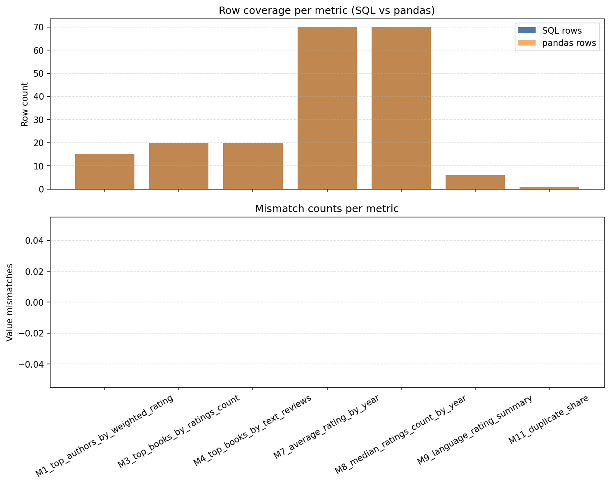
Visual checkpoint

