Slide 1
CSED311 Lab2: RTL Design
Jaehun Ryu
jaehunryu@postech.ac.kr
Contact the TAs at csed311-ta@postech.ac.kr

Slide 2
Contents
Combinational logic
Register-Transfer Level
Finite State Machine
Assignment

Slide 3
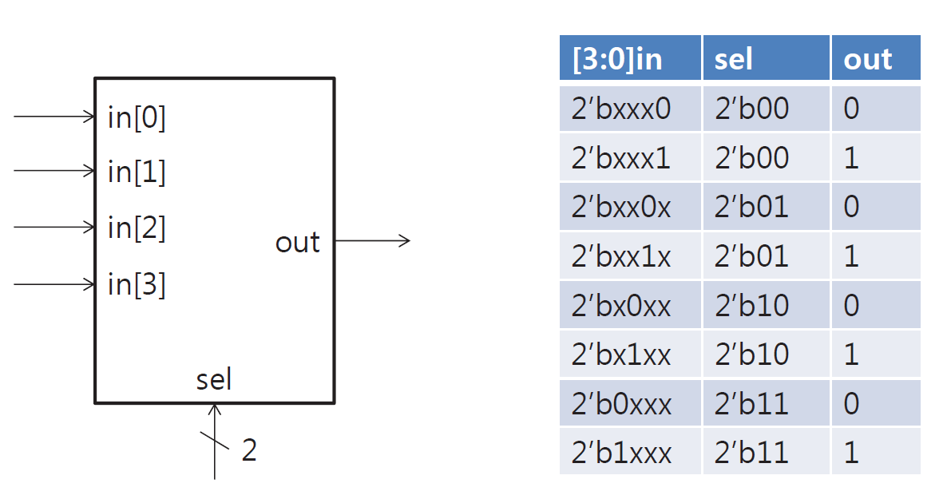
Combinational logic
Represents Boolean function (time(clk)-independent)
Output is a function of inputs only
output = f(input)
Example: 4-to-1 mux

Slide 4
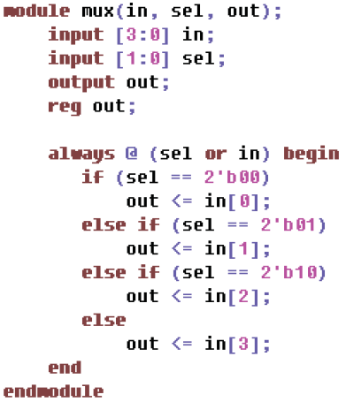
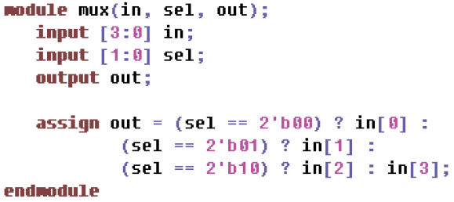
Combinational logic
Implementation with Verilog (mux)
Using Assign | Using Always

Slide 5
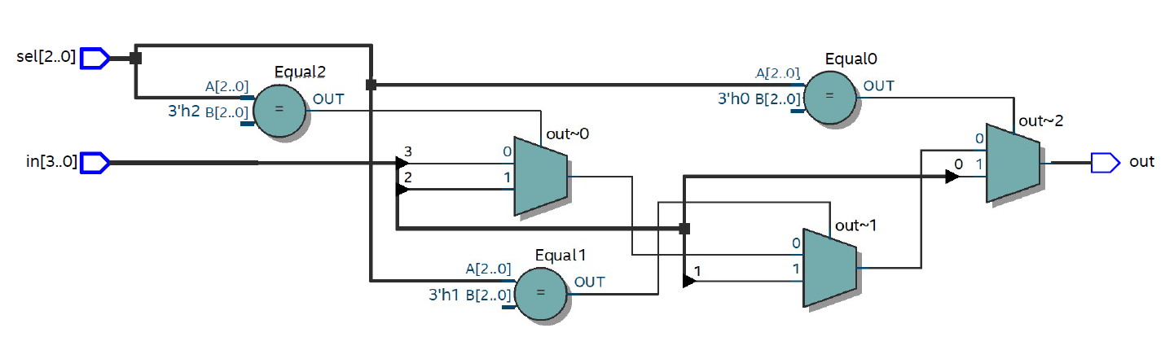
Combinational logic
RTL schematic

Slide 6
Register-Transfer Level
The design method to implement a synchronous circuit with a HDL (Hardware Description Language)
Synchronous circuit consists of:
Register: a memory element synchronized by the clock signal
Combinational logic: logical function

Slide 7
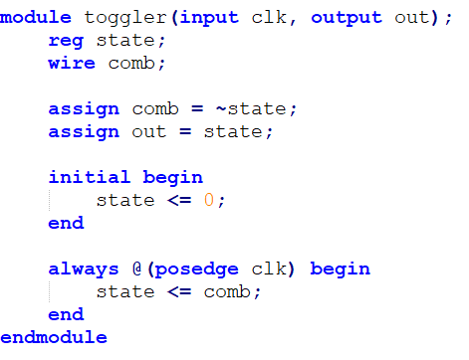
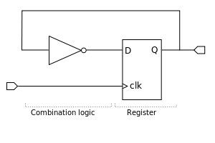
RTL - example
Toggler example
<Fig 1. “Register transfer level - example toggler” (Register-transfer level, Wikipedia, https://en.wikipedia.org/wiki/Register-transfer_level)>

Slide 8
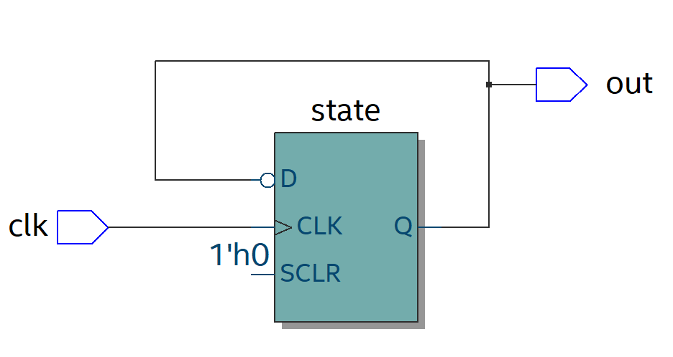
RTL - example
Toggler example

Slide 9
Finite State Machine (FSM)
Moore machine
Mealy Machine

Slide 10
Finite State Machine (FSM)
Moore Machine
Outputs only depend on the current state.
REGISTER
(state memory)
Combinational Logic
Combinational Logic
STATE
INPUT
OUTPUT
clk
OUTPUT only depends on STATE
-> OUTPUT changes at clk only
(synchronous)
STATE

Slide 11
Finite State Machine (FSM)
Mealy Machine
Outputs depend on the current state and the current inputs
INPUT
REGISTER
(state memory)
Combinational Logic
Combinational Logic
STATE
OUTPUT
clk
OUTPUT depends on STATE and INPUT
-> OUTPUT can be changed when INPUT changes, even no clk (asynchronous)
STATE

Slide 12
Finite State Machine (FSM)
Mealy Machine
Mealy Machine can be made synchronous
INPUT
REGISTER
(state memory)
Combinational Logic
Combinational Logic
STATE
clk
D flip flop
OUTPUT
STATE

Slide 13
FSM Code Structure
ports and variables declaration
Combinational logic
Sequential logic
Combinational logic derives the next state and outputs
assign statement + wire data type
always @(…) block + reg data type (assignment)
Sequential logic stores the current state
always @(posedge clock) block + reg data type (assignment)

Slide 14
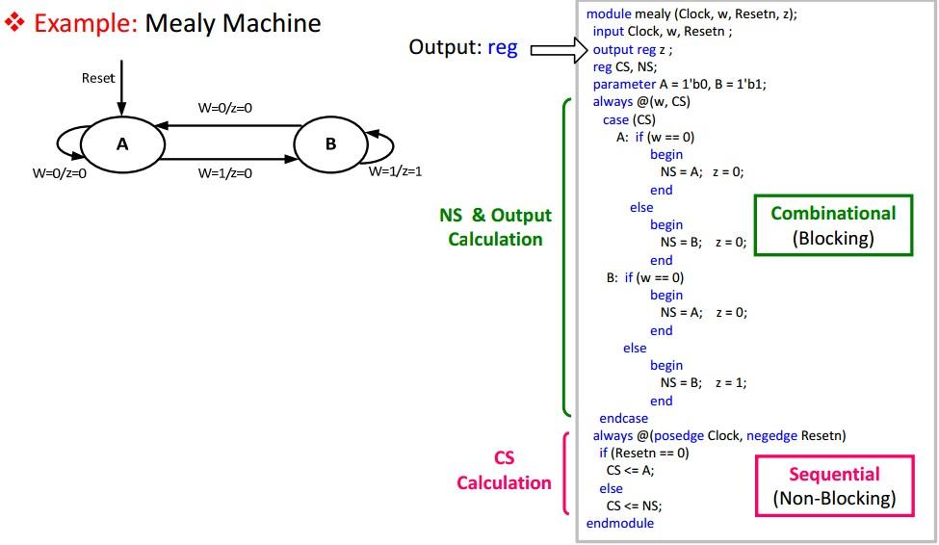
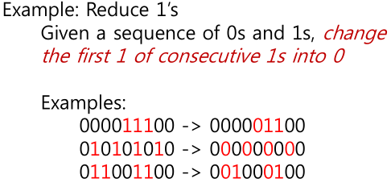
FSM Code Structure
z is output and z is in combinational logic part
-> asynchronous Mealy Machine

Slide 15
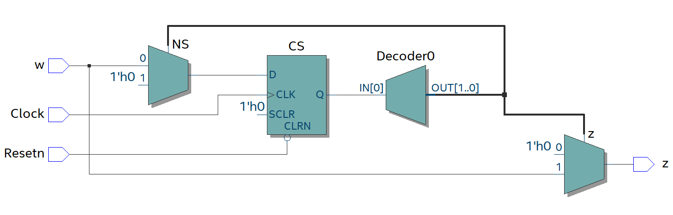
FSM Code Structure

Slide 16
Assignment
Implement a simple vending machine RTL in Verilog
A simple Finite State Machine (FSM)
Your vending machine should cover all use-cases (in the next slides)
A skeleton code and testbench will be provided.
Submit a report and code to LMS
Due date
Code: 2021. 3.15 / 09:00 am
Report: 2021. 3. 15 / 24:00 am
Demo
2021 3. 16 07:30 pm ~ 09:30 pm

Slide 17
Assignment
Vending machine interface
INPUT
Signal | Description | Number of bit(s)
i_input_coin | Insert Coin | 1 for each type of coins
i_select_item | Select Item | 1 for each type of items
i_return_trigger | Return change | 1
clk | clock | 1
reset_n | reset | 1
OUTPUT
Signal | Description | Number of bit(s)
o_output_item | Indicate dispensed items | 1 for each type of items
o_available_item | Indicate item availability | 1 for each type of item
o_return_coin | Indicate type of coin (change) | 1 for each type of coins

Slide 18
Assignment
Vending machine use-case
Assumption: infinite item, change
Sequence
1. Insert money (available money unit: 100, 500, 1000 won) and initialize waiting time(=100)
2. Vending machine shows all available items where (item cost <= current money)
2.a. decrease waiting time(-1)
3.a. Insert money within the waiting time
3.a.1. Go to 2 and initialize waiting time(=100)
3.b. Select an item within the waiting time
3.b.a. Case1: the item is available
3.b.a.1. The item is dispensed
3.b.a.2. Go to 2 and initialize waiting time(=100)
3.b.b. Case 2: the item is unavailable
3.b.b.1. Nothing happens. Waiting time is not reset.
3.c. No input within the waiting time
3.c.1 Return changes
a*. Whenever press the return button
a*.1. Return changes
a*.2. Go to 1

Slide 19
Assignment
Submission
Submit your assignment to LMS with filename:
Lab2_{TeamID}_{StudentID1}_{StudentID2}.pdf
PDF file of your report
Lab2_{TeamID}_{StudentID1}_{StudentID2}.zip
Zip file of your code (*.v)(without testbench)

Slide 20
Assignment tips
If your modelsim is not displaying the output of $display or $monitor, then try using vending_machine_tb_f.v. (output will be written to output.txt)
If your simulation keeps running, the testbench module is waiting for the output signals. (o_output_item or o_return_coin)
If your vending machine code passes all tests, you will get the message “Passed = 23, Failed = 0”.

Slide 21
Assignment tips
#1: When modeling sequential logic, use nonblocking assignments.
#2: When modeling latches, use nonblocking assignments.
#3: When modeling combinational logic with an always block, use blocking assignments.
#4: Do not mix blocking and nonblocking assignments in the same always block.
#5: Do not make assignments to the same variable from more than one always block.
#6: Use $strobe to display values that have been assigned using nonblocking assignments.
#7: Do not make assignments using #0 delays.

Slide 22
Evaluation criteria (source code)
ModelSim 동작여부
ALL PASS 여부
전체적인 기능 이해 여부
FSM의 이해 여부
모듈화 여부
Combinational logic의 이해 여부
Sequential logic의 이해 여부

Slide 23
Announcement
If you have any problem, contact TAs with following options
Microsoft Teams – Lab QnA channel (highly recommended)
Mail – TA alias (“csed311-ta”)
PLMS – Question Board
Please check the new team number and time slot in PLMS
A time slot will be open in 2021-03-09 22:00:00

Slide 24
Reference
“Register-transfer level”, Wikipedia, last modified Jan 24, 2019, accessed Mar 03, 2019, https://en.wikipedia.org/wiki/Register-transfer_level
http://www.sunburst-design.com/papers/CummingsSNUG2000SJ_NBA.pdf

