Slide 2
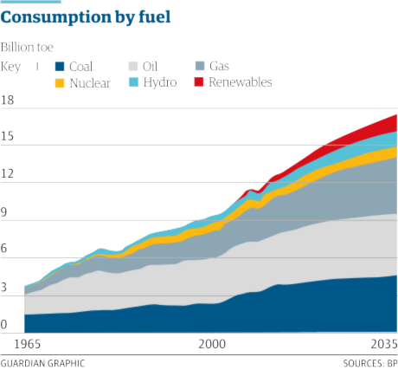
It’s all about energy
2012
  7 billion people;
  270 million barrels of oil equivalent per day
2060
  7 billion people;
  460 million barrels of oil equivalent per day
That’ll be more than 50% of the global energy demand!

Slide 3
Gradual depletion of existing oil and gas fields
Deeper targets, more complex geology and more unfamiliar accumulations
Development of innovative geophysical subsurface imaging technologies

Slide 4
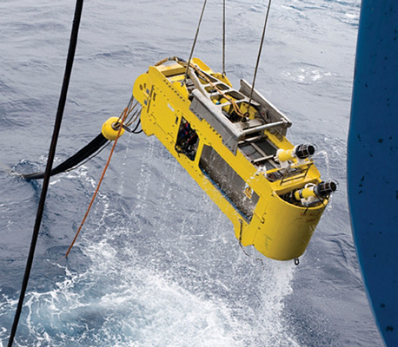
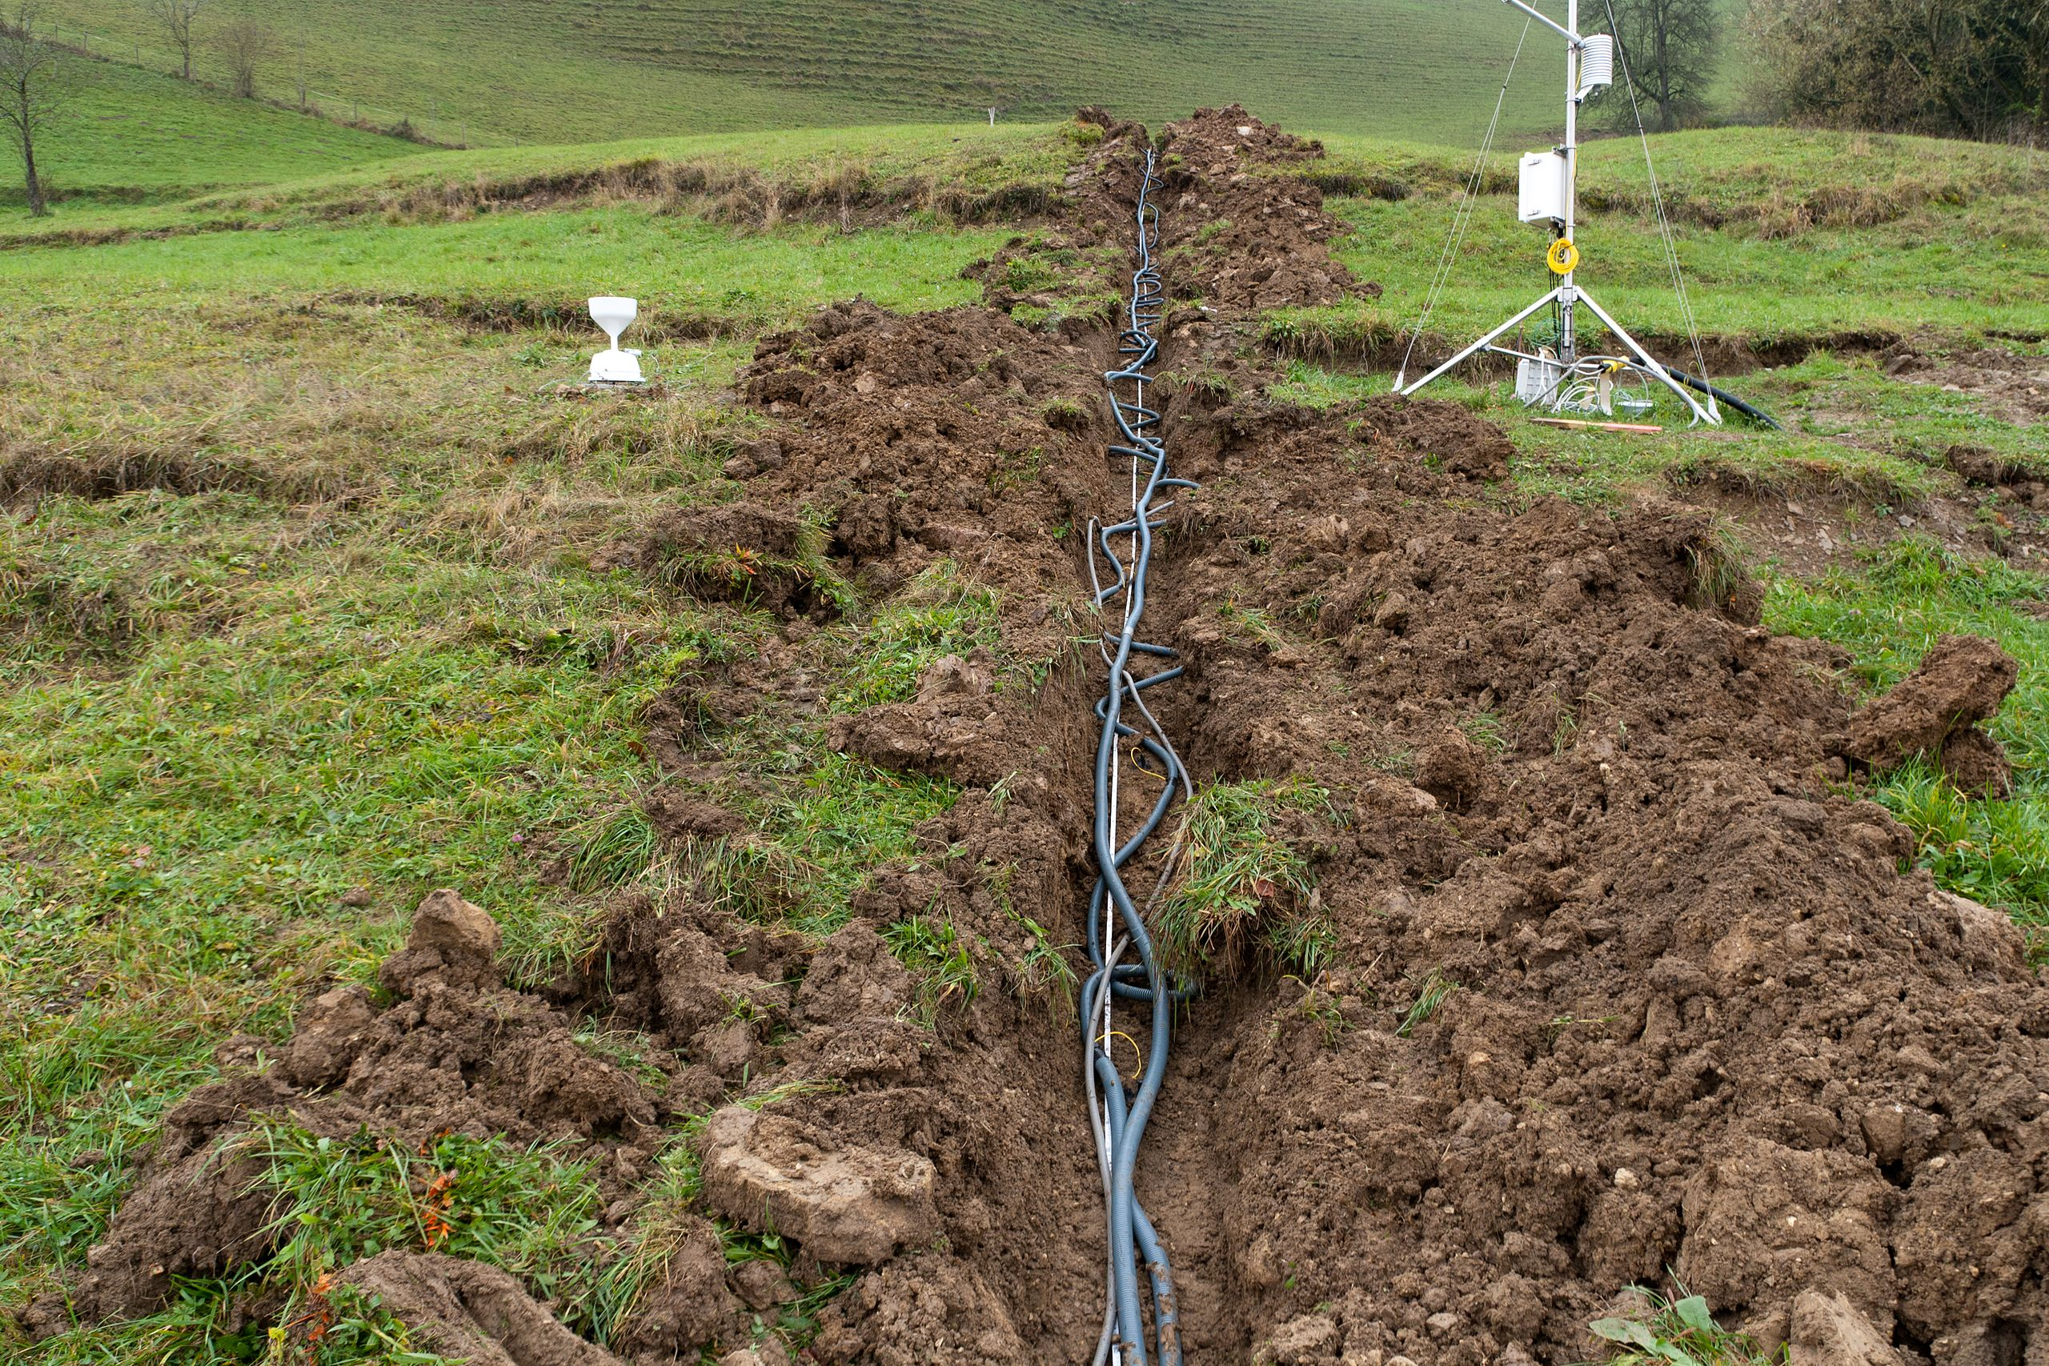
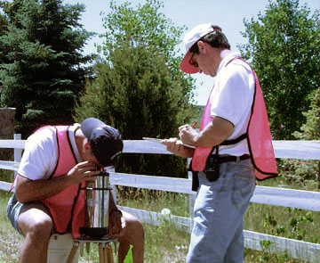
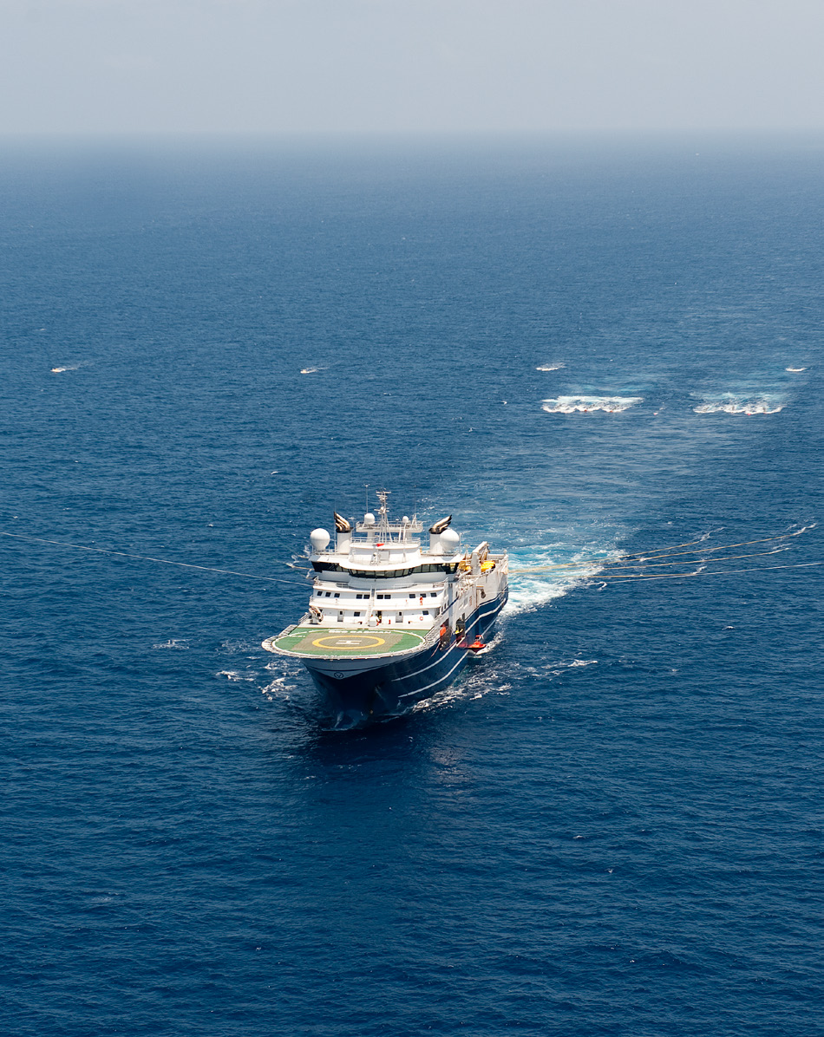
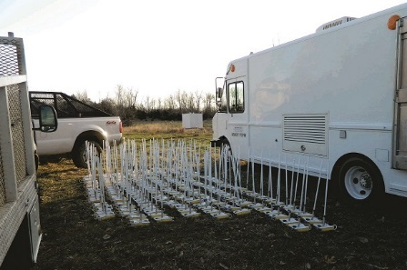
Geophysical exploration
Electrical resistivity tomography
Ground-penetrating radar
Induced polarization
Seismic tomography and Reflection seismology
Magnetotellurics
ACQUISITION
PROCESSING
VISUALIZATION

Slide 6
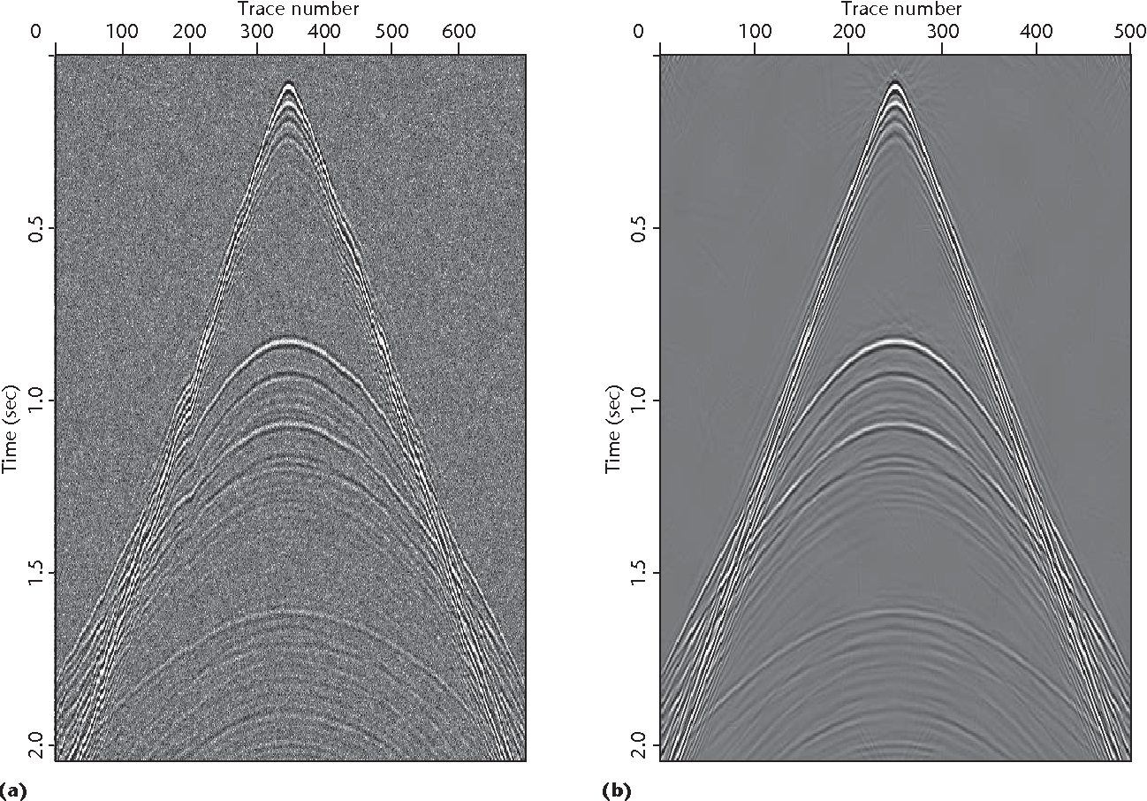
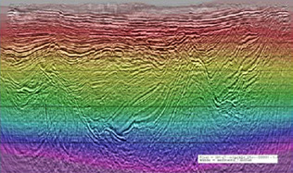
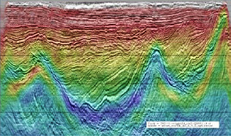
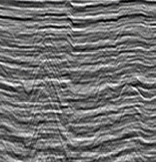
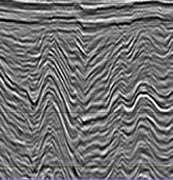

Geophysical exploration
inversion
Denoising, deconvolution
ACQUISITION
PROCESSING
VISUALIZATION
Filtering
migration

Slide 7
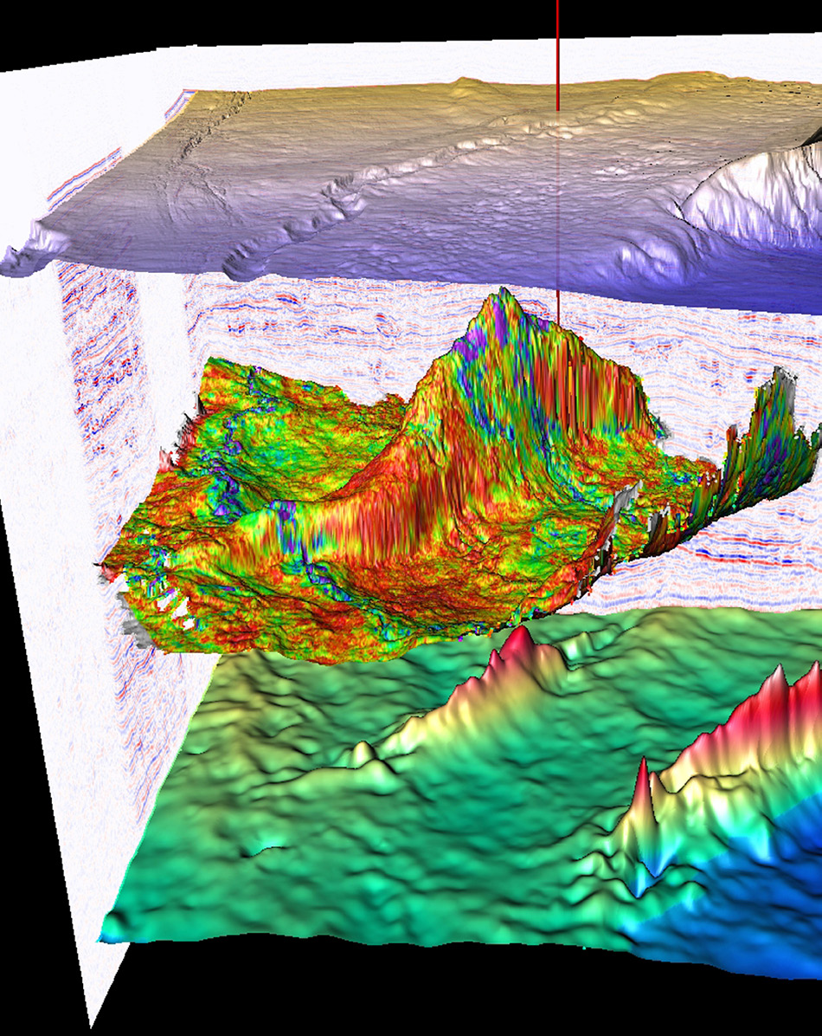
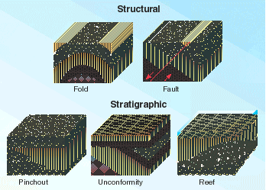
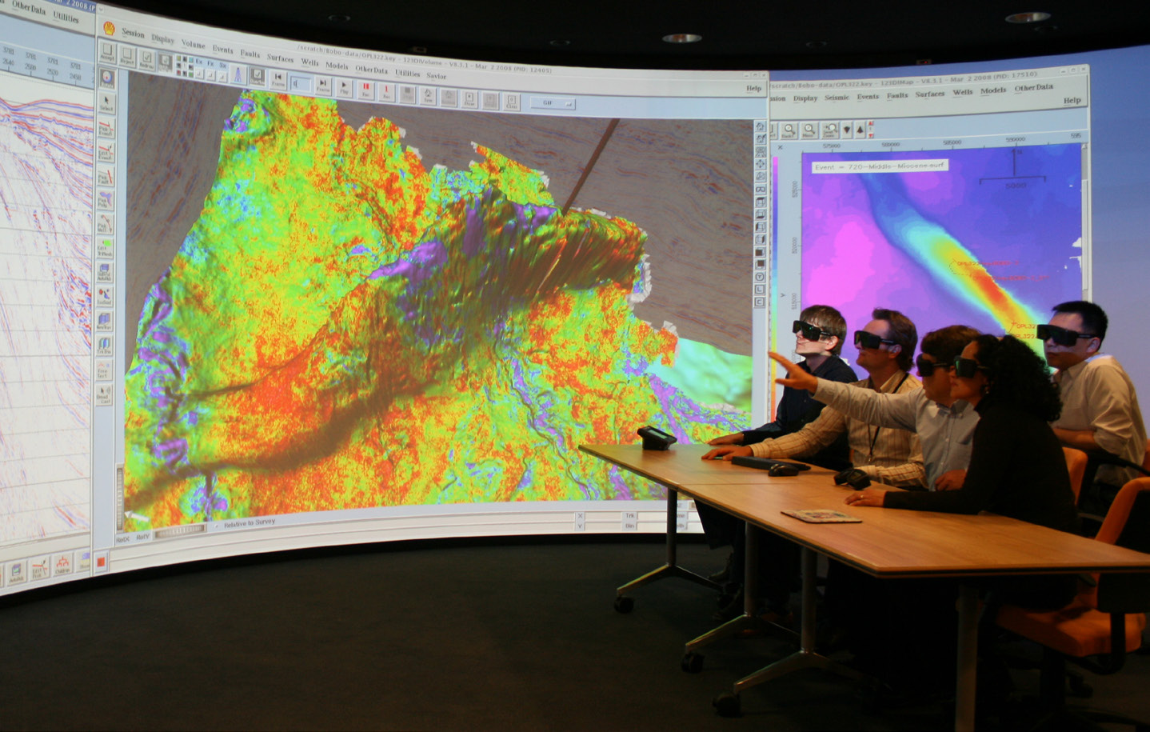
Geophysical exploration
ACQUISITION
PROCESSING
VISUALIZATION
Structural trap
and
stratigraphic trap
i4D

