Slide 1

Mastering the Tic Tac Toe Strategy: Outsmarting Your Opponent

Slide 2
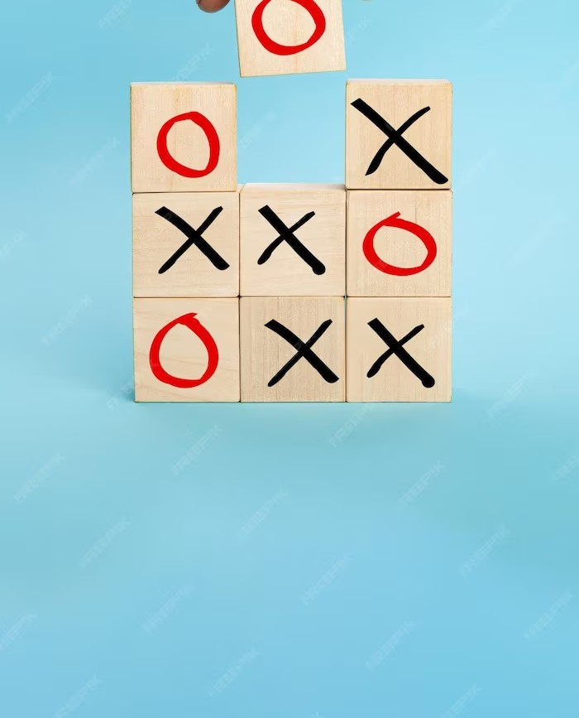


Introduction
Welcome to the world of Tic Tac Toe! In this presentation, we will explore strategies that will help you outsmart your opponent. Learn how to analyze the board, anticipate your opponent's moves, and create winning opportunities. Get ready to become a Tic Tac Toe master!

Slide 3

Working
To become a master of Tic Tac Toe, it is essential to have a thorough understanding of the game board.
The board consists of a 3x3 grid, and during each turn, players must strategically place their symbol (X or O) on any vacant space. It is crucial to pay close attention to the central square and the corners, as they provide strategic advantages.
Familiarizing yourself with the layout of the board is the initial step towards achieving victory!

Slide 4

Uses
Uses of tic tac toe:
To outsmart your opponent, you must anticipate their moves. Observe their patterns and strategies. Look for opportunities to block their winning moves while planning your own. By staying one step ahead, you can gain a signiﬁcant advantage and increase your chances of winning the game.

Slide 5

Advantages
Educational:
Ideal for learning Python and programming logic.
Demonstrates basic control structures and data handling.
Clean & Well-Structured:
Code is organized and easy to understand.
Suitable as a foundation for more complex projects.
Customizable:
Open to modification and enhancement.
Add features or improve aesthetics according to preferences.
Cross-Platform:
Runs on any platform supporting Python.
No platform-specific limitations.

Slide 6

Disadvantages
Disadvantages of the Tic-Tac-Toe Game
Limited to Two Players:
Designed for a two-player game, not suitable for more players.
Basic Graphics:
Lacks a graphical user interface (GUI).
Minimal visual appeal.
No AI Opponent:
Does not include an AI opponent for single-player games.

Slide 7

Future Scope
Future Scope of the Tic-Tac-Toe Game
AI Opponent:
Implement an AI player for single-player mode.
Multiplayer Support:
Enable online multiplayer capabilities for remote play.
Improved Graphics:
Enhance the visual design for a more engaging user experience.
Statistics & Leaderboards:
Track player statistics and game history for competition.
Customization:
Allow players to choose themes and customize their game.
Cross-Platform Compatibility:
Make the game available on various platforms, including mobile.

Slide 8
Conclusion
Congratulations! You are now equipped with the knowledge to become a Tic Tac Toe master. Remember to analyze the board, anticipate your opponent's moves, and create winning opportunities. Practice these strategies, and soon you'll be outsmarting your opponents with ease. Now go and conquer the world of Tic Tac Toe!

