Slide 1
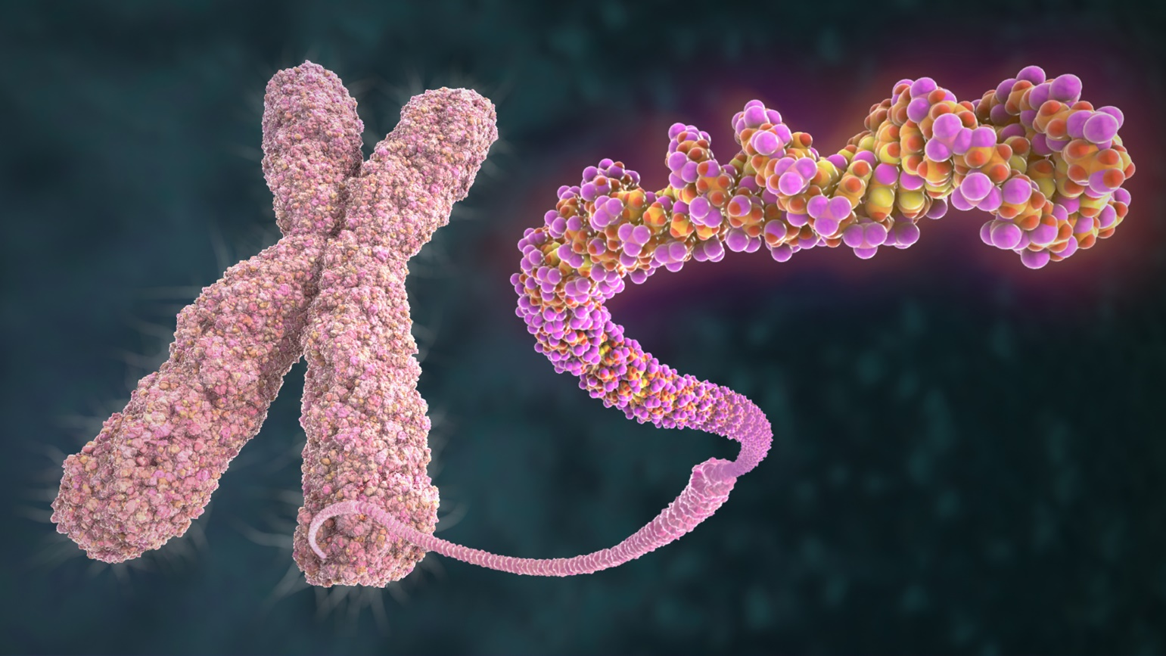
Analysis of Variable Number Tandem Repeats in Human Populations
Beth Becker

Slide 2
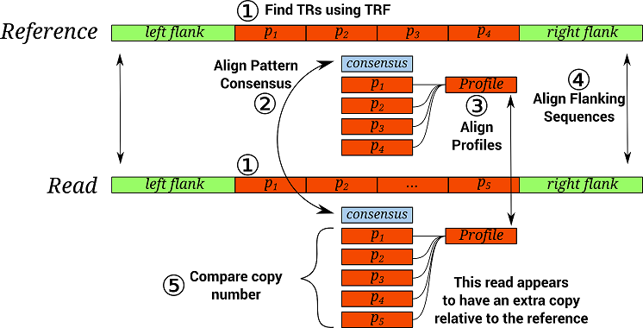
About VNTRs:
Variable Number Tandem Repeats (VNTRs) are short sequences that found in DNA that repeat
Copy Number – the number of times a particular pattern repeats
Used in forensic and paternity tests

Slide 3
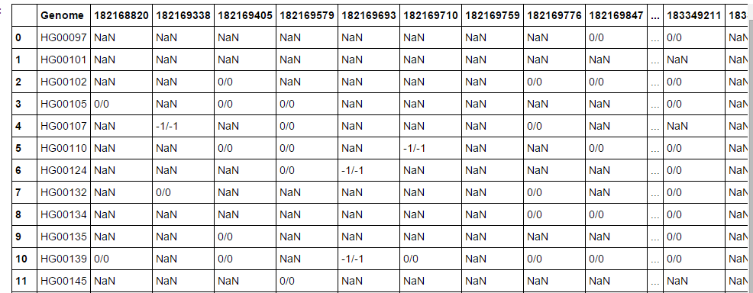
Data Collection
VNTRSeek – program designed from Dr. Gary Benson’s Lab that can detect the location and copy number of VNTRs
Provided information about 148 people from 9 human populations
Reference VNTR information (position on chromosome, copy number, pattern, etc.
Thousand Genomes Project – meta data about the people, such as population and gender
NCBI- information on the lengths of humans chromosomes

Slide 4
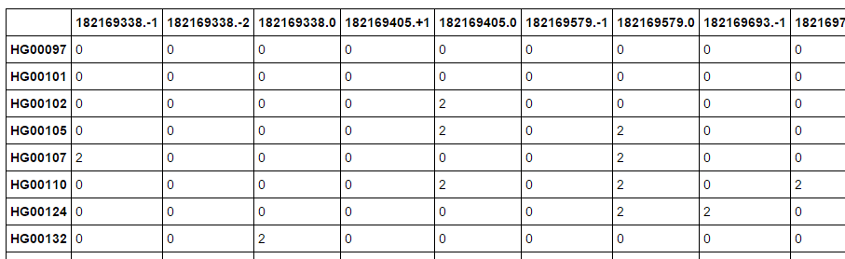
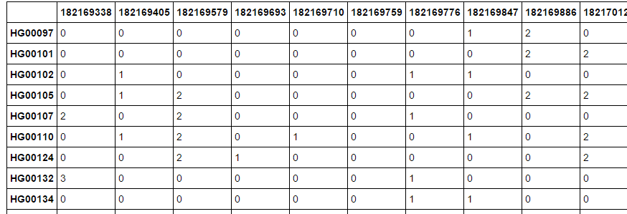
Data Processing: 2 Methods
Method 1: Created separate category for each allele for each VNTR, totaled how many times it occurred for each person:
Method 2: Scaled values so that lowest copy number was 1, then averaged for each VNTR found in each genome

Slide 5
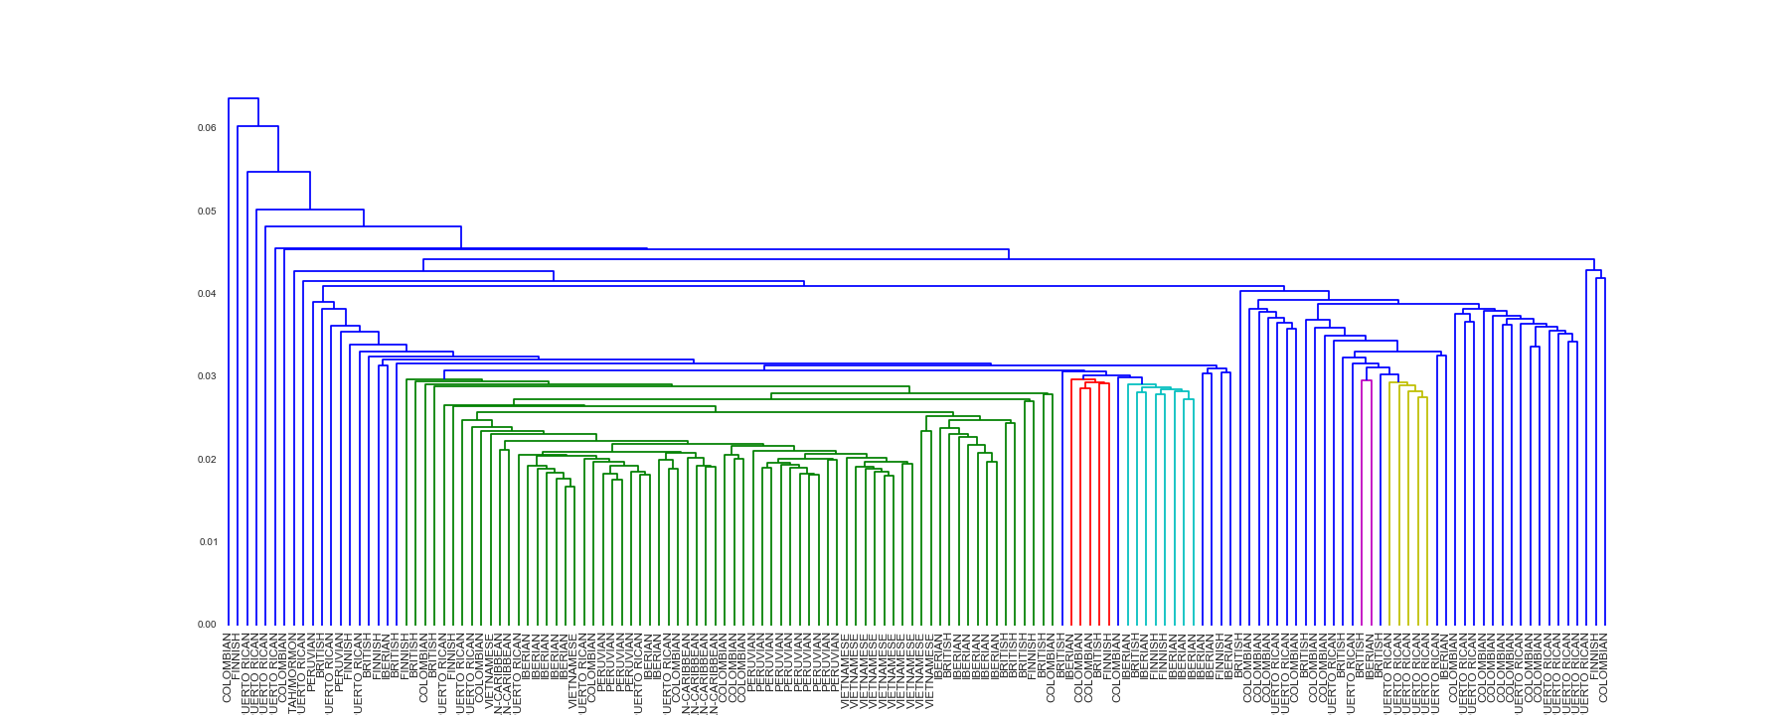
Hierarchical Clustering individuals: method 1

Slide 6
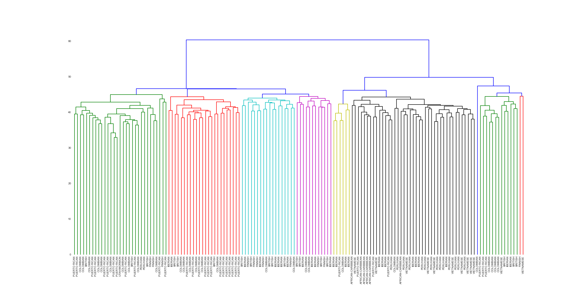
Hierarchical Clustering individuals: method 2

Slide 7
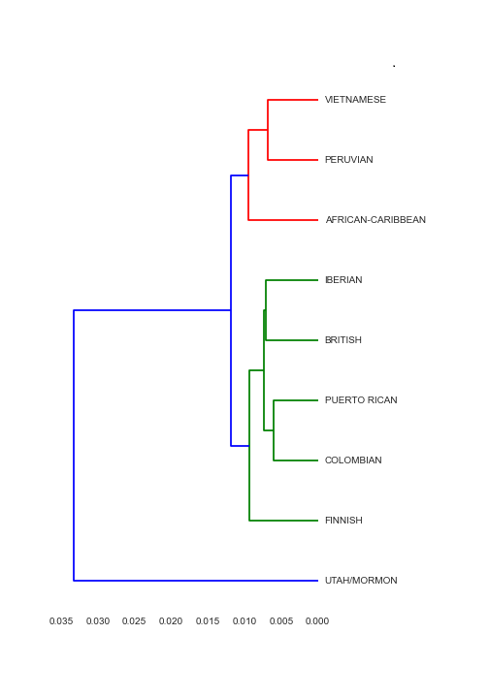
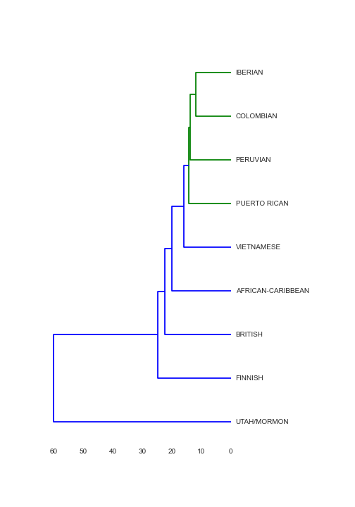
Hierarchical Clustering by population
Method 1
Method 2

Slide 8
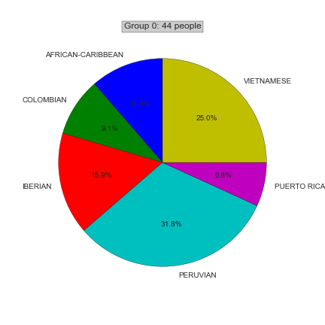
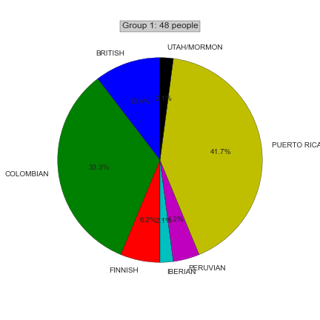
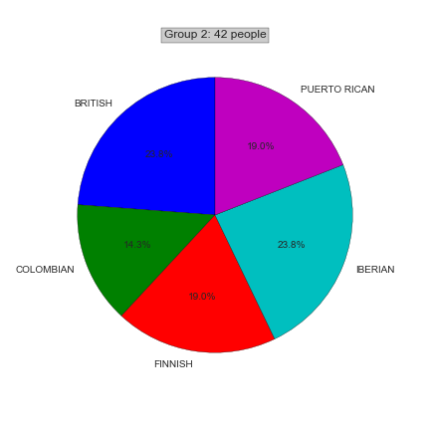
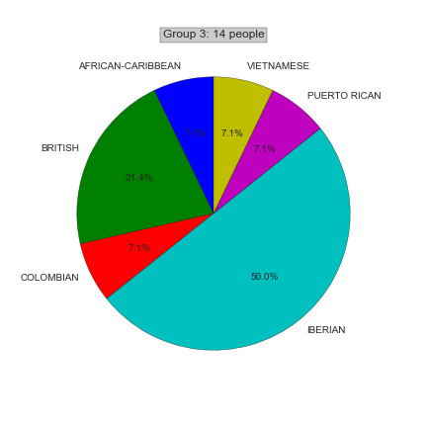
K-means clustering
Used Processing Method 2 to do K-means clustering.

Slide 9
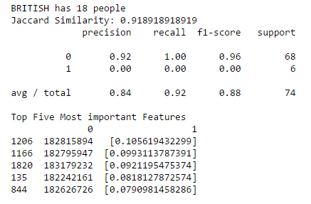
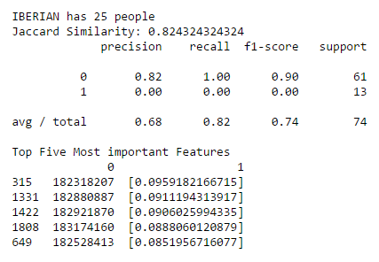
Predicting population from VNTR
British Model
Iberian Model
F1 score is high, indicates good model
F1 score is high, indicates good model

Slide 10
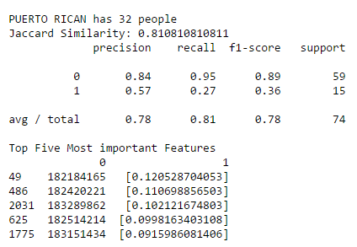
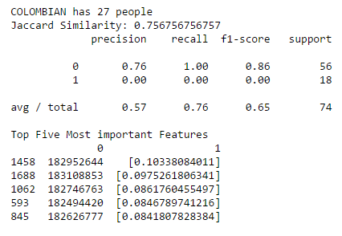
Predicting population from VNTR
Puerto Rican Model
Colombian Model
F1 score not great.
Jaccard Similarity is also not great.
F1 score not great.
Jaccard Similarity is also not great.
Models may be worse with Hispanic populations because they are more similar to each other, making it harder for them to be predicted.

Slide 11
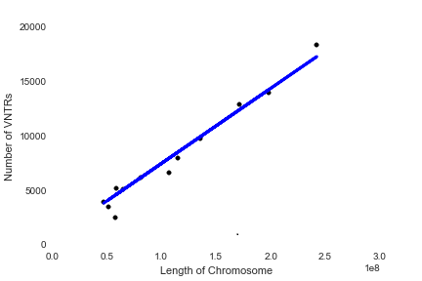

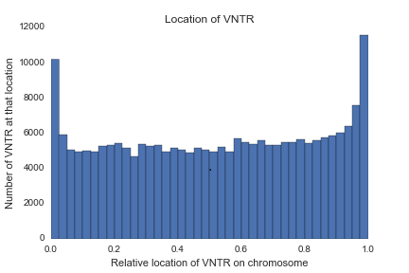
Information about filtered reference set of TRs
TRs are spread out evenly through the genome, except on the ends. This makes sense because there are very repetitive elements on the ends of chromosomes called telomeres.
There is a strong linear correlation between the length of a chromosome and the number of TRs on it. (R² = 0.97)

