Slide 1
U.S. PUBLIC PENSION ASSET ALLOCATIONS
Research Question: How do fund characteristics (performance and composition) effect the asset allocations of U.S. public pension funds from 2001-2016?
By: Bethany Bailey
Notes:
This quarter I’m interesting in building a predictive model for public pension asset allocations

Slide 2
IMPORTANCE OF TOPIC What factors influence asset allocation of U.S. public pensions?
WHY PUBLIC PENSIONS?
Many U.S. public pensions are underfunded
In 2016, the median funding ratio (assets available for payments to retirees) was 71.1% (Bloomberg)
In 2017, “US public pension funds lack $3.85tn that they need to pay the retirement benefits of current and retired workers” (Financial Times)
WHY ASSET ALLOCATION?
Modern portfolio theory - reducing portfolio risk through diversified, uncorrelated assets
Notes:
According to financial times, US public pension funds lack $3.85tn (2017)
Asset Allocation is major component of investment return and risk

Slide 3
DATA
- Public Plans Database
Plan-level data on 170 public pension plans: 114 administered at a state level and 56 administered locally
Covers 2001-2016 (16 years)
Covers 95 percent of public pension membership and assets nationwide
Includes information on
Asset Allocation
Membership composition (type and quantity)
Funding
Returns
Etc.

Slide 4
VARIABLES
Endogenous:
Asset Allocation
Potential exogenous variables to consider:
Funded Ratio
Number of pensioners in plan
Assets under management
Pension industry
Previous year’s investment return
Notes:
Funded ratio: ratio of assets to liabilities
Possible Extension:
New exogenous variable: State/City political leadership (anyone have a suggested data source?)
State: State House/Governorship split or held by one party (Dem. Vs. Rep.)
City: Mayor/Elected body split or held by one party (Dem. Vs. Rep.)

Slide 5
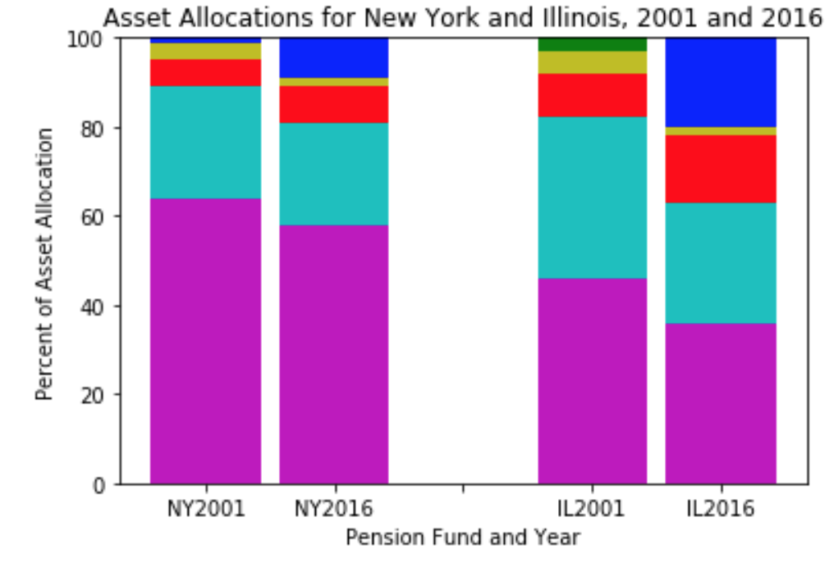
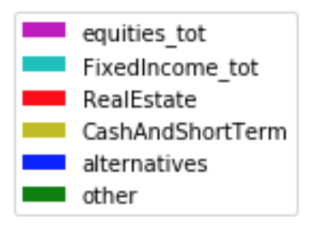
DEFINING ASSET ALLOCATION: BREAKDOWN
% total assets invested in:
Equities
Fixed Income
Alternatives
Real Estate
Cash/Short-Term
Other
Vary by year and plan
NY has higher funded ratio
than IL

Slide 6
DEFINING ASSET ALLOCATION: CATEGORICAL?
Operationalizing asset allocation
Classifier
High (1) and low (0) equity to
fixed income ratio
Continuous
Finer-grained ratio
Scale of allocation profiles
Different Models?
Predict 6 categories

Slide 7
MODEL/THEORY
Let’s do a horse race!
Logistic Regression vs. Random Forest vs. Neural Net
Take model strengths/weaknesses into account
Classification vs. continuous model of asset allocation
Adding more features (Neural Net vs. Random Forest)

Slide 8
POTENTIAL ISSUES WITH MODEL
Data is relatively small (170 obs/year)
Include resampling methods
Time-Series data
Will need to account for changes in markets and investment strategies over time
Omitted Variable Bias and correlations between variables
Need to think hard about the exogenous variables I use

Slide 9
PLACE IN EXISTING LITERATURE
Pennacchi and Rastad, 2010
Analyzed factors that effect risk in 125 public pension funds, as measured by tracking error
Weller and Wegner, 2008:
Have public sector pension plan managers acted “imprudently” to chase returns after encountering underfunding?
Notes:
Tracking error: Public pension funds’ portfolio allocation relative to a benchmark portfolio that best hedges the fund’s liability risks (payments to pensioners)
Funds have higher tracking error following periods of low performance
Rate of discounting liabilities influences portfolio risk (as one goes up, so does the other)
Pension plans have have riskier allocations when they have greater representation by plan participants on their Boards of Trustees (gambling behavior)
Weller and Wegner:
- Looked at Federal Reserve's Flow of Funds, dating from 1952 to 2007
- imprudent investment behavior: no portfolio rebalancing, employer conflicts of interest, trustee conflicts of interest, and failure to implement best investment practices

Slide 10
CONTRIBUTION
Looking at overall asset allocation (not a measure of risk or prudent behavior)
Different exogenous variables
More data years and more recent (as pensions have gotten more underfunded)
Different models
Notes:
How this research differs

