Slide 1






MEDITO

Slide 2


Hello!
We are BIT students.
We are here to present our mobile app project.
You can find us under our GitHub accounts
@hermelalemma.github.com
@bethelhem920.github.com

Slide 3
Being Yourself, Being
Self Aware Is The
Key To Happiness

Slide 4
1.
Introduction of
The app
Brief Description

Slide 5
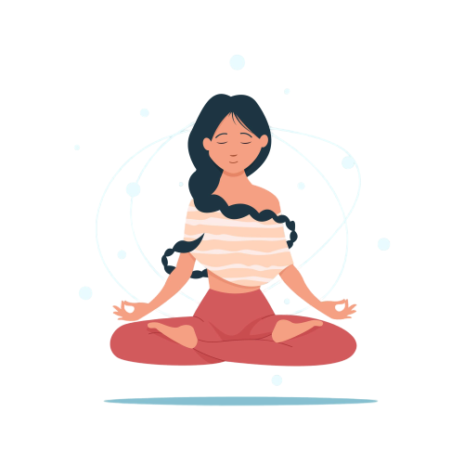
Big concept
Stay free from stress and
Keep calm and sleep better.

Slide 6
Introduction
Medito is a meditation app where you can tackle everyday stress and anxiety.
It can give you a sense of calm, peace and balance that can benefit both your emotional well-being and your overall health.

Slide 7
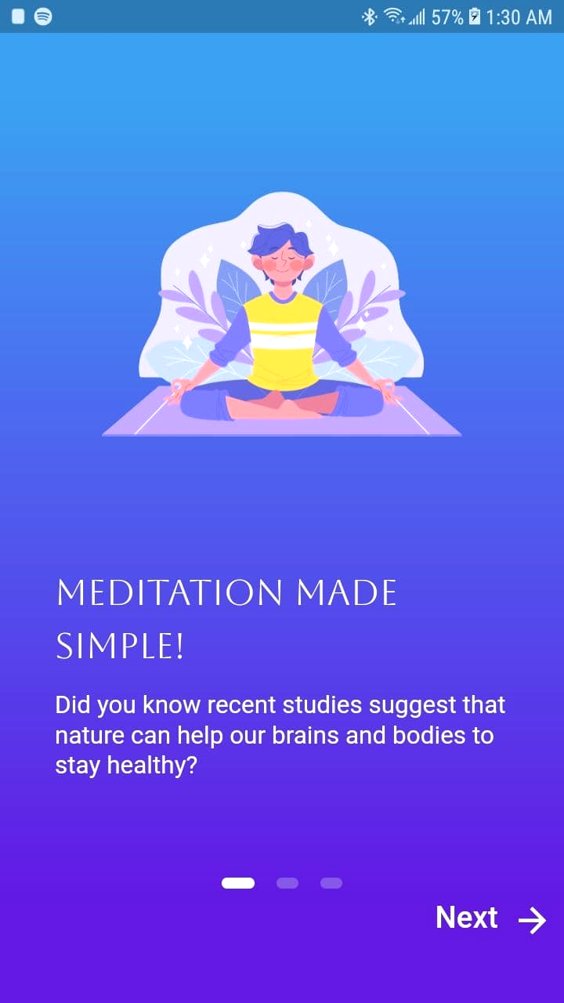
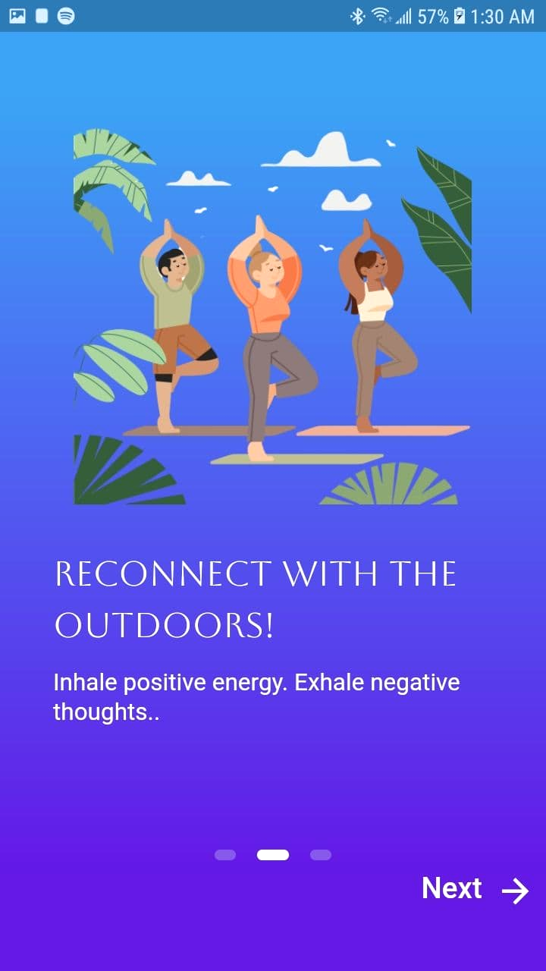
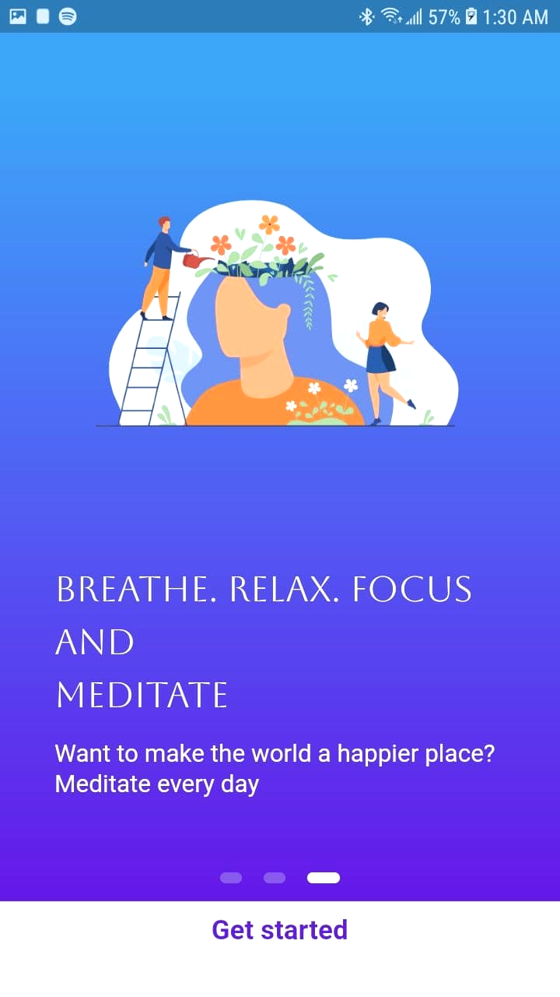

Slide 8
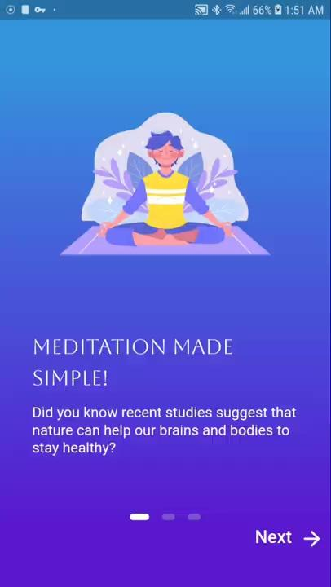
Onboarding
Screen
Just a few clicks and
you’re in a way to
calm place.

Slide 9
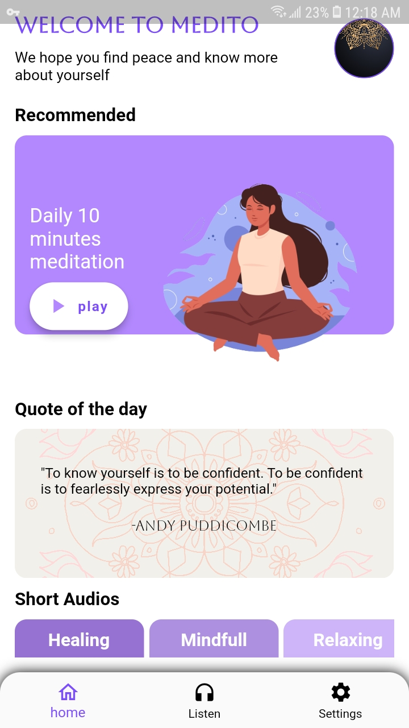
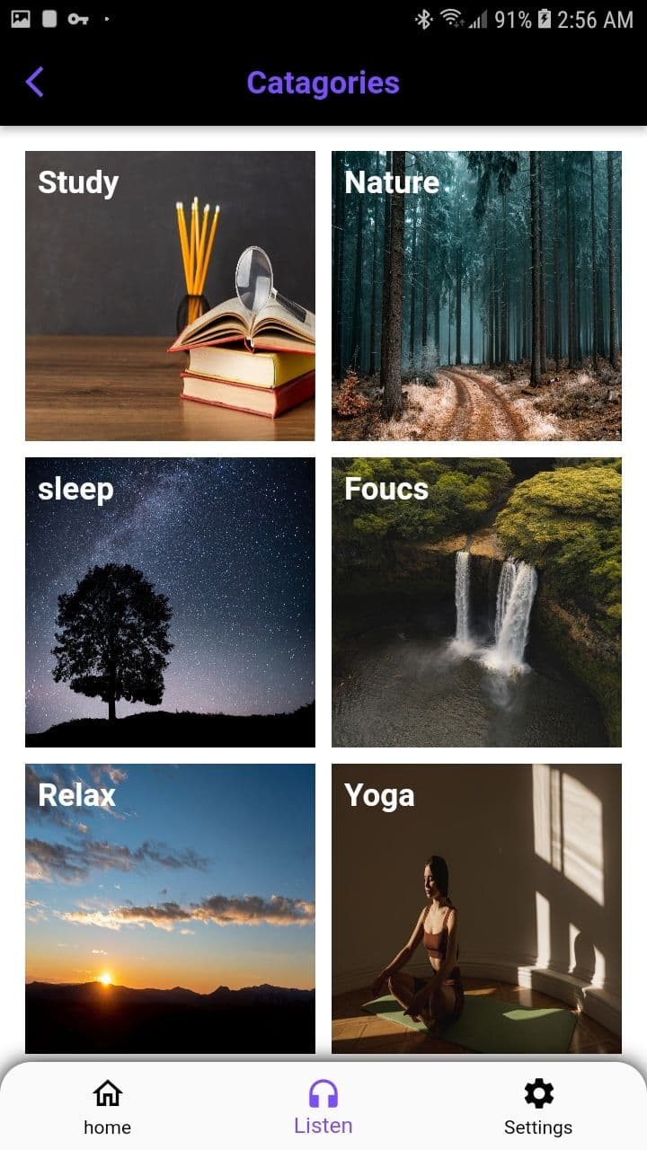
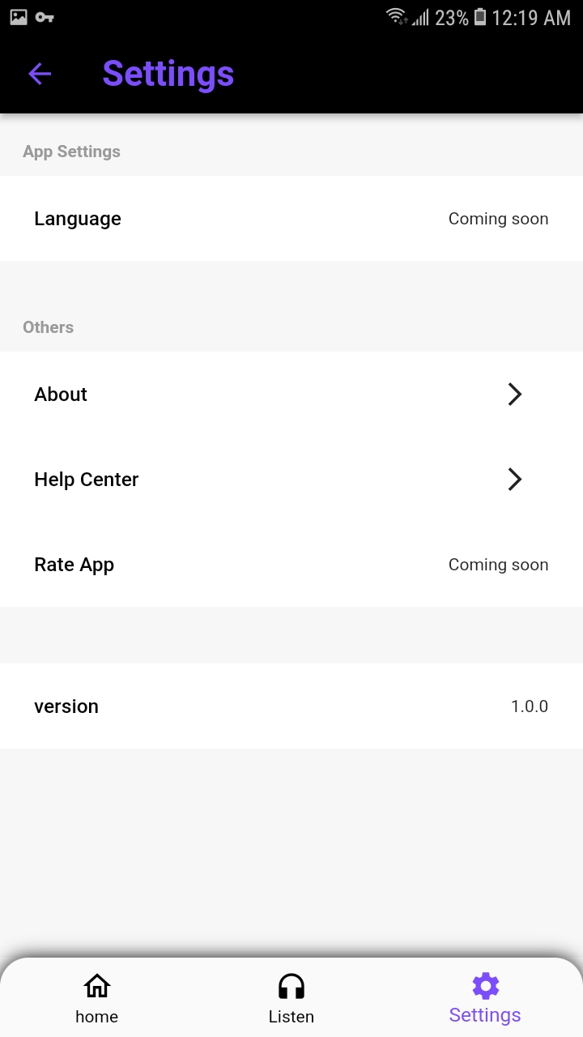

Slide 10
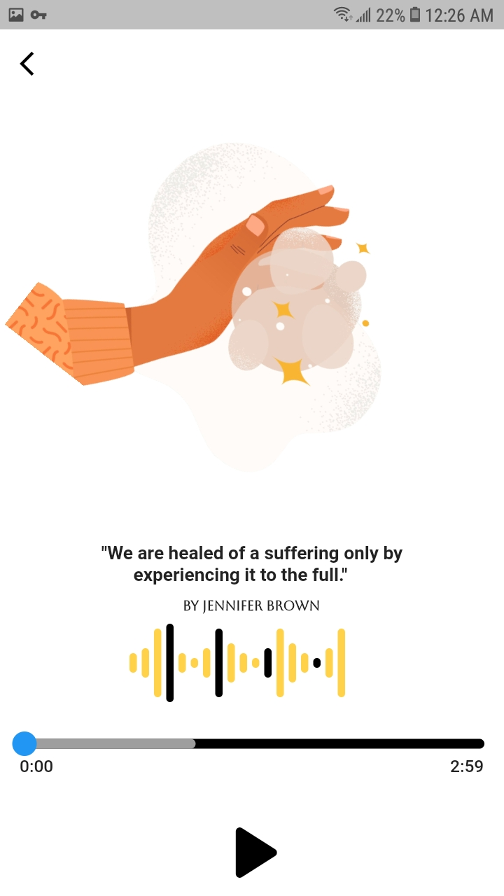
Features
It has an audio player under different categories like study,
Nature, sleep, focus and
So on.

Slide 11
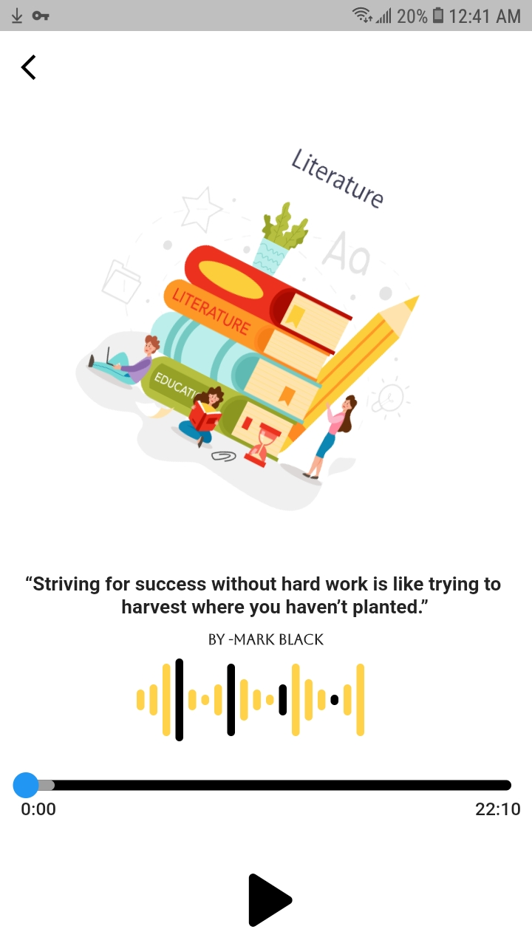
Features
You can choose short audios straight from
the dashboard.
There is also setting where you will find the version, help center and about.

Slide 12
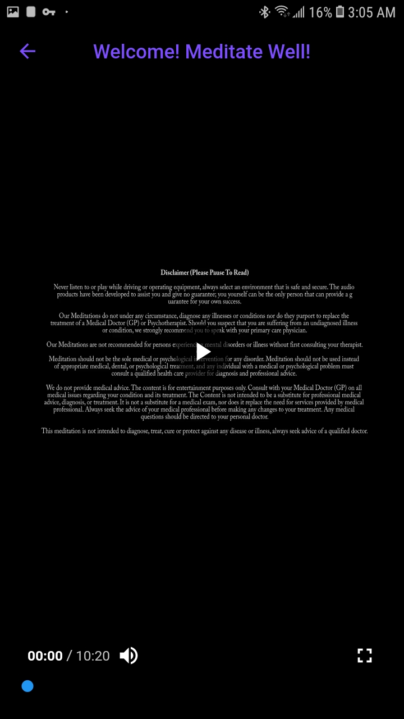
Features
There is also a daily 10 minutes guided meditation which is recommended.

Slide 13
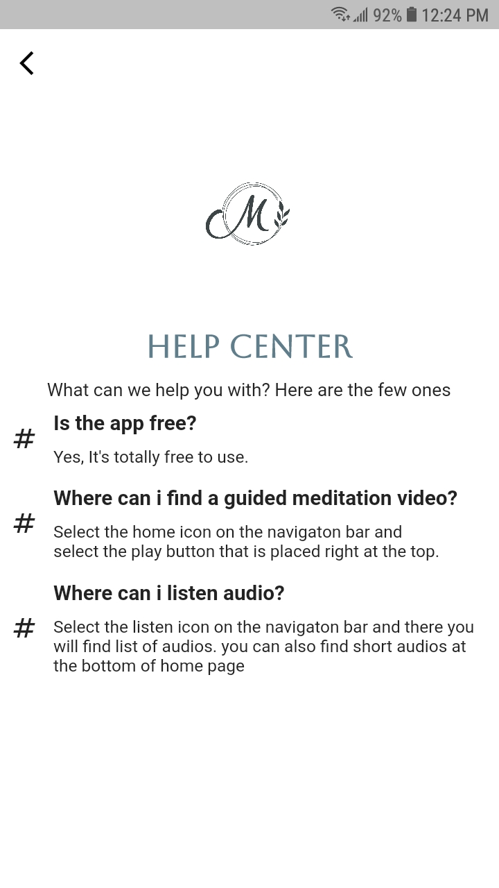
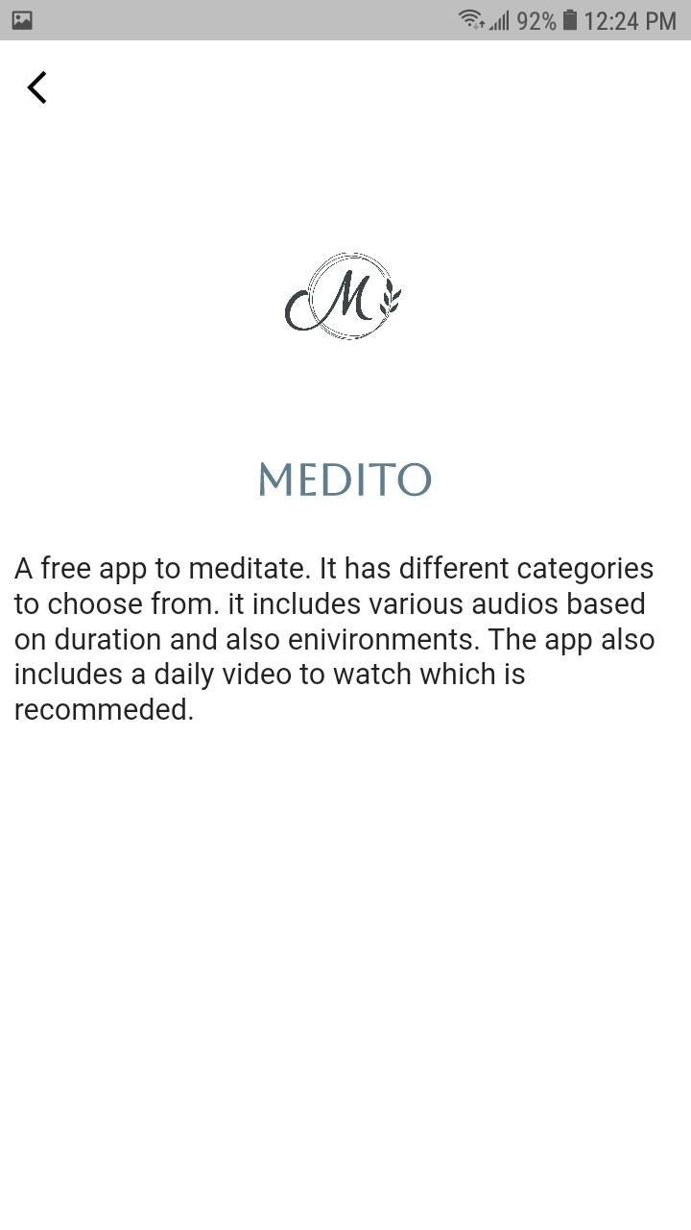
Features
From the setting, you can find a help center and info about the app.

Slide 14


Thanks!
Any questions?

Slide 15
Credits
Thanks to all the people who made this project come to alive and also would like to give a special thanks to our instructor @Robel Milashu for giving us this opportunity.

Slide 16



Team Presentation
Bethlehem Nigussu A BIT student
1201186
Hermella Asamenew A BIT student
1201986

