Slide 1
ONLINE RETAIL TRANSACTION ANALYSIS
Done By: Elizabeth S

Slide 2
Project Overview
This project analyzes online retail transactions using Power BI.
The dashboard helps understand:
Sales performance
Product demand
Customer distribution
Country-wise revenue
Interactive visuals and filters allow deeper analysis of business trends.

Slide 3
Project Objectives
• Analyze overall sales performance
• Identify top-selling products
• Understand customer purchasing patterns
• Study revenue trends over time
• Compare sales across countries
• Build an interactive Power BI dashboard

Slide 4
Dataset Overview
Dataset: Online Retail Transactions
The dataset contains records of retail purchases made by customers.
Key attributes include:
• InvoiceNo – Unique order identifier
• Description – Product name
• Quantity – Number of items purchased
• UnitPrice – Price per item
• InvoiceDate – Date of transaction
• CustomerID – Unique customer identifier
• Country – Customer location
Calculated Field:
Revenue = Quantity × UnitPrice

Slide 5
Visuals Used in the Project
The following visualizations were used in the Power BI dashboard:
• Card Visuals – Total Sales, Total Orders, Total Customers, Total Quantity
• Bar Charts – Sales by Country and Product
• Line Charts – Monthly Revenue Trend and Quantity Trend
• Donut Chart – Customer Distribution by Country
• Map Visual – Revenue by Country
• Slicers – Country filters for interactive analysis

Slide 6
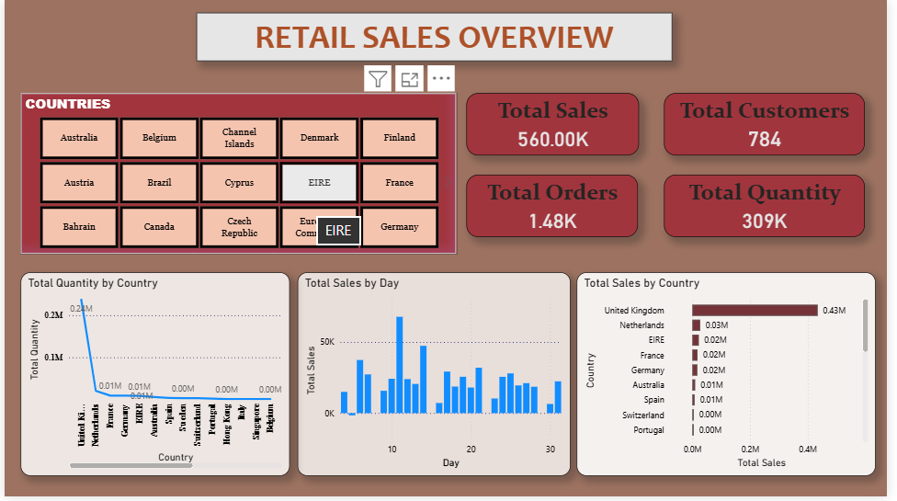
Retail Sales Overview

Slide 7
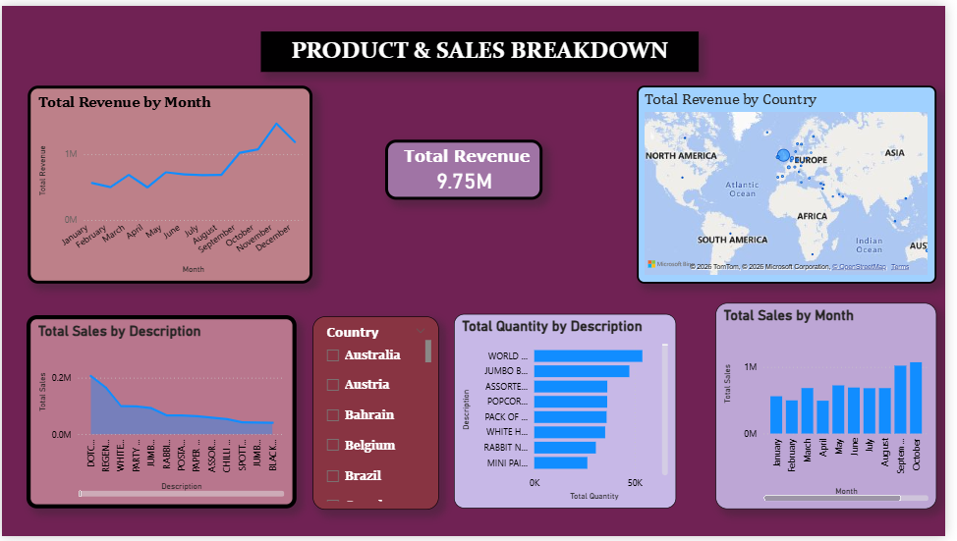
Product & Sales Breakdown

Slide 8
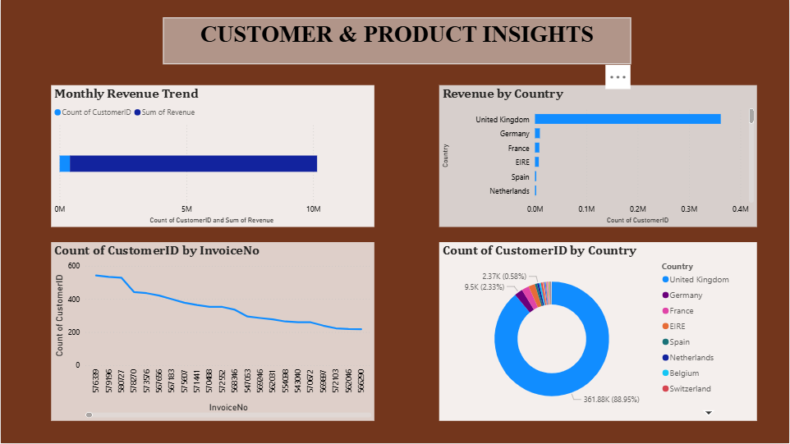
Customer & Product Insights

Slide 9
Key insights
This project demonstrates how Power BI can be used to analyze retail transaction data effectively.
The dashboard provides insights into sales performance, product demand, and customer distribution.
Interactive filters allow deeper exploration of the data, helping businesses make data-driven decisions.

Slide 10
conclusion
This project demonstrates how Power BI can be used to analyze retail transaction data effectively.
The dashboard provides insights into sales performance, product demand, and customer distribution.
Interactive filters allow deeper exploration of the data, helping businesses make data-driven decisions.

Slide 11
Thank you

