Slide 1
FAVOR
Money can buy most things.
For everything else there’s FAVOR ☺
Open Category
Ivan Sergeev : Semion Rozov : Chris Amevor : KT Tan

Slide 2
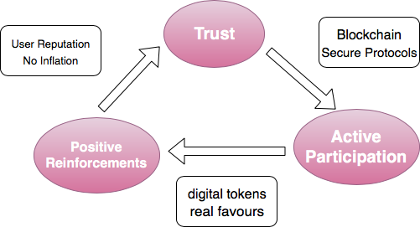
The Idea
We want to create a DApp that would allow people to exchange favors — small tasks completed by a person in close nexus to a requestor
Users register what favors they need fulfilled and what services they can provide in form of FVR smart contracts
Focus on sustainable social interaction
Free from commercial incentives
Allows for gifts and philanthropic donations for users
Intuitively simple
Can serve as a basis for other social projects on the Blockchain
Why do we need Blockchain for this?
A trust-based platform benefitting both parties to the transaction
Decentralized Exchange, cuts the middle-man

Slide 3
The Disruption Potential What is the outcome for society?
This is about social sustainability:
“We want to decouple small favors like walking someone’s dog or helping out with shopping from a monetary value, as it is often difficult to estimate a fair fiat equivalent”
Asking for a favor directly can be problematic…
One might have difficulties to ask for something in person
It can be sometimes awkward to give money for simple tasks
FVR incentivises people to help each other out because it guarantees them an equivalent “good” in return. In an ideal world, we would not need the Blockchain for that…

Slide 4
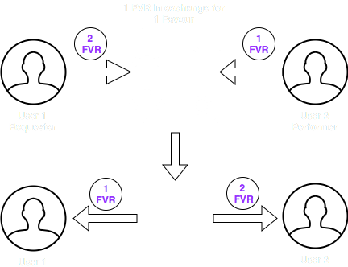
The Solution
Do a favor = get a FVR
Ask for a favor = spend a FVR
Strictly symbolic & inflation-free value
Designed to be free from bots and cheating: members are incentivised to act fairly through special token economics:
In order to engage in a contract, users need to spend commitment tokens which they get back after successful fulfillment of the contract
It’s in the user’s interest to cooperate
New users have to earn their first FVR token by completing a task from a random list of 1-10 (for stricter rules, a task that requires physical verification). Their commitment token is granted by the smart contract, but only released after a number of successful interactions.
The system can’t be misused by bots, because the net balance in the botnet would remain constant for the same number of bots (tokens can’t leave) and the creation of new tokens would require new bots, and thus more work.

Slide 5
FAVOR dAPP
Solidity for Smart Contracts on ETH (working)
WebAPP for UI
(JS 💩 HTML 💩 CSS…) (w.i.p.)
View FVR balance
View available listings
View active listings
Create new listing
(Play Slide Show for Animation)
Protocols
Searching
Privacy
Security
Negotiation
Transparency
Trust
Acting

Slide 6
Difficulties/open challenges
We encountered challenges with:#
X
X
x
We would like to incorporate:
a reputation ranking process
an encryted messaging to negotiate details

Slide 7
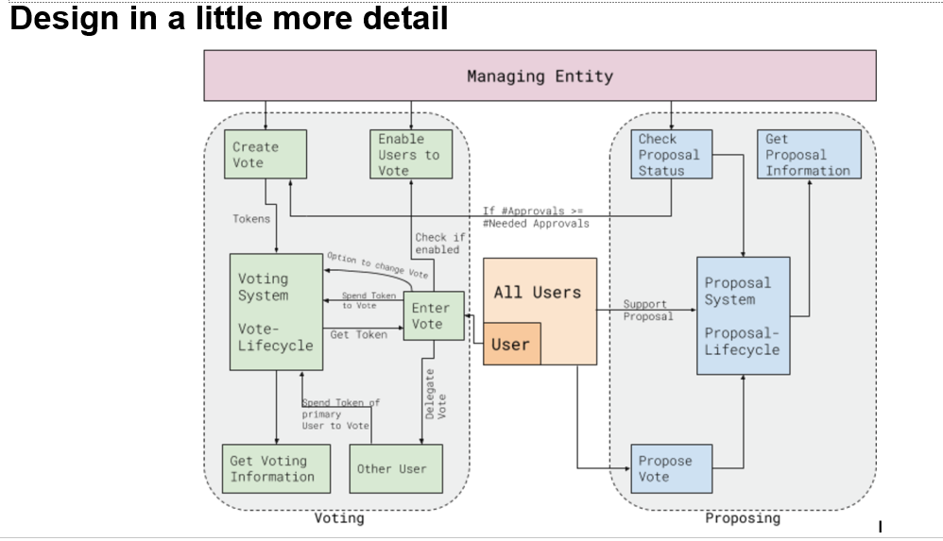
The Protocol

Slide 8
GUI

