Slide 1
Our Purpose
WHY
Encourage the purchase of organic soybeans. Make the world a BETHer place.
WHAT
HOW
HOW
By leveraging IoT and blockchain we are able to trace assets (soybeans/trucks), thereby minimizing the risk of selling inorganic as organic.
WHY
WHAT
We want to help companies secure their supply chain by tracking goods, minimizing organic fraud.

Slide 2
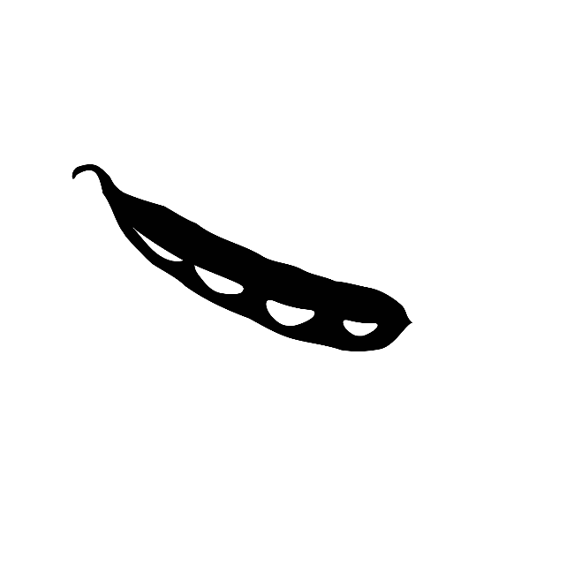
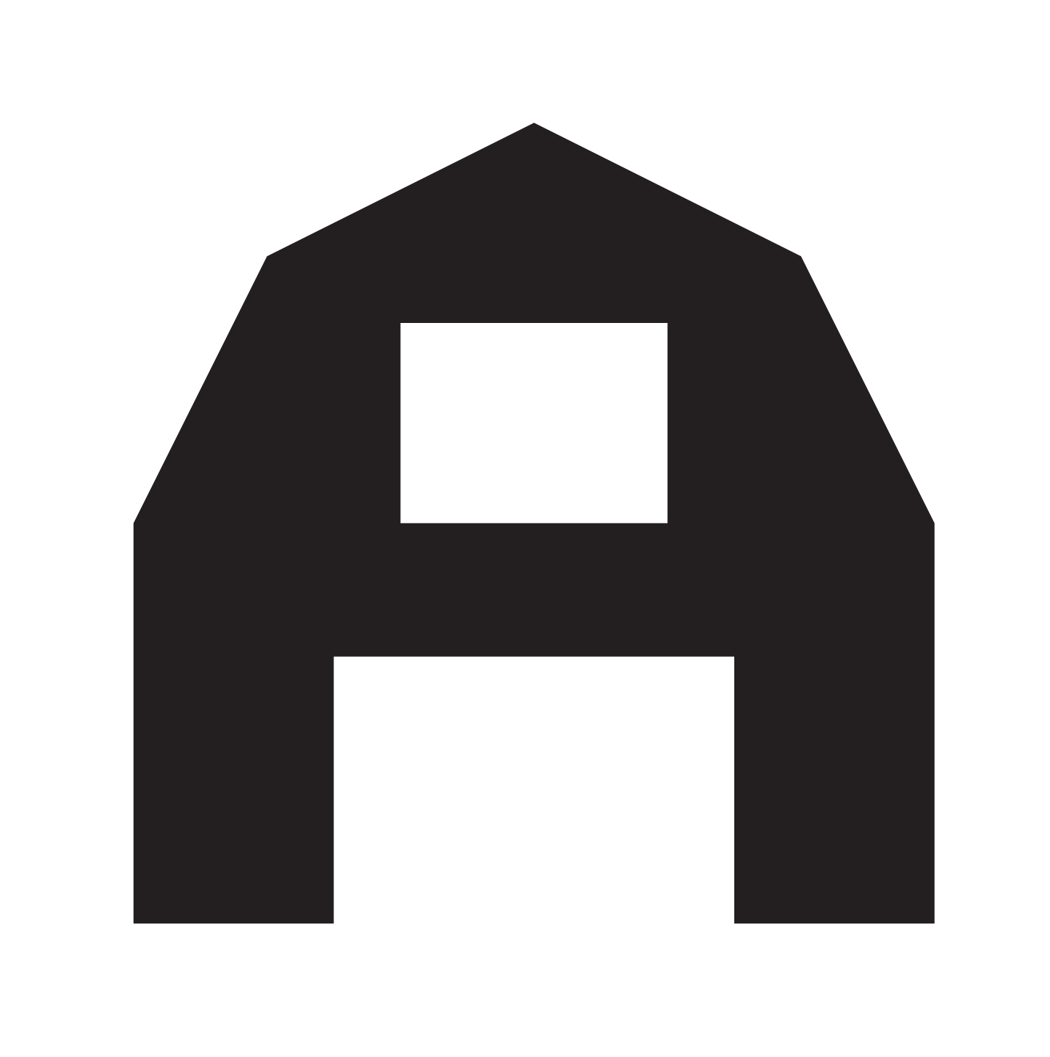
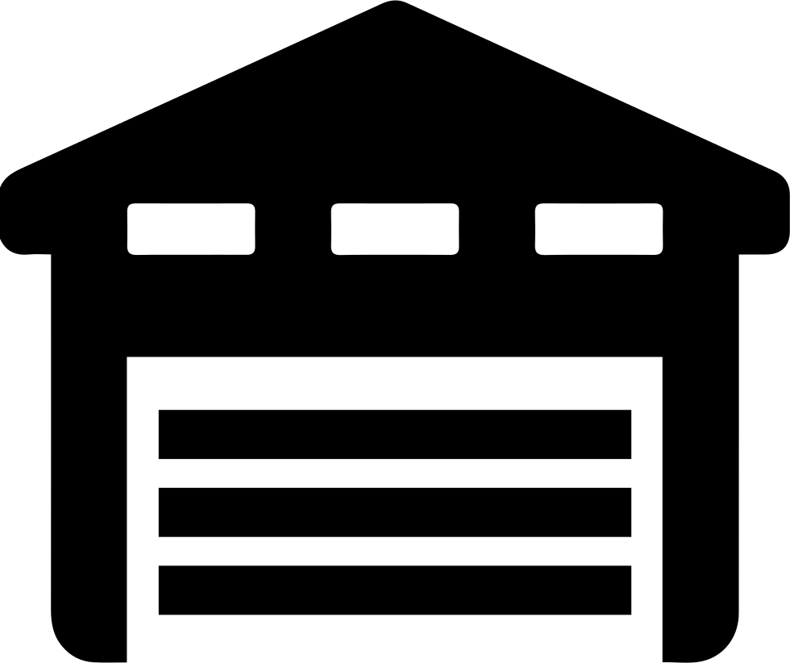
Supply Chain and Vulnerabilities
Vulnerabilites
Soybean Field
Farmer Warehouse
Trader Warehouse
The supply chain encompasses two types of actors: farmers and traders (supermarkets and consumers are out of scope).
Farmers harvest soybeans, optionally store them in their own warehouse, and transport them via truck to a traders warehouse (possibly using a subcontractor.)
The goal is to prevent the sale of soybeans labelled “organic” that have been illegally mixed with inorganic.
Mixing can take place at points where beans are transferred from one storage container to another.

Slide 3

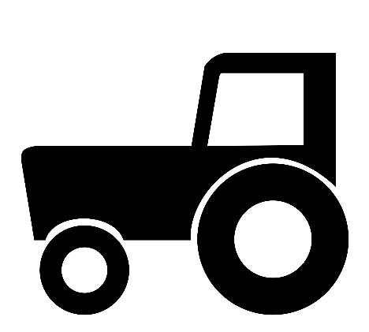
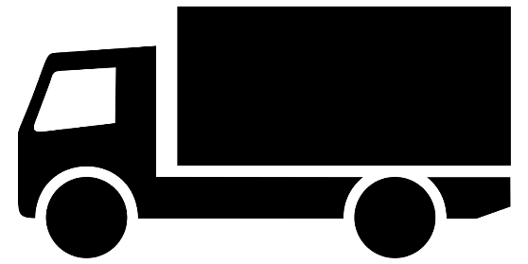
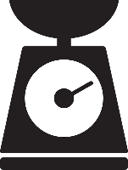
Preventing Fraud
inorganic
organic
Combine
Truck
Our solution: record the weight of organic beans as they are harvested, save data to blockchain.
Again record the weight of organic beans as they enter the trader’s warehouse, save data to blockchain.
If actor (e. g. farmer) tries to inflate weight of organic beans with inorganic beans, the change in weight is detected in trader’s warehouse.
Blockchain

Slide 4
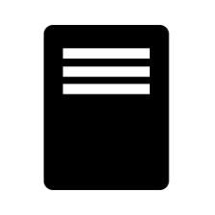
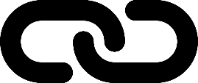
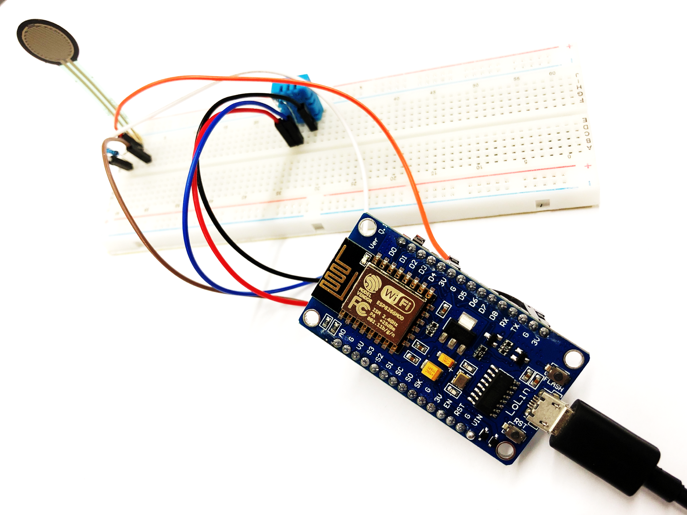

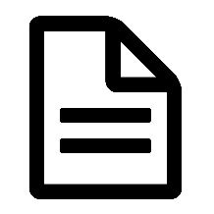
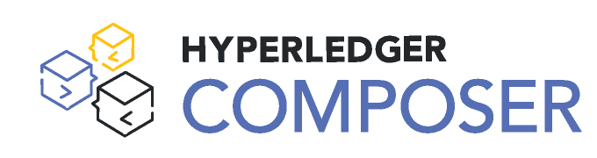
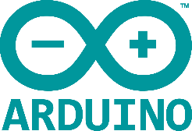
Our Setup
REST Server
Forcer
Execute Smart Contract contingent on weight data
Store weight data on Blockchain
Secure Supply Chain
ESP8266
Programme ESP8266
with Arduino
Smart Contract
Blockchain

Slide 5
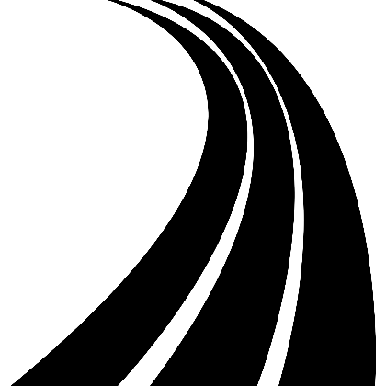

Our Vision
PREVENT FRAUD
Leverage IoT to secure the supply chain
Fully automate the supply chain data acquisition
TRACK SOYBEANS
Follow the soybeans from seeding to the supermarket
Know where your beans grow and be sure of their route
CUSTOMER CENTRIC
Review the criteria important to you
organic
carbon footprint
Not just a certificate but evidence

