Slide 1
C
A
S
C
A
D
E
S
W
O
R
D
L
E
A WORDLE DUPE CREATED SOLELY THROUGH GENERATIVE AI

Slide 2
W
I
N
D
S
U
R
F
C
A
S
C
A
D
E
Founded in 2021
Primary feature is AI agent called Cascade
Integrated directly with projects
Automates coding and development tasks
Can create files, install dependencies, and execute terminal commands

Slide 3
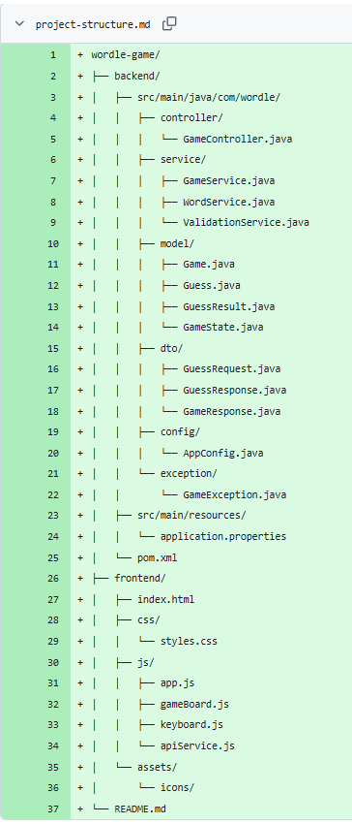
I
N
I
T
I
A
L
P
R
O
M
P
T
Write a program where the user has 6 chances to guess a randomly chosen 5 letter English word. Code the frontend using JavaScript, CSS, and HTML. Write the backend in Java. Connect the frontend and backend using RESTful API.
Use an external English word list API to provide the vault of possible English 5 letter words that the program can randomly choose from as the answer. Have the backend handle word selection, validation, and game rules. Have the frontend handle keyboard, user input, and display.
Do not write full implementation code yet. Start with the overall project design. More prompts to follow. End result must demonstrate good object oriented programming and design.
Formulated initial prompt as group in class
Backend (Java, REST API, validation, normalization)
Frontend (JavaScript, CSS, HTML, handle initial input)
Discussed error handling
Started slow

Slide 4
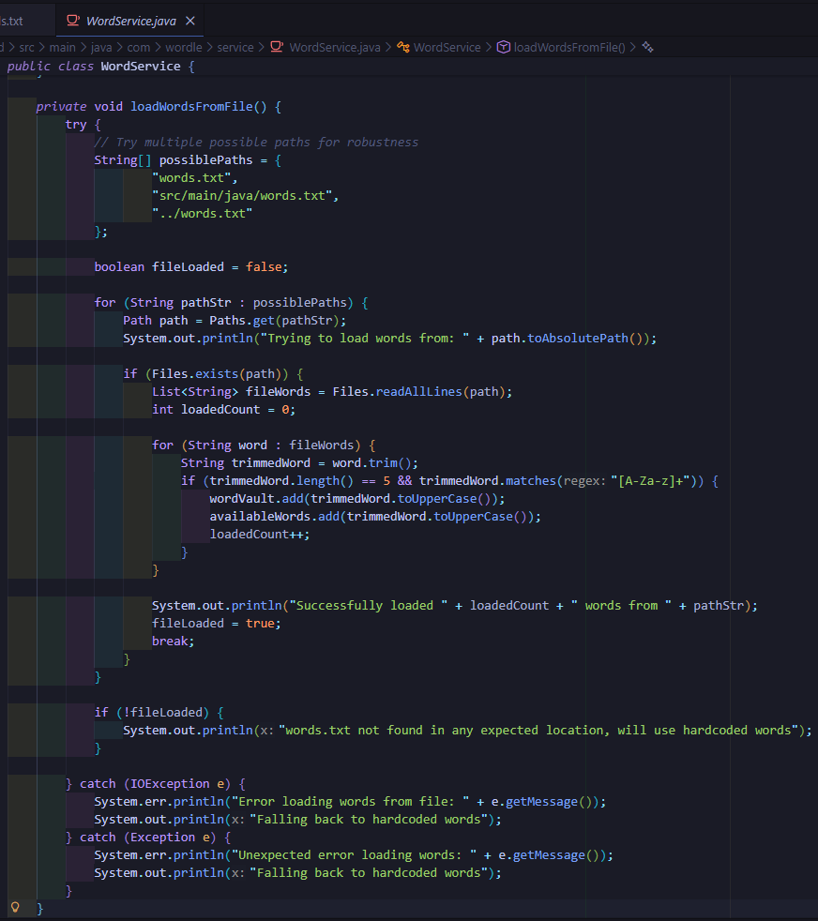
B
A
C
K
E
N
D
P
R
O
M
P
T
Initial
Set up game logic
Clarified rules
Clarification on error handling
Further Prompting
AI initially included Maven, requested removal for simplicity. Removed Spring dependencies.
Used Java’s Built-in HTTP Server and custom REST API
Expanded initial word bank using text file to supply words
Safe paths and exception handling utilized
Notes:
First backend prompt: Working on backend game logic. Normalize all user input to uppercase. Only allow the Roman Alphabet to be typed in. Do not take numbers or symbols as input. Do not allow the user to enter an incomplete guess (less than 5 letters). Handle/reject if the user tries to enter more than 5 letters in one guess. Allow the user to guess the same word in the same run.
Only allow answers that are real words in the English language (using the vault used to select the correct answer). If user attempts to enter an invalid word, display a message saying the entry is invalid. Do not take it as a guess.
Allow the user to play multiple times. Each run will have a new random word chosen as the correct answer.

Slide 5
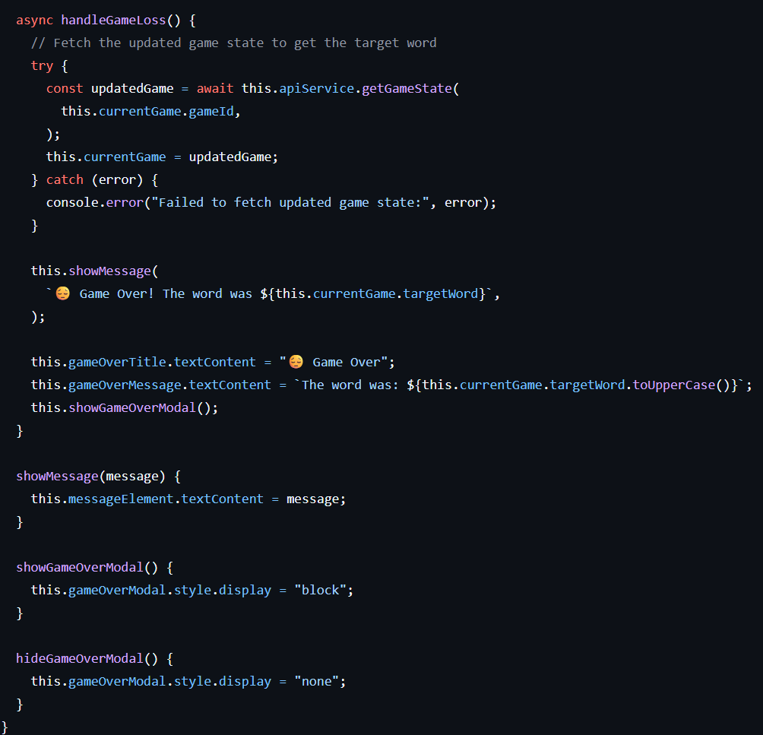
F
R
O
N
T
E
N
D
P
R
O
M
P
T
Initial
Create Frontend Server
GUI implementing Wordle characteristics
Communicates with Backend Server
Further Prompting
AI had incorrect route mapping initially
Fixed issue of correct word not being fetched from backend upon failure (so the correct word could be displayed)
Notes:
First backend prompt: Working on backend game logic. Normalize all user input to uppercase. Only allow the Roman Alphabet to be typed in. Do not take numbers or symbols as input. Do not allow the user to enter an incomplete guess (less than 5 letters). Handle/reject if the user tries to enter more than 5 letters in one guess. Allow the user to guess the same word in the same run.
Only allow answers that are real words in the English language (using the vault used to select the correct answer). If user attempts to enter an invalid word, display a message saying the entry is invalid. Do not take it as a guess.
Allow the user to play multiple times. Each run will have a new random word chosen as the correct answer.

Slide 6
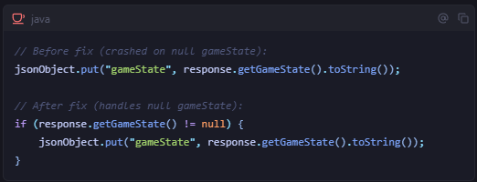
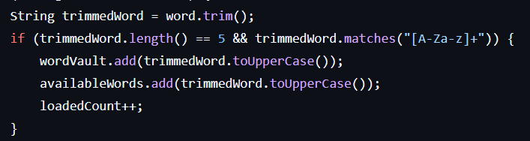
B
U
G
F
I
X
E
S
Fixed backend crashing when processing invalid guesses
Problem: breaking at JSON conversion
Solution: adding a null check on the gameState
Fixed invalid words from entering the wordVault
Problem: invalid words were in the word list
Solution: filtering out only the valid words
Notes:
First backend prompt: Working on backend game logic. Normalize all user input to uppercase. Only allow the Roman Alphabet to be typed in. Do not take numbers or symbols as input. Do not allow the user to enter an incomplete guess (less than 5 letters). Handle/reject if the user tries to enter more than 5 letters in one guess. Allow the user to guess the same word in the same run.
Only allow answers that are real words in the English language (using the vault used to select the correct answer). If user attempts to enter an invalid word, display a message saying the entry is invalid. Do not take it as a guess.
Allow the user to play multiple times. Each run will have a new random word chosen as the correct answer.

Slide 7
T
H
A
N
K
S
Bethany Feddes, Michael Mihailov, Daniel Episcopo

Slide 8

SlideChef

