Slide 1
Scheduling System
Askold Horčička
Kryštof Havel
Jiří Jirásek
Juraj Janíček
Jakub Štefan

Slide 2
Overview
System for creating, managing and scheduling courses, viewing schedules and calculating statistics
4 types of users (roles):
Manager
Schedule Committee Member
Teacher
Student
Manual Scheduling (no algorithms)

Slide 3
Features
Core:
Registering new course (Kryštof Havel)
Scheduling a course (Jakub Štefan)
Collision detection (Jiří Jirásek)
Schedule viewing (Askold Hořčička)
Statistics viewing (Juraj Janíček)
Other:
Editing existing course
Viewing unscheduled courses
Notifying user on schedule change
Notes:
Viewing unscheduled courses pro committee membery

Slide 4
Responsibilites
Registering new course
Show course creation dashboard
Show course creation form
List all courses of the teacher
Store course detail to the database
Scheduling a course
Show scheduling page
Fetch courses
Filter currently taught courses
List all unscheduled courses
Store schedule info to database
Statistics viewing
Fetch historical data
Calculate requested statistic
Display the statistic
Export the statistic
Collision Detection
Check for room conflict
Check for teacher conflict
Display conflict alert
Mark schedule as conflicted in DB
Schedule viewing
Display desired schedule
Filter based on room, teacher, year
Highlight conflicts
Fetch schedule from database
Notes:
Viewing unscheduled courses pro committee membery

Slide 5
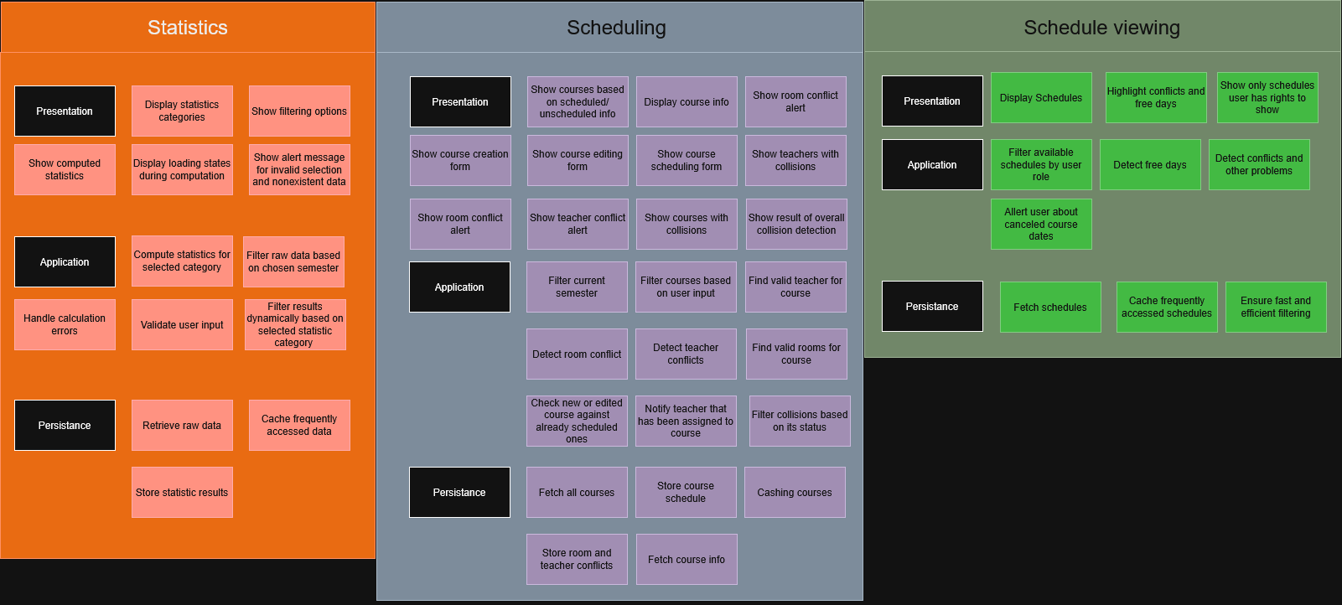
Responsibilites - grouping
Notes:
Viewing unscheduled courses pro committee membery

Slide 6
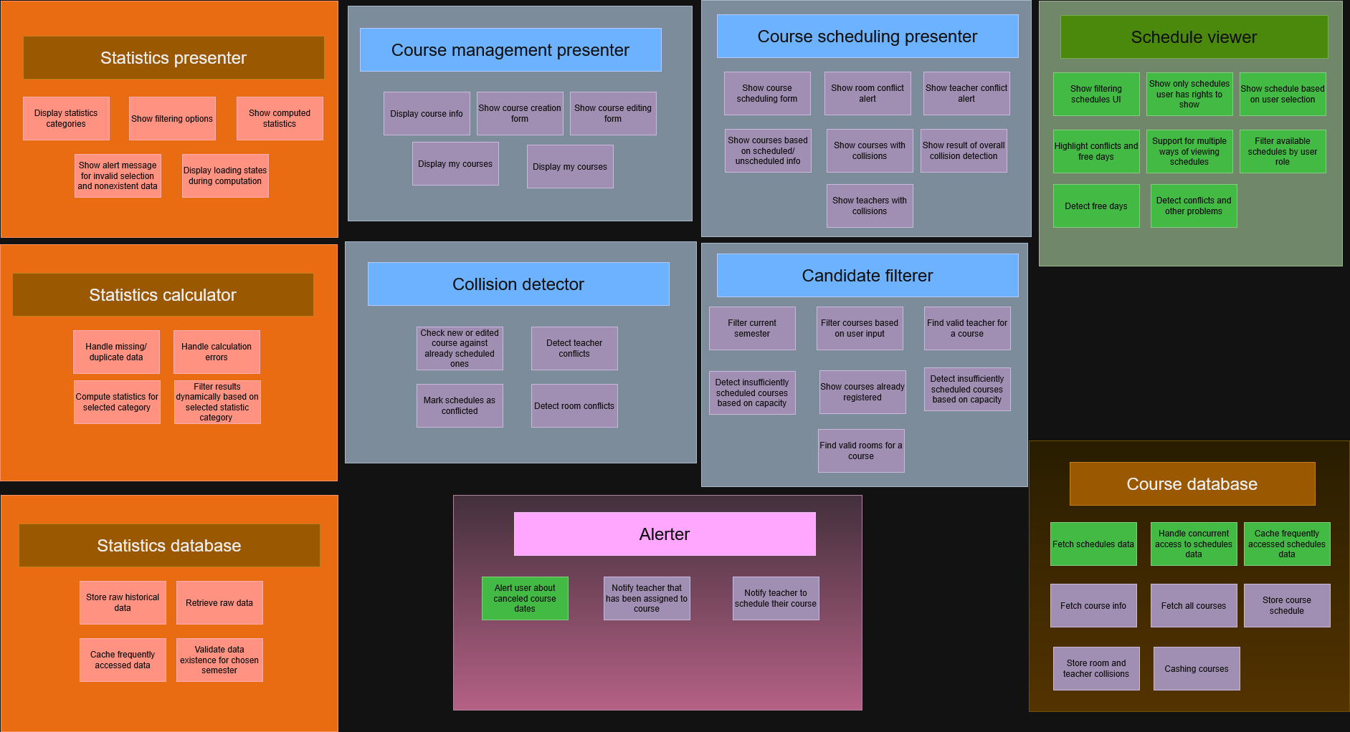
Responsibilites - modules
Notes:
Viewing unscheduled courses pro committee membery

Slide 7
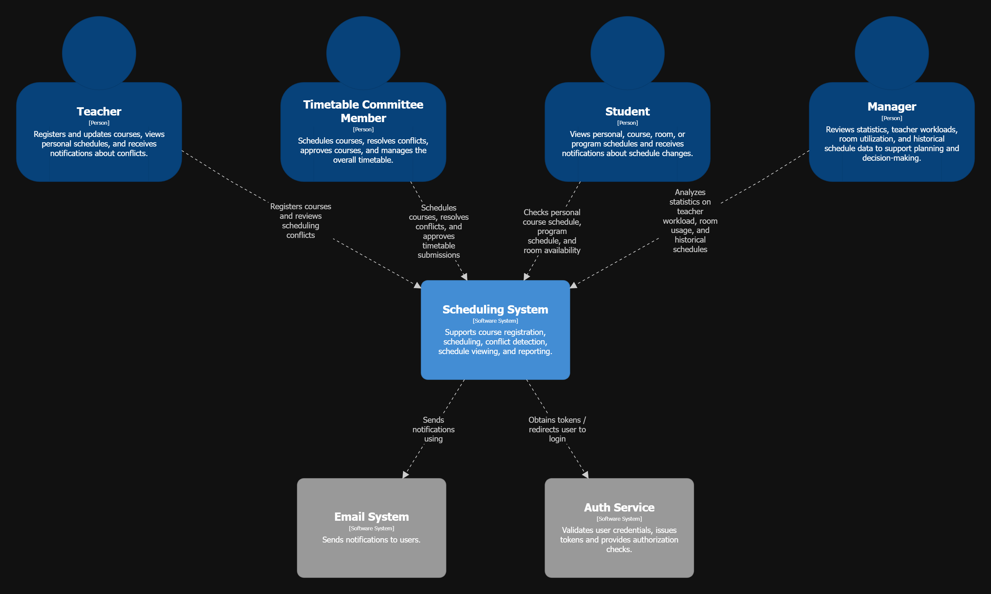
C4 – L1
Notes:
Viewing unscheduled courses pro committee membery

Slide 8
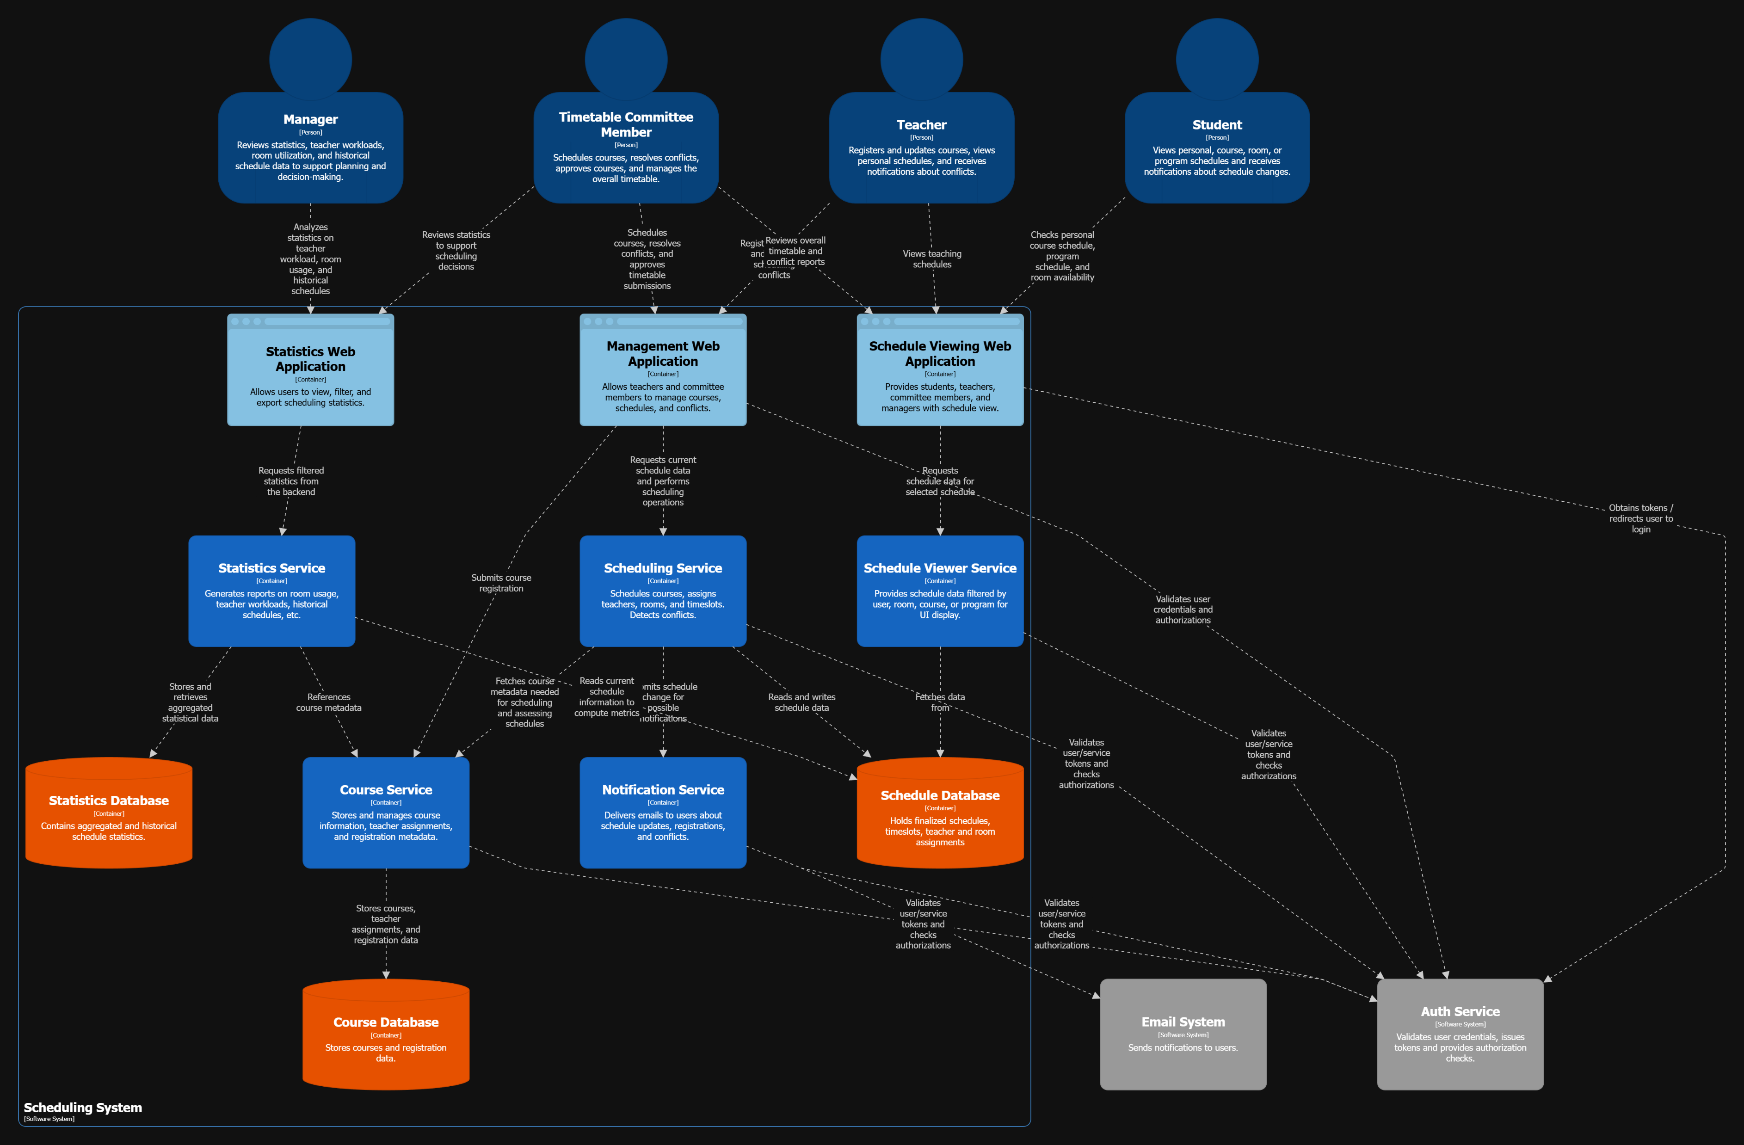
L2
Juraj – Statistics
Jakub – Scheduling
Jiří – Frontend
Kryštof – Dynamic diagrams
Askold – Schedule viewing
Notes:
Viewing unscheduled courses pro committee membery

Slide 9
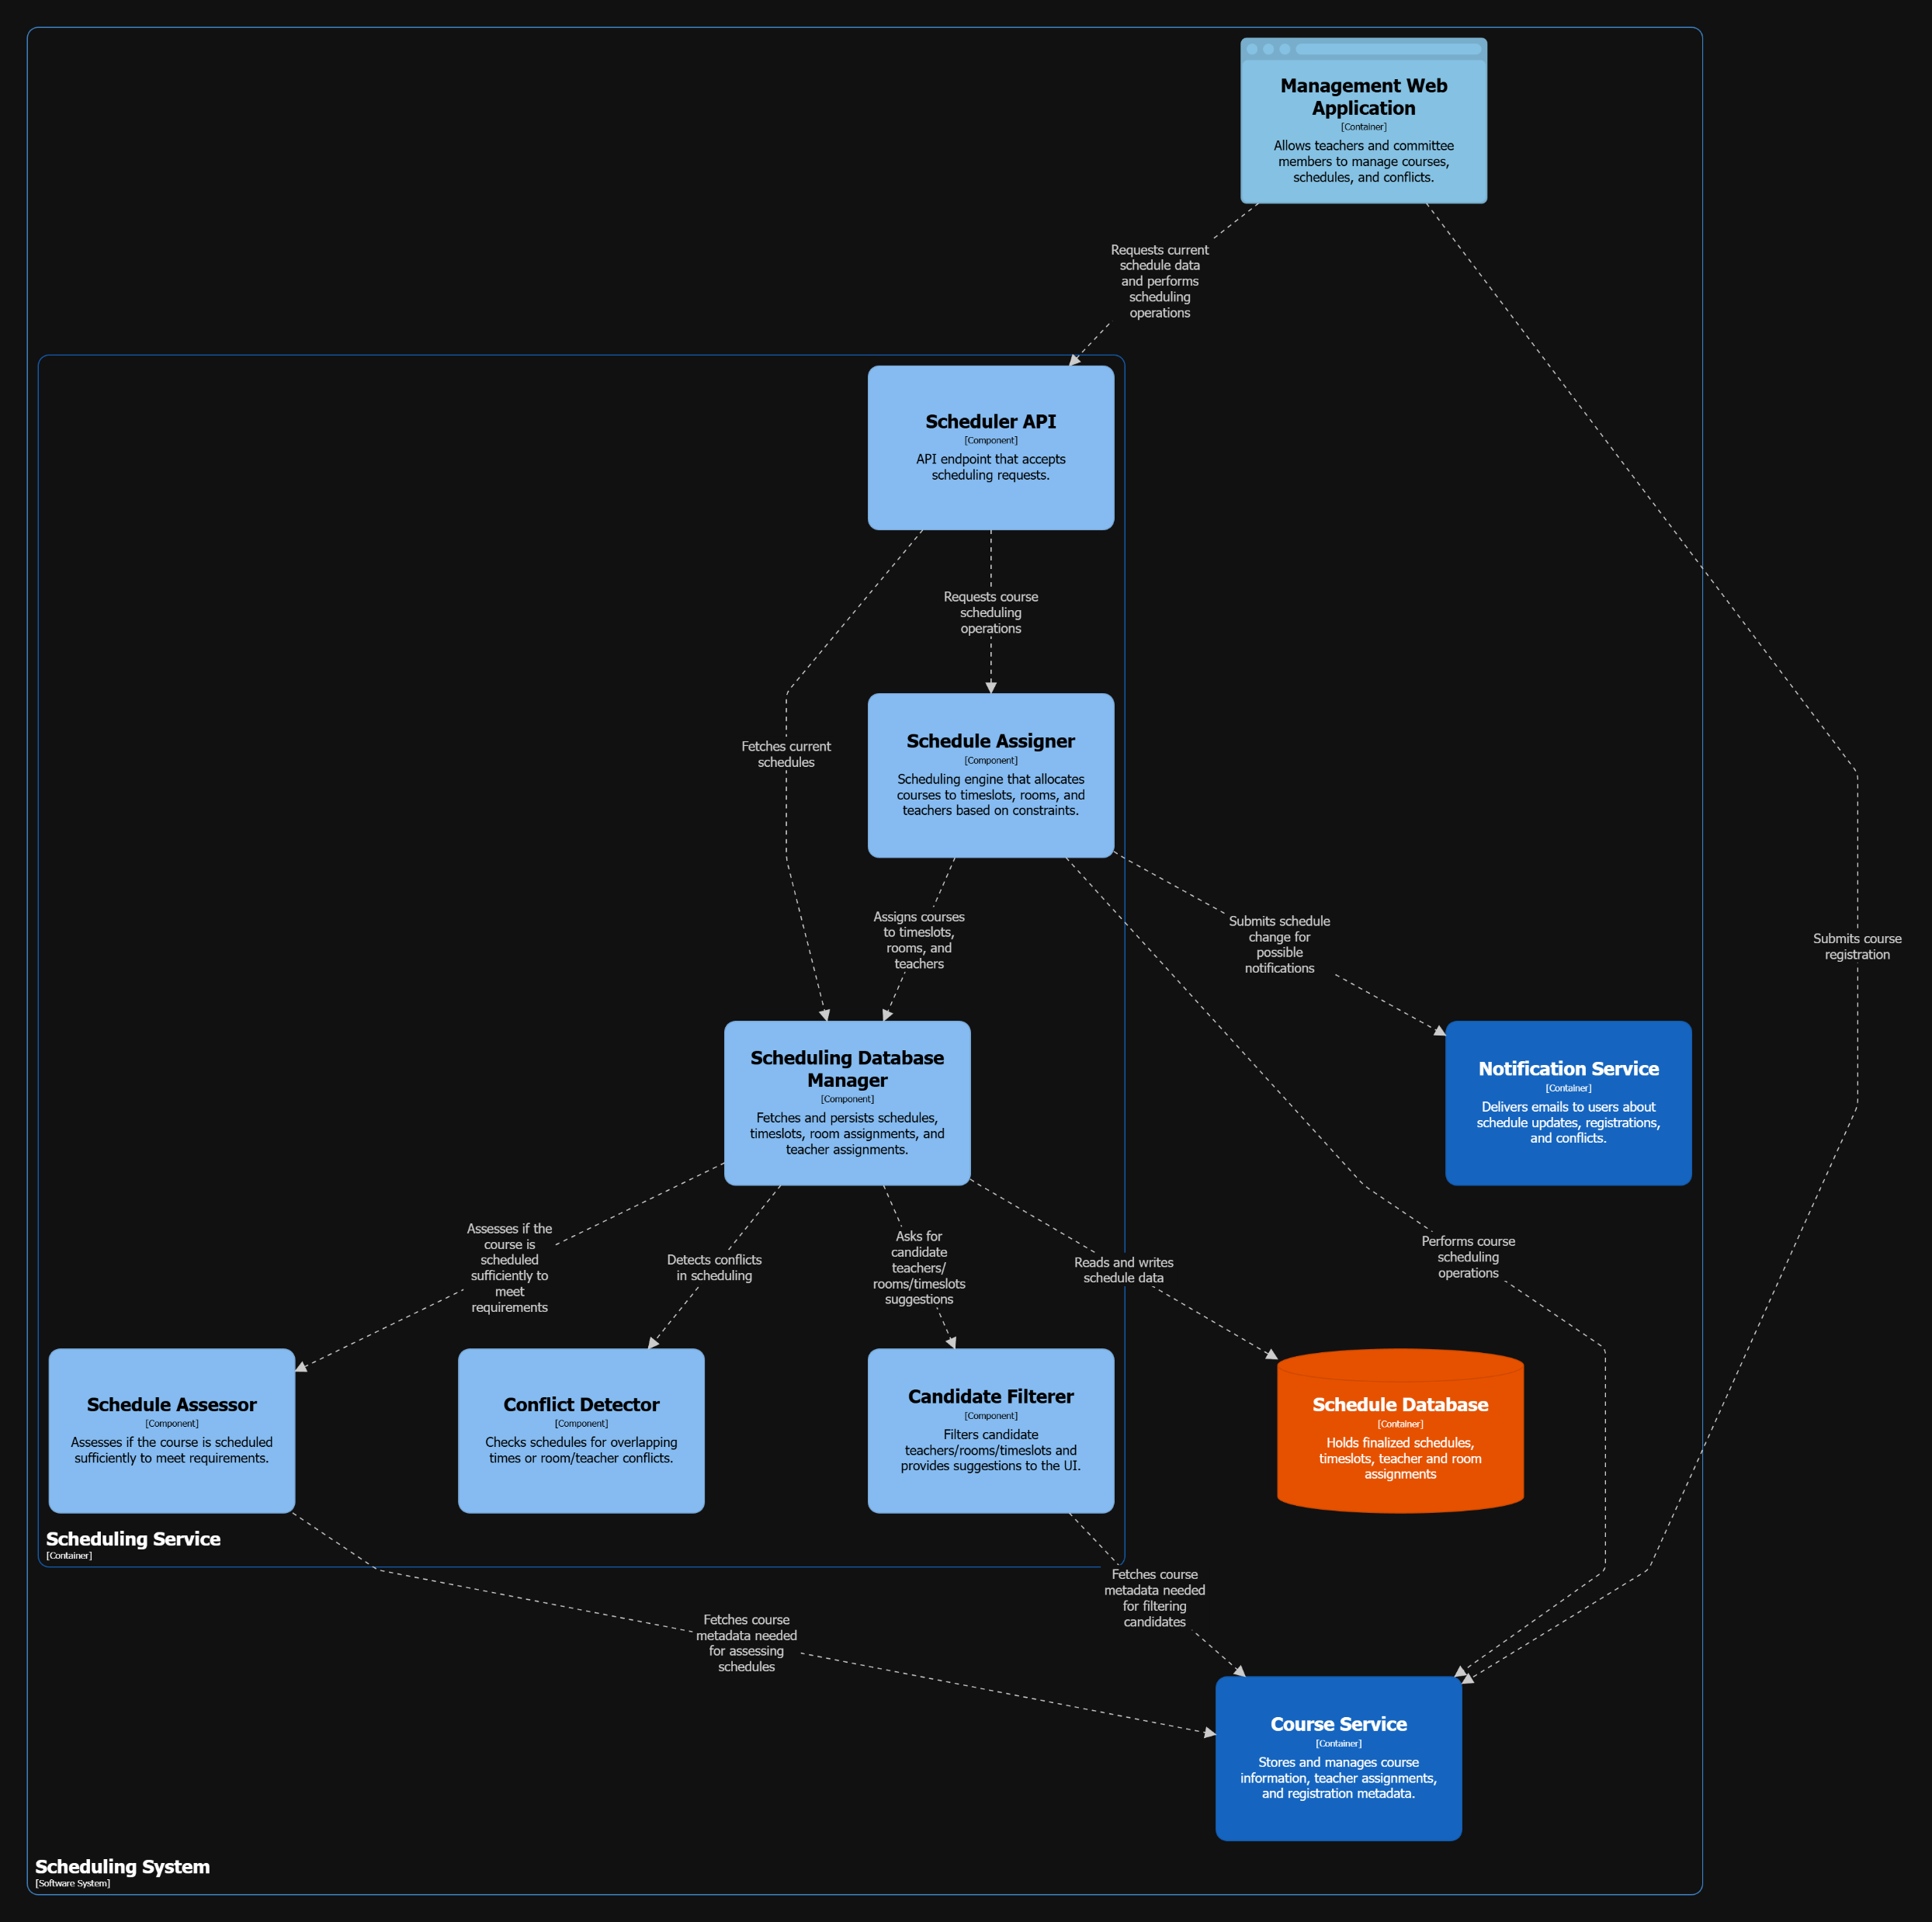
L3 – Scheduling service

Slide 10
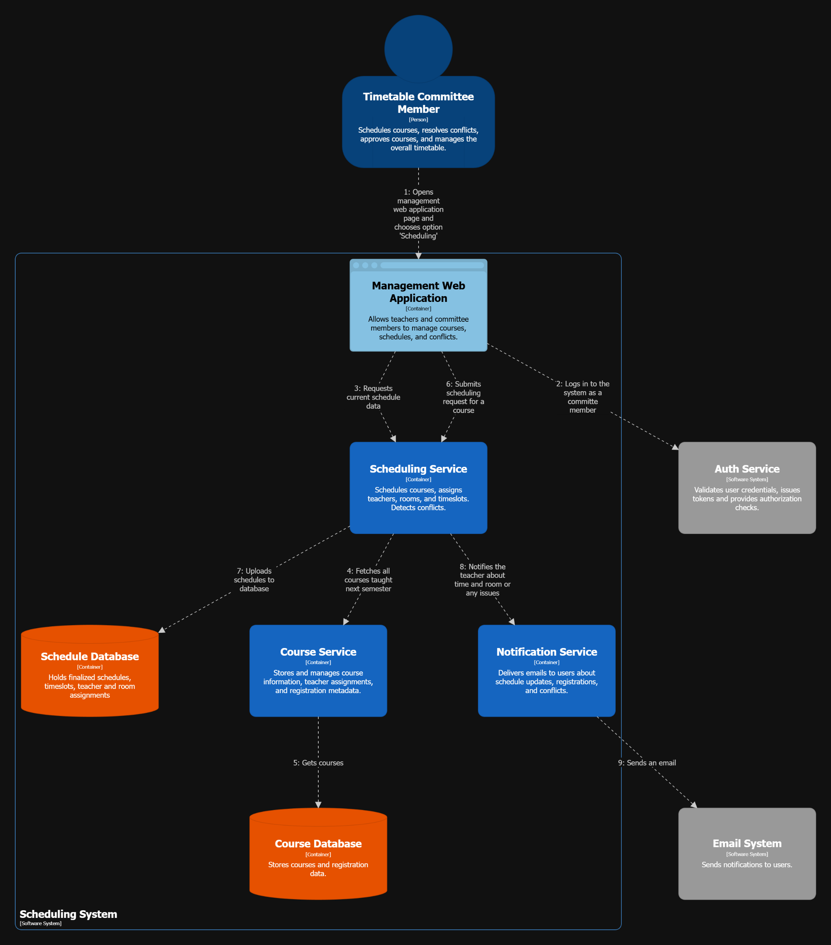
Dynamic diagram
Scheduling a course
(Kryštof Havel)
Notes:
Viewing unscheduled courses pro committee membery

Slide 11
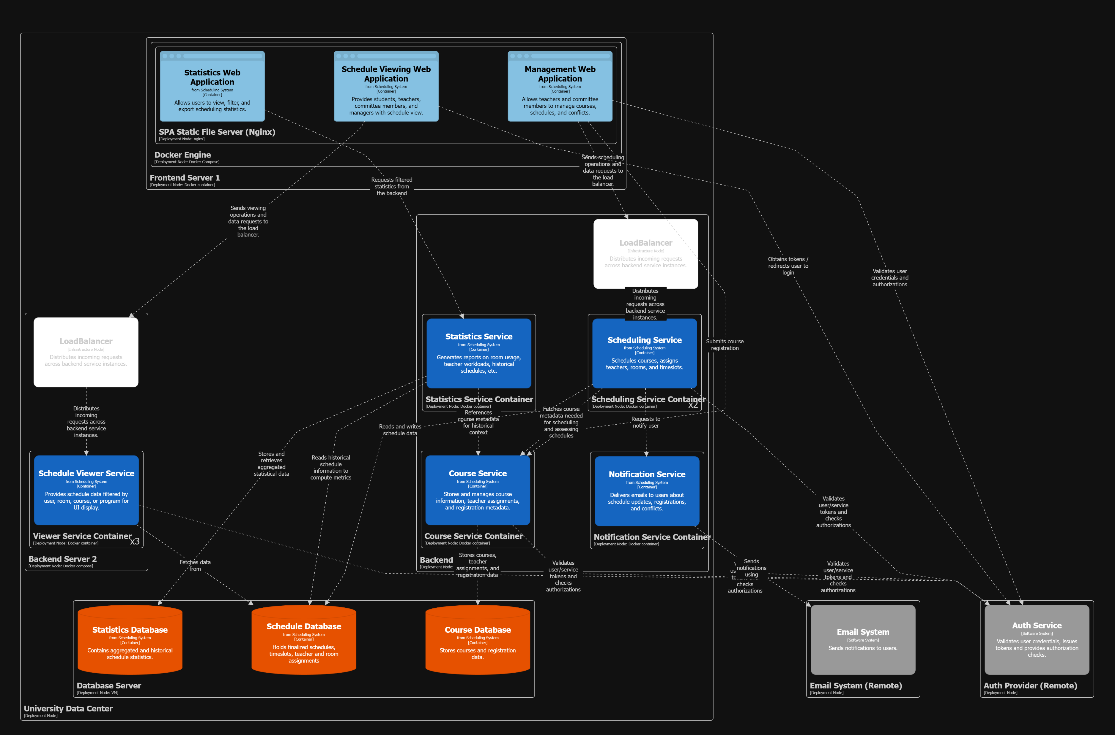
Deployment diagram
Production
(Jiří Jirásek)
Notes:
Viewing unscheduled courses pro committee membery

