Slide 1
Schedule 2
( formerly ENR1 )
Viet Bui
Erik Leššo
Khanh Duong
Tomáš Vikiszály
Alžbeta Kulichová

Slide 2
Overview of quality requirements
Modifiability
  Scenario: Add a new conflict rule
Testability
  Scenario: Testing of new course statistics
  Scenario: Testing of scheduling - Tomáš
Performance
  Scenario: Mass schedule viewing - Bety
  Scenario: Repeated statistics queries
Availability
  Scenario: Notification Service Availability - Bui
Scalability
  Scenario: Add new statistics category - Kuba
  Scenario: Growing number of users for schedule viewing
Security
  Scenario: Unauthorized course modification - Erik
  Scenario: Stolen access token used by attacker

Slide 3
Testing of scheduling
System Tester
Scheduling Service
100% repeatable test results
runs tests
tested on dummy data instead of database
Testing Environment
scheduling and conflict logic are tested without using UI or database (Unit tests)
tests are deterministic and fast
Solution: no need to modify architecture as there is a separation between business logic and infrastructure
TESTABILITY

Slide 4
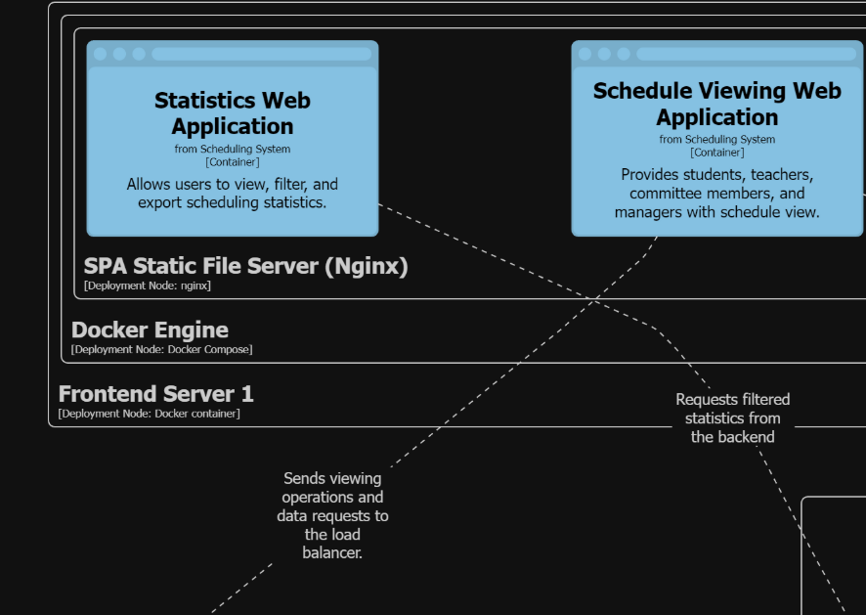
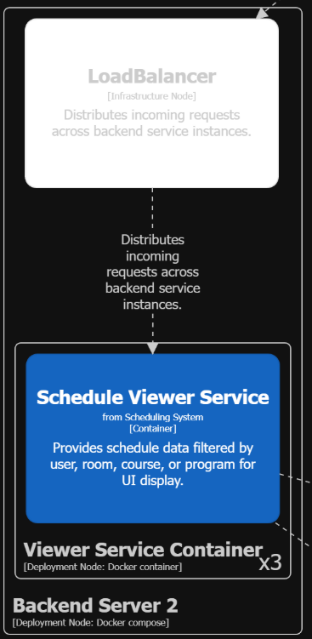
Mass schedule viewing
Students
Schedule Viewing Web App
Latency up to 3s
thousands of requests to open schedule page at a 1s time frame
Reads requests sent
Normal operation
when timetable is published, thousands of students request schedules at the same time
the Schedule Viewer Service is replicated and stateless, so requests are distributed evenly
Solution: architecture update is not needed as horizontal scaling and load balancing are already implemented
PERFORMANCE

Slide 5
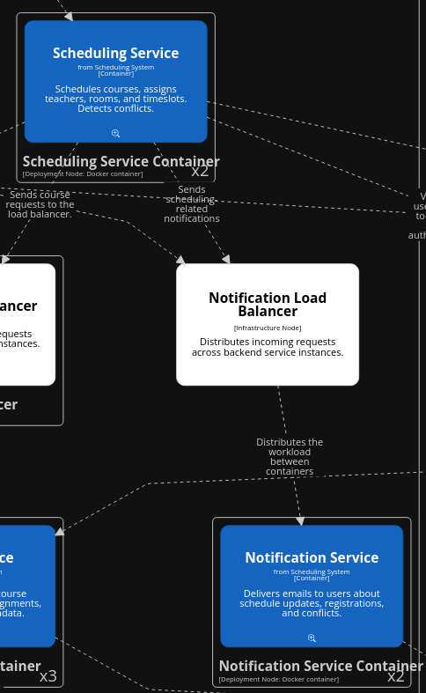
Notification Service Availability
Scheduling Service
Notification Service
No downtime
Unable to use for notification
Recover, log
Normal operation
AVAILABILITY
System now runs multiple duplicates of Notification Service under a load balancer
When some Notification Service clone returns error while sending notification, we log it and dispatch to a working instance
No synchronization needed, as instances of Notification Service operate independently without shared state

Slide 6
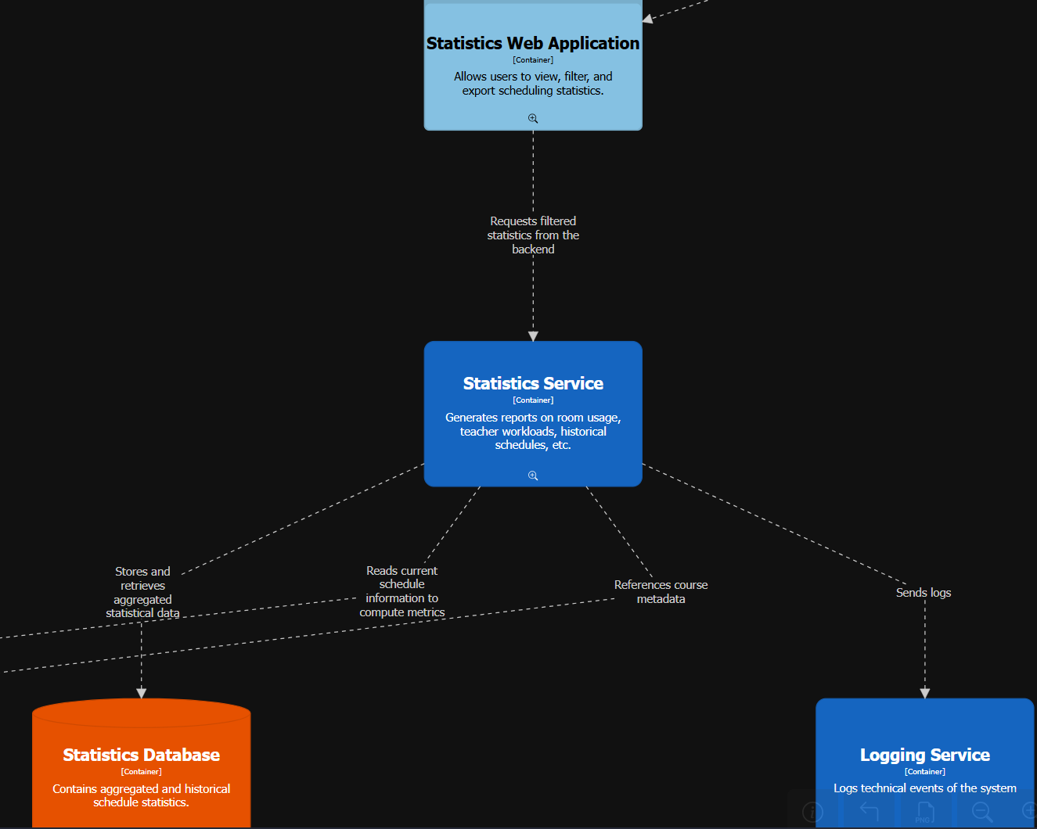
Add new statistics category
System developer
Statistics service
The database is updated without a hitch
Add a new statistics category
New statistics category is added to the statistics service
Normal operation
SCALABILITY
Solution: Architecture is able to handle this, everything goes through the statistics service, which requests the data needed from the course service

Slide 7
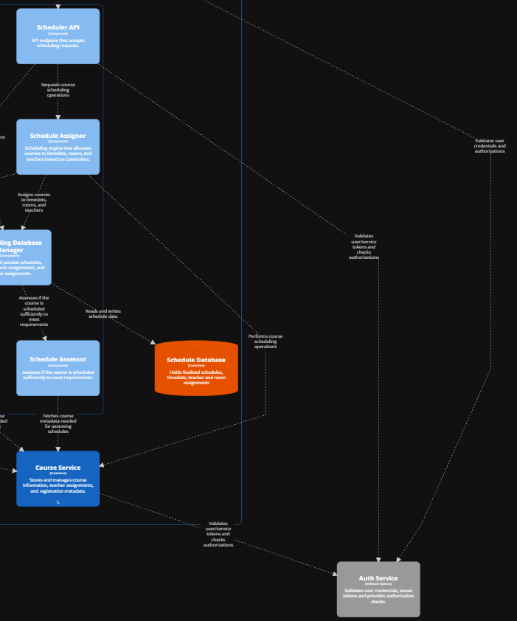
Unauthorized course modification
Student
Course Service
http 403, prevent unauthorized action
Call course registration API
Validate token
Normal operation
SECURITY
Solution: The architecture must be updated to bridge the Auth Service with the Scheduler API. This ensures that specific API calls related to teacher schedules and administrative tasks are strictly protected against unauthorized access.

Slide 8
Thank you for your attention

Slide 9
Any questions?

