Slide 1
Enrollment 1
Viet Bui
Erik Leššo
Khanh Duong
Tomáš Vikiszály
Alžbeta Kulichová

Slide 2
Overview of Features
Student's schedule preview
Student's schedule planning
Student's enrollment self-management
Student profile update
Student course recommendation
Teacher’s lectures management
Teacher – Communication via Email
Enrollment lock and notifications
Export of student personal data

Slide 3
Overview of Features
Student's schedule preview
Student's schedule planning
Student's enrollment self-management
Student profile update
Student course recommendation
Teacher’s lectures management
Teacher – Communication via Email
Enrollment lock and notifications
Export of student personal data

Slide 4
Student's enrollment self-management
“As a student, I want a way to manage my enrollments,
so that I can formally attend my classes.”
Displays available lecture/practical tickets for that course
Lets Students to select ticket(s) for enrollment creation/cancellation
System validation
Updates database
O
V
E
R
V
I
E
W

Slide 5
Student's enrollment self-management
RESPONSIBILITIES
Course collection responsibilities
Load courses from the database.
Display available course options.
Enrollment execution responsibilities
Update the student’s schedule.
Update student enrollment records.
Update course ticket per enrollment change.
Notification responsibilities
Send result confirmation notifications.
Enrollment validation responsibilities
Validate compliance with faculty rules
Verify prerequisites and course capacity.
Execute enrollment transaction safely.
Check for time conflicts.

Slide 6
Student profile update
“As a student, I want to be able to view and edit my profile
to see and correct my personal information without
physically going to student department office.”
Lets Student modifies desired fields
System validation
Updates database
O
V
E
R
V
I
E
W

Slide 7
Student profile update
RESPONSIBILITIES
Profile Retrieval Responsibilities
Request profile data
Display stored profile data and enable
edit mode.
Profile Editing Responsibilities
Provide profile's editing fields
Save validated changes to the database.
Sort the students according to certain
criteria (Name, Year, etc.)
Profile Change Validation Responsibilities
Validate changes to editable fields.
Indicate editable fields.
Check for restricted or sensitive data modifications.
Log all profile changes for compliance.
Notification Responsibilities
Notify the SDO when sensitive data (e.g., IBAN,
contact email) changes.
Send profile change summary notification to email

Slide 8
Teacher’s lectures management
“As a teacher, I want a way to create and manage my lectures
so that can I plan and officially set up my lectures.”
Lets teacher create a new lecture or edits an existing one
The system checks for time collisions or conflicts
Updates database
O
V
E
R
V
I
E
W

Slide 9
Teacher’s lectures management
RESPONSIBILITIES
Lecture Management Responsibilities
Facilitate creation of new lectures
Display existing lectures
Allow editing of existing lectures
Update the teacher's list of taught courses
Log all lecture changes for reference.
Transmit changes to courses to the database.
Notify the affected students of the changes.
Management Authorization Responsibilities
Validate teacher permissions.
Allow granting permissions to other teachers
for managing related course tickets
Lecture Validation Responsibilities
Check for time conflicts and invalid entries.
Check for physical capacities of lecture rooms

Slide 10
Enrollment Lock and Notifications
“As a student department officer (SDO), I need the system
to automatically lock enrollments and send notifications before
and after the processing period, to ensure deadlines are followed.”
Lets SDO to set the closing date for student enrollments
When the date is reached, the system disables new enrollments or modifications
The system sends confirmation emails to affected students and teachers.
O
V
E
R
V
I
E
W

Slide 11
Enrollment Lock and Notifications
RESPONSIBILITIES
Enrollment responsibilities
Allow SDO to set closing dates
Allow amendment of enrollment closing dates.
Schedule automatic system actions based on deadlines.
Validate configuration changes.
Automated processing responsibilities
Send pre-closure, closure, and post-closure notifications.
Disable new enrollments or modifications after deadline.
Process pending enrollments before full lock.
Notifications and
override responsibilities
Send confirmation emails to affected students and teachers.
Allow SDO to manually reopen
or extend enrollment.
Record all actions in the audit log.

Slide 12
Export of Student Personal Data
“As a student department officer, I want to export student
information so that I can share it easily with institutions,
such as healthcare or government offices.”
Lets SDO to select which data fields should be included in the export
Lets SDO to select the desired export format (e.g., CSV, XLSX, or PDF)
Generation of file
O
V
E
R
V
I
E
W

Slide 13
Export of Student Personal Data
RESPONSIBILITIES
Data export responsibilities
Provide access to the “Data Export” section.
Display available data categories for selection.
Allow to export in whichever format (CSV, XLSX, PDF).
Data validation responsibilities
Verify access permissions and visibility rules.
Compile and anonymize selected data fields.
Allow to only export selected data.
Generate the export file in the chosen format.
Confirmation responsibilities
Enable file download for SDO.
Log the export event for compliance
and tracking.
Show the progress of the export.
Notify the user of successful export
completion.
Generate concise file name according
to some predefined criteria
(Year, Category, etc.).

Slide 14
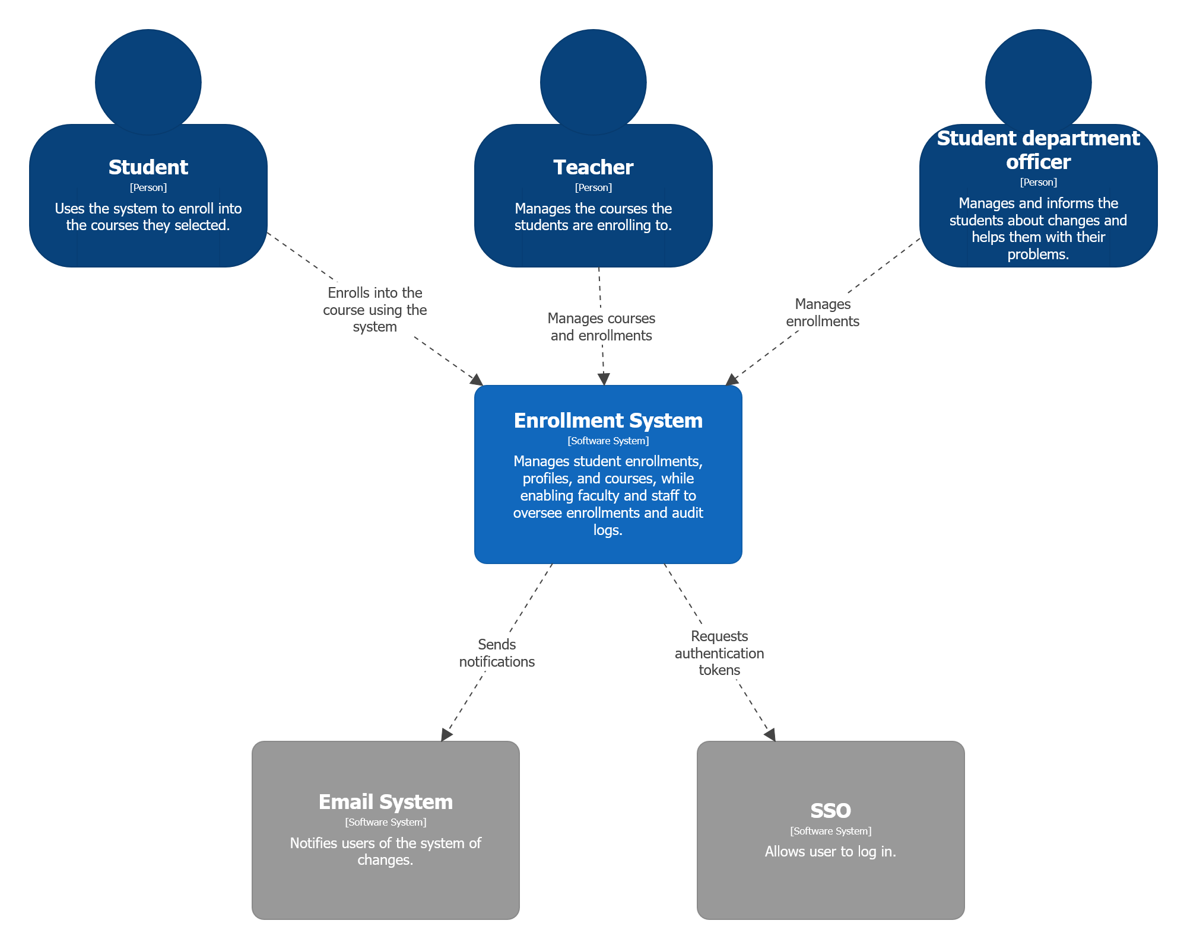
System
Overview

Slide 15
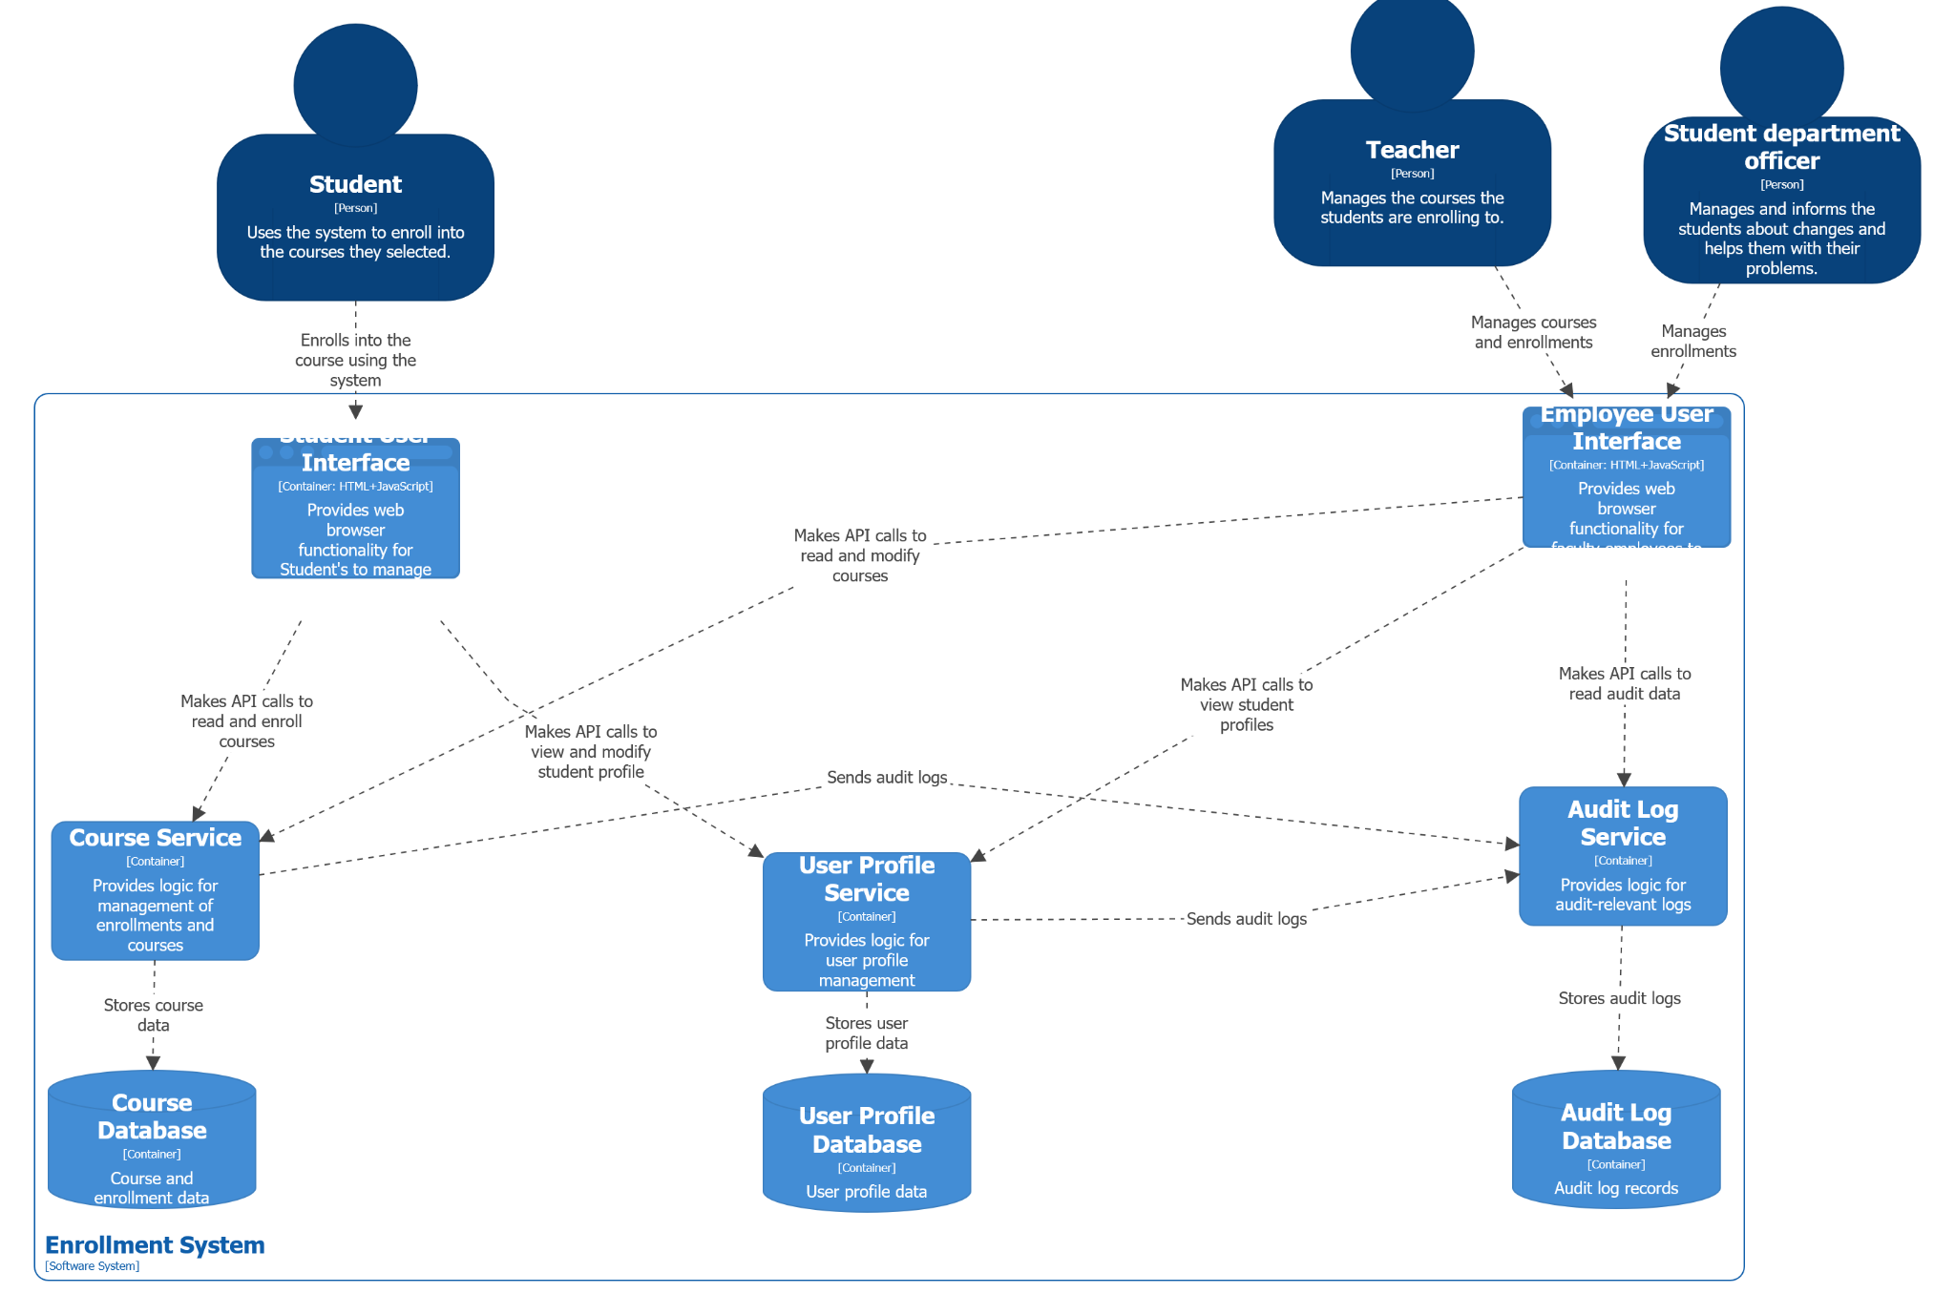
Container diagram

Slide 16
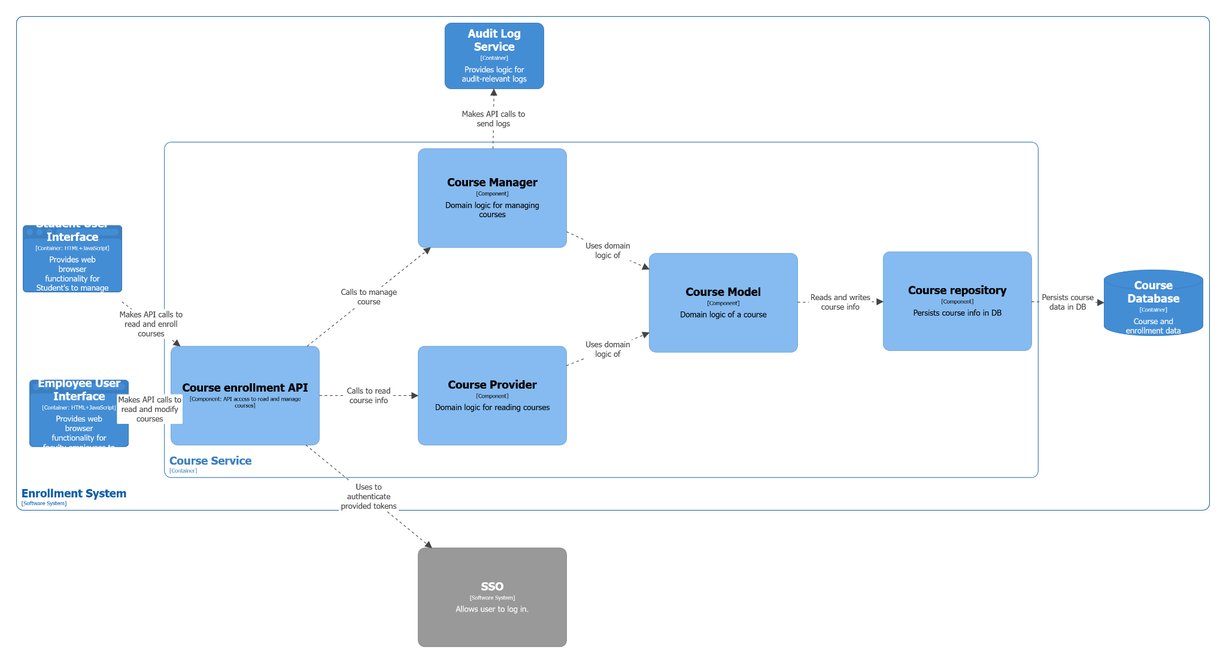
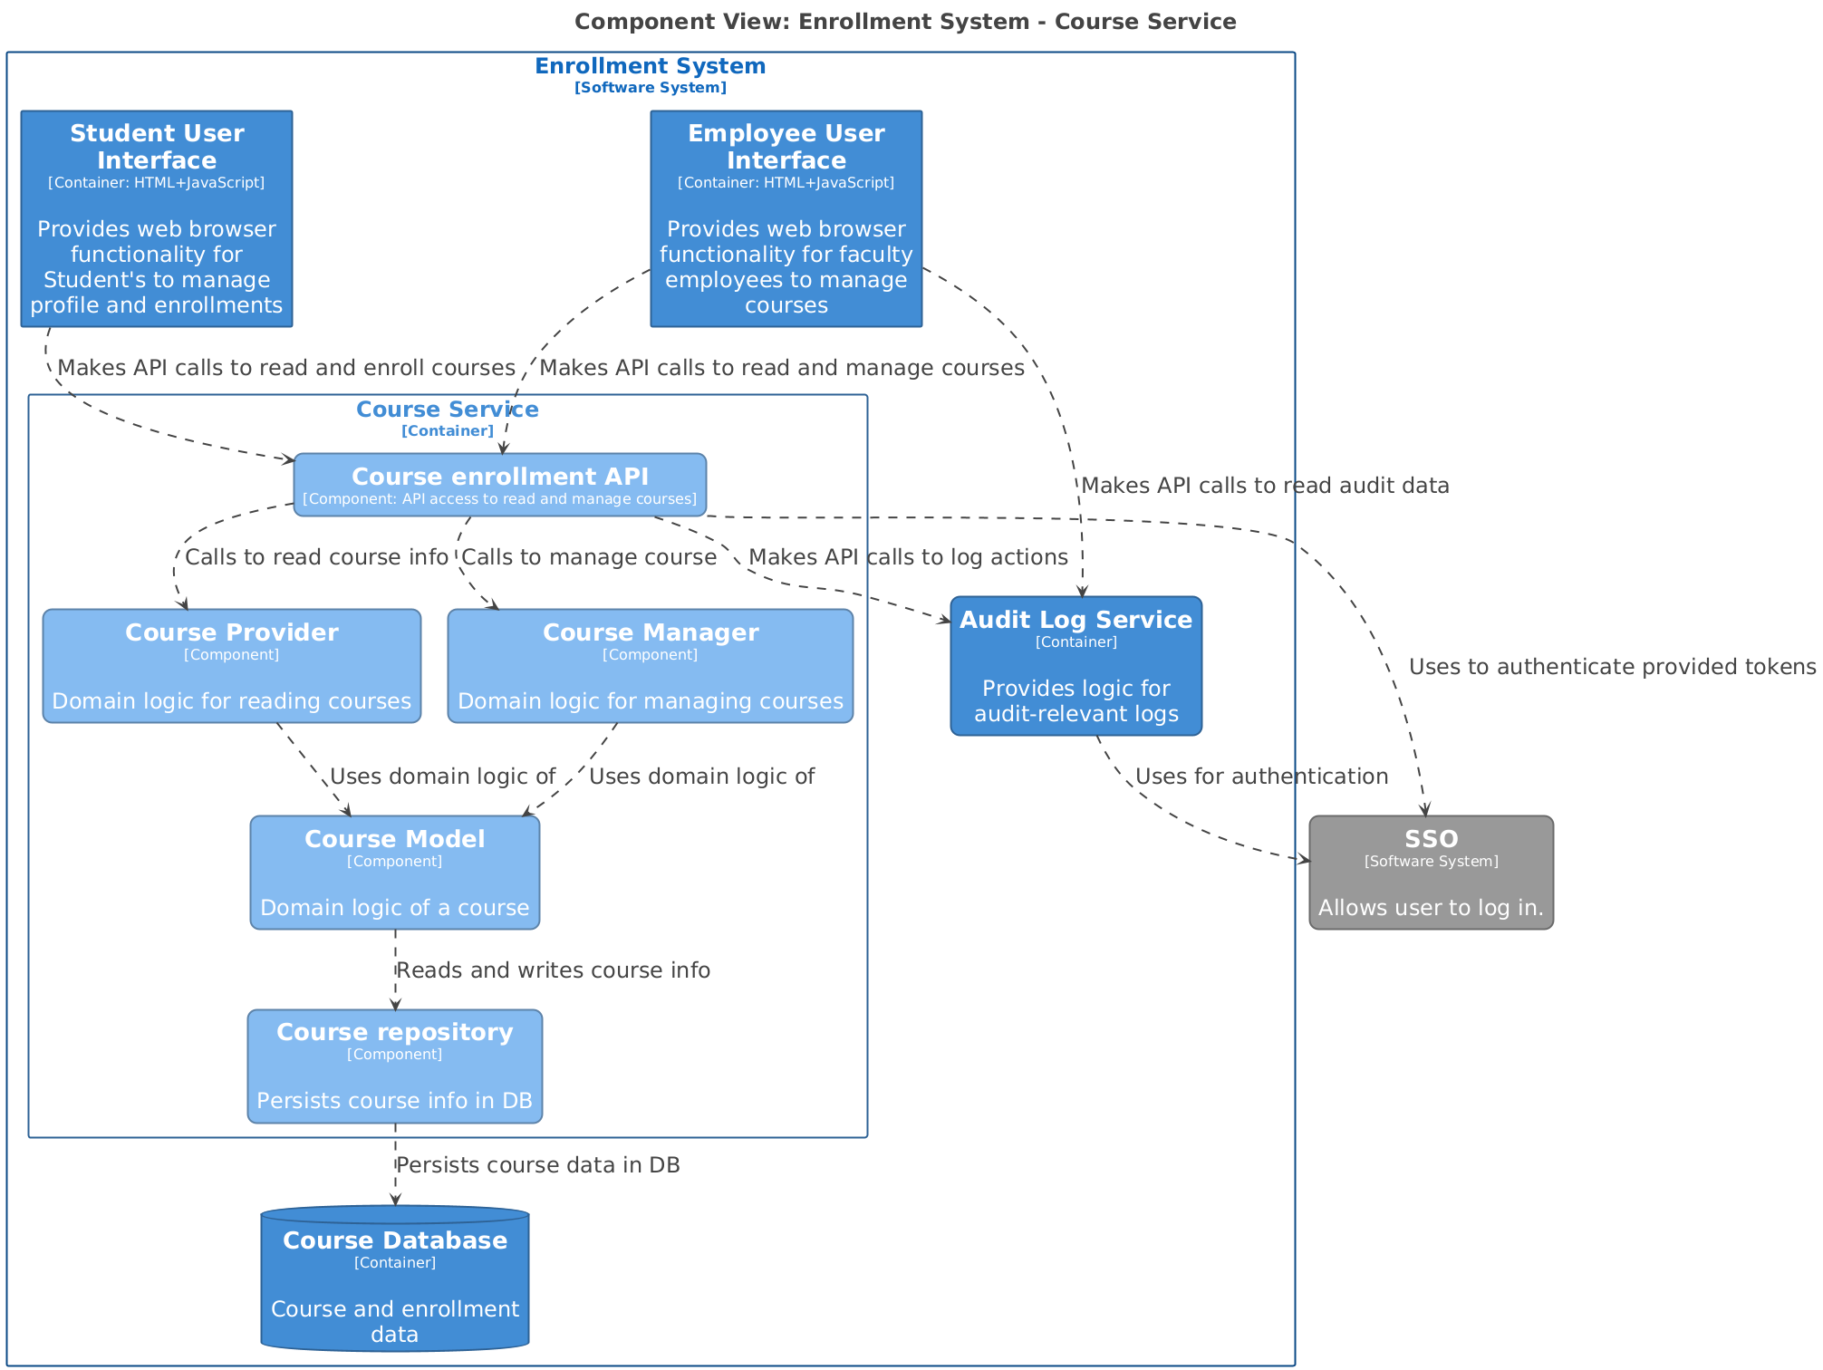
L3:
Course
Service

Slide 17
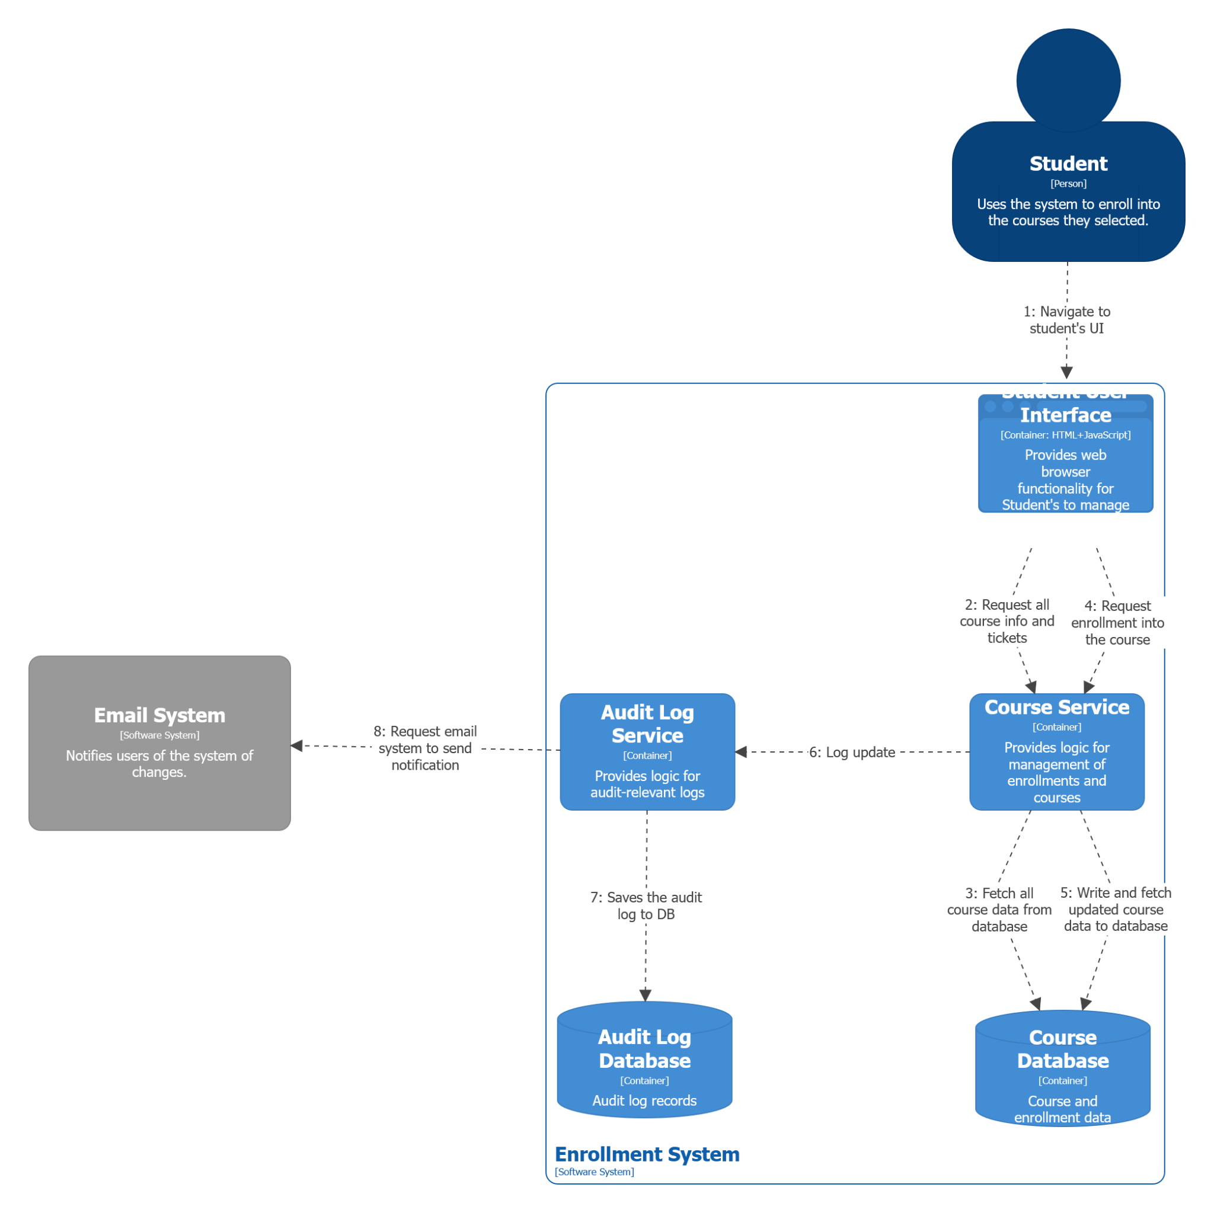
Dynamic
View:
Student’s enrollment

Slide 18
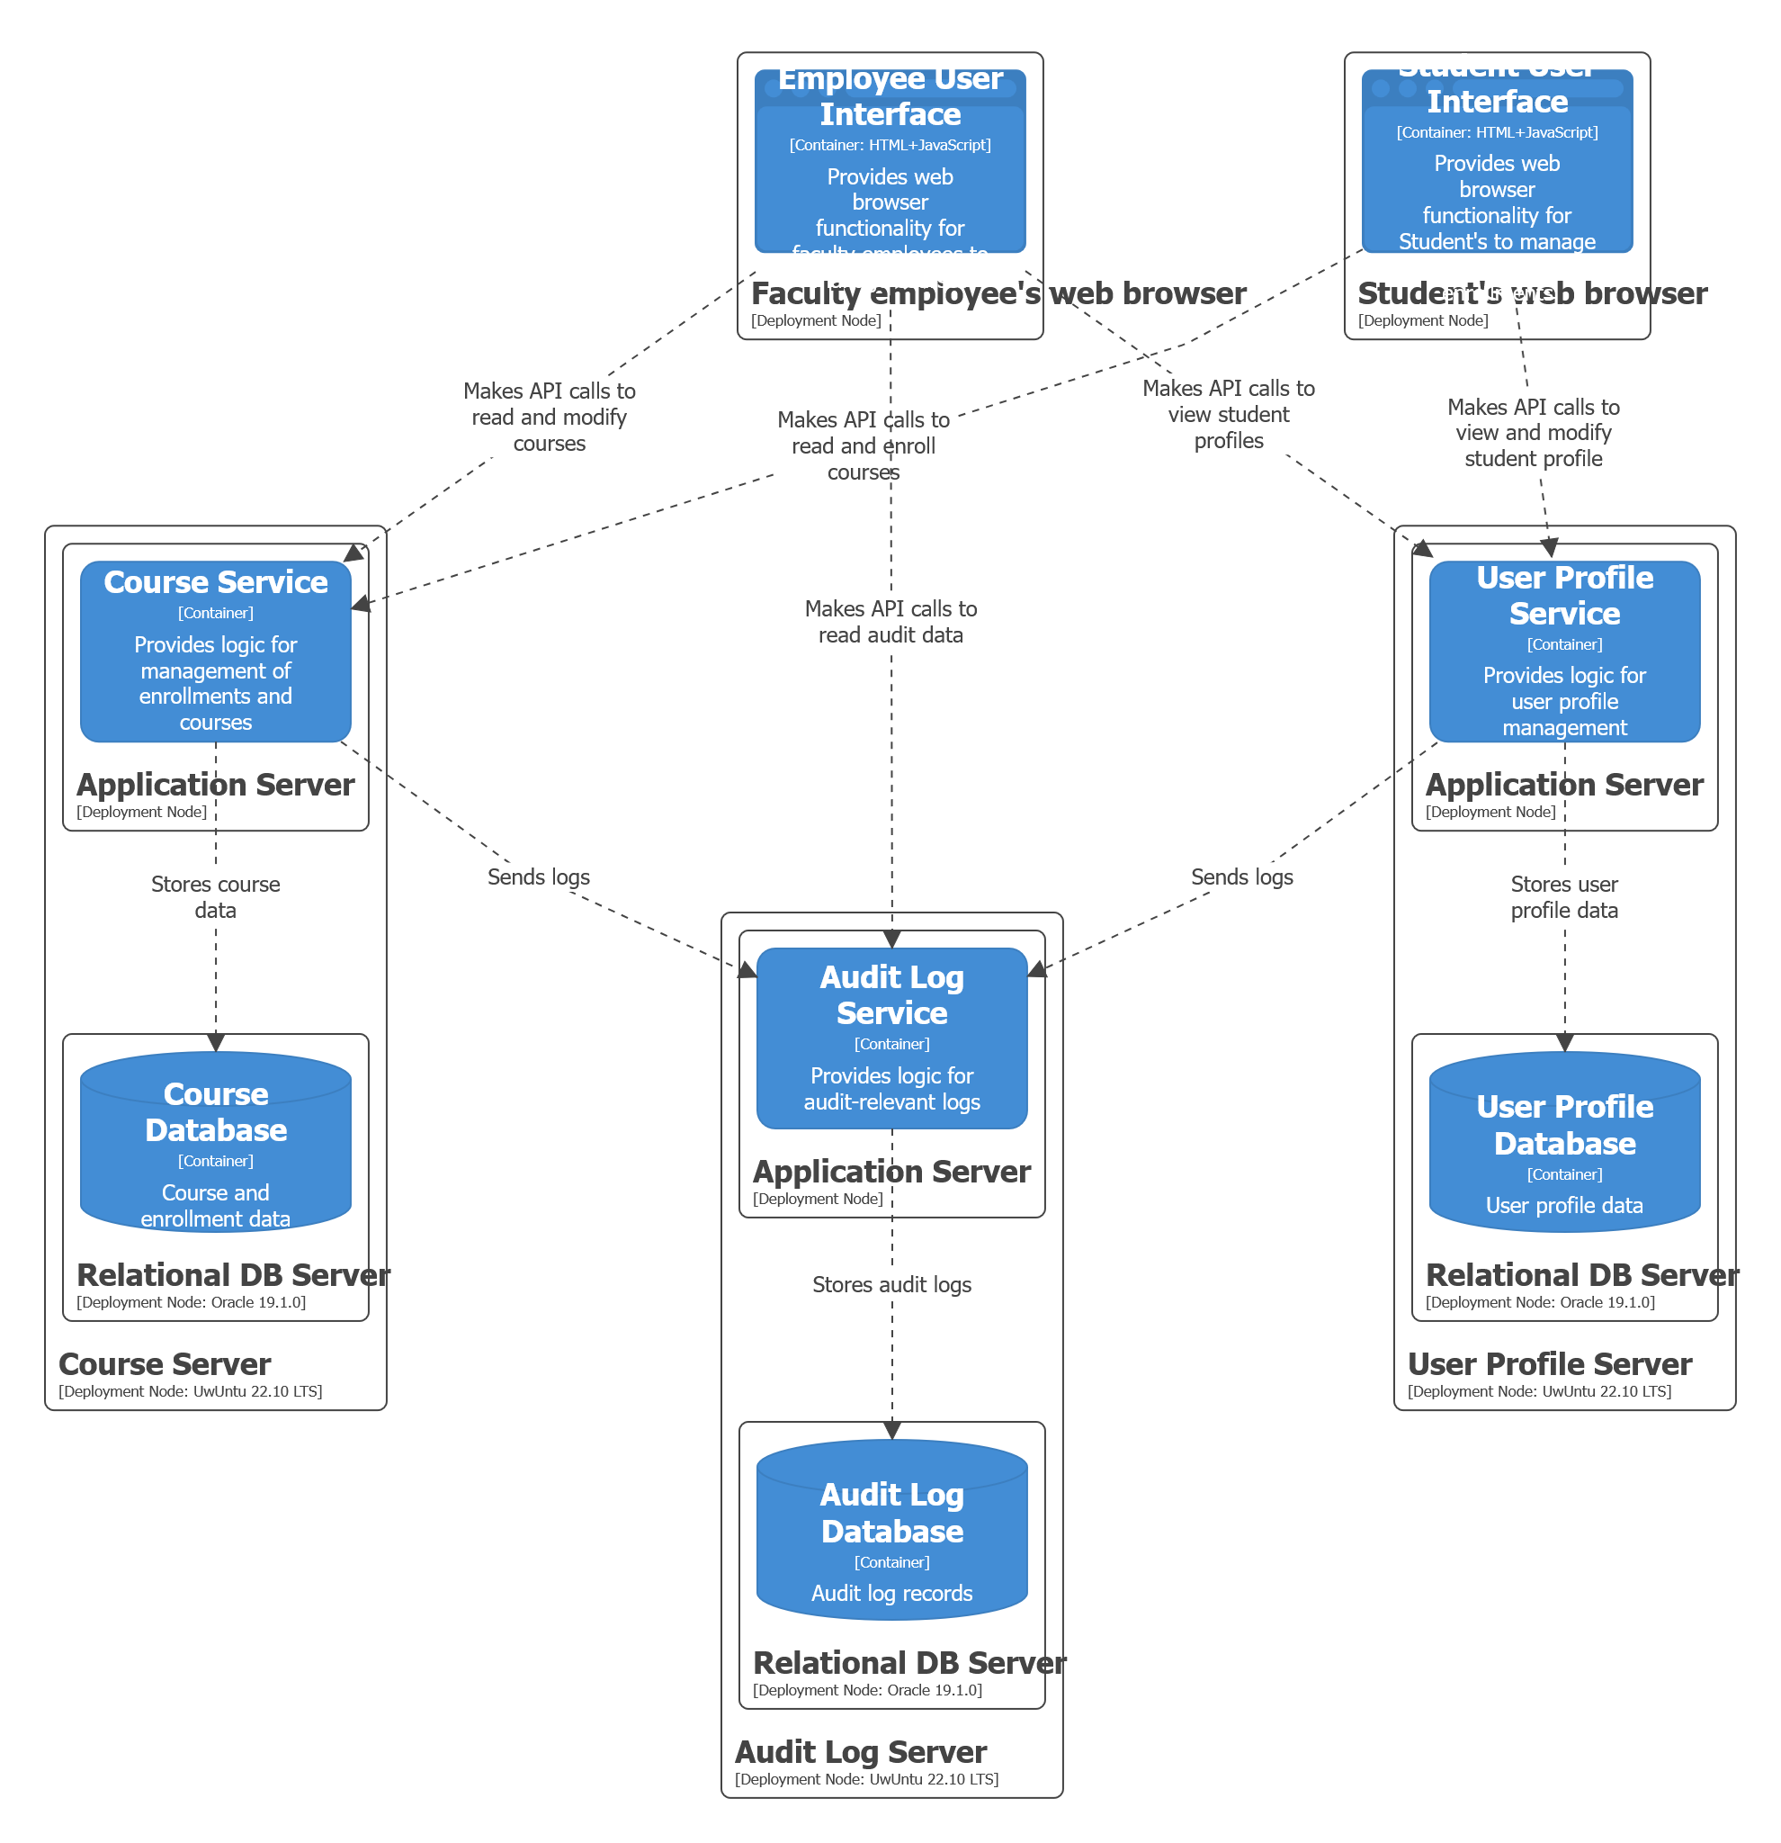
Deployment
Diagram

Slide 19
Thank you for your attention

Slide 21
Presentation of your architecture (12-13mins long):
- start with the name of your project and the names of the team members
- present an overview of the features (2mins)
- present an overview of the responsibilities based on the features (2mins)
--- present them grouped logically based on the groupings from the practicals
--- start with L1, then continue to L2, explain all containers and relationships between them (4mins)
----- show who worked on what at the L2 level (no need to explain, just show it on the slides)
--- select one or two most interesting containers from L2 and explain their components at L3 (2mins)
--- show one dynamic diagram and explain it shortly, show who worked on it (1mins)
--- show one deployment diagram and explain it shortly, show who worked on it (2mins)
Bui
Kuba
Bety
Erik

