Slide 1

Designing and Developing a Movie Recommendation System

Slide 2

Dataset Overview
100836 ratings
3683 tag applications
9742 movies
610 users
tags.csv:
  User-generated metadata about movies
  userID, movieID, tag, Timestamp
movies.csv:
  Movie details and genres
  movieID, Title, Genres
links.csv:
  External identifies for movies
  movieID, imdbID, tmdbID

Slide 3
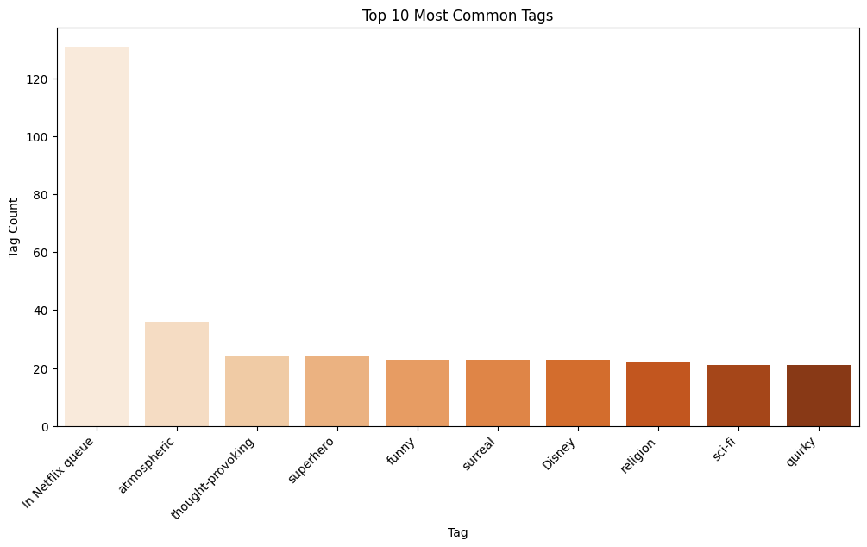
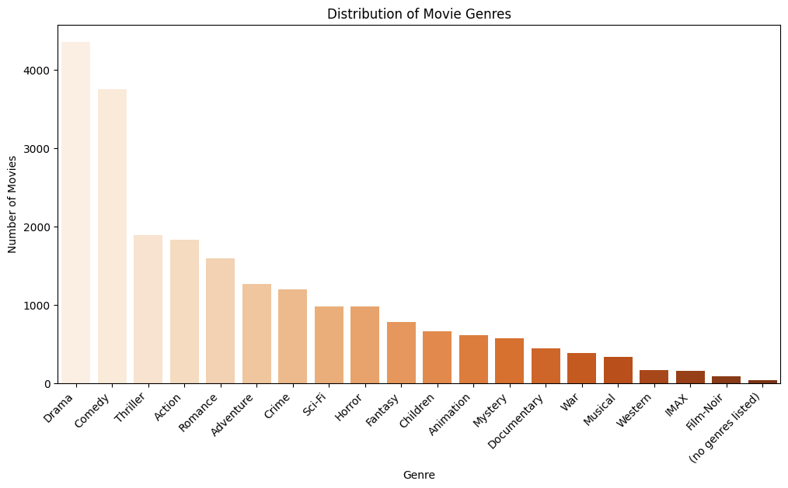
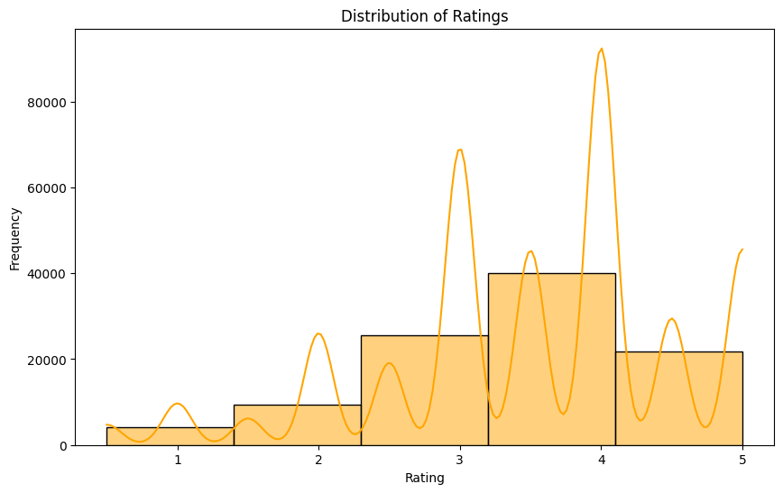
Data Visualisation

Slide 4
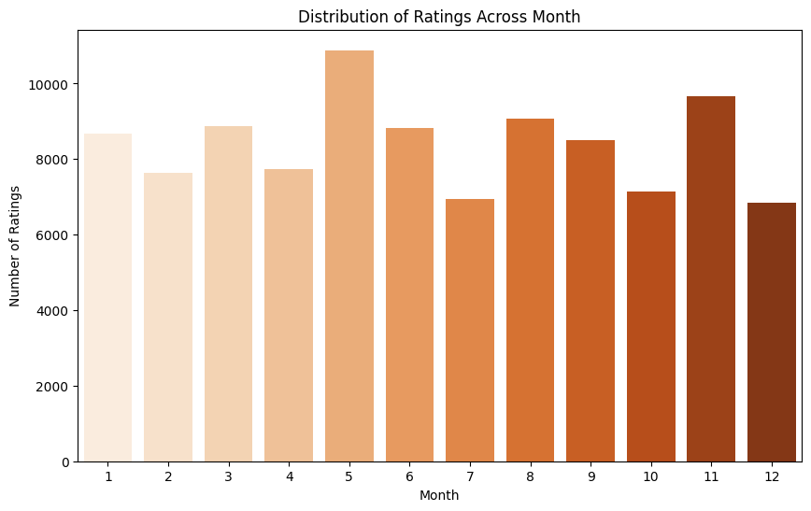
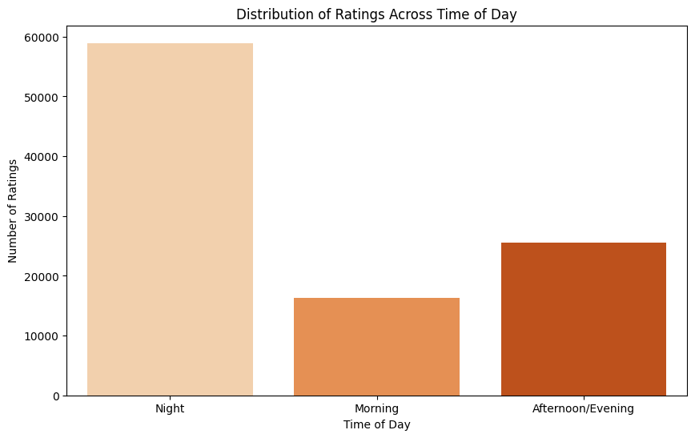
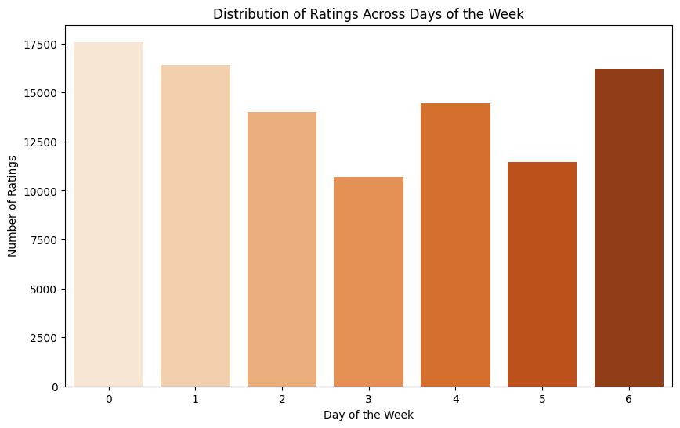
Data Visualisation

Slide 5
Challenges and Considerations
Challenges:
  Sparse Data- Addressing sparse user-generated tags and diverse movie genres
  Integration of External Data- Efficiently incorporating IMDB and TMDB
  Relevance Scoring- Developing a mechanism to incorporate the relevance scores for tags
Ethical Considerations:
  Privacy- Ensuring user data privacy and confidentiality
  Fairness- Avoiding bias based on demographics or preferences

Slide 6
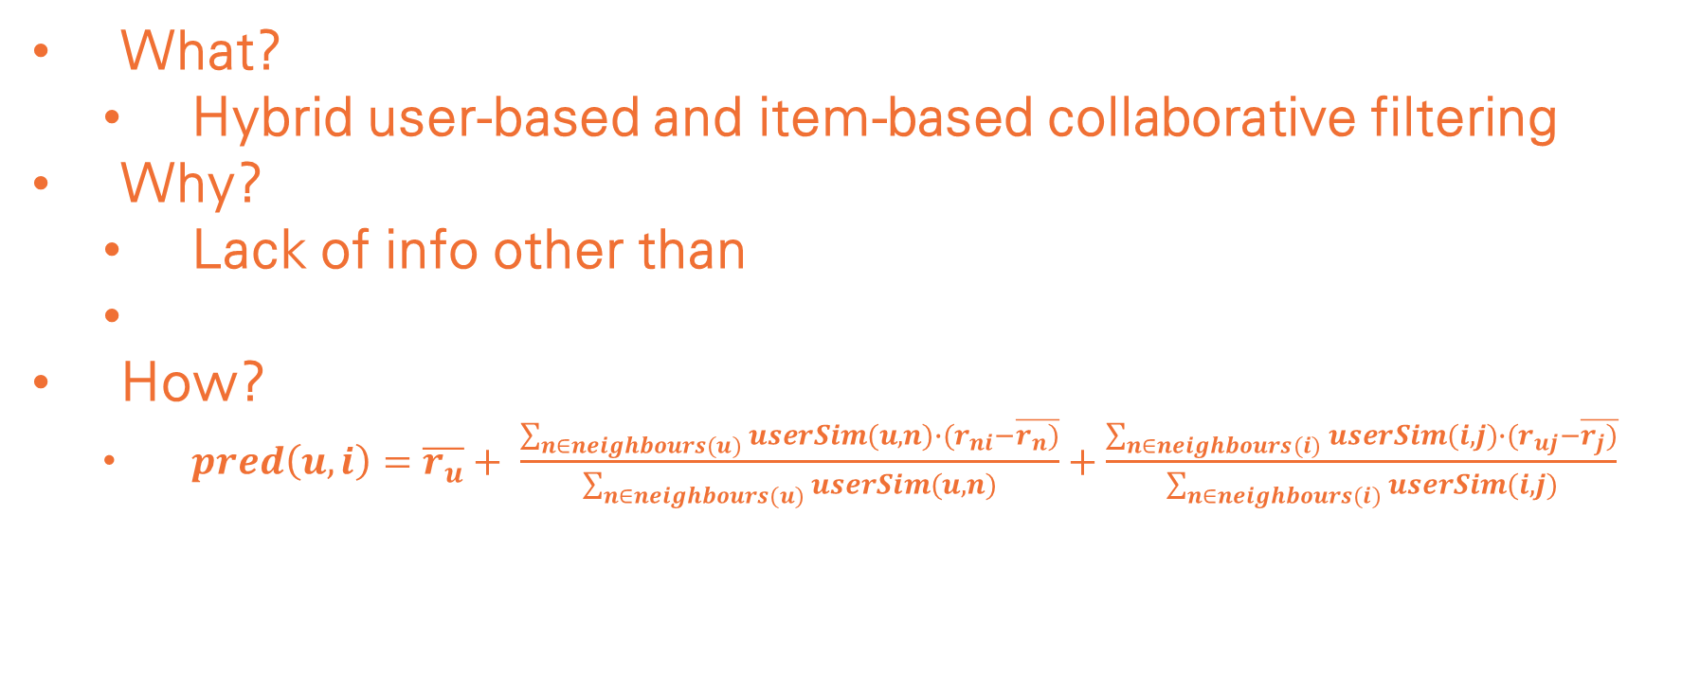
RS1- Collaborative Filtering
What?
  Hybrid user-based and item-based collaborative filtering
Why?
  Lack of info other than
How?
  $pred\left(u,i\right)=\overline{r_{u}}+ \frac{\sum_{n∈neighbours(u)}{userSim(u,n)∙(r_{ni}−\overline{r_{n})}}}{\sum_{n∈neighbours(u)}{userSim(u,n)}}+\frac{\sum_{n∈neighbours(i)}{userSim(i,j)∙(r_{uj}−\overline{r_{j})}}}{\sum_{n∈neighbours(i)}{userSim(i,j)}}$

