Slide 1
PROJECT : BREAST CANCER DETECTION & SURVIVAL ANALYSIS
INTRO & BACKGROUND INFO:
Over the past decades, machine learning techniques have been widely used in intelligent health systems, particularly for breast cancer diagnosis and prognosis. In this documentation project, we will to create a breast cancer detection and survival evaluation model using machine learning and the Python programming language.

Slide 2
BACKGROUND OF THE PROJECT
Breast cancer is one of the types of cancer that starts in the breast. It occurs in women, but men can get breast cancer too. It is the second leading cause of death in women. As the use of data in the heath sector is very common today, we can use machine learning to predict whether a patient will survive a deadly disease like breast cancer or not. So if you want to learn how to predict the survival of a breast cancer patient, this article is for you. In this article, I will take you through the task of breast cancer survival prediction with machine learning using Python.

Slide 3
OBJECTIVES OF THE PROJECT
WE will implement a Naive Bayes algorithm in Machine Learning using Python. For this task, we will use a breast cancer tumor dataset for breast cancer detection and survival chances prediction.
The data will be collected from willing individuals who may either be male or female, the males will be removed from the dataset since they are not prone to breast cancer.

Slide 4
DATASET COLLUMNS ANALYSIS
Assuming you have a dataset of over 400 breast cancer patients who underwent surgery for the treatment of breast cancer. Below is the information of all columns in the dataset:
Patient_ID: -> ID of the patient
Age: -> Age of the patient
Gender: -> Gender of the patient
Protein1, Protein2, Protein3, Protein4: -> expression levels
Tumor_Stage: -> Breast cancer stage of the patient

Slide 5
DATASET COLLUMNS ANALYSIS
Histology: -> Infiltrating Ductal Carcinoma, Infiltration Lobular Carcinoma, Mucinous Carcinoma
ER status: -> Positive/Negative
PR status: -> Positive/Negative
HER2 status: -> Positive/Negative
Surgery_type: -> Lumpectomy, Simple Mastectomy, Modified Radical Mastectomy, Other
DateofSurgery: -> The date of Surgery
DateofLast_Visit: -> The date of the last visit of the patient
Patient_Status: -> Alive/Dead
Notes:
So by using this dataset, our task is to predict whether a breast cancer patient will survive or not after the surgery.

Slide 6
Breast Cancer Survival Prediction using Python
We will start the task of breast cancer survival prediction by importing the necessary Python libraries and the dataset we need:
1. import pandas as pd -> for loading the dataset
2. import NumPy as np ->numerical python
3. import plotly.express as px
4. from sklearn.model_selection import train_test_split
5. from sklearn.svm import SVC

Slide 7
LOADING AND INSPECTING THE DATASET
We then import the dataset in our IDE and display the first few rows
=> data = pd.read_csv("BRCA.csv")
print(data.head())
We then check whether the columns of this dataset contains any null values or not:
=> print(data.isnull().sum())

Slide 8
PREPROCESSING THE DATA
We check if this dataset has some null values in each column, If they are, will drop them:
data = data.dropna()
Now let’s have a look at the insights about the columns of this data:
data.info() //information about the dataset

Slide 9
PREPROCESSING THE DATA
Breast cancer is mostly found in females, so let’s have a look at the Gender column to see how many females and males are there:
print(data.Gender.value_counts())
//prints the number of persons as per gender//
As expected, there are more females suffering from breast cancer than males.

Slide 10
PREPROCESSING THE DATA
Let’s Now have a look at the stage of tumor of the patients:
# Tumour Stage
stage = data["Tumour_Stage"].value_counts()
transactions = stage.index
quantity = stage.values
figure = px.pie(data,
values=quantity,
names=transactions,hole = 0.5,
title="Tumour Stages of Patients")
figure.show()

Slide 11
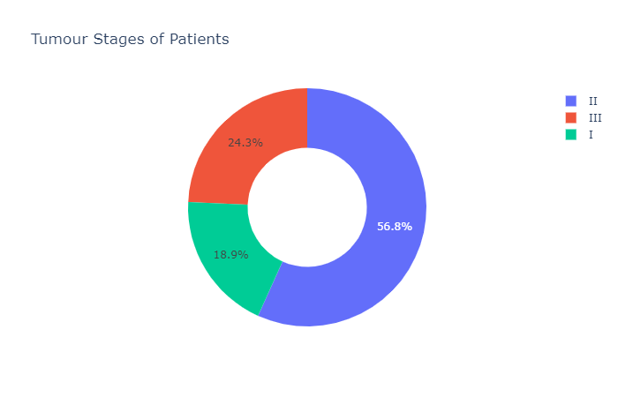
PREPROCESSING THE DATA
The above code draws a pie chart as shown. This clearly shows the distribution of data as per different cancer tumor stages.
It is clear that many women suffer from cancer stage III as compared to stage I & II due to discovery stages.

Slide 12
DATA ANALYSIS
Now let’s have a look at the histology of breast cancer patients. (Histology is a description of a tumor based on how abnormal the cancer cells and tissue look under a microscope and how quickly cancer can grow and spread):
# Histology
histology = data["Histology"].value_counts()
transactions = histology.index
quantity = histology.values
figure = px.pie(data,
values=quantity,
names=transactions,hole = 0.5,
title="Histology of Patients")
figure.show()

Slide 13
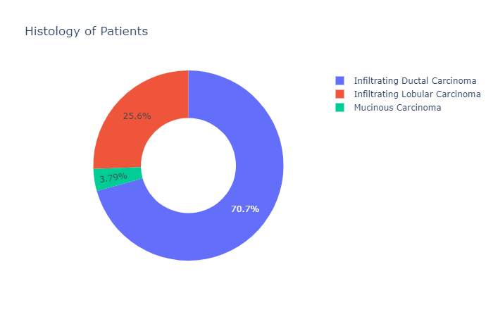
DATA ANALYSIS
The pie chart above is outputted , it shows the relation between histology and percentage of females.

Slide 14
DATA ANALYSIS
Now we look at the values of ER status, PR status, and HER2 status of the patients:
# ER status
print(data["ER status"].value_counts())
# PR status
print(data["PR status"].value_counts())
# HER2 status
print(data["HER2 status"].value_counts())

Slide 15
DATA ANALYSIS
Lets explore the type of surgeries to be performed to patients:
# Surgery_type
surgery = data["Surgery_type"].value_counts()
transactions = surgery.index
quantity = surgery.values
figure = px.pie(data,
values=quantity,
names=transactions,hole = 0.5,
title="Type of Surgery of Patients")
figure.show()

Slide 16
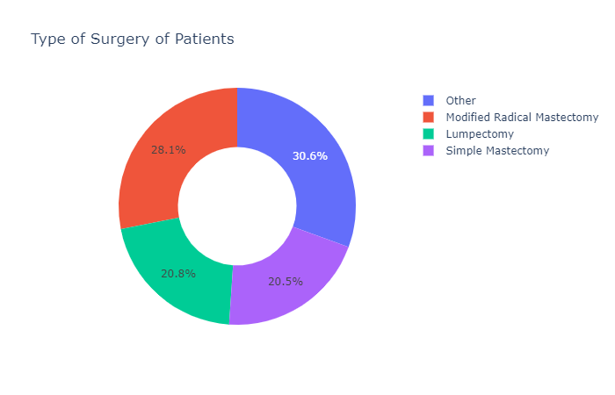
DATA ANALYSIS

Slide 17
TRAINING THE MODEL
the dataset has a lot of categorical features. To use this data to train a machine learning model, we need to transform the values of all the categorical columns:
data["Tumour_Stage"] = data["Tumour_Stage"].map({"I": 1, "II": 2, "III": 3})
data["Histology"] = data["Histology"].map({"Infiltrating Ductal Carcinoma": 1,
"Infiltrating Lobular Carcinoma": 2, "Mucinous Carcinoma": 3})
data["ER status"] = data["ER status"].map({"Positive": 1})
data["PR status"] = data["PR status"].map({"Positive": 1})
data["HER2 status"] = data["HER2 status"].map({"Positive": 1, "Negative": 2})
data["Gender"] = data["Gender"].map({"MALE": 0, "FEMALE": 1})
data["Surgery_type"] = data["Surgery_type"].map({"Other": 1, "Modified Radical Mastectomy": 2, "Lumpectomy": 3, "Simple Mastectomy": 4})
print(data.head())

Slide 18
SPLITTING THE DATA
Before training the model, we need to split the data into training and test set:
# Splitting data
x = np.array(data[['Age', 'Gender', 'Protein1', 'Protein2', 'Protein3','Protein4', 'Tumour_Stage', 'Histology', 'ER status', 'PR status', 'HER2 status', 'Surgery_type']])
y = np.array(data[['Patient_Status']])
xtrain, xtest, ytrain, ytest = train_test_split(x, y, test_size=0.10, random_state=42)

Slide 19
TRAINING THE MODEL
Lets now train the mode
model = SVC()
model.fit(xtrain, ytrain)

Slide 20
TESTING OUR MODEL
Now let’s input all the features that we have used to train this machine learning model and predict whether a patient will survive from breast cancer or not:
# Prediction
# features = [['Age', 'Gender', 'Protein1', 'Protein2', 'Protein3','Protein4', 'Tumour_Stage', 'Histology', 'ER status', 'PR status', 'HER2 status', 'Surgery_type']]
features = np.array([[36.0, 1, 0.080353, 0.42638, 0.54715, 0.273680, 3, 1, 1, 1, 2, 2,]])
print(model.predict(features))
##the output is boolean, either dead or alive

