Slide 1
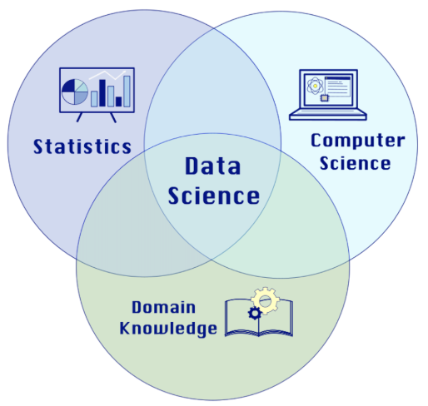
Introducing Technology Specifics
TYCDSI 2026

Slide 2
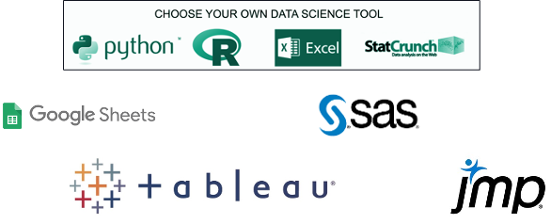
Software

Slide 3
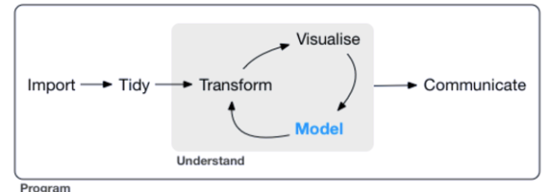
Ideal Data Science Deliverables
Notebook files
RMarkdown, Quarto, Jupyter
.Rmd/.qmd/.ipynb + .docx/.pdf/.html

Slide 4
Quarto Example in RStudio
Activity Start:
Template Quarto file
All necessary files uploaded
Complete work in Quarto file
Render to html file
Export .qmd and .html file to submit!
Let’s see it in RStudio!

Slide 5
Learn by Doing Activity
Download your own copy of the quarto and data files here (link)
Upload them to your Posit Cloud
Check out the student qmd and attempt what you like!
Render the file to html
Try this before you even make any changes yourself!
Check out the key and sample submission files!
Export your qmd, html, and data files to your computer
Upload these files to your previous GitHub repository

Slide 6


