Slide 1

Face Recognition: a good trip through multiple dimensions
Beto Sibileau
Barcelona, May 2020

Slide 2

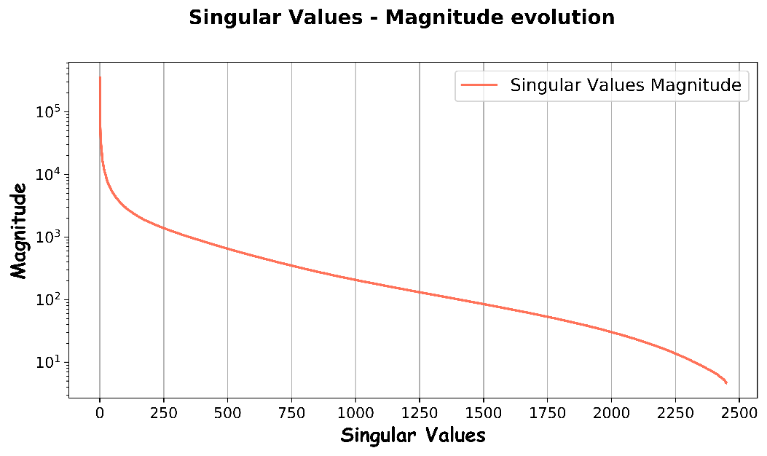
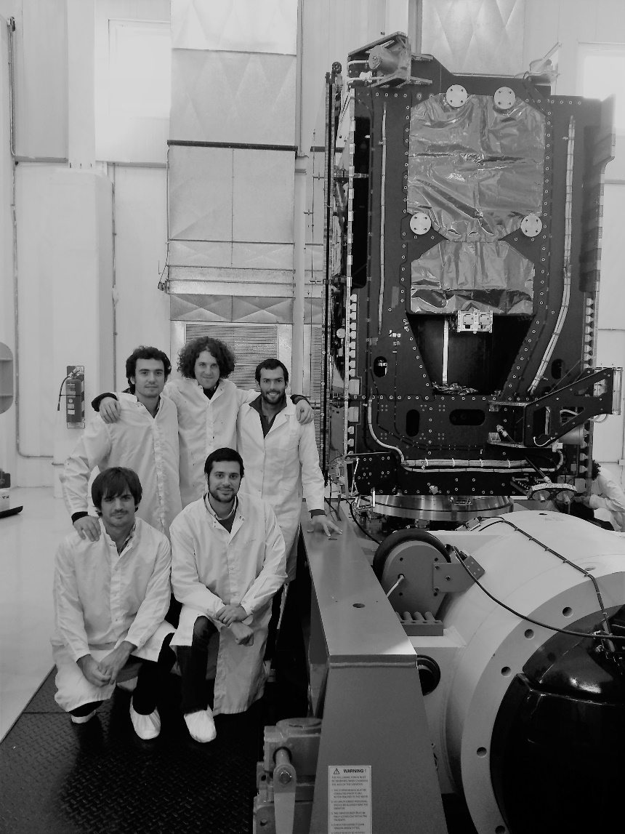
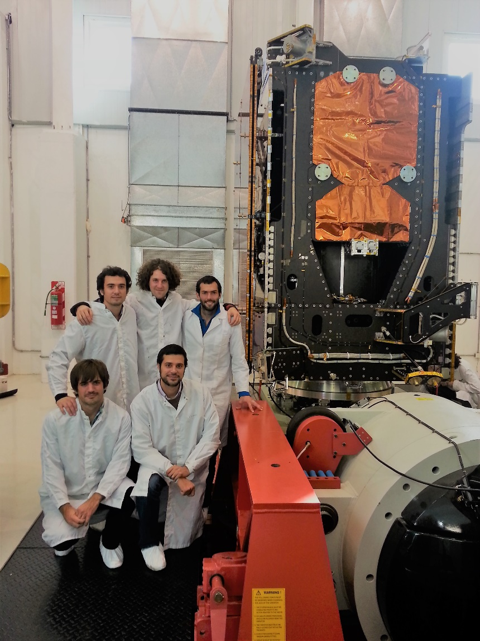
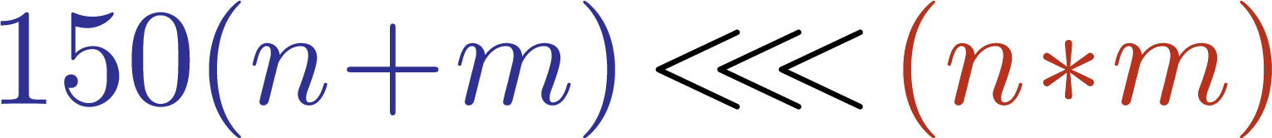





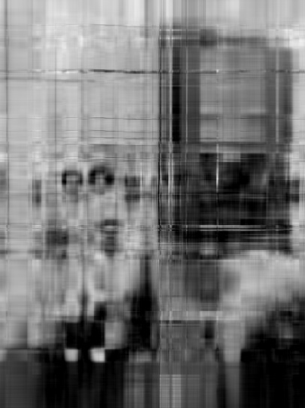




Project Motivation
Dimensionality
Reduction !!!
2

Slide 3
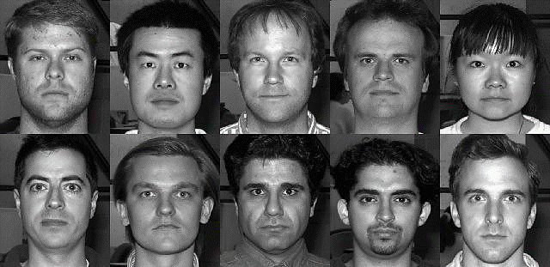



Face Recognition
From Yale Database to Machine Learning
38 people, ~ 60 conditions
192x168 pixels (matrix)
features
Dimensionality Reduction:
(balanced) target
Principal Components Analysis (PCA)
kernel – PCA
Supervised ML Classifier (parameter tuning testing accuracy)

Slide 4
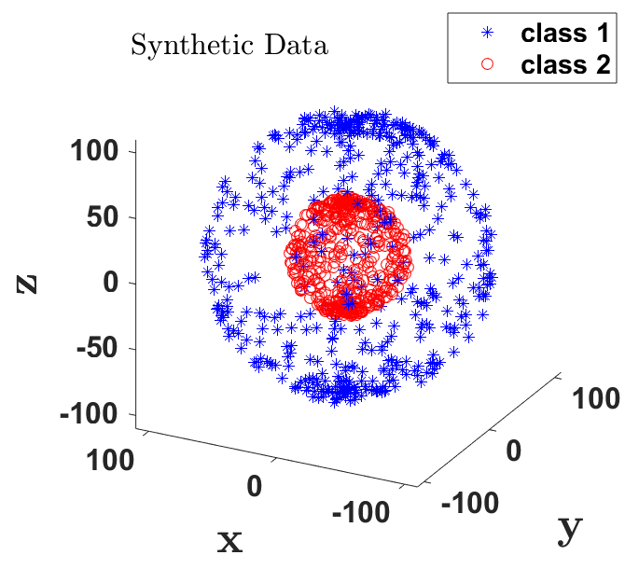
Research Question Motivation
Dimensionality Reduction – PCA and k-PCA
2 steps in one shot
Price to pay:
Parameter tuning
Quan Wang (2020). Kernel PCA and Pre-Image Reconstruction.

Slide 5


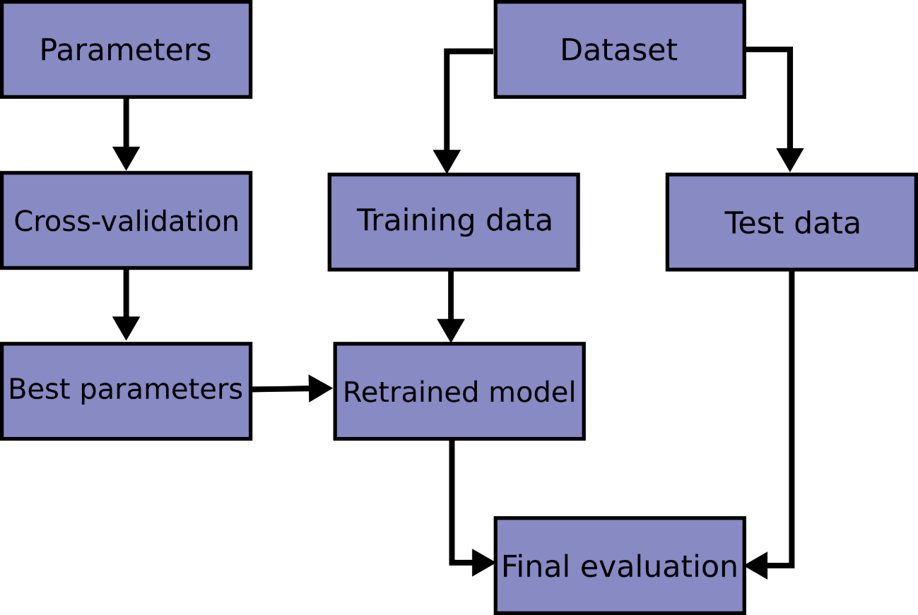
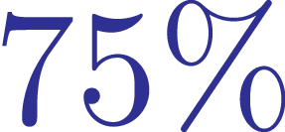
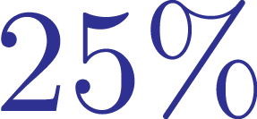

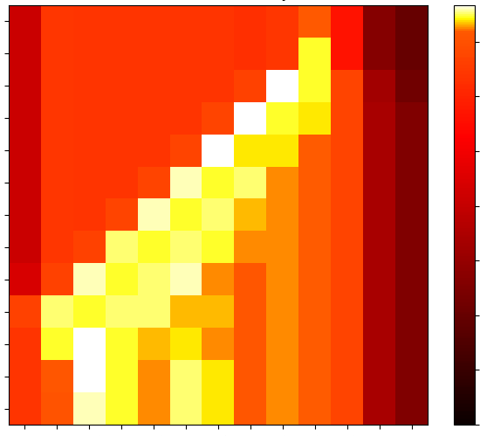


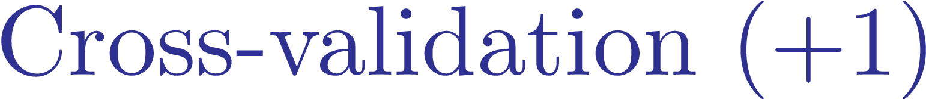

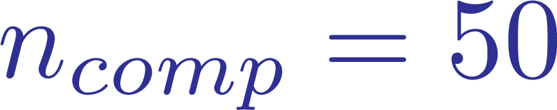


ML Classification Pipeline
Dimensionality Reduction & SVC
Support Vector Classification (SVC):
Radial Basis Functions (RBF).
Parameters tuning: and (grid search).
🙂
PCA: direct measure of reduction quality.
Hyper-parameter Tuning:
Number of reduced components: 10.
Best parameters on grid boundaries:
🙂
☹
☹
k-PCA: add extra parameter tuning:
Source: https://scikit-learn.org/

Slide 6
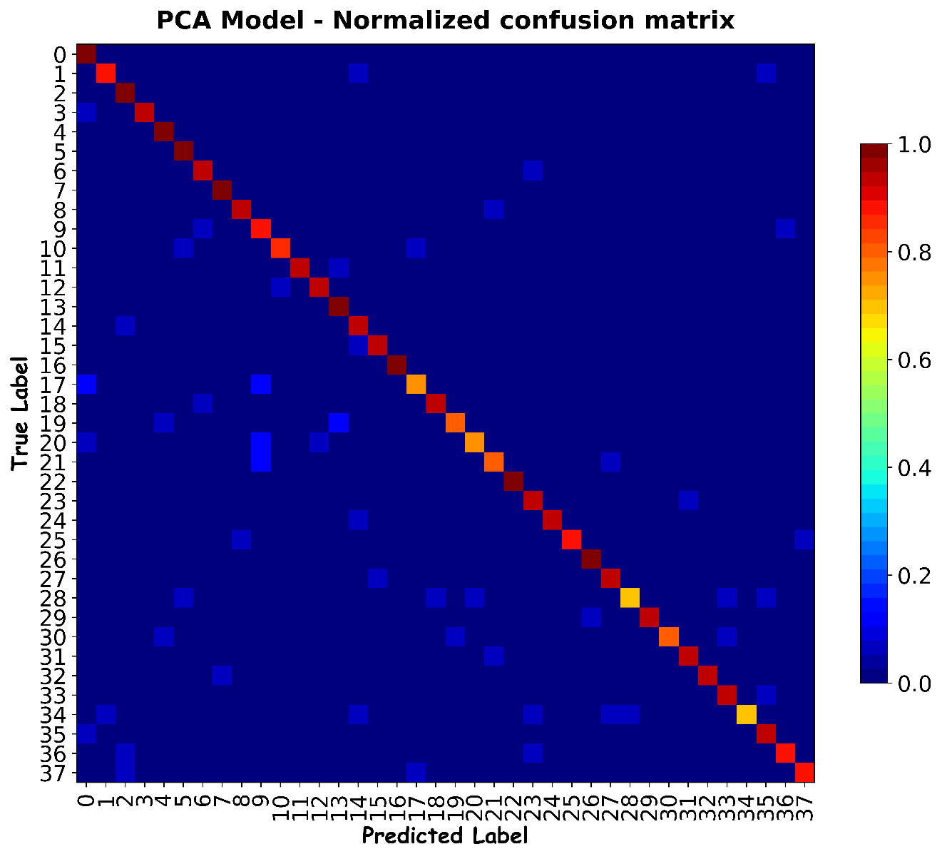
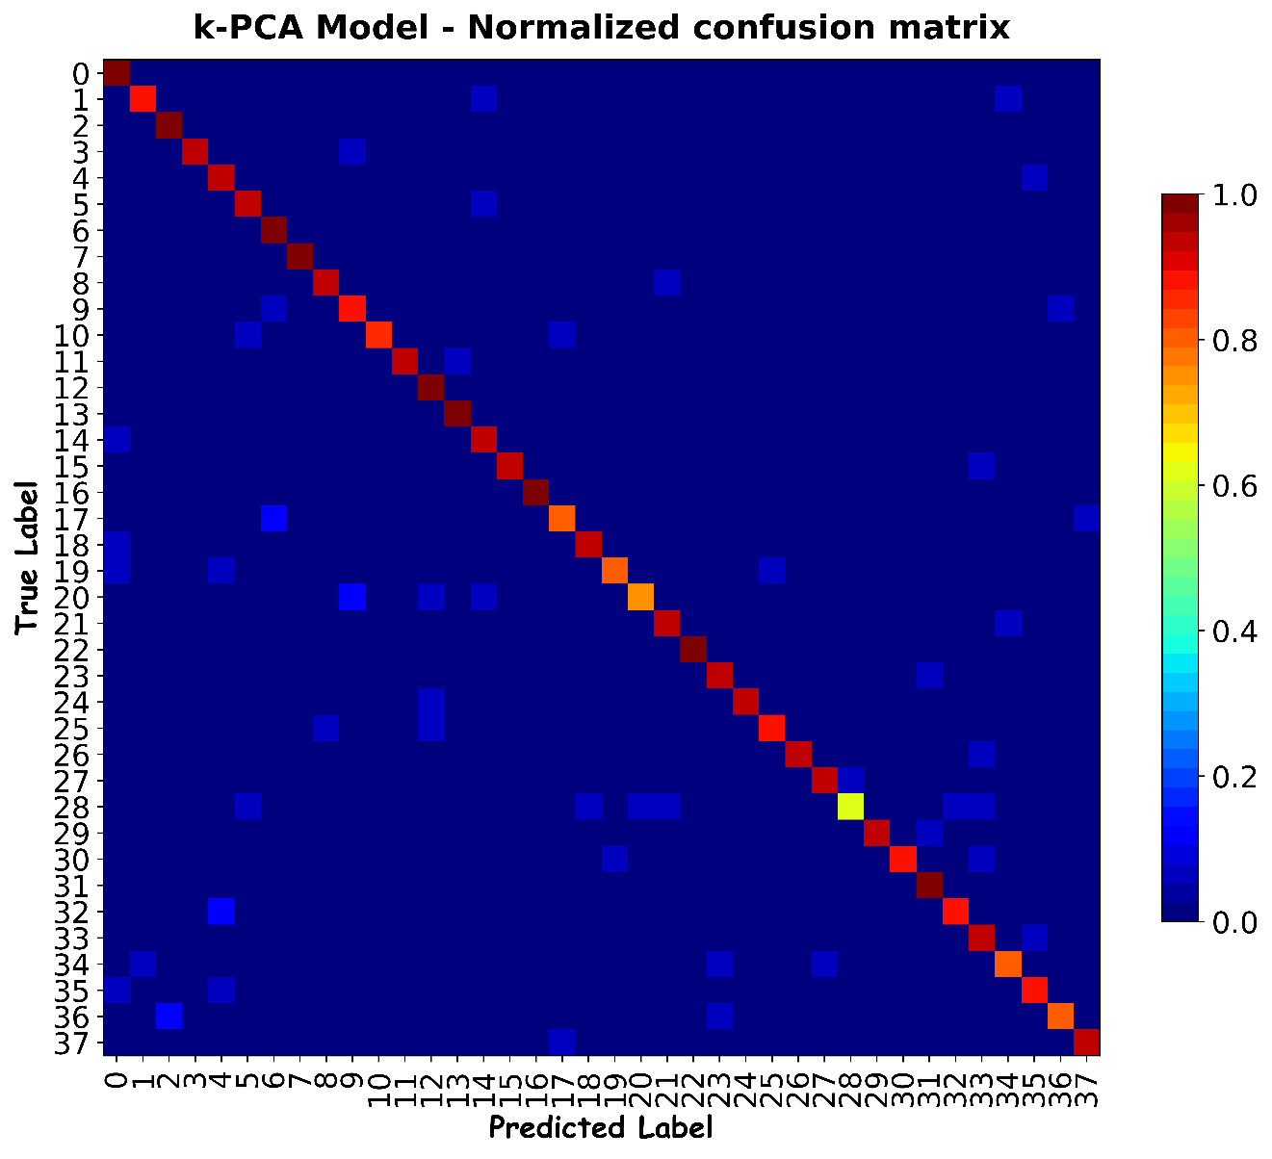
ML Classification Results
PCA vs. k-PCA – Confusion Matrix

Slide 7
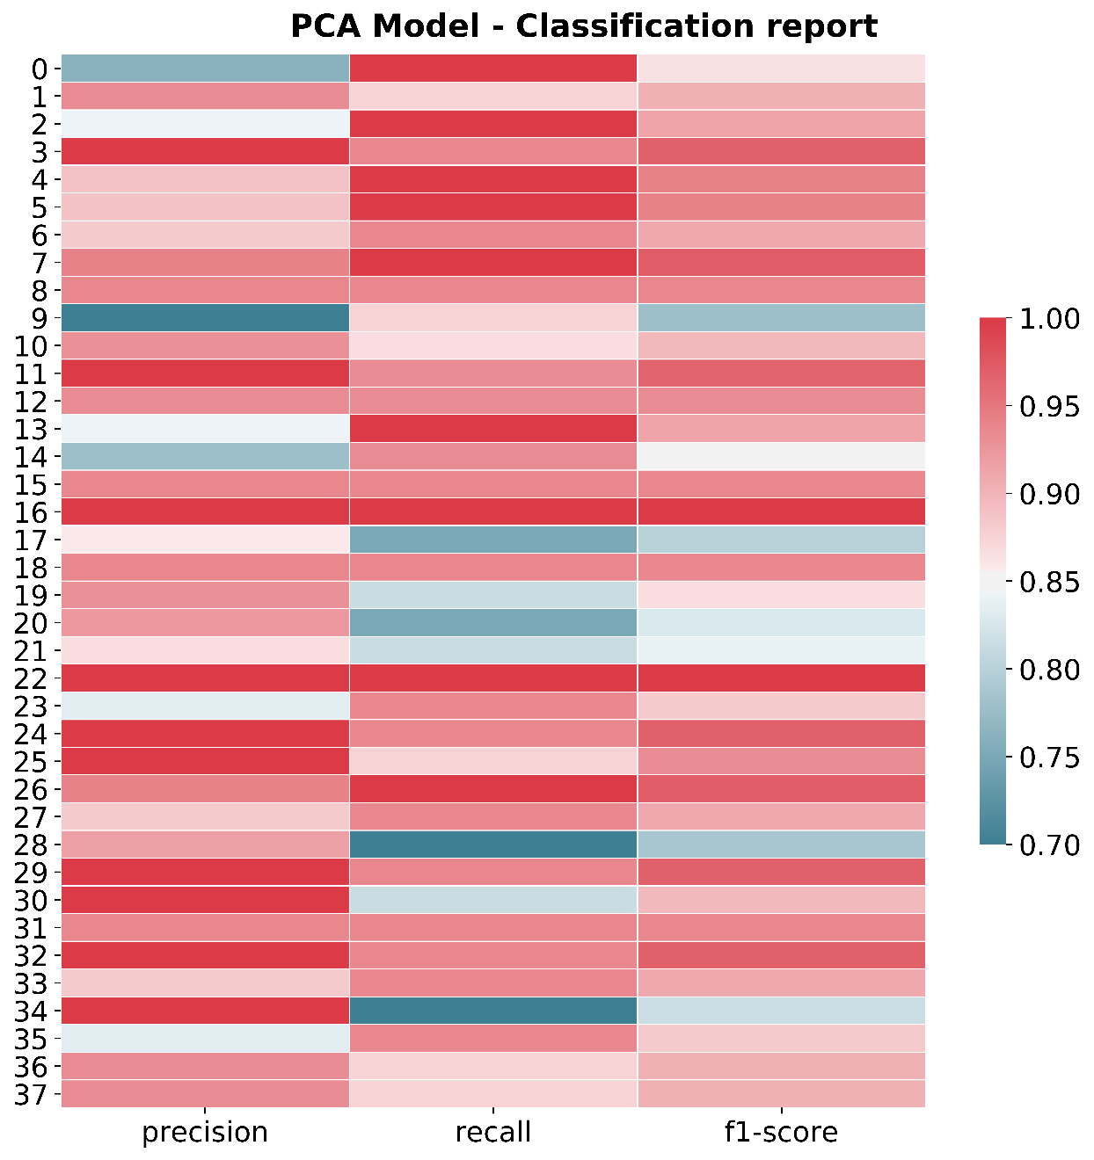
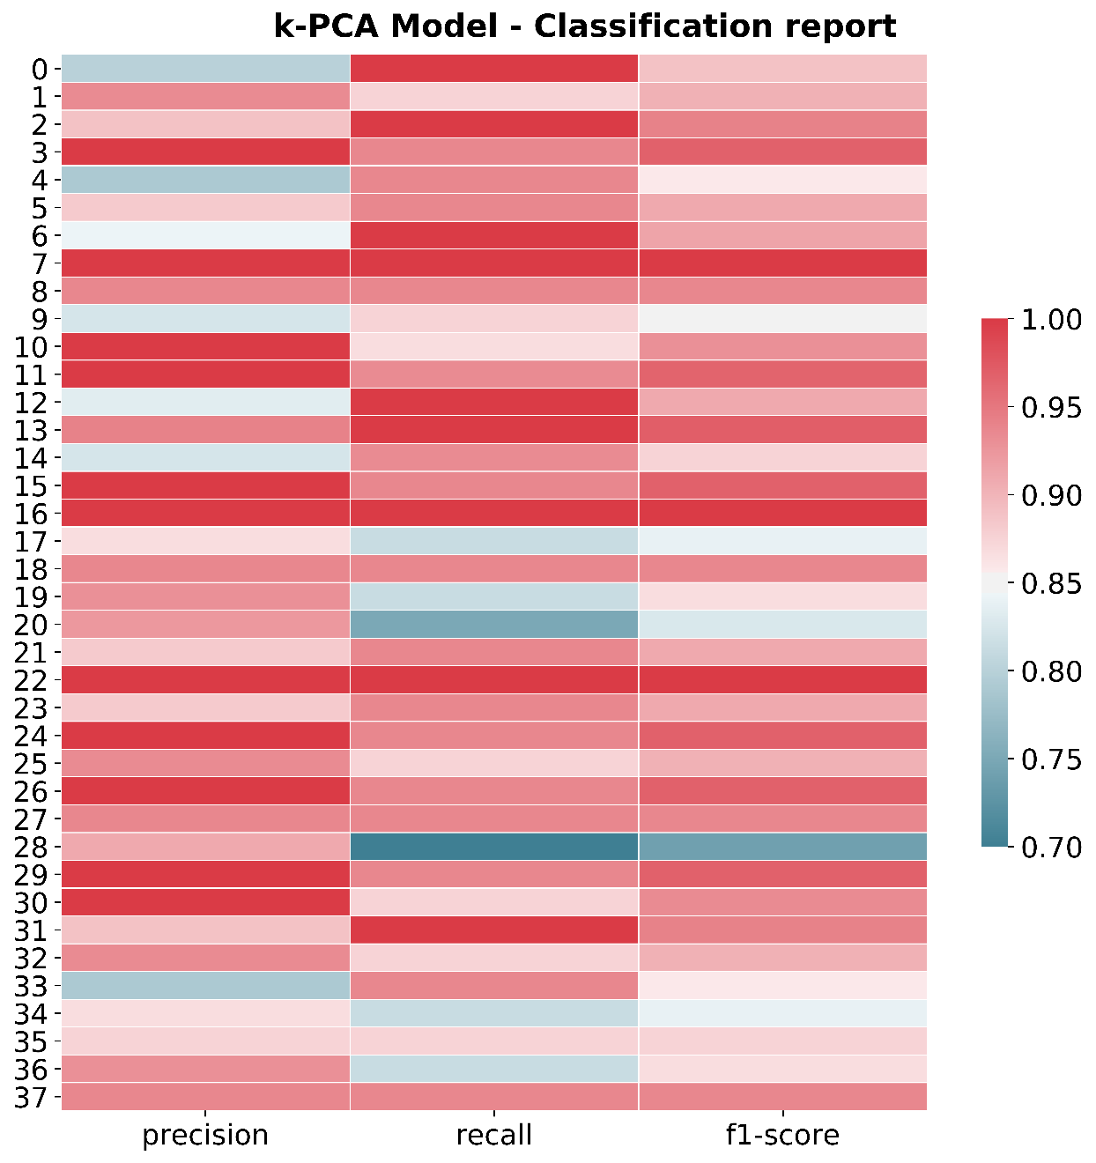
ML Classification Reports
PCA vs. k-PCA

Slide 8

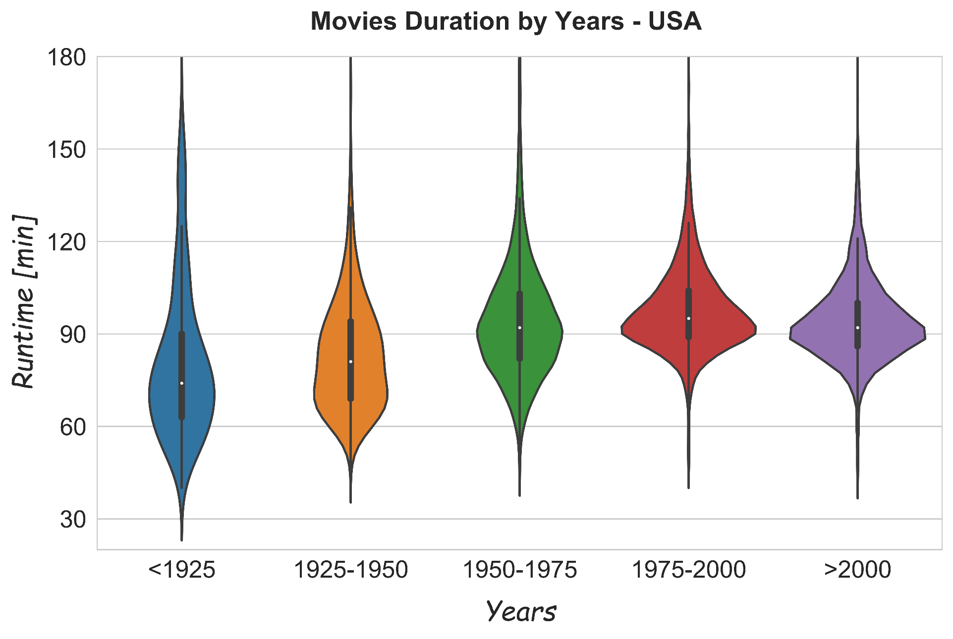
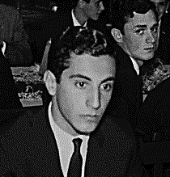

Movies Duration
USA
Countries and Years
5

Slide 9

Concluding remarks
Distinct user rating systems show strong correlation.
Movie runtimes don’t win ratings (could be targeted: country trends).
Keep our business riding: go deep into data!
Thanks for attending! Questions?

Slide 10
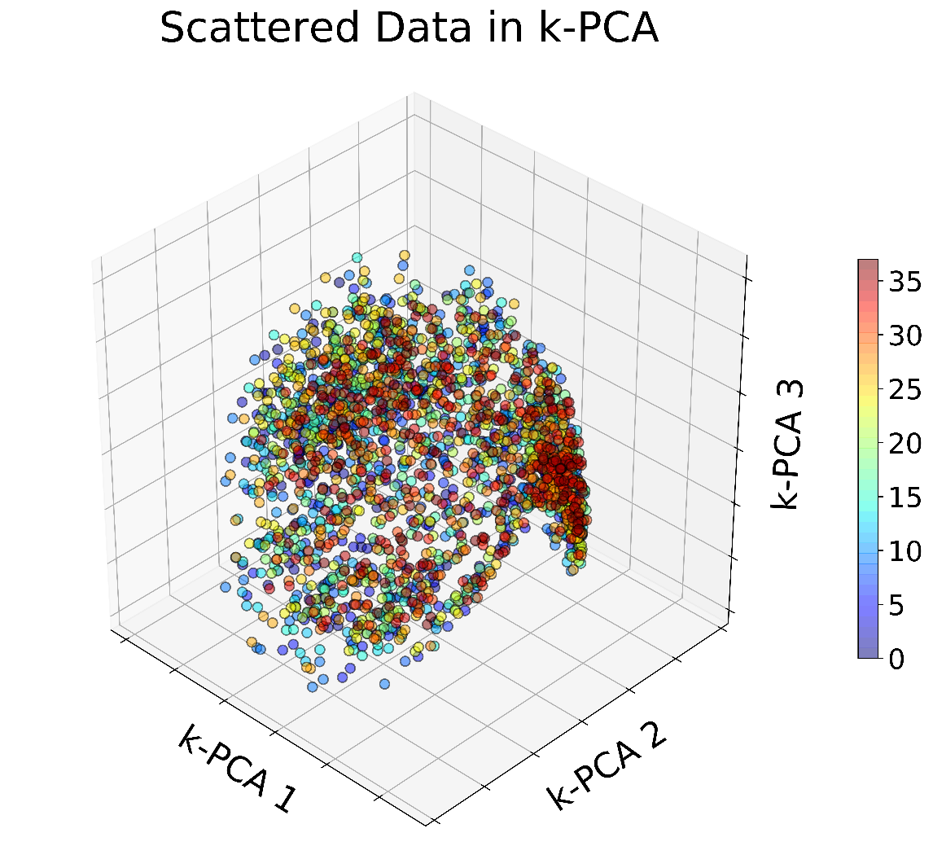
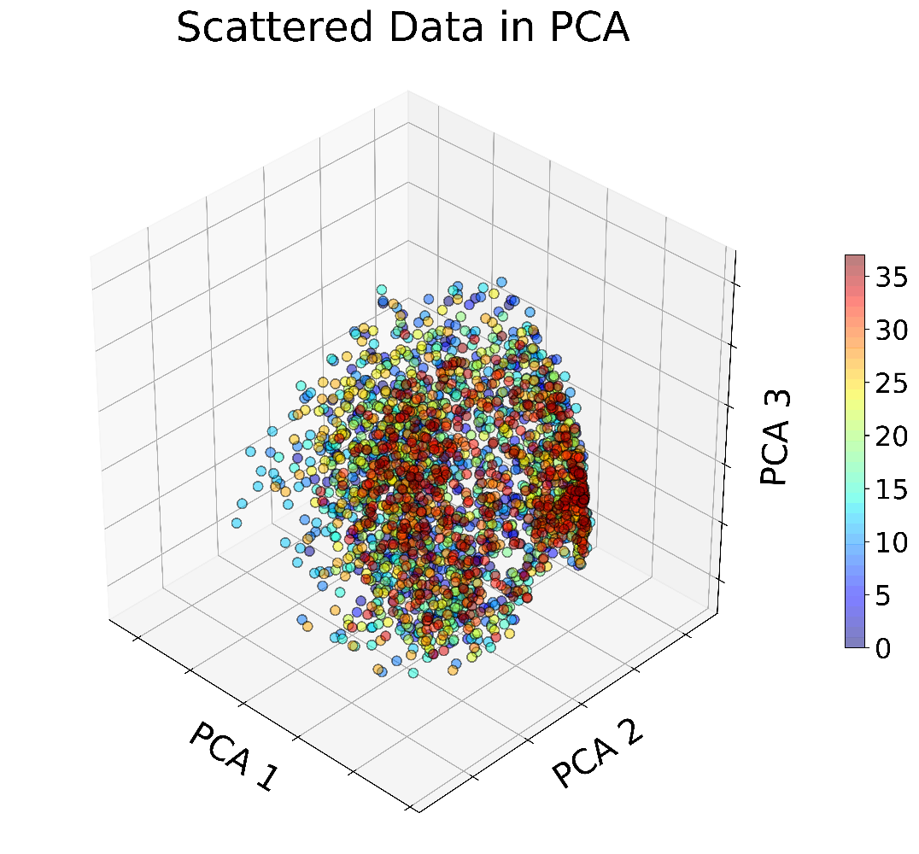

ML Classification Pipeline
k-PCA & SVC (RBF)
Support Vector Classification (SVC):
Parameters tuning: and .
🙂
Low number of k-PCA components: 10.
Parameters Grid search:

Slide 11
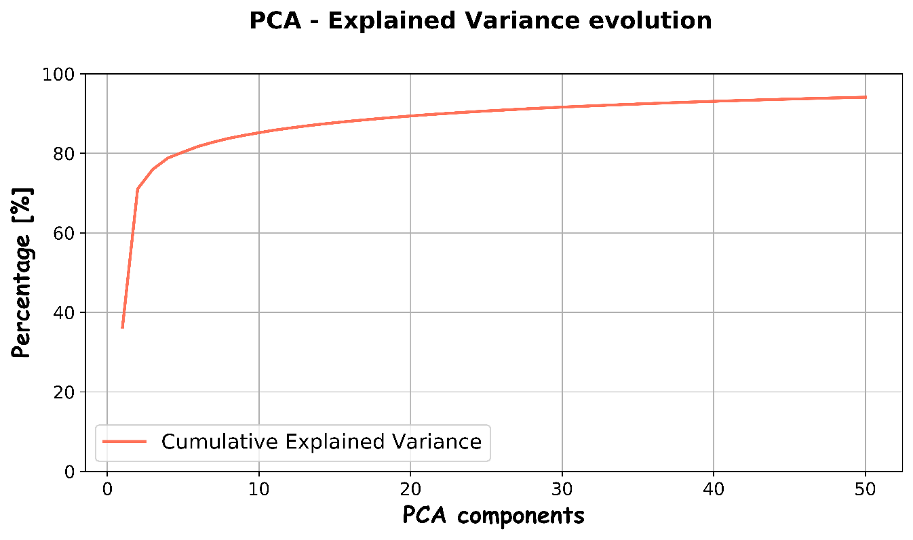
ML Classification Pipeline
PCA / k-PCA & SVC
🙂
PCA: direct measure of reduction quality.
Support Vector Classification (SVC):
Radial Basis Functions (RBF) kernel.
Parameters tuning: and (grid search).
Tuning tips:
Best parameters on grid boundaries:
Low number of PCA components: 10.
☹
🙂
Source: https://scikit-learn.org/

