Slide 1

Machine Learning Face Recognition:
a good trip through multiple dimensions
Beto Sibileau
Barcelona, May 2020

Slide 2
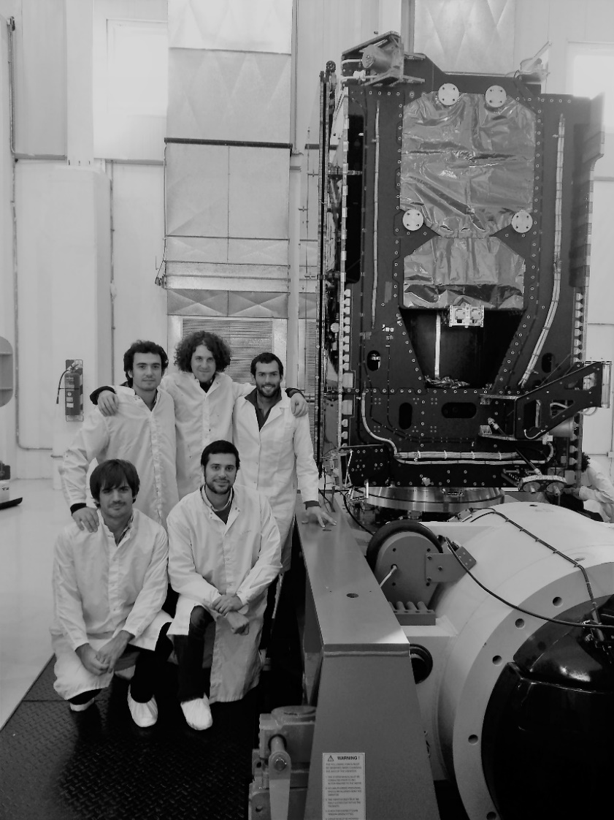
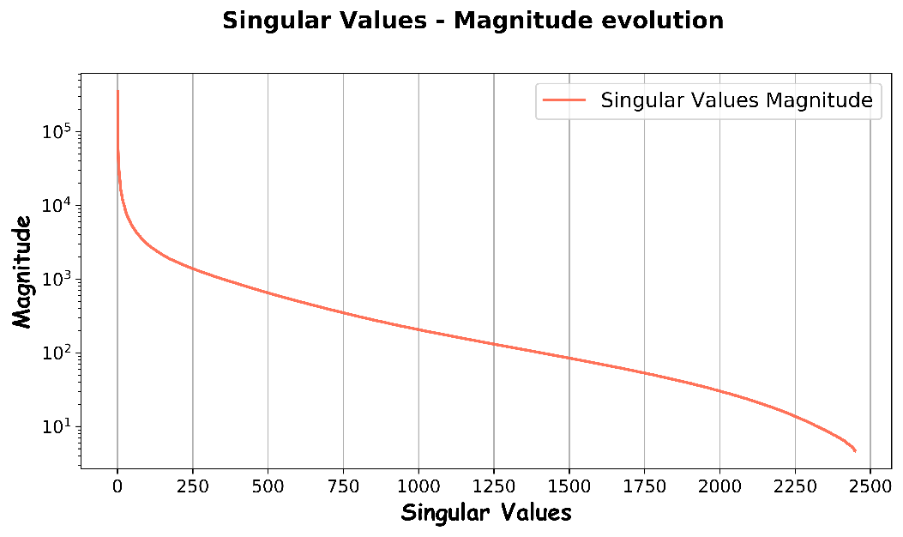
Project Motivation
Big data or meaningful data?
Singular Value Decomposition (SVD)
“Meaningful data”
“Big data”
Using SVD I will build again the “same photo” but using only meaningful data 11% of the original size.
Image Features Extraction
2

Slide 3
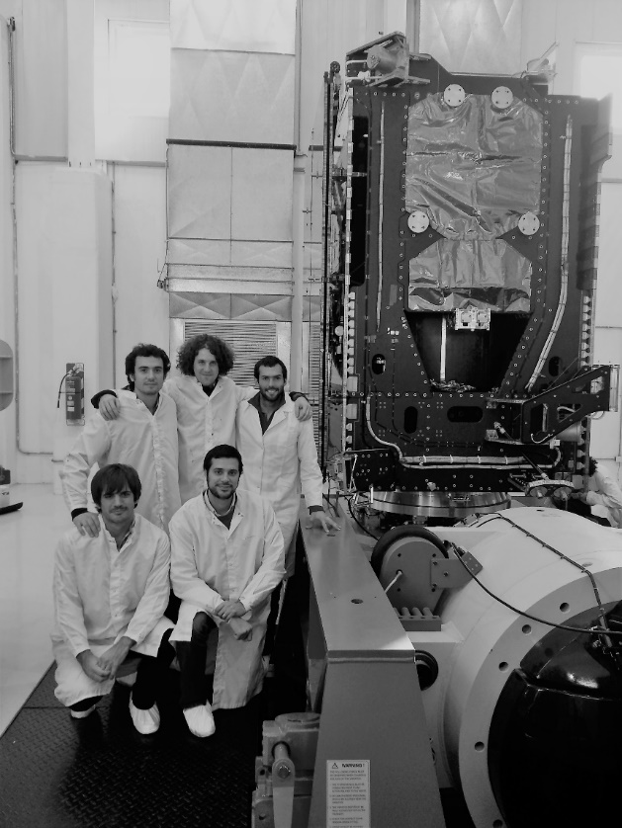

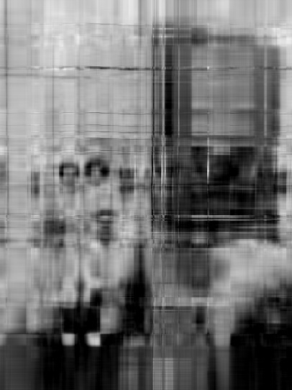

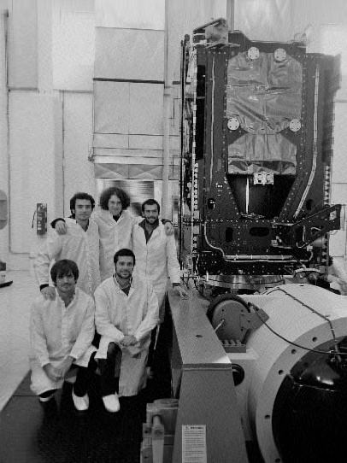




Meaningful Data
“Meaningful data”
89% original data size reduction
or “Dimensionality Reduction”
3

Slide 4
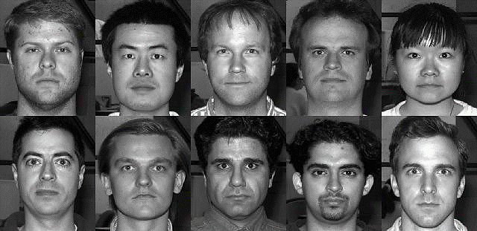
Application: Face Recognition
Yale Faces Database
38 people, ~ 64 lighting conditions
(balanced dataset of 2414 entries)
Supervised Machine Learning
Multi-label (38) Classification Problem
High dimensionality (32256 features)
Support Vector Classifier (SVC)
Principal Components Analysis (PCA)
Dimensionality Reduction
kernel – PCA

Slide 5
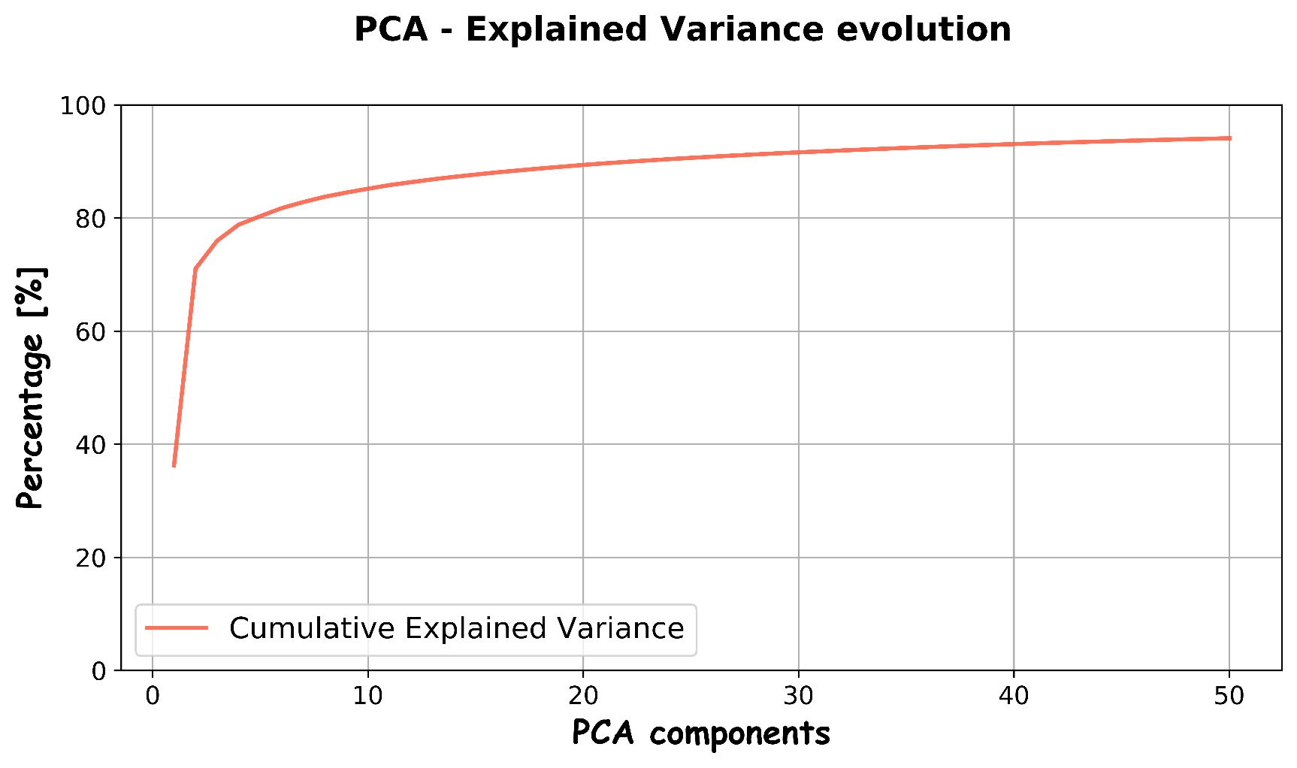


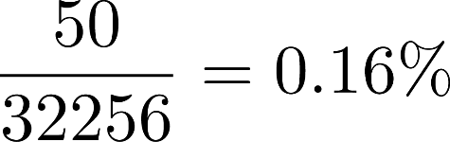
Pre-processing Data
Reduced Number of Dimensions?
PCA reduction quality or “explained variance” (applied to whole dataset):
Reduction Factor:
🙂

Slide 6
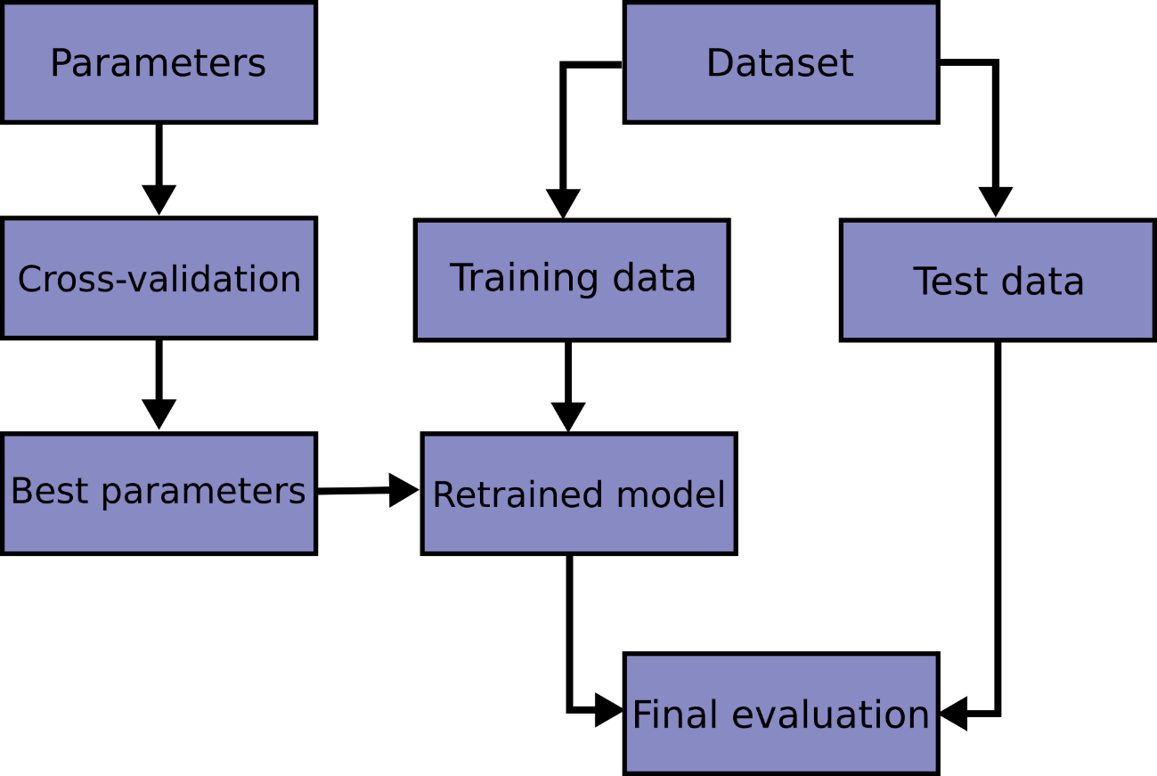


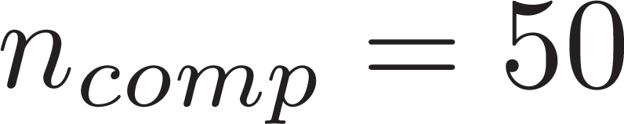
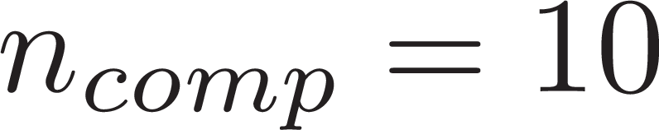
Machine Learning Pipeline
Hyper-parameter tuning
SVC kernel: Radial Basis Functions (RBF)
kernel-PCA: RBF
Grid-search cross-validation (CV)
5-fold Stratified Shuffle Split (keep balanced data)

Slide 7
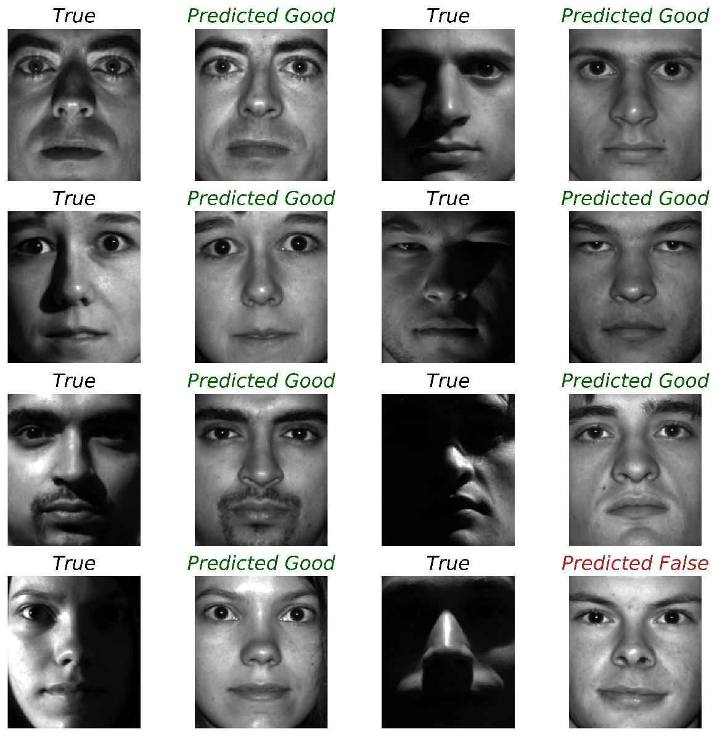
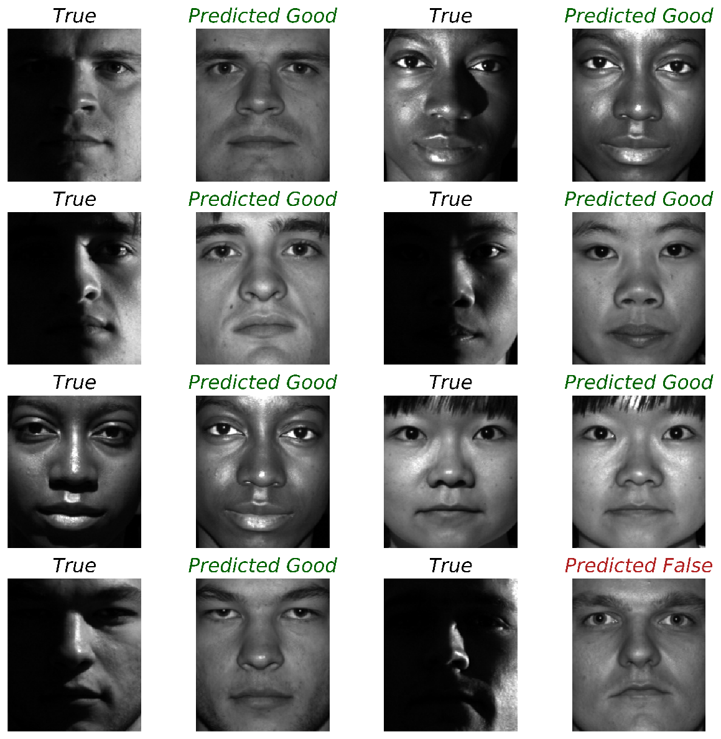
Machine Learning Classification Results
Mean CV accuracy: 90% (using PCA)
Mean CV accuracy: 92% (using k-PCA)

Slide 8

Concluding Remarks
Achievements
Multi-label (38 people) Face Classification:
Mean CV accuracy: 90% (PCA) and 92% (k-PCA)
PCA Dimensionality Reduction: 98% (94% explained variance)
Future Developments
Face Classification: fake or manipulated identities
Where are the limits of the present approach (e.g: database size)?
When does trendy approaches like CNN really pay off?

