Slide 1
BMW Data Challenge: Estimating the winning market price
Alberto P. Sibileau
Barcelona, July 26th, 2022

Slide 2
Introduction
Data Challenge – BMW second-hand cars pricing
Dataset:
~5000 rows (samples) x 18 columns (variables and a target; small data)
Target column: used cars selling price, i.e: the highest bid reached during a B2B auction
Remaining columns: 17 (independent) variables or features
The target is a continuous variable
Challenge: estimate the price dependence on the independent variables (regression)
Questions:
Show the estimated price out-of-sample accuracy
What are the most important variables that determine the car selling price?
How does the estimated car price changes over time?
Sensitivity of car price change over time with respect to the variables
Seasonality patterns in pricing (e.g: summer vs winter prices for certain cars)
How to optimize the loss when buying a second-hand car?
2

Slide 3
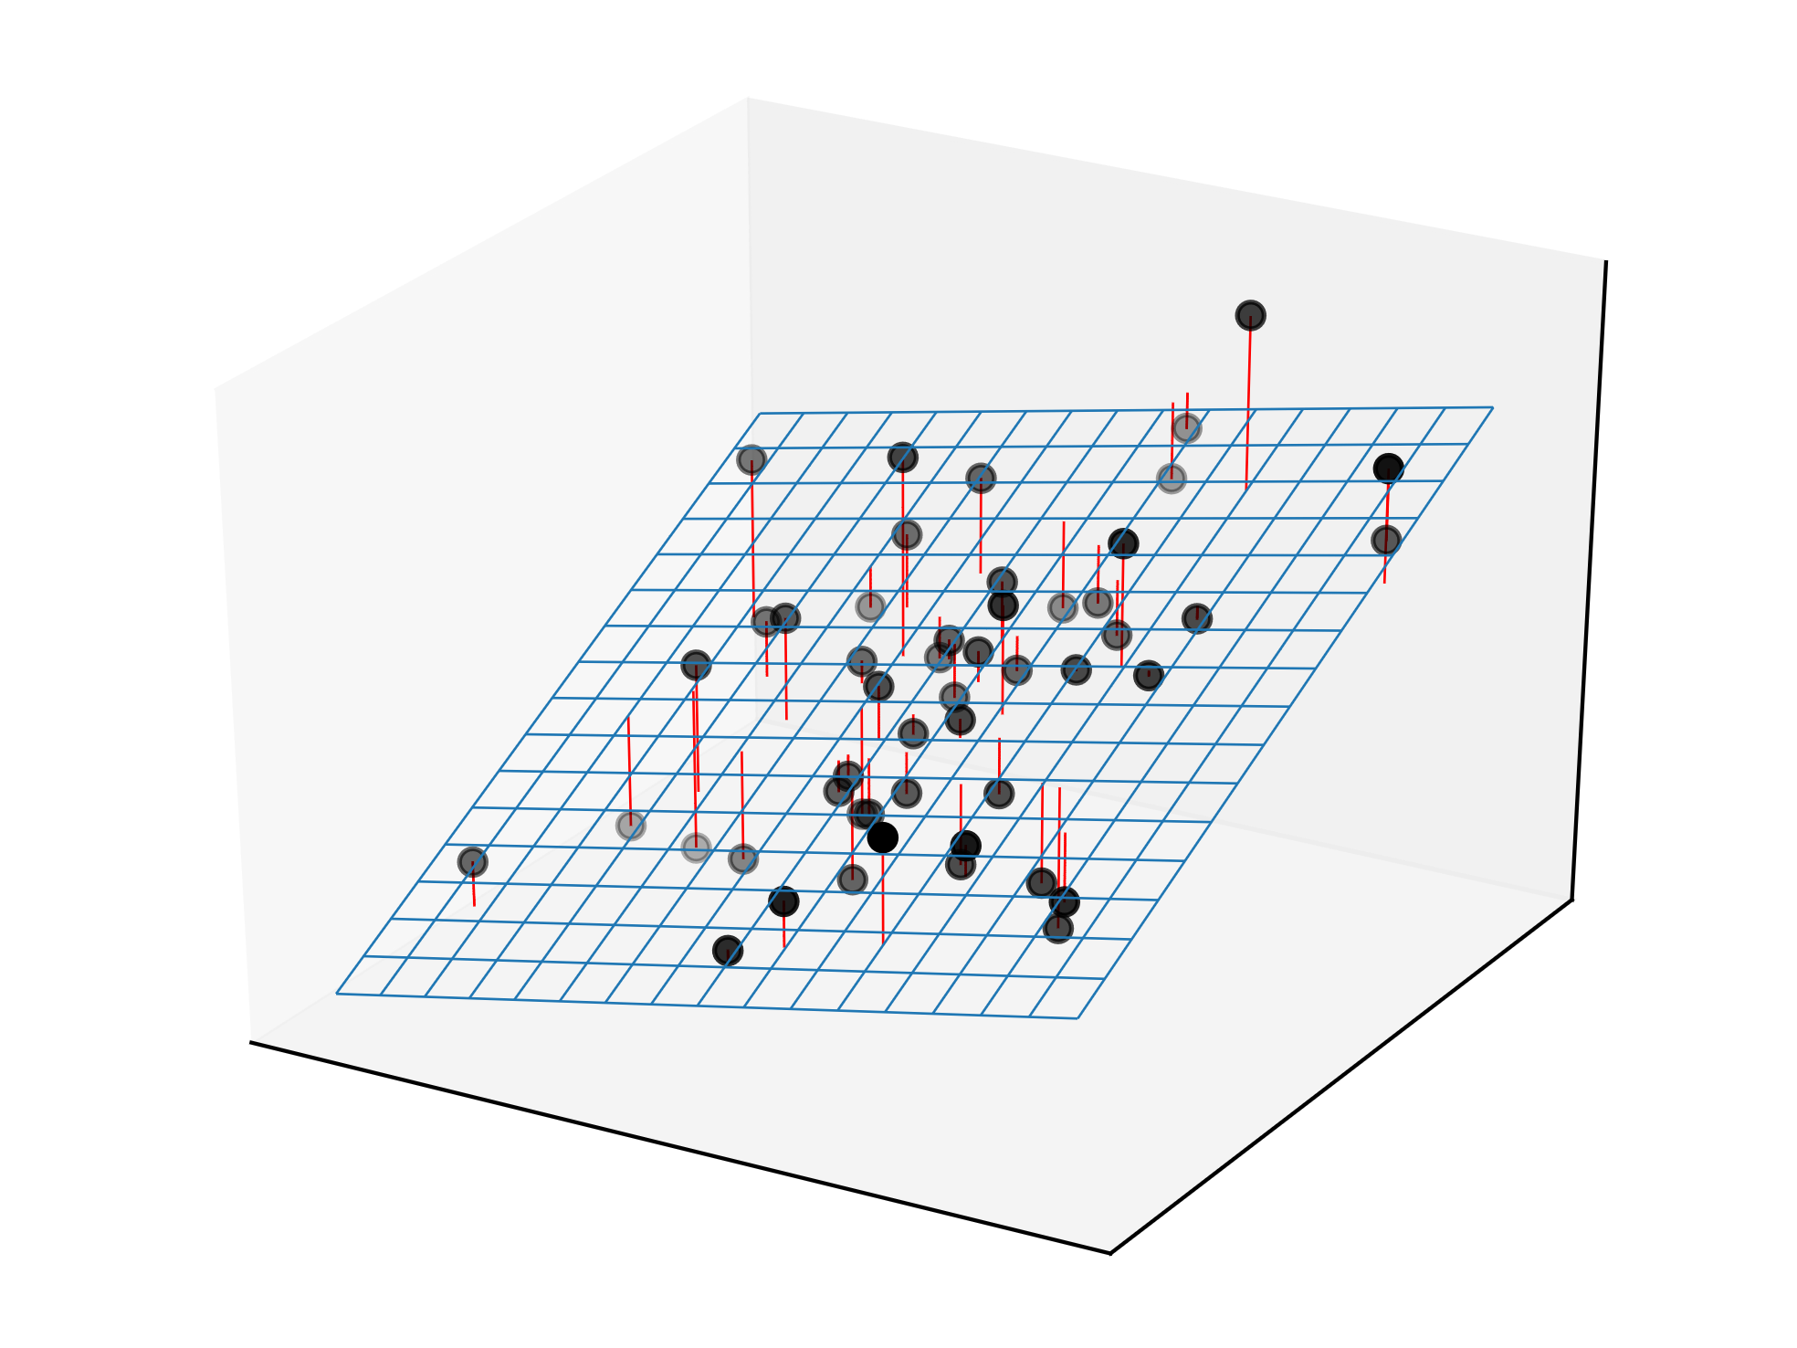
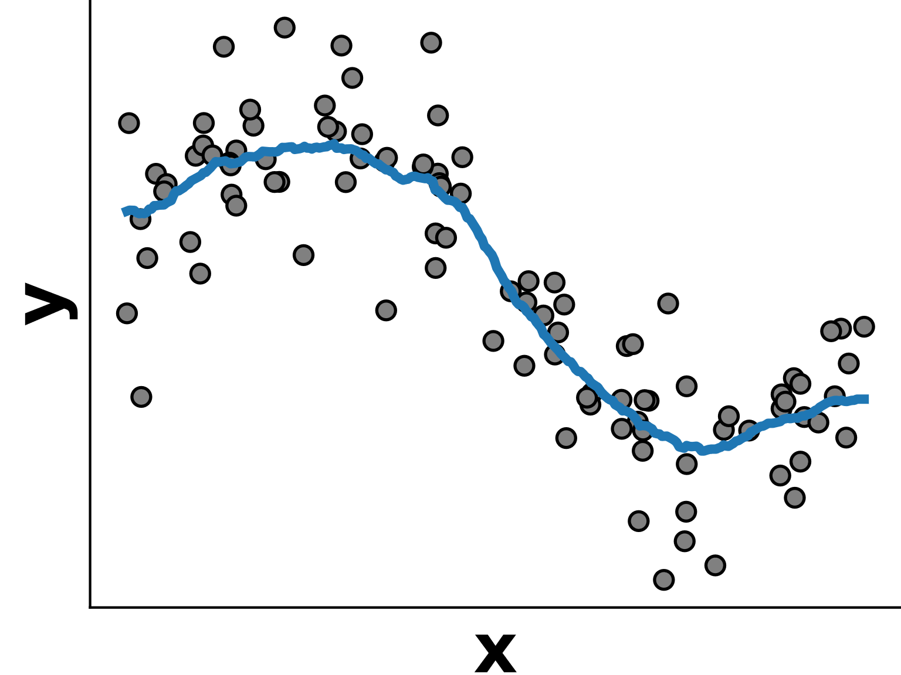
Introduction
Regression Challenge
Reveal the behavior of a continuous variable through a sample of its features
Make predictions
z
x
y
© INRIA, ML in Python
© INRIA, ML in Python
Linear Model (2D)
Ensembled model (1D)
3

Slide 4
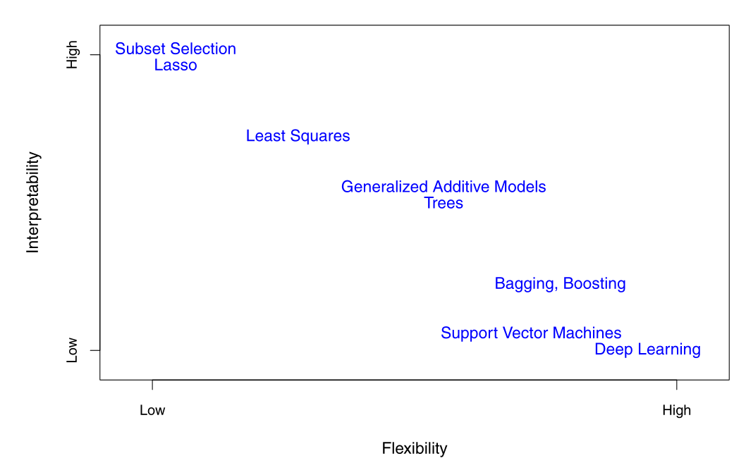
Introduction
Interpretability vs Flexibility Trade-off
Parsimony vs Black-box (involve few or all variables)
Under-fit, Good-fit or Over-fit? (hyper-parameters)
Interpretability and Flexibility trade-off for different Statistical Learning Methods (© ISL, 2021)
4

Slide 5
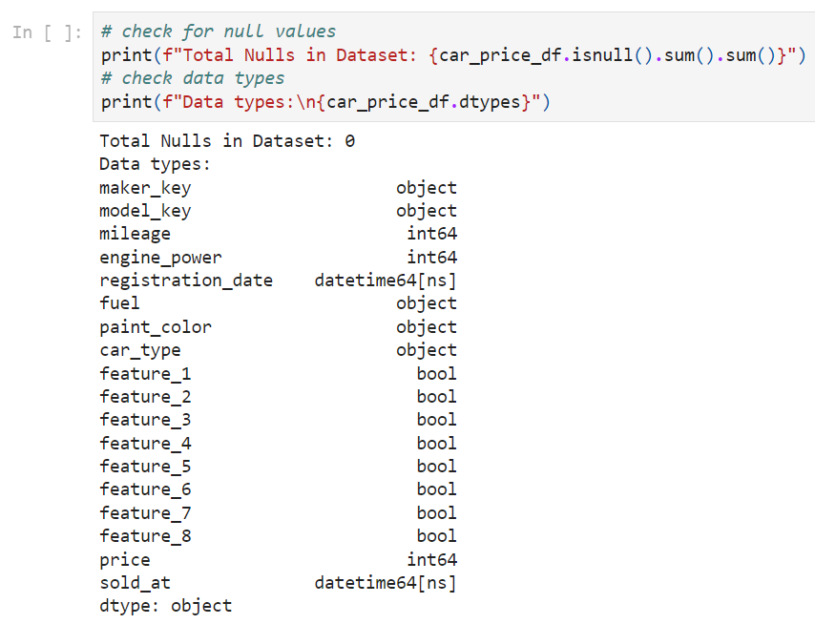
Data Ingestion & Cleaning
Variable Types, Description & Cleaning
Original Set:
17 variables or features (13 categorical and 4 numerical)
Numerical target
Variable types: integer, datetime, Boolean, strings
There are no null values
Drop categorical feature “Maker”:
All cars are BMW
Drop samples based on numerical columns description:
A zero value for car engine power
A negative value for car mileage
5

Slide 6
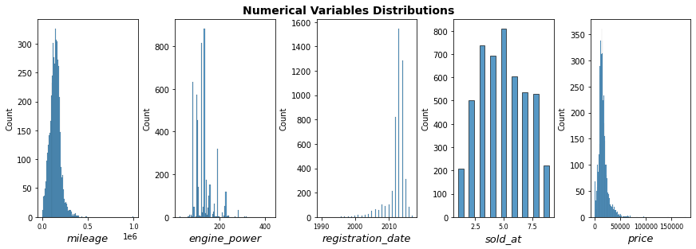
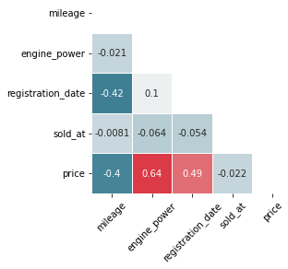
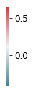
Exploratory Data Analysis (EDA)
Numerical Variables
Spearman correlations
Transformed to years (1990 to 2017):
Relevant to cars age
Transformed to months (1 to 9):
Relevant for price changes over the year
Assumes changes over the week not relevant for B2B auction
Some skewed distributions (e.g: price, relevant to linear regression)
Four correlations between numerical variables (mid to mid-high intensity)
6

Slide 7
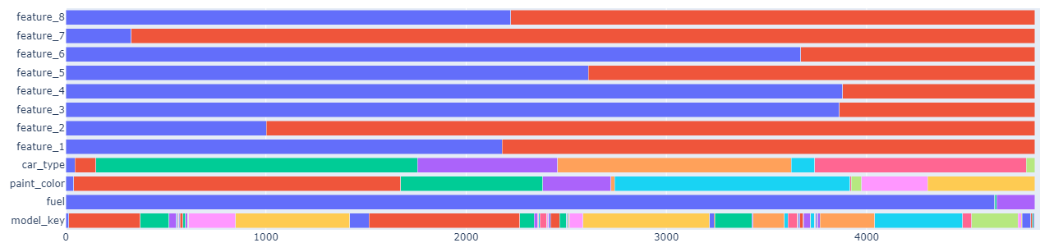
Exploratory Data Analysis (EDA)
Categorical Variables Cardinality
Dataset Cardinality
Drop electric and hybrid cars (underrepresented population)
Four colors with the smallest number of samples are recategorized as ‘other colors’
72 Model keys are recategorized as 12 ‘BMW model series’ (100-600 and X1-X6 series)
Categories with low number of samples impact the model cross-validation
7

Slide 8
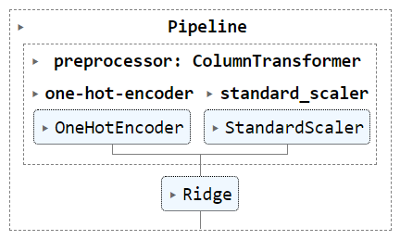
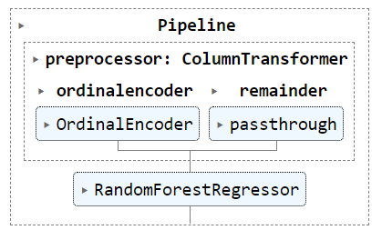

Sci Kit Learn Modelling
Pipelines
Linear Model
Ensembled Model
Baseline Model
Dummy Regressor
Cars selling price median (full dataset)
Linear Model Performance
OneHotEncoder: sensitive to categorical ordering; not sensitive to augmented columns
Feature Scaling: sensitive
Ensembled Models
OrdinalEncoder: not sensitive to categorical ordering; sensitive to augmented columns
Feature Scaling: not sensitive
8

Slide 9
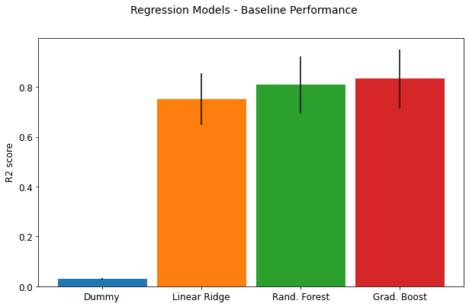
Default Models Score (Q1)
Are these models predictive?
Metric: r2 test-score evaluated by 5-fold-shuffled cross-validation
Linear Model (Ridge): high interpretability; regularization could deal with correlated features
Ensembled Models: higher flexibility; “Bagging” and “Boosting” ensembling strategies
Regression Models - Default r2-performance (CV test score)
Message: models are predictive; it is worth the analysis
9

Slide 10
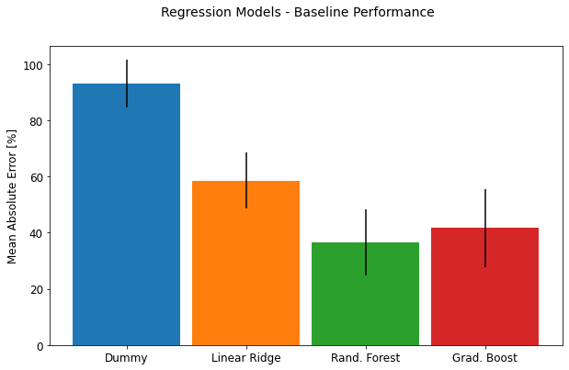
Default Models Score (Q1)
Mean absolute error percentage [%]
Metric: mean absolute error percentage, test-score evaluated by 5-fold-shuffled cross-validation
How well do our models generalize to unseen data?
Regression Models - Generalization Performance (CV test score)
Message: models improve our baseline; let’s try to do better
10

Slide 11
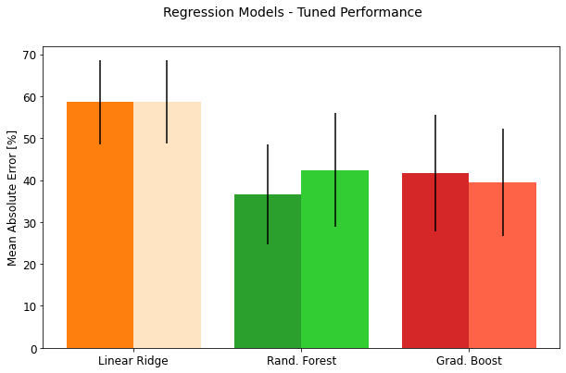
Hyperparameter Tuning (Q1)
Nested Cross-Validation
Two loops over two splits (per each combination of parameters)
Linear Ridge Regularization Parameter
Random Forest Parameters: number and depth of trees (max_leaf_nodes, symmetry not enforced)
Gradient Boosting Parameters: number, depth of trees and learning rate
Regression Models Tuned Performance
Message: models don’t improve significantly over-fitting; use Random Forest for analysis
11

Slide 12
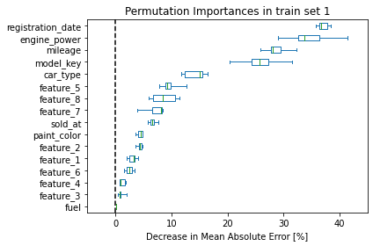
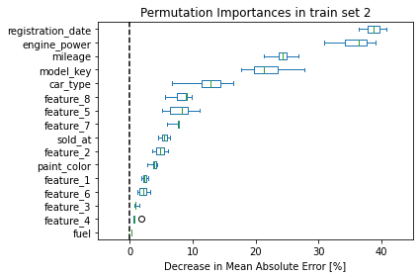
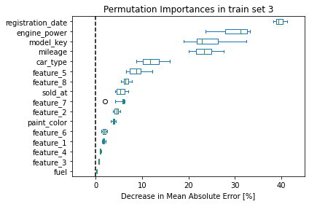
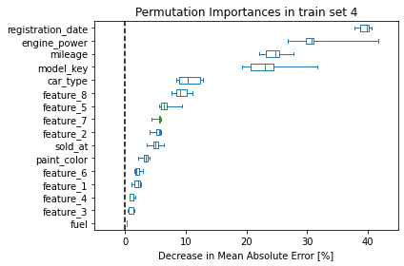
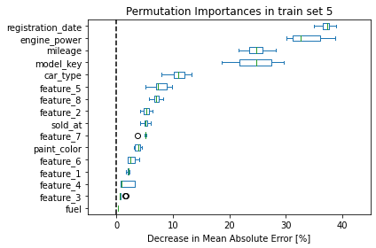
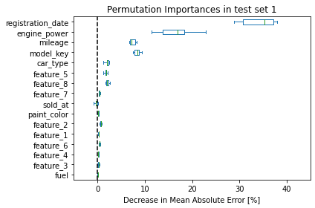
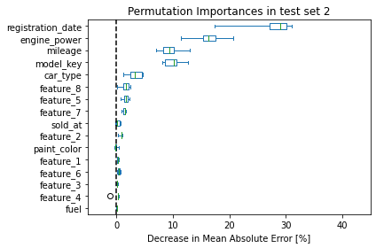
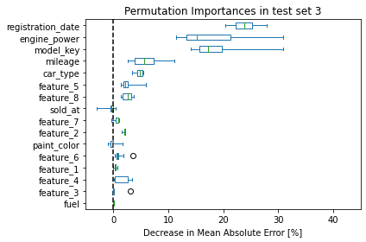
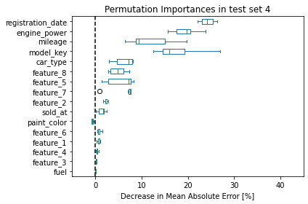
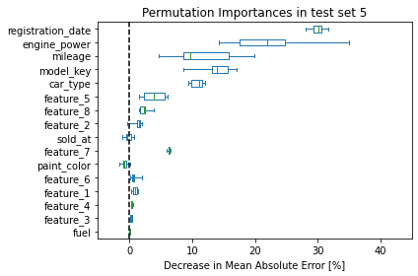
Feature Evaluation (Q2) – Random Forest
Permutation Importance – Train and Test CV-sets
The car selling price is highly determined by the characteristics:
Registration date, Engine Power, model, mileage and car type
Car equipment 5 and 8 are the most important features determining the selling price
Features that are important on the training set but not on the test set might cause overfitting
Rebuild the model dropping fuel, color and features 1, 3, 4, 6
12

Slide 13
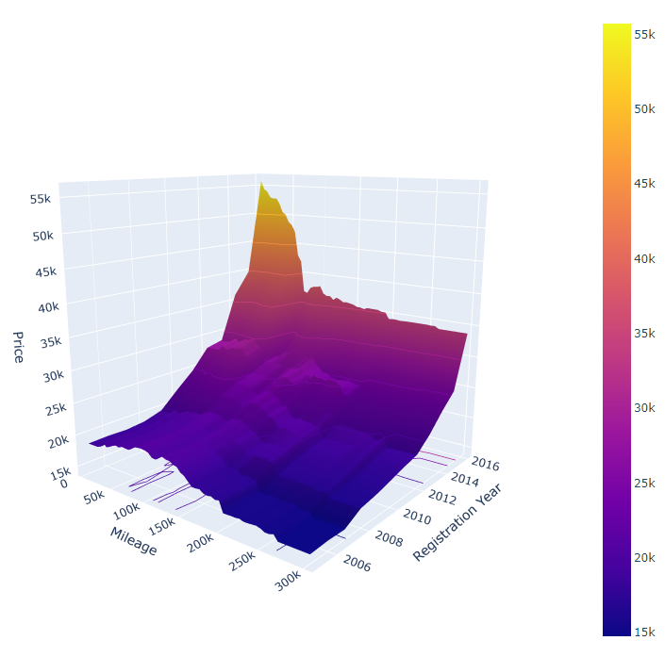
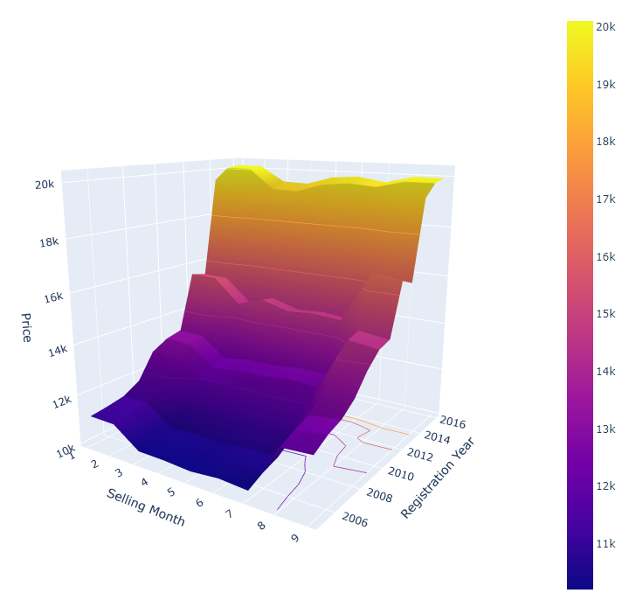
Business Question (Q3) – Random Forest (reduced)
Estimated price over time
Price vs Mileage and Year
Price vs Year and Selling Month
400 series, 230 hp, convertible, Features 5 and 8, sold at May
300 series, 140 hp, 30000 mi, estate, no Features
Increasing Mileage: Young age, high depreciation; Old age: slight appreciation (people’s trust?)
Seasonality patterns: filter car populations and test statistical significance?
Web application deployed at https://data-challenge-dash.herokuapp.com/
13

Slide 14
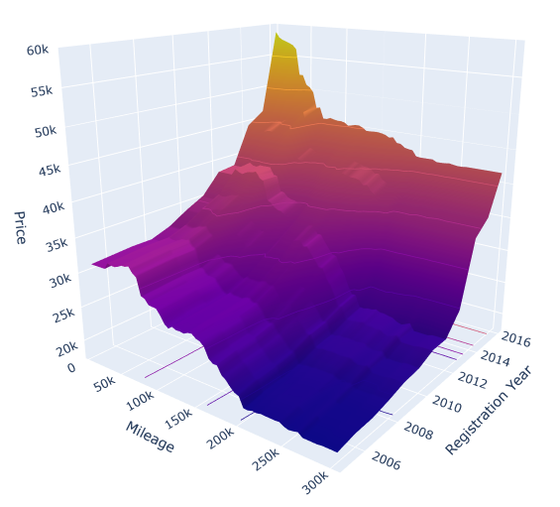
Business Question (Q4) – Random Forest (reduced)
Second-hand best buy
Price vs Mileage and Year
Search direction: Increase mileage (10k) and car age (1 year) → blue arrow in the plot (mileage and year)
Loss function: price difference in the search direction → selling point minus buying point in the plot
Constraint: car buying price at least $20,000
Optimal variables selected: year 2013 with 60k miles ($1,000 expected loss; buying price $39,620)
500 series, 320 hp, estate, Features 5 and 8, sold at May
14

Slide 15
Concluding Remarks
Models built to solve this challenge are predictive, then we could use them to answer business questions
We have used Random Forest to provide cars selling price insights
These are the car characteristics that determine the most its selling second-hand price: Registration date, Engine Power, model, mileage, car type, features 5 and 8
A web application have been deployed to visualize the pricing parametric analysis
Pricing optimization could be explore using the built model in a constrained optimization solver
Seasonality patterns statistical significance could be studied by testing target populations from the dataset, derived from the present analysis
The models accuracy could be improved by focusing on over-fitting
15

Slide 16
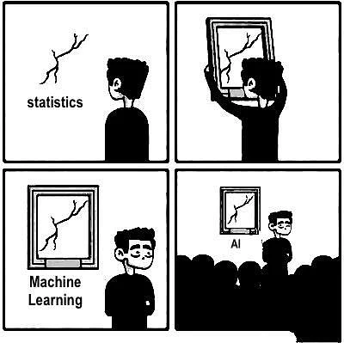
Questions
Thank you very much for your attention!
16

