Slide 1

Predicting stroke risk: A machine learning analysis
The Datamaniacs: Kelly cash, betsy james, joe kim, grace sun and sophie qiao

Slide 2
How many of you have known a friend or family member that has suffered a stroke?

Slide 3

Stroke statistics & Risk factors (USA)
1 in 6 cardiovascular disease related deaths are due to stroke
Someone dies of stroke every 4 minutes
$46 billion in health care costs between 2014 and 2015
Leading causes: High blood pressure, high cholesterol, smoking, obesity and diabetes
Risk increases with age
https://www.cdc.gov/stroke/facts.htm

Slide 4

Rationale & Plan
Stroke is an important healthcare issue!
Create a machine learning model that predicts the likelihood of stroke based on a set of parameters (including known risk factors)
Dataset source: Kaggle Stroke Prediction Dataset
Models to evaluate: KNN, Random Forest, Logistic Regression, SVM, Decision Tree, Gaussian Naive Bayes, Neural Networks, Gradient Boosting

Slide 5
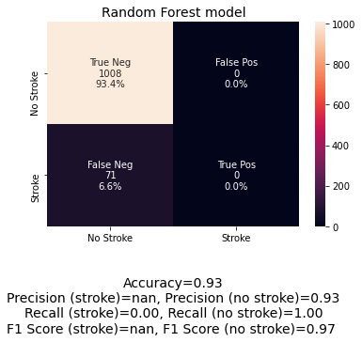
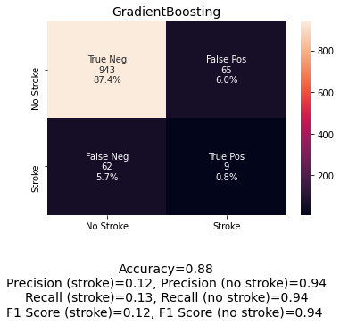
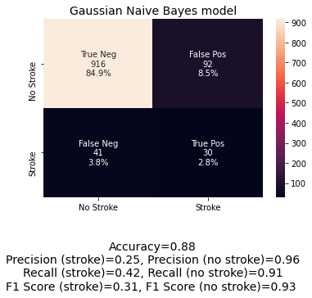

Models: Confusion matrix comparison
Random Forest, Logistic Regression, SVM and KNN all same results
High accuracy
No stroke predicted
Lower accuracy
Some true positive (stroke) prediction
Gaussian Naive Bayes
Less proportion of false neg
More true positives

Slide 6
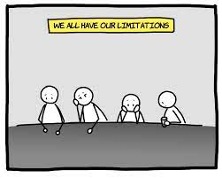
Limitations of the dataset
Not a large dataset by machine learning standards
Limited features that were actual measurements
BMI, Average glucose level, age
Other features: categorical, requiring encoding
Imbalanced classes: only 5.7% positive for stroke

Slide 7

Routes we investigated to improve model performance
Normalizing data
Standard scaling
Cross validation
Imbalanced learn library: SMOTE (Synthetic Minority Oversampling Technique) to obtain balanced classes

Slide 8

If we had more time
Ensure the dataset has more balanced classes
Obtain more data including features such as cholesterol level, history of stroke, average blood pressure

Slide 9

questions

Slide 10
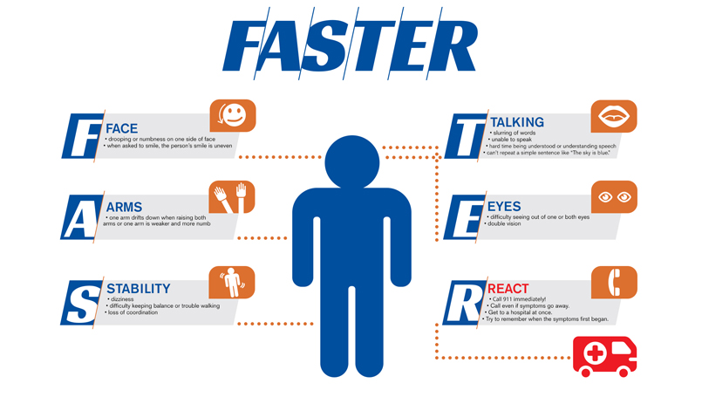
Stroke warning symptoms

Slide 11
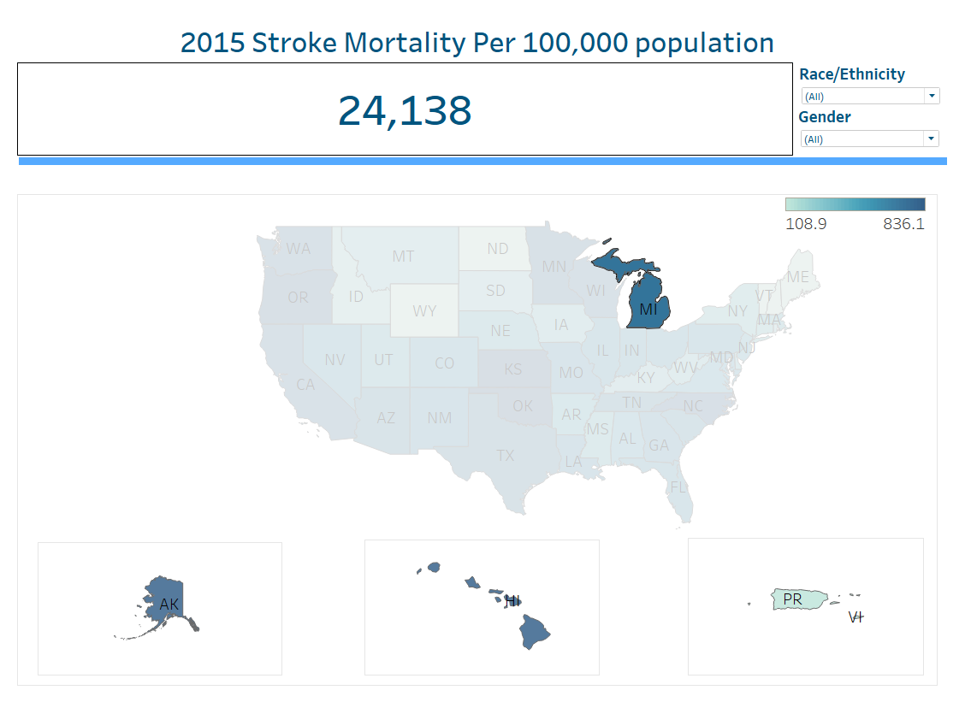

Slide 12
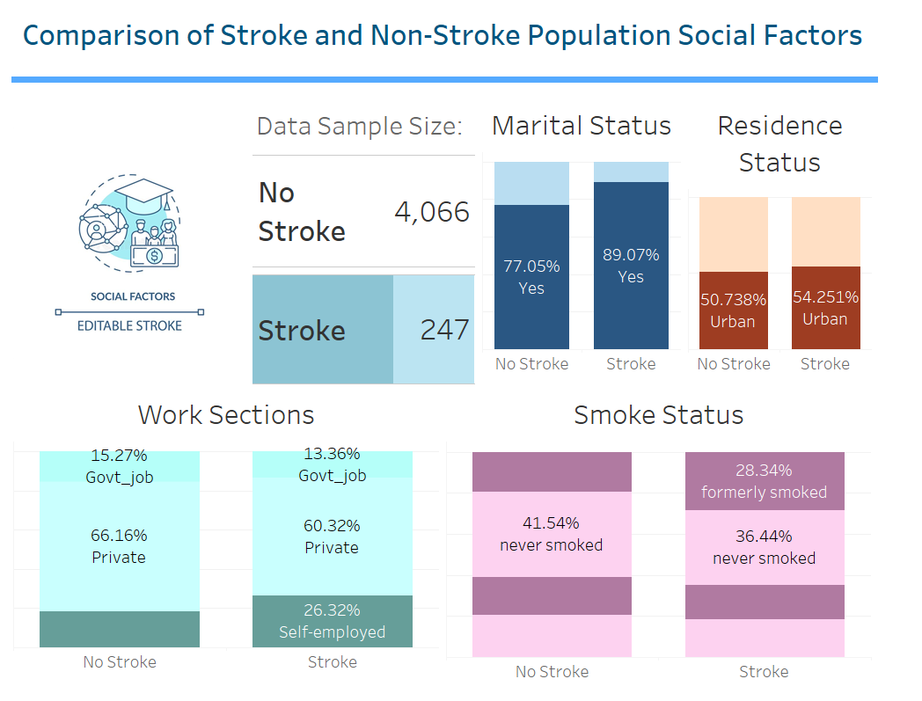

Slide 13
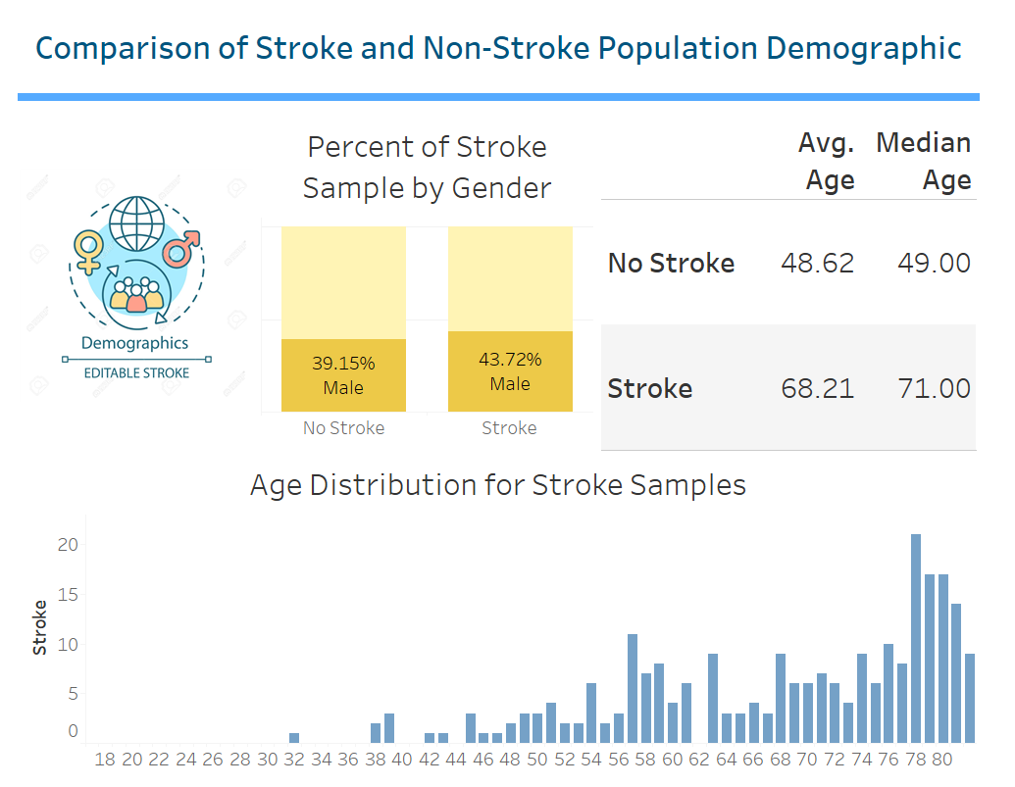

Slide 14
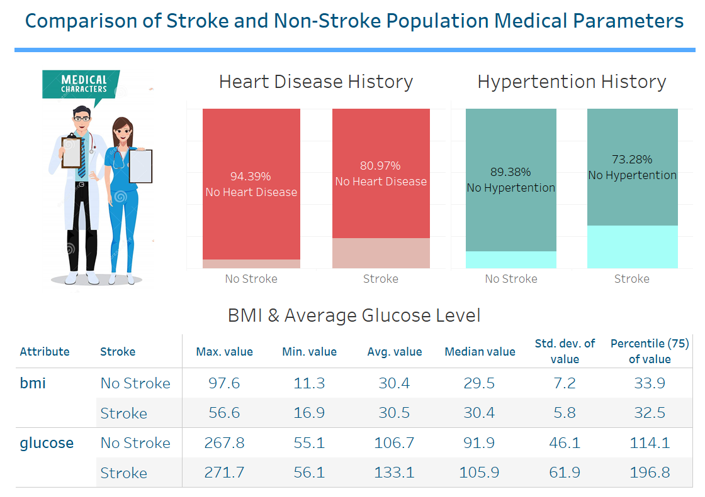

Slide 15
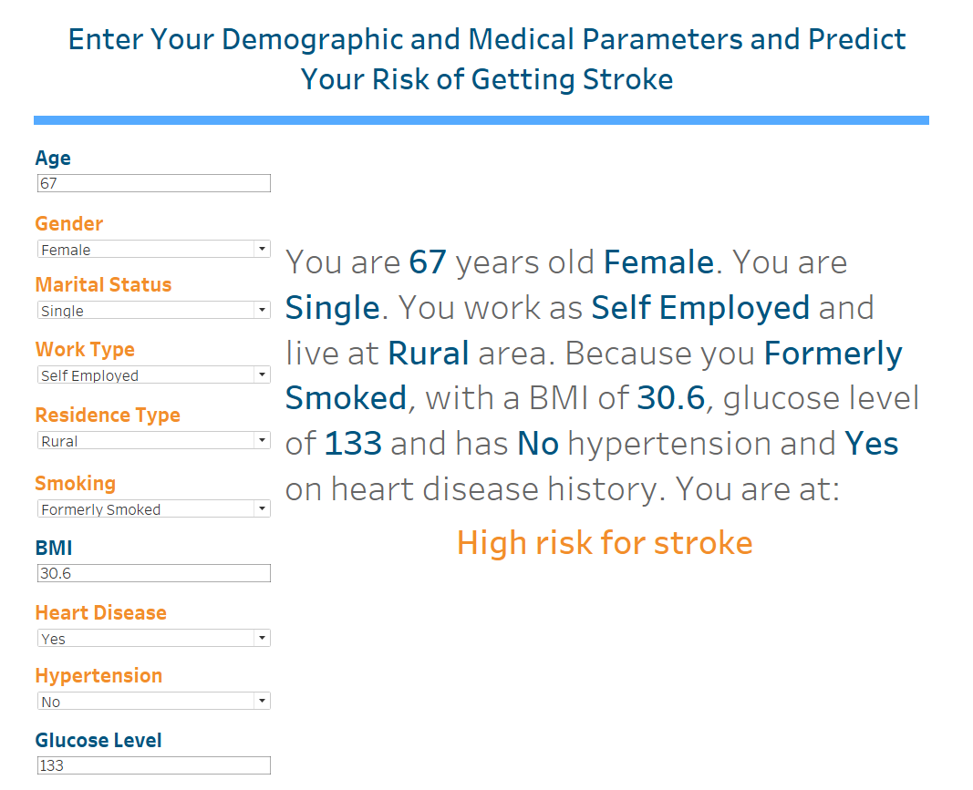

Slide 16
