Slide 1
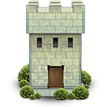
meCastle

Slide 2
Systembeschreibung
Was ist meCastle?
„Encryption in a box“
UI for easy management of Certs
create Root CAs / Trust Center
create, revoke, renew certs
User Certs (j.doe@example.com)
Server Certs (www.example.com)

Slide 3
Status
Installable XAR app
Creates Root CA(s)
Creates Server Certs
Creates Client Certs
What we have (Git, demo)
In progress:
deployment of email, server + vpn certs
UI for ‚create cert‘
Notes:
DEMO von exist-ca

Slide 4
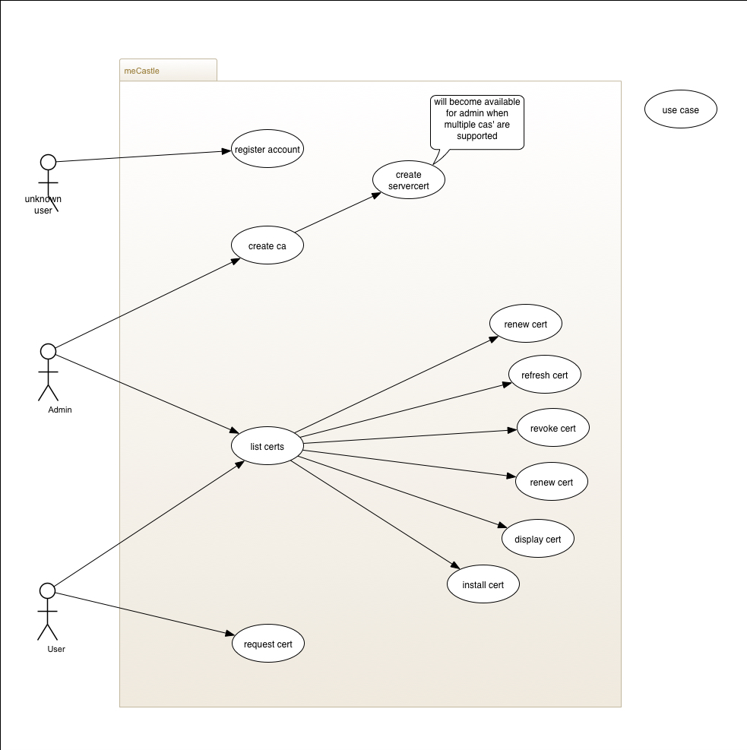

Slide 5
Anwendungsbereiche
It‘s for closed ‚Closed audiences‘
Email Encryption
S/Mime
(GPG?)
VPN
OpenVPN
IPSec
Web Server
Server Cert
Browser (https)
existCA
Code/Document signing
Chat encryption
OwnCloud
File Storage, Apps
Document Server
eXistdb Metadata
GridFS
DNS Management (ediscom)
SSH Key Management
JMX messaging
(...) ?

Slide 6
Denkbare Varianten
Small device ~ 150-250 € (0.5 GB / 4 GB)
meCastle App
VPN gateway
NAS option
Medium appliance ~ 800 € (4 GB / 128 GB)
Rackmount option
Big appliance ~ 2000 – 2500 € (16 GB / ???)
Options:
Remote backup via VPN

Slide 7
Audiences
Architects, authors, engineers, doctors, lawyers, reporters, inventors...
Small businesses and organisations that lack the experts and money to buy enterprise-grade security solutions
Medium size businesses with own IT department but lacking time or specialized knowledge
Address the huge segment below the solutions from IBM, HP, Bull ...

Slide 8
Priorisierung und Validierung
Wie kommt man zum konkreten Produkt?
Kriterien:
Welche Anwendungen sind massen-tauglich?
Aufwand der Umsetzung
Höhe des Endpreises

Slide 9
What‘s in the box?
Initial box (small profile):
Email certs
HTTPS
VPN
Basic Fileserver: access by Samba, WebDav, NFS
~bundle with OwnCloud?
Probably working with an external NAS to reduce cost per unit.

Slide 10
Finanzierung
Crowdfunding allows to validate the business case and explore the market. Generate some customers. Aufwand: ca. 3 Monate Vorbereitung.
Förderprogramme: erfordert ca. 50-60% Eigenkapital. Aufwand: ähnlich dem Crowdfunding wobei man Agenturen dafür einschalten kann.
Initiale Schritte der Entwicklung können eigenfinanziert werden.

Slide 11
Marketing
Crowdfunding kann bei guter Vorbereitung bereits eine gewisse Bekanntheit erzeugen.
Eigene Homepage (new brand)
Vernetzung Security Scene Berlin
Partnerschaften
Aktive Pressearbeit
Externe Berater
Messen

Slide 12
Summary
Product ‚meCastle‘ within reach
What‘s next?
Strategic decision needed
Business plan
‚Tailor the box‘ (sizing, features, audience)
Financing is likely needed
Prepare campaign
Find partners (peer review, added-value)
Setup a new company alongside exist solutions
Notes:
Groundworks are done – Prototype within reach.

