Slide 1








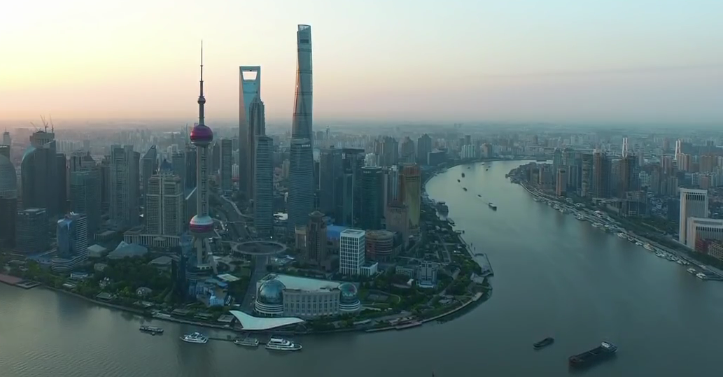
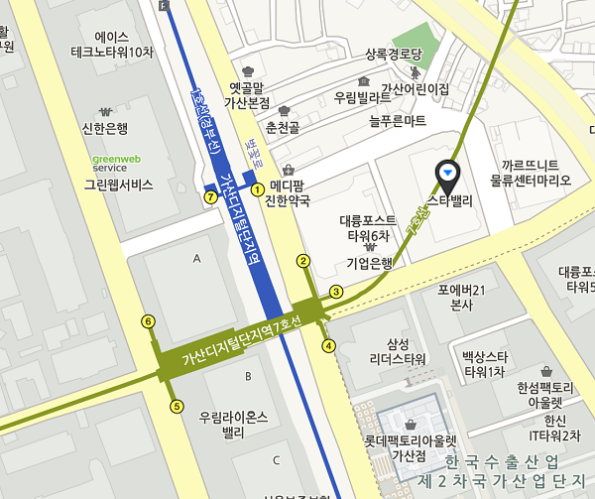
> better code ■
1
2
News Team Partner Contact
Sino-Korea Cross-Border IT Consulting
> 中韩跨境环境下的IT咨询、系统设计、开发
> 为中韩联合创业留学生们提供孵化环境、天使投资
3
4
News
6/20
Tony Ahn delivers a lecture on iOS programming at Fast Track Campus until the end of month
6/14
bettercode signed an MOU with China Weihai Beiyang Incubation Center
Management Team
5
Tony Ahn (CEO) | (前)IT Wise Co-Founder & Executive Consultant Advisory committee member for City of Seoul Korea Spring User Group Co-Founder
Youngwan Ahn (CMO) | (前)Global Marketing Office at Samsung Electronics MBA from 光华管理学院 at Peking University Member of Korean Angel Investor Association
Advisory Team
6
Roger Chen | Vice President of Samsung China
Bin Dai | Head of App Annie China
Xuefeng Piao | Professor of Harbin Institution of Technology
YongSeok Park | Head of Com2Us China
Partner
7
8
北京衣念科技发展有限公司
E-Land Systems China
是由韩国衣恋集团投资注册，坐落于北京朝阳区恒通商务园内，是一家集软件应用程序开发、自主产品研发为一体的软件研发公司，国家级高新技术企业。公司主要致力于提供ERP等商务解决方案，引领顾客进行改革，以推动社会的发展和进步。
Contact
9
Seoul Office
10
서울시 금천구 디지털로9길 99
(가산동, 스타밸리)
천재교육 에듀테크 센터
99, Digital-ro 9-gil,
Geumcheon-gu, Seoul,
08510, Rep. of KOREA
beijing
Weihai
Seoul
Shanghai
Shenzhen
© 2016 bettercode All Rights Reserved.
11

Slide 2
> better code ■
News Team Partner Contact
Sino-Korea Cross-Border IT Consulting
> 中韩跨境环境下的IT咨询、系统设计、开发
> 为中韩联合创业留学生们提供孵化环境、天使投资
News
6/20
Tony Ahn delivers a lecture on iOS programming at Fast Track Campus until the end of month
6/14
bettercode signed an MOU with China Weihai Beiyang Incubation Center
Management Team
Tony Ahn (CEO) | (前)IT Wise Co-Founder & Executive Consultant Advisory committee member for City of Seoul Korea Spring User Group Co-Founder
Youngwan Ahn (CMO) | (前)Global Marketing Office at Samsung Electronics MBA from 光华管理学院 at Peking University Member of Korean Angel Investor Association
Advisory Team
Roger Chen | Vice President of Samsung China
Bin Dai | Head of App Annie China
Xuefeng Piao | Professor of Harbin Institution of Technology
YongSeok Park | Head of Com2Us China
Partner
北京衣念科技发展有限公司
E-Land Systems China
是由韩国衣恋集团投资注册，坐落于北京朝阳区恒通商务园内，是一家集软件应用程序开发、自主产品研发为一体的软件研发公司，国家级高新技术企业。公司主要致力于提供ERP等商务解决方案，引领顾客进行改革，以推动社会的发展和进步。
Contact
Seoul Office
서울시 금천구 디지털로9길 99
(가산동, 스타밸리)
천재교육 에듀테크 센터
99, Digital-ro 9-gil,
Geumcheon-gu, Seoul,
08510, Rep. of KOREA
beijing
Weihai
Seoul
Shanghai
Shenzhen
© 2016 bettercode All Rights Reserved.

