Slide 1


> better code ■
Sino-Korea Cross-Border IT Consulting
NEWS TEAM PARTNER CONTACT

Slide 2
> better code ■
Sino-Korea Cross-Border IT Consulting
NEWS TEAM PARTNER CONTACT
Management
Tony Ahn (CEO) | (前)IT Wise Co-Founder & Executive Consultant Advisory committee member for City of Seoul Korea Spring User Group Co-Founder
Youngwan Ahn (CMO) | (前)Global Marketing Office at Samsung Electronics MBA from 光华管理学院 at Peking University Member of Korean Angel Investor Association
Advisor
Roger Chen | Vice President of Samsung China
Bin Dai | Head of App Annie China
Xuefeng Piao | Professor of Harbin Institution of Technology
YongSeok Park | Head of Com2Us China

Slide 3






> better code ■
Sino-Korea Cross-Border IT Consulting
NEWS TEAM PARTNER CONTACT
北京衣念科技发展有限公司
E-Land Systems China
是由韩国衣恋集团投资注册，坐落于北京朝阳区恒通商务园内，是一家集软件应用程序开发、自主产品研发为一体的软件研发公司，国家级高新技术企业。公司主要致力于提供ERP等商务解决方案，引领顾客进行改革，以推动社会的发展和进步。
Notes:
北京衣念科技发展有限公司
E-Land Systems China
천재교육 에듀테크 센터
天才教育公司孵化器中心
베이양그룹
北洋集团 北洋之星
하얼빈공업대학(위해분교)
哈尔滨工业大学(威海分校)

Slide 4
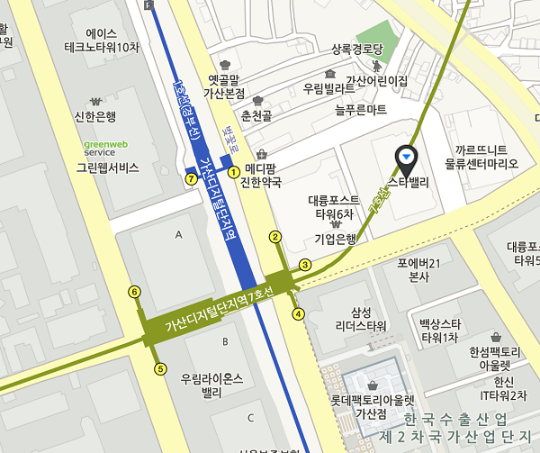
> better code ■
Sino-Korea Cross-Border IT Consulting
NEWS TEAM PARTNER CONTACT
Seoul Office
서울시 금천구 디지털로9길 99
(가산동, 스타밸리)
천재교육 에듀테크 센터
99, Digital-ro 9-gil,
Geumcheon-gu, Seoul,
08510, Rep. of KOREA
beijing
Weihai
Seoul
Shanghai
Shenzhen
Notes:
Seoul: 서울시 금천구 가산동 스타밸리
Beijing: 北京市朝阳区酒仙桥路10号
Shanghai: 上海黃浦区方斜路525弄1号
Shenzhen: 深圳市龙岗区梅坂大道雅南路1号
Weihai: 威海市高新区火炬路169号

Slide 5
> better code ■
NEWS TEAM PARTNER CONTACT
Sino-Korea Cross-Border IT Consulting

Slide 6

> better code ■
NEWS TEAM PARTNER CONTACT
Sino-Korea Cross-Border IT Consulting

Slide 7
> better code ■
Sino-Korea Cross-Border IT Consulting
NEWS TEAM PARTNER CONTACT

Slide 8
> better code ■
NEWS TEAM PARTNER CONTACT
Sino-Korea Cross-Border IT Consulting

