Slide 1

Token Taxonomy & Classification Framework
Document Token

Slide 2
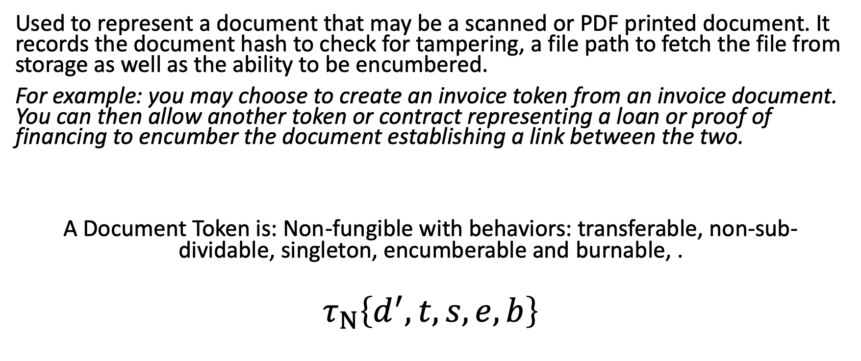
Document Token
Used to represent a document that may be a scanned or PDF printed document. It records the document hash to check for tampering, a file path to fetch the file from storage as well as the ability to be encumbered.
For example: you may choose to create an invoice token from an invoice document. You can then allow another token or contract representing a loan or proof of financing to encumber the document establishing a link between the two.
A Document Token is: Non-fungible with behaviors: transferable, non-sub-dividable, singleton, encumberable and burnable, .
$$τ_{Ν}\left\{d^{′},t,s,e,b\right\}$$

Slide 3
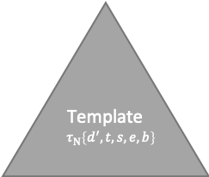
Example
1. Client Create Request
5. Encumber Document
Template
$$τ_{Ν}\left\{d^{′},t,s,e,b\right\}$$
2. Send File to Storage
File Storage
3. Return file path and hash
4. Create
5. Encumber
Document Token Instance

