Slide 1
Loan Default Rate Prediction for Investor

Slide 2
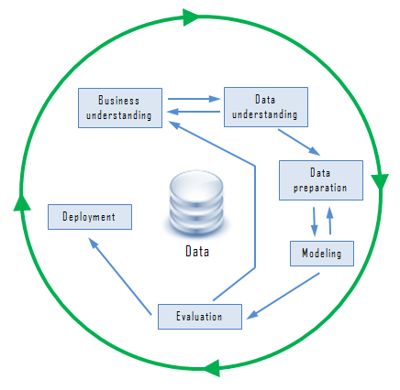
Business Model and Business Goal
week1
1.Data Exploration
2.Come Up Potencial Problem and Possible work directions
week3
1.Feature Engineering
2.Modeling
Data Preparation
Data Understanding
Feature Engineering
Machine Learning Model
Model Evaluation and Recommendation
week2
1.Understand business model
2.Data Preparation and Cleaning
3.NLP
week4
1.Machine Learning Models
2.Wrap up

Slide 3
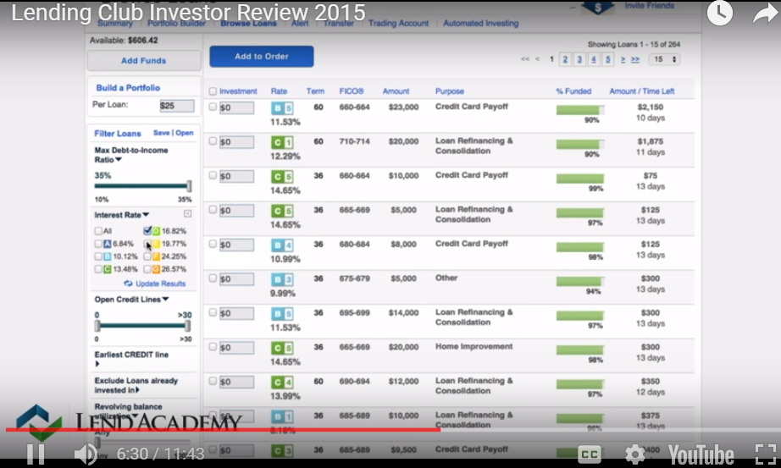
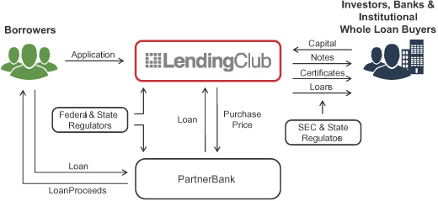
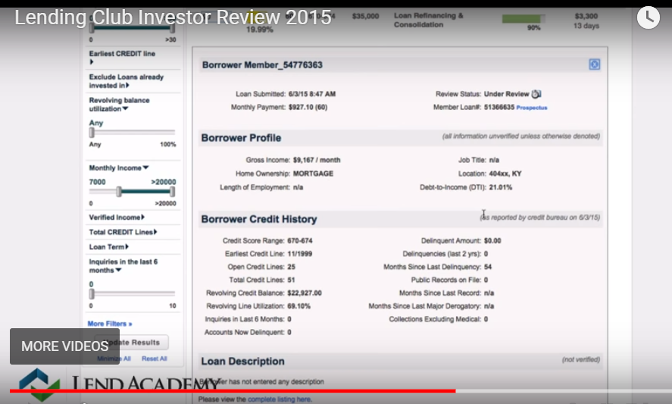
Business Model and Business Goal
Lending Club is a peer to peer loan platform. In this project, we will predict will a loan default or not based on lending club’ historical data so that we can provide insight to lending club investors how to choose a profitable loan

Slide 4
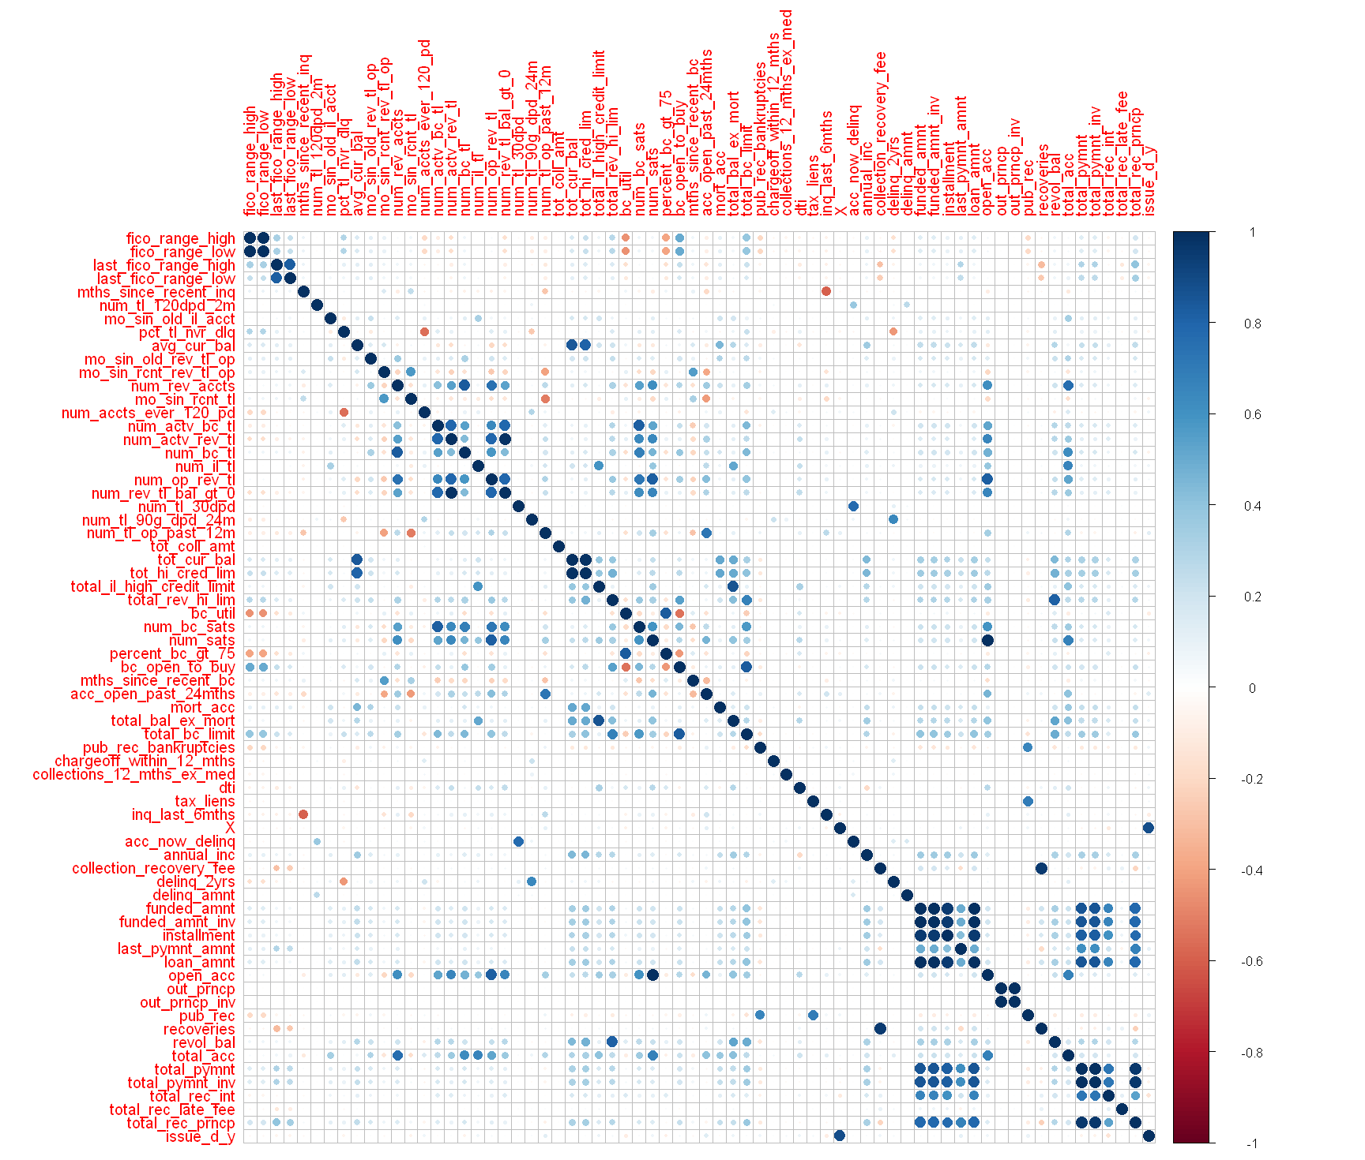
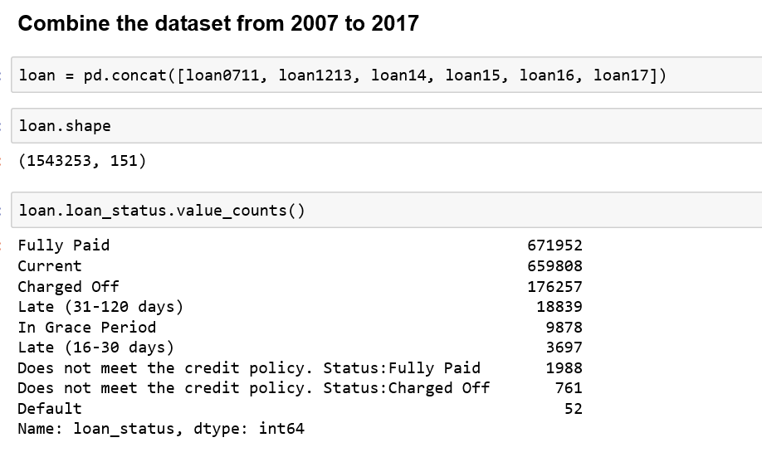
Data Preparation
Is_fullypaid
1:Fully Paid
0:Charged Off
Business Goal → Predictors
Investor known features and some replacement features

Slide 5
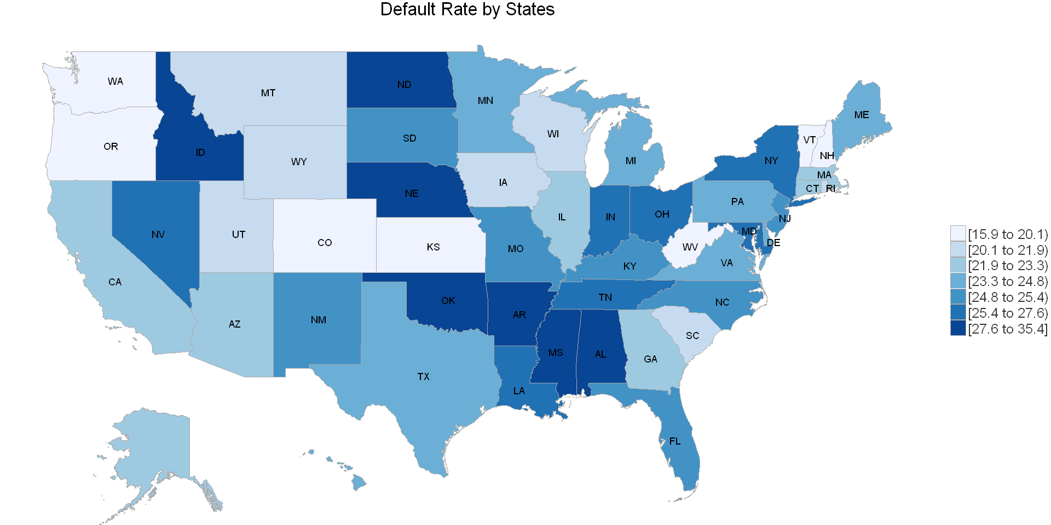
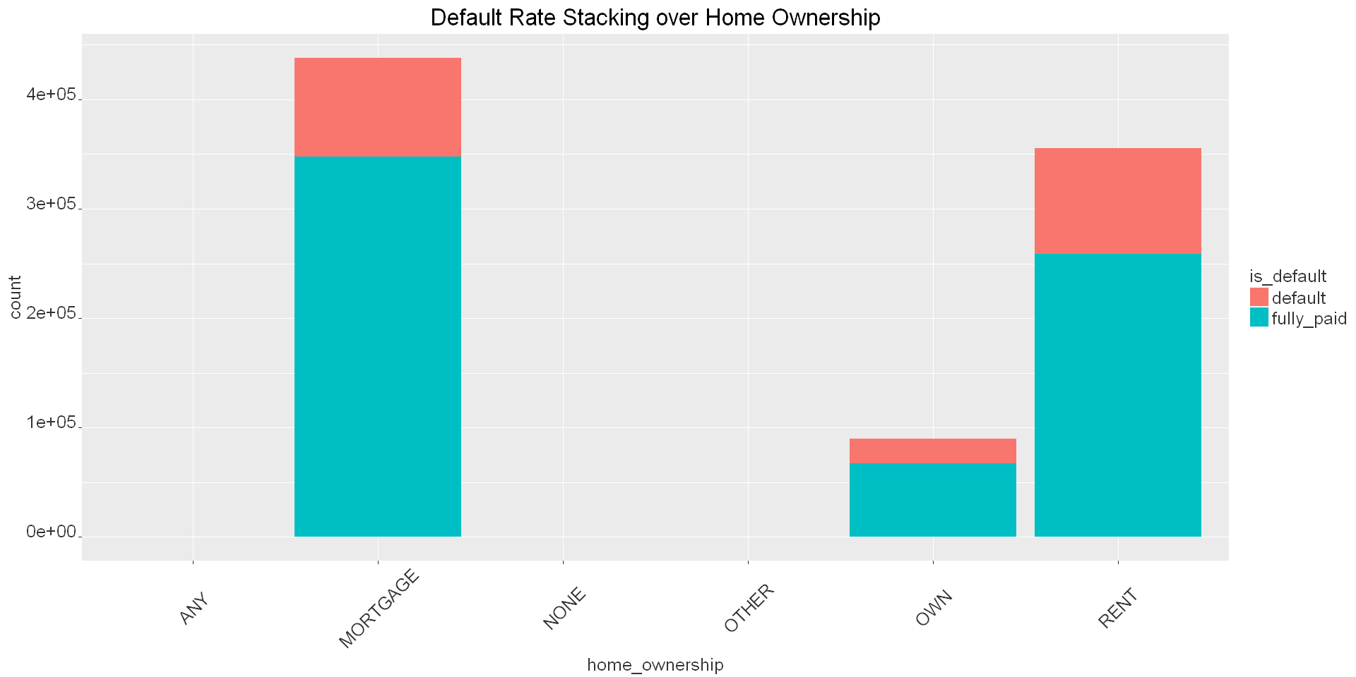
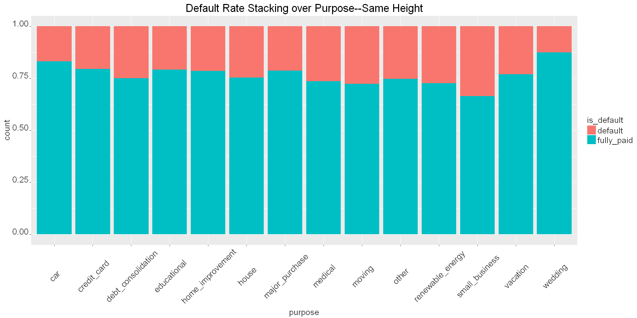
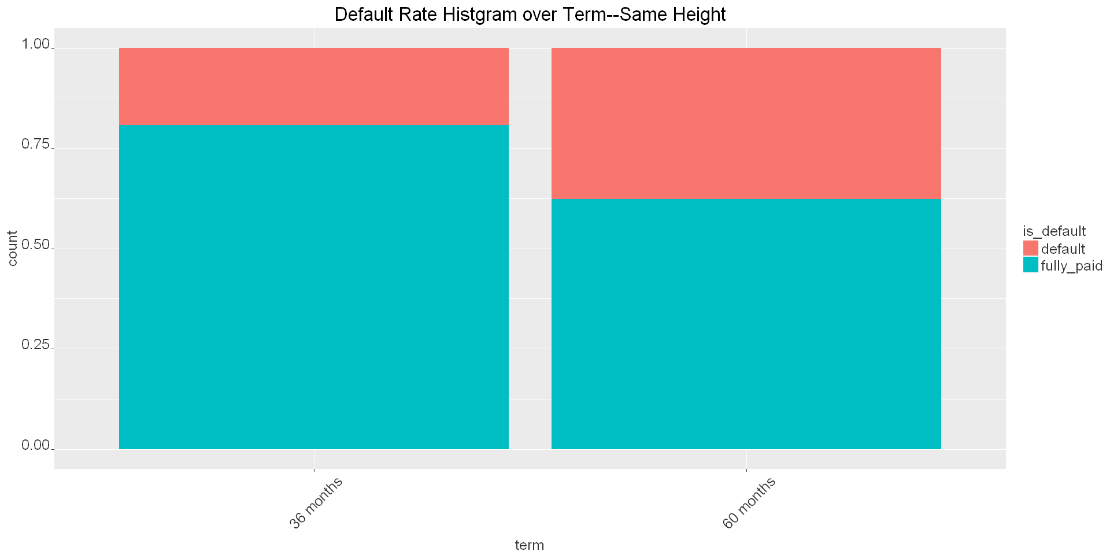
Data Understanding

Slide 6
Feature Engineering
1. Missing Value: Delete columns with too mang missing value and impute other missing value with median
2. Collapsing: addr_state, emp_length, Purpose, scale numeric data into range 0 to 1
Target: 'fully_paid’
Predictor:
Loan Payment: 'int_rate','grade’, 'term', 'purpose_1', 'installment’,
Borrower Features: 'home_ownership_1','emp_length_1', 'dti', 'last_fico_range_low', 'addr_state_1’
Borrowers’ credit history: 'revol_bal','revol_util','pct_tl_nvr_dlq','annual_inc','delinq_2yrs','delinq_amnt','acc_now_delinq','chargeoff_within_12_mths','collections_12_mths_ex_med','mths_since_recent_inq’,'mo_sin_old_rev_tl_op','inq_last_6mths’

Slide 7
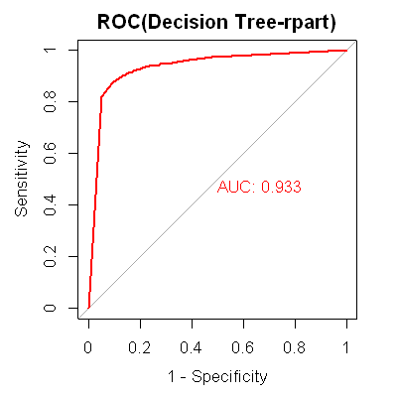
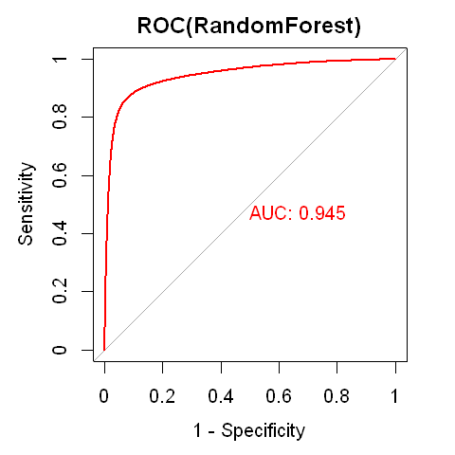
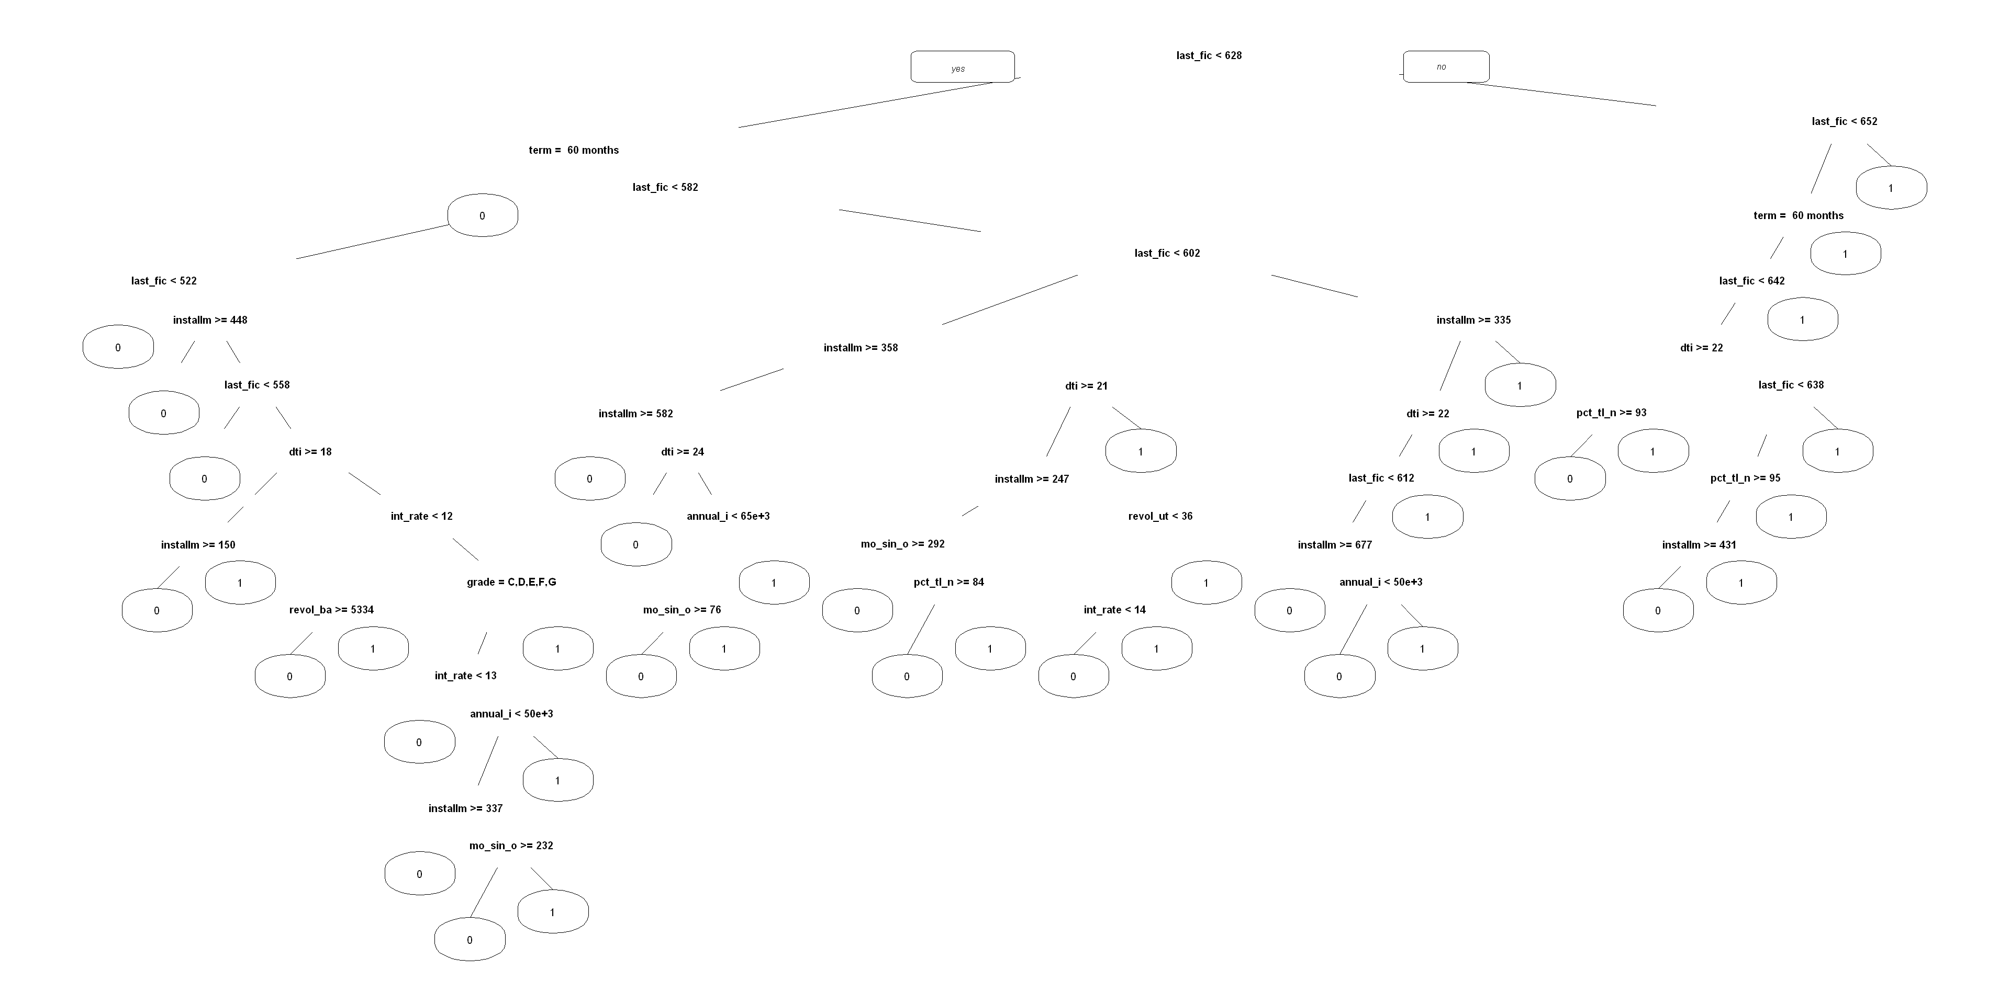
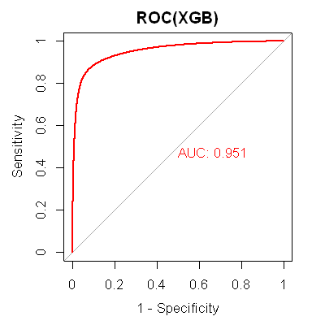
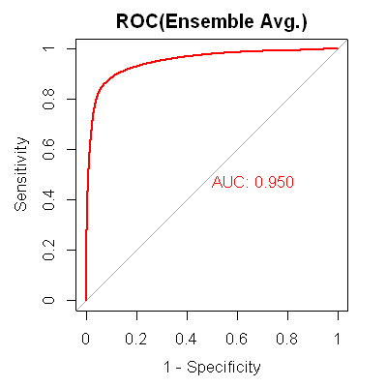
Machine Learning Modeling
Glmnet logistic regression with regularization
Decision Tree
Random Forest-Tune parameter using Grid Search(Downsampling)
XGBoost

Slide 8
Wrap Up
Provide investment insights to investor and other stackholders
Need more payment features to uncover hidden information. Tried to put payment features, but failed
Test the model on small amount data and then implement the model to large amount data
Balance the time between data exploration and data modeling.
Cannot put text variable such as description into the model due to too much missing value.

