Slide 1

NVSleep: Using Non-Volatile Memory to Enable Fast Sleep/Wakeup of Idle Cores
Xiang Pan and Radu Teodorescu Computer Architecture Research Lab
http://arch.cse.ohio-state.edu

Slide 2
Outline
Motivation
NVSleep Framework Design
NVSleep Implementation
Evaluation
Conclusion
NVSleep: Using Non-Volatile Memory to Enable Fast Sleep/Wakeup of Idle Cores
Xiang Pan and Radu Teodorescu

Slide 3
Motivation
Idle/leakage power: source of inefficiency in CMPs
Expected to increase in future technologies
Cores are often idle, wasting power
Power gating can help
Functional units with little or no states (ALUs) – power gating OK
Most FUs have significant states (RF, ROB, …) – power gating expensive
NVSleep Idea: non-volatile memory can enable fast micro-checkpointing
Reduce the performance overhead of power gating
Enable power gating during short idle intervals (e.g. stalls on LLC misses)
Shimpi et al., The Haswell Review: Intel Core i7-4770K & i5-4670K Tested, www.anandtech.com
NVSleep: Using Non-Volatile Memory to Enable Fast Sleep/Wakeup of Idle Cores
Xiang Pan and Radu Teodorescu

Slide 4
STT-RAM in NVSleep
We use Spin Transfer Torque RAM, a new type of magnetic memory
STT-RAM can be a good candidate for NVSleep checkpointing
STT-RAM has other good characteristics:
~4X higher density than SRAM, better scalability
Infinite write endurance
NVSleep checkpointing
STT-RAM
Non-volatility
✓
Long data retention time (as long as 10 years)
Low latency access
✓
Fast read (~0.9X SRAM)
and slow write (~ 20X SRAM)
Low energy
✓
Low energy read (~0.7X SRAM)
and high energy write
(~20X SRAM)
NVSleep: Using Non-Volatile Memory to Enable Fast Sleep/Wakeup of Idle Cores
Xiang Pan and Radu Teodorescu

Slide 5
Outline
Motivation
NVSleep Framework Design
NVSleep Implementation
Evaluation
Conclusion
NVSleep: Using Non-Volatile Memory to Enable Fast Sleep/Wakeup of Idle Cores
Xiang Pan and Radu Teodorescu

Slide 6
NVSleep Framework
NVSleep leverages STT-RAM for on-chip storage structures
Write latency-tolerant units (caches, TLBs, etc.) are implemented with STT-RAM (combined with SRAM write buffers to help hide long latency writes)
Write latency-sensitive units (RF, ROB, etc.) are implemented with hybrid SRAM/STT-RAM design
STT-RAM
Core
SRAM
Caches, TLBs, etc.
SHTDWN
Execution Cluster
CMOS
WAKEUP
RF, ROB, etc.
NVSleep: Using Non-Volatile Memory to Enable Fast Sleep/Wakeup of Idle Cores
Xiang Pan and Radu Teodorescu

Slide 7
SRAM/STT-RAM hybrid Design
SRAM Master
STT-RAM Shadow
bank 0
SRAM for primary storage
STT-RAM shadow of identical size used for micro-checkpointing
Banked design to parallelize checkpointing process
bank 1
bank 2
bank 3
checkpoint control
NVSleep: Using Non-Volatile Memory to Enable Fast Sleep/Wakeup of Idle Cores
Xiang Pan and Radu Teodorescu

Slide 8
Outline
Motivation
NVSleep Framework Design
NVSleep Implementation
Evaluation
Conclusion
NVSleep: Using Non-Volatile Memory to Enable Fast Sleep/Wakeup of Idle Cores
Xiang Pan and Radu Teodorescu

Slide 9
NVSleep Implementation
NVSleepMiss: Hardware-driven
Ideal for short idle events, detected by hardware
Our implementation: cores sleep on LLC misses
NVSleepBarrier: Software API
Exposes NVSleep to the system software
Can be used by the OS or applications to “suspend” cores quickly
Ideal for software observable idle events such as blocking on synchronization (e.g. barriers, locks, etc.)
Our implementation: cores sleep when blocked on barriers
NVSleep: Using Non-Volatile Memory to Enable Fast Sleep/Wakeup of Idle Cores
Xiang Pan and Radu Teodorescu

Slide 10
NVSleepMiss: Hardware-driven
Checkpointing and wakeup of cores are coordinated by the L1 cache controller of each core
Hardware-driven checkpointing/wakeup sequence:
1
LD(0x00FF)
2
LLCMiss(0x00FF)
LD issued, missed in L1
LLC miss reported by LLC
Sleep signal sent to Core 0
Checkpointing starts
Core 0 goes to sleep after stalls
Missing data returns
Wakeup signal sent to Core 0
Core 0
L1
L2
Cache
4
CKP
MSHR
0x00FF
5
Sleep
CTRL
3
SHTDWN
6
Data(0x00FF)
7
WAKEUP
…
…
Core N
L1
CTRL
NVSleep: Using Non-Volatile Memory to Enable Fast Sleep/Wakeup of Idle Cores
Xiang Pan and Radu Teodorescu

Slide 11
NVSleepBarrier: Software API
Expose micro-checkpointing system to software through API
Dedicated sleep(0xADDR) instruction
When executed on a core – it will shut down
Wakeup triggered by another core through write operation to 0xADDR
Example application in barrier:
All but last thread – sleep(&sense)
Last thread writes to sense, wakes-up all other threads
void barrier(int count, int sense, int num_threads)
{
int local_sense;
local_sense = !sense;
if (count != (num_threads - 1)) {
while (local_sense != sense) {
sleep(&sense);
}
}
else {
count = 0;
sense = local_sense;
}
}
NVSleep: Using Non-Volatile Memory to Enable Fast Sleep/Wakeup of Idle Cores
Xiang Pan and Radu Teodorescu

Slide 12
NVSleepBarrier: Software API
Software-driven checkpointing/wakeup sequence:
1
sleep(&sense)
Core 0
L1
L2
Cache
2
&sense
r
sleep(&sense) executed by Core 0
“&sense” reserved in Core 0 L1
write(&sense) executed by Core N
Coherence: invalidate(&sense)
Wakeup signal sent to all cores
CTRL
5
WAKEUP
Core 1
L1
&sense
r
CTRL
…
…
4
INV(&sense)
3
ST(&sense)
Core N
L1
&sense
w
CTRL
NVSleep: Using Non-Volatile Memory to Enable Fast Sleep/Wakeup of Idle Cores
Xiang Pan and Radu Teodorescu

Slide 13
Outline
Motivation
NVSleep Framework Design
NVSleep Implementation
Evaluation
Conclusion
NVSleep: Using Non-Volatile Memory to Enable Fast Sleep/Wakeup of Idle Cores
Xiang Pan and Radu Teodorescu

Slide 14
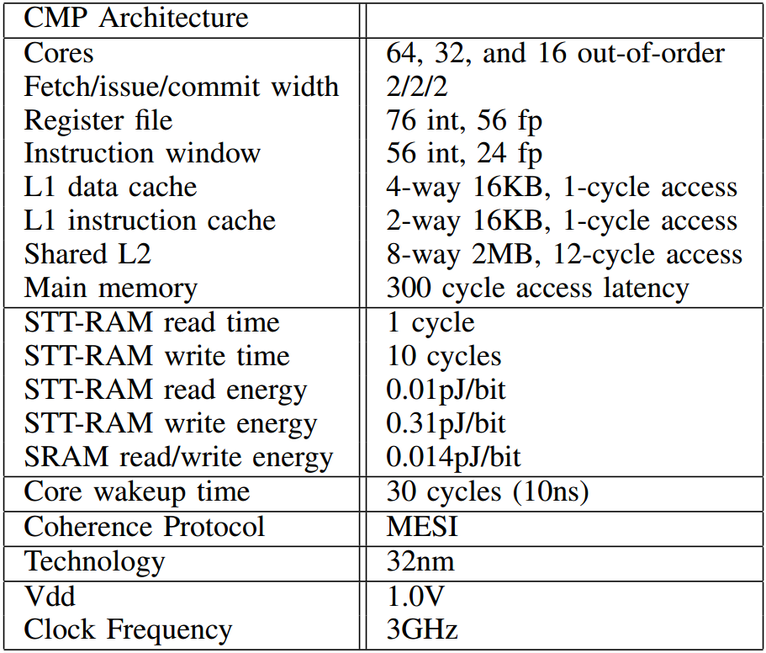
Methodology
Simulation Framework:
SESC for architecture simulation
CACTI, McPAT, and NVSim for power, energy, and area simulation
Benchmarks:
Single-threaded: SPEC CPU2000
Multi-threaded: SPLASH2 and PARSEC
Main Evaluated Configuration:
CMP with 64 out of order cores
8-bank design SRAM/STT-RAM hybrid structures
3.3ns STT-RAM write latency for checkpointing
NVSleep: Using Non-Volatile Memory to Enable Fast Sleep/Wakeup of Idle Cores
Xiang Pan and Radu Teodorescu

Slide 15
NVSleepMiss Energy Reduction
NVSleepMiss: 23% (SPECFP) and 17% (SPECINT) energy reduction
10%
23%
30%
NVSleep: Using Non-Volatile Memory to Enable Fast Sleep/Wakeup of Idle Cores
Xiang Pan and Radu Teodorescu

Slide 16
NVSleepBarrier Energy Reduction
NVSleepBarrier: 34% energy reduction for apps with >10 barriers
NVSleep: Using Non-Volatile Memory to Enable Fast Sleep/Wakeup of Idle Cores
Xiang Pan and Radu Teodorescu

Slide 17
Sensitivity Studies
Num of Banks | energy/access (pJ) | area (mm2)
1 | 0.448 | 0.007543
2 | 0.552 | 0.012091
4 | 0.628 | 0.018883
8 | 0.741 | 0.029032
More details can be found in the paper!
NVSleep: Using Non-Volatile Memory to Enable Fast Sleep/Wakeup of Idle Cores
Xiang Pan and Radu Teodorescu

Slide 18
Conclusion
The first work to use non-volatility feature of STT-RAM to implement pipeline-level checkpointing
A general and low overhead framework for reducing energy through exploiting short idle execution phases
Achieved energy reduction of 17-34% with less than 3% performance and area overheads
NVSleep: Using Non-Volatile Memory to Enable Fast Sleep/Wakeup of Idle Cores
Xiang Pan and Radu Teodorescu

Slide 19
Questions?
Thank you!
NVSleep: Using Non-Volatile Memory to Enable Fast Sleep/Wakeup of Idle Cores
Xiang Pan and Radu Teodorescu

Slide 20
Backup Slides
NVSleep: Using Non-Volatile Memory to Enable Fast Sleep/Wakeup of Idle Cores
Xiang Pan and Radu Teodorescu

Slide 21
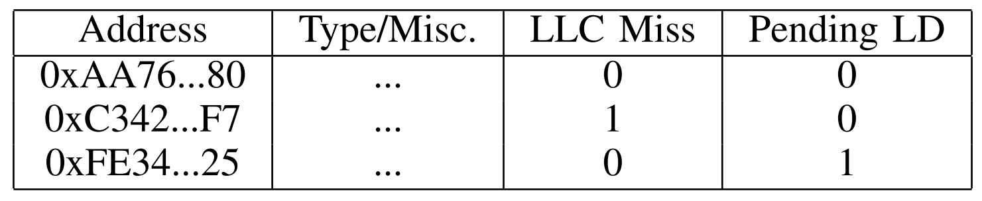
NVSleep MSHR Design
NVSleep: Using Non-Volatile Memory to Enable Fast Sleep/Wakeup of Idle Cores
Xiang Pan and Radu Teodorescu

Slide 22
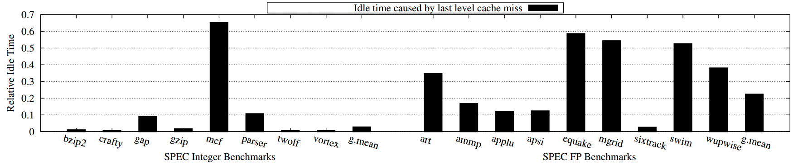
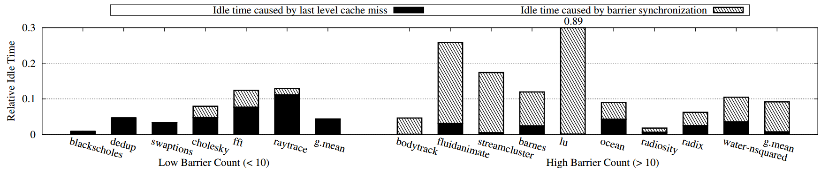
Core Idle Time Analysis
NVSleep: Using Non-Volatile Memory to Enable Fast Sleep/Wakeup of Idle Cores
Xiang Pan and Radu Teodorescu

Slide 23
Performance Overhead
NVSleep: Using Non-Volatile Memory to Enable Fast Sleep/Wakeup of Idle Cores
Xiang Pan and Radu Teodorescu

Slide 24
Area Overhead
Area – less than 3% compared to SRAM baseline
STT-RAM shadow structures increase area
STT-RAM caches help decrease area
NVSleep: Using Non-Volatile Memory to Enable Fast Sleep/Wakeup of Idle Cores
Xiang Pan and Radu Teodorescu

