Slide 1

Quick Update
David E. Bernholdt Oak Ridge National Laboratory
Michael A. Heroux, James M. Willenbring Sandia National Laboratories Better Scientific Software Tutorial
Software Productivity Track ATPESC 2020
See slide 2 for license details

Slide 2
License, Citation and Acknowledgements
License and Citation
This work is licensed under a Creative Commons Attribution 4.0 International License (CC BY 4.0).
The requested citation the overall tutorial is: David E. Bernholdt, Better Scientific Software tutorial, in RF SciDAC 2020 Workshop, Knoxville, Tennessee. DOI: 10.6084/m9.figshare.11918397
Individual modules may be cited as Speaker, Module Title, in Better Scientific Software Tutorial…
Acknowledgements
Additional contributors to this this tutorial include: Anshu Dubey, Mike Heroux, Alicia Klinvex, Jared O’Neal, and Katherine Riley, James M. Willenbring
This work was supported by the U.S. Department of Energy Office of Science, Office of Advanced Scientific Computing Research (ASCR), and by the Exascale Computing Project (17-SC-20-SC), a collaborative effort of the U.S. Department of Energy Office of Science and the National Nuclear Security Administration.
This work was performed in part at the Argonne National Laboratory, which is managed managed by UChicago Argonne, LLC for the U.S. Department of Energy under Contract No. DE-AC02-06CH11357.
This work was performed in part at the Oak Ridge National Laboratory, which is managed by UT-Battelle, LLC for the U.S. Department of Energy under Contract No. DE-AC05-00OR22725.
This work was performed in part at Sandia National Laboratories. Sandia National Laboratories is a multi-mission laboratory managed and operated by National Technology and Engineering Solutions of Sandia, LLC., a wholly owned subsidiary of Honeywell International, Inc., for the U.S. Department of Energy’s National Nuclear Security Administration under contract DE-NA0003525. SAND NO SAND2017-5474 PE

Slide 3
Outline
Refining our Epic
PSIP: Productivity and Sustainability Improvement Planning

Slide 4
More on Epic, Story, Task

Slide 5
Epic, Story, Task Review
Break down and refine when and as needed
Close to when the work will be done
Only for work that will take place
Can be valuable for estimating
There is no “correct” level of granularity
Epics are very high level objectives
Stories should represent an increment of value to the customer
“Definition of Done” – understandable to user
Tasks are the steps necessary to complete a story
May not individually provide value to the customer

Slide 6
Definition of Done
Simplified definition: When all acceptance criteria are met
Acceptance criteria
“Conditions that a software product must satisfy to be accepted by a user, customer or stakeholder.” – Microsoft Press
“Pre-established standards or requirements a product or project must meet.” – Google
Can include functional, non-functional, and performance requirements.

Slide 7
Definition of Done
Important to establish for a story before estimating or beginning a task
Defined by the team, acceptable to customer
Customer language
Should not specify an implementation unnecessarily

Slide 8
Refining Our Epic
Epic: Refactor code for enhanced modularity
Description: The heat equation code needs refactoring to improve modularity. Specifically, there are utilities that could be generalized and used with for other applications. Also, the integration function is currently hard-coded. In the future, we want to use alternative integration functions, so we should generalize the interface for this function.
Story 1: Separate out utilities
Definition of Done
Task list
Story 2: Separate out integration function
Definition of Done
Task list

Slide 9
Refining Our Epic
Story 1: Separate out utilities
Definition of Done
Unit tests pass
Code review completed
Integration/system tests pass
Utility performance is at least 95% of pre-separation performance
Utility usability demonstrated outside of heat equation application
Story 2: Separate out integration function
Task 1: Add testing for integration function to protect functionality during refactor
Needed testing should be specified
Task 2: Generalize interface to allow alternative implementations
Task 3: Expose current integration function through the new interface & run tests

Slide 10
Agile Estimation
Key concept:
It is easier to accurately estimate many small tasks than to estimate a large epic.
Epic: Huge refactor effort
Tasks:
Add tests
Generalize interface
Expose existing interface
Estimating is hard
Requires practice
With practice, it is still hard
Stories are estimated using “story points”
Relative estimate
Many estimating techniques
Should NOT map to hours, days, etc
Definition of done needed, tasking not required
Tasks are estimated in hours
Absolute estimate
Useful for planning schedules

Slide 11
How To Get Better
“Use iteration and incrementation only for projects you want to succeed.”
Adaptation of Martin Fowler quote

Slide 12
Strategy for Incremental Productivity Improvements
Identify, analyze, prototype, test, revise, deploy. Repeat.
Realistic: There is a cost.
Startup: Overhead
Payoff: Best if soon, clear
Working model:
Reserve acceptable time/effort for improvement.
Improve how you do your work on the way to getting it done.
Repeat.
Old Process
New Process
Cost
Start
Progress
Finish

Slide 13
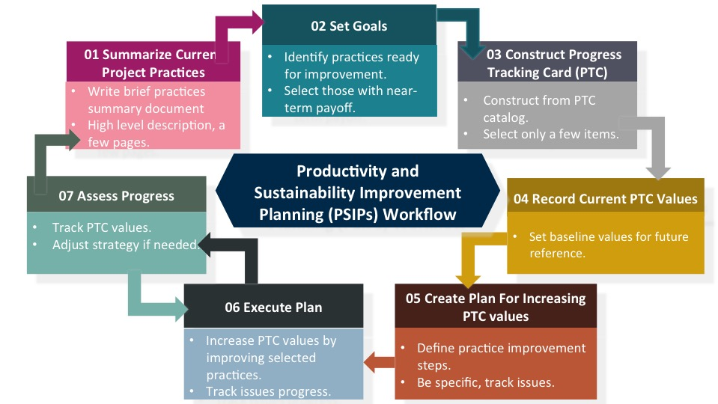
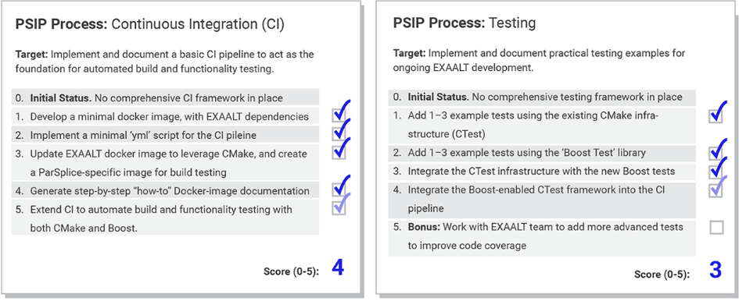
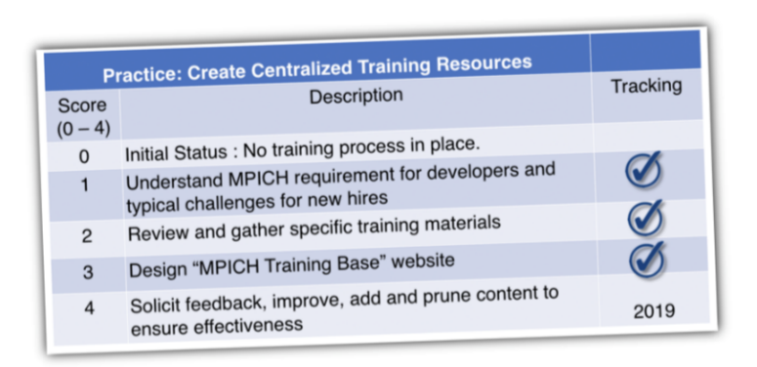
Productivity and Sustainability Improvement Planning (PSIP) Examples: EXAALT & MPICH – Add PSIP URL
PSIP workflow helps a team create user stories, identify areas for improvement, select a specific area and topic for a single improvement cycle, and then develop those improvements with specific metrics for success.
EXAALT PSIP: Continuous integration (CI) testing
BSSw blog article: Adopting Continuous Integration for Long Timescale Materials Simulation, Rick Zamora (Sept 2018)
MPICH PSIP: Onboarding new team members

Slide 14
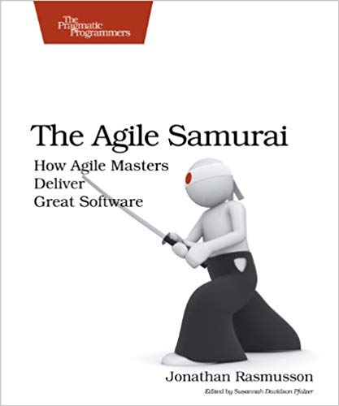
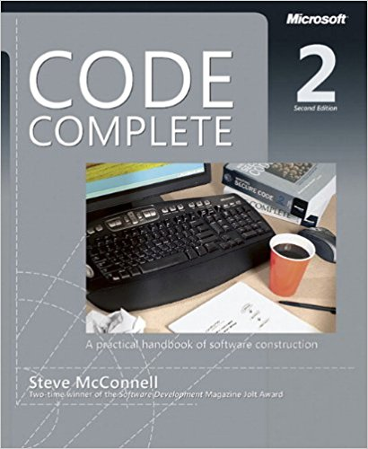
Other Resources
The Agile Samurai: How Agile Masters Deliver Great Software (Pragmatic Programmers), Jonathan Rasmusson.
http://a.co/eUGIe95
Excellent, readable book on Agile methodologies.
Also available on Audible.
Code Complete: A Practical Handbook of Software Construction, Steve McConnell.
http://a.co/eEgWvKj
Great text on software.
Construx website has large collection of content.
More Effective Agile: A Roadmap for Software Leaders, Steve McConnell.
http://a.co/22EPvt6
New: A realistic view of Agile effectiveness with great advice for project leaders.

