Slide 1
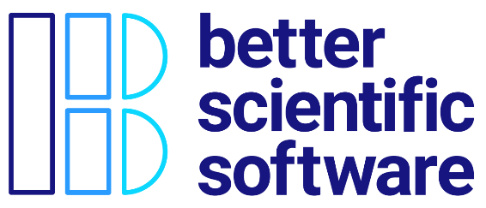
Final Summary
David E. Bernholdt, David Rogers Oak Ridge National Laboratory
Michael A. Heroux Sandia National Laboratories
Better Scientific Software Tutorial RF SciDAC 2020 Workshop
See slide 2 for license details

Slide 2
License, Citation and Acknowledgements
License and Citation
This work is licensed under a Creative Commons Attribution 4.0 International License (CC BY 4.0).
The requested citation the overall tutorial is: David E. Bernholdt, Better Scientific Software tutorial, in RF SciDAC 2020 Workshop, Knoxville, Tennessee. DOI: 10.6084/m9.figshare.11918397
Individual modules may be cited as Speaker, Module Title, in Better Scientific Software Tutorial…
Acknowledgements
Additional contributors to this this tutorial include: Anshu Dubey, Mike Heroux, Alicia Klinvex, Jared O’Neal, and Katherine Riley, James M. Willenbring
This work was supported by the U.S. Department of Energy Office of Science, Office of Advanced Scientific Computing Research (ASCR), and by the Exascale Computing Project (17-SC-20-SC), a collaborative effort of the U.S. Department of Energy Office of Science and the National Nuclear Security Administration.
This work was performed in part at the Argonne National Laboratory, which is managed managed by UChicago Argonne, LLC for the U.S. Department of Energy under Contract No. DE-AC02-06CH11357.
This work was performed in part at the Oak Ridge National Laboratory, which is managed by UT-Battelle, LLC for the U.S. Department of Energy under Contract No. DE-AC05-00OR22725.
This work was performed in part at Sandia National Laboratories. Sandia National Laboratories is a multi-mission laboratory managed and operated by National Technology and Engineering Solutions of Sandia, LLC., a wholly owned subsidiary of Honeywell International, Inc., for the U.S. Department of Energy’s National Nuclear Security Administration under contract DE-NA0003525. SAND NO SAND2017-5474 PE

Slide 3
Research Software Used in Policymaking gets Scrutiny
Mar. 16: Neil Ferguson (Imperial College) briefed UK Parliament on epidemiological modeling of COVID-19 pandemic
Epidemiological models like this helped prompt government action, but have lots of assumptions
April 1: Nicholas Lewis (independent climate science researcher in UK) can’t easily see where some of the assumptions come from – publishes a blog article
April 22: Imperial collaborates with Microsoft to refactor and clean up the code, which is released on GitHub
May 16: Daily Telegraph and Fox News sensationalize the story
“In our commercial reality, we would fire anyone for developing code like this and any business that relied on it to produce software for sale would likely go bust,” David Richards, co-founder of British data technology company WANdisco
May 29: CODECHECK independently reproduces paper reporting Imperial’s results
Documentation and test cases become more critical as the code’s results became more relevant!
https://www.nature.com/articles/d41586-020-01003-6
https://www.nicholaslewis.org/imperial-college-uk-covid-19-numbers-dont-seem-to-add-up/
https://www.foxnews.com/world/imperial-college-britain-coronavirus-lockdown-buggy-mess-unreliable
https://github.com/mrc-ide/covid-sim/issues/116 ‘’There appears to be a bug in either the creation or re-use of the network file’’
https://philbull.wordpress.com/2020/05/10/why-you-can-ignore-reviews-of-scientific-code-by-commercial-software-developers/amp/
http://doi.org/10.5281/zenodo.3865491

Slide 4
Science through computing is, at best, as credible as the software that produces it!

Slide 5
Summary
There are many beneficial software development practices that we don’t have time to cover in this tutorial. That doesn’t mean they’re not useful and important!

