Slide 1
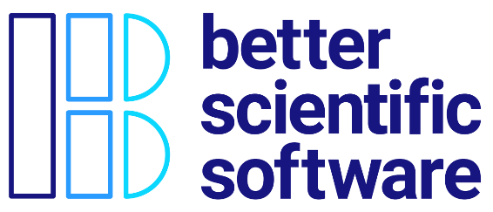
Motivation and Overview of Best Practices in HPC Software Development
David E. Bernholdt Oak Ridge National Laboratory
Anshu Dubey, Katherine M. Riley Argonne National Laboratory
Better Scientific Software Tutorial, SC20, November 2020
See slide 2 for license details

Slide 2
License, Citation and Acknowledgements
License and Citation
This work is licensed under a Creative Commons Attribution 4.0 International License (CC BY 4.0).
The requested citation the overall tutorial is: David E. Bernholdt, Anshu Dubey, Patricia A. Grubel, Rinku K. Gupta, Better Scientific Software tutorial, in SC ‘20: International Conference for High Performance Computing, Networking, Storage and Analysis, online, 2020. DOI: 10.6084/m9.figshare.12994376
Individual modules may be cited as Speaker, Module Title, in Better Scientific Software tutorial…
Acknowledgements
Additional contributors include: Mike Heroux, Alicia Klinvex, Mark Miller, Jared O’Neal, Katherine Riley, David Rogers, Deborah Stevens, James Willenbring
This work was supported by the U.S. Department of Energy Office of Science, Office of Advanced Scientific Computing Research (ASCR), and by the Exascale Computing Project (17-SC-20-SC), a collaborative effort of the U.S. Department of Energy Office of Science and the National Nuclear Security Administration.
This work was performed in part at the Argonne National Laboratory, which is managed by UChicago Argonne, LLC for the U.S. Department of Energy under Contract No. DE-AC02-06CH11357.
This work was performed in part at the Oak Ridge National Laboratory, which is managed by UT-Battelle, LLC for the U.S. Department of Energy under Contract No. DE-AC05-00OR22725.
This work was performed in part at the Lawrence Livermore National Laboratory, which is managed by Lawrence Livermore National Security, LLC for the U.S. Department of Energy under Contract No. DE-AC52-07NA27344.
This work was performed in part at the Los Alamos National Laboratory, which is managed by Triad National Security, LLC for the U.S. Department of Energy under Contract No.89233218CNA000001
This work was performed in part at Sandia National Laboratories. Sandia National Laboratories is a multi-mission laboratory managed and operated by National Technology and Engineering Solutions of Sandia, LLC., a wholly owned subsidiary of Honeywell International, Inc., for the U.S. Department of Energy’s National Nuclear Security Administration under contract DE-NA0003525.

Slide 3
Science through computing is, at best, as credible as the software that produces it!

Slide 4
The Success of Computational Science Creates the Challenges of Computational Science
Better Scientific Understanding
Positive feedback loop
More complex codes, simulations and analysis
More moving parts that need to interoperate
Variety of expertise needed – the only tractable development model is through separation of concerns
It is more difficult to work on the same software in different roles without a software engineering process
Onset of higher platform heterogeneity
Requirements are unfolding, not known a priori
The only safeguard is investing in flexible design and robust software engineering process
More Hardware
Resources
Higher Fidelity
Model
More Diverse
Solvers
Supercomputers change fast
Especially now!
Notes:
Numerical models

Slide 5
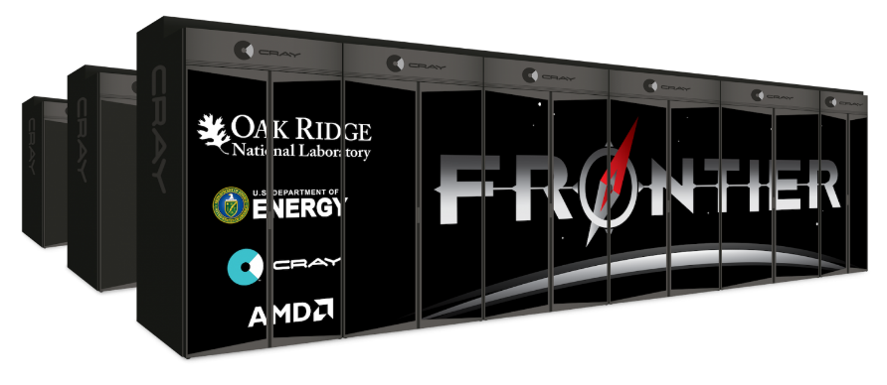
Scientific Facilities Provide Valuable Resources
Major supercomputers often cost O($100M)
All cost millions more to operate, annually
Significant allocations on large supercomputers can be worth millions
Even if you don’t pay the $ you have to spend the time and effort to get the allocation
Sponsors’ concern: Are you being a good steward of the resources?
Your concern: Are you getting the most science possible out of your work (aka scientific productivity)?

Slide 6
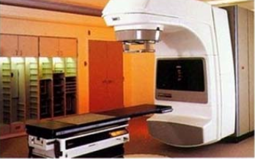
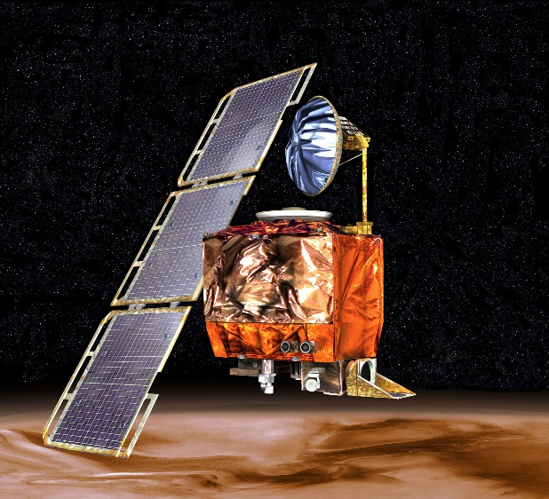
High-Consequence Software-Related Scientific Failures
Therac-25 (1985-1987)
Mars Climate Orbiter (1999)
Computer-controlled radiation therapy system
Poor software design, development and testing practices allowed flaws that let to at least six cases of substantial radiation overdoses, three fatal
Incorrect trajectory adjustment caused loss of the orbiter as it was supposed to enter Martian orbit
Discrepancy in the units used in two different software components
One component didn’t follow specifications
Inadequate testing at the interface
Concerns raised earlier in the mission were ignored because they weren’t properly documented
Just two of many examples

Slide 7
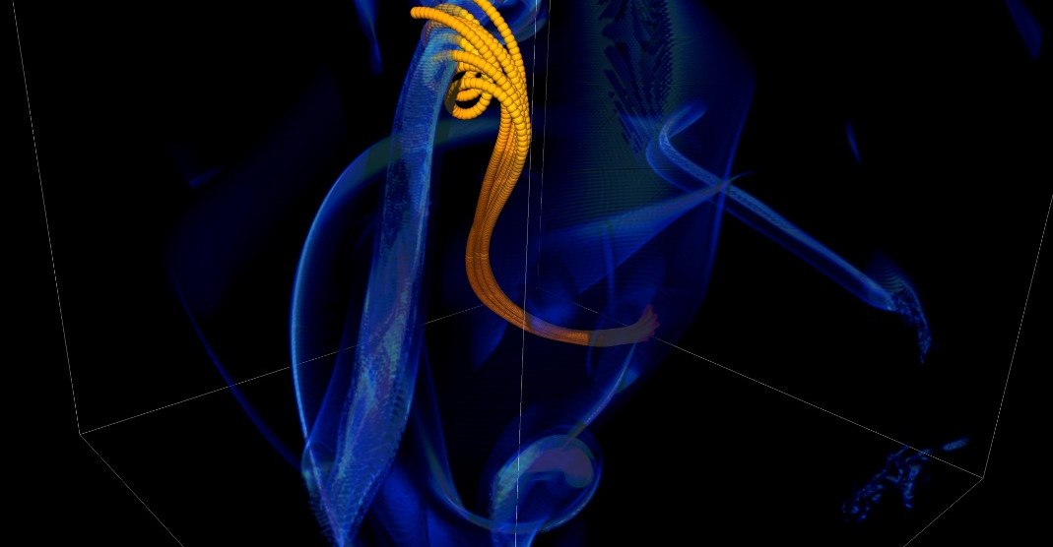
More Subtle Impacts on Scientific Productivity
In 2005, the FLASH astrophysics team was offered a unique opportunity to access one of the biggest machines in the world at that time (BG/L) for a dedicated run
Short notice to prepare
< 1month to get ready for 1.5 week run
Quick and dirty development of particle capability in code
Error in tracking particles resulted in duplicated tags from round-off
Had to develop post-processing tools to correctly identify trajectories
6 months to process results
FLASH had a software process in place. It was tested regularly. This was one instance when the full process could not be applied because of time constraints.
Notes:
2005, BG/L
This was not even a situation like retracting results

Slide 8
Technical Debt
The cost implied cost of additional rework caused by choosing an easy (limited) solution now instead of using a better approach that would take longer.
-- Wikipedia
Like monetary debt, the more you accumulate, the harder it is to pay off
Increases cost of maintenance
Parts of software may become unusable over time
Inadequately verified software produces questionable results
Increases ramp-up time for new developers
Overall, reduces software and science productivity

Slide 9
Challenges Developing Scientific Applications Today
Technical
Sociological
All parts of the model and software system can be under research
Requirements change throughout the lifecycle as knowledge grows
Verification complicated by floating point representation
Real world is messy, so is the software
Increasing architectural diversity
Competing priorities and incentives
Sponsors often care more about scientific publications than software per se
Limited resources
Need for interdisciplinary interactions
Many different kinds of expertise to be successful

Slide 10
Good scientific process requires good software practices
Good software practices increase software sustainability
Good software practices increase scientific productivity
Software sustainability
increases scientific productivity

Slide 11
Best Practices for Scientific Software Development
Baseline
Desirable
Invest in extensible code design
Use version control and automated testing
Institute a rigorous verification and validation regime
Define and enforce coding and testing standards
Clear and well-defined policies for
Auditing and maintenance
Distribution and contribution
Documentation
Provenance and reproducibility
Lifecycle management
Open development and frequent releases
This tutorial will focus primarily on scientific software as distinct from more generic software engineering best practices

Slide 12
Continual, Incremental Software Process Improvement
Target: your project should include “just enough” software engineering so that you can meet your short-term and longer-term scientific goals effectively
Identify your team’s “pain points” in your software development processes
Set a goal for something to improve
Target processes and behaviors, not just tasks
Pick something that you can address in a few months that will give you a noticeable benefit
Agree on a plan to address it, identify markers of progress and what is “done”
Write them down
Work your plan, track your progress
When you are done, celebrate…
…then pick a new pain point to address
Old Process
New Process
Cost
Start
Progress
Finish
The new process costs something to implement, but it pays off over time
Productivity and Sustainability Improvement Planning
https://bssw.io/psip

Slide 13
Agenda
Time (Eastern US) | Module | Topic | Speaker | Time (UTC)
2:30pm-2:35pm | 00 | Introduction | David E. Bernholdt, ORNL | 19:30-19:35
2:35pm-2:45pm | 01 | Motivation and Overview of Best Practices in HPC Software Development | David E. Bernholdt, ORNL | 19:35-19:45
2:45pm-3:15pm | 02 | Agile Methodologies | Rinku Gupta, ANL | 19:45-20:15
3:15pm-3:30pm | 03 | Git Workflows | Patricia Grubel, LANL | 20:15-20:30
3:30pm-4:00pm | 04 | Software Design | Anshu Dubey, ANL | 20:30-21:00
4:00pm-4:15pm | 05 | Software Testing 1 | Rinku Gupta, ANL | 21:00-21:15
4:15pm-4:35pm |  | Break (live Q&A and demo of Kanban hands-on activities) | David E. Bernholdt and All | 21:15-21:35
4:35pm-4:50pm | 06 | Software Testing 2 | Anshu Dubey, ANL | 21:35-21:50
4:50pm-5:35pm | 07 | Refactoring | Anshu Dubey, ANL | 21:50-22:35
5:35pm-5:50pm | 08 | Continuous Integration | David E. Bernholdt, ORNL | 22:35-22:50
5:50pm-6:05pm | 09 | Reproducibility | Patricia Grubel, LANL | 22:50-23:05
6:05pm-6:10pm | 10 | Summary | David E. Bernholdt, ORNL | 23:05-23:10
6:10pm-6:30pm |  | Live Q&A and demo of CI hands-on activities | David E. Bernholdt and All | 23:10-23:30
Please evaluate us: https://submissions.supercomputing.org/?page=Submit&id=TutorialEvaluation&site=sc20

