Slide 1

Software Testing 2 Example for Building a Test-Suite
Anshu Dubey Argonne National Laboratory
Better Scientific Software Tutorial, SC20, November 2020
See slide 2 for license details

Slide 2
License, Citation and Acknowledgements
License and Citation
This work is licensed under a Creative Commons Attribution 4.0 International License (CC BY 4.0).
The requested citation the overall tutorial is: David E. Bernholdt, Anshu Dubey, Patricia A. Grubel, Rinku K. Gupta, Better Scientific Software tutorial, in SC ‘20: International Conference for High Performance Computing, Networking, Storage and Analysis, online, 2020. DOI: 10.6084/m9.figshare.12994376
Individual modules may be cited as Speaker, Module Title, in Better Scientific Software tutorial…
Acknowledgements
Additional contributors include: Mike Heroux, Alicia Klinvex, Mark Miller, Jared O’Neal, Katherine Riley, David Rogers, Deborah Stevens, James Willenbring
This work was supported by the U.S. Department of Energy Office of Science, Office of Advanced Scientific Computing Research (ASCR), and by the Exascale Computing Project (17-SC-20-SC), a collaborative effort of the U.S. Department of Energy Office of Science and the National Nuclear Security Administration.
This work was performed in part at the Argonne National Laboratory, which is managed by UChicago Argonne, LLC for the U.S. Department of Energy under Contract No. DE-AC02-06CH11357.
This work was performed in part at the Oak Ridge National Laboratory, which is managed by UT-Battelle, LLC for the U.S. Department of Energy under Contract No. DE-AC05-00OR22725.
This work was performed in part at the Lawrence Livermore National Laboratory, which is managed by Lawrence Livermore National Security, LLC for the U.S. Department of Energy under Contract No. DE-AC52-07NA27344.
This work was performed in part at the Los Alamos National Laboratory, which is managed by Triad National Security, LLC for the U.S. Department of Energy under Contract No.89233218CNA000001
This work was performed in part at Sandia National Laboratories. Sandia National Laboratories is a multi-mission laboratory managed and operated by National Technology and Engineering Solutions of Sandia, LLC., a wholly owned subsidiary of Honeywell International, Inc., for the U.S. Department of Energy’s National Nuclear Security Administration under contract DE-NA0003525.

Slide 3
How do you build a scaffolding of tests ?
Real dependency
Mocked up
dependency
Approach the problem sideways
Components can be exercised against known simpler applications
Same applies to combination of components
Build a scaffolding of verification tests to gain confidence
Unit test
Unit test
Unit test

Slide 4
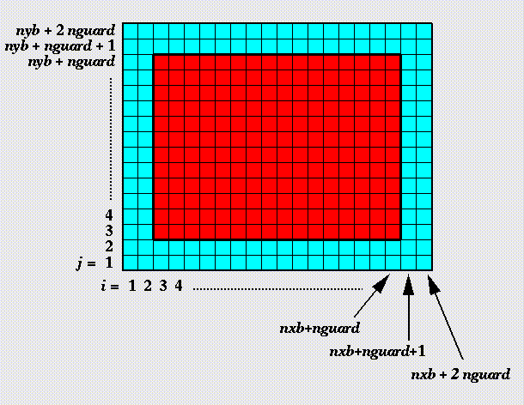
Scaffolding Example from FLASH
Unit test for Grid halo cell fill
Verification of guard/ghost/halo cell fill
Use two variables A & B
Initialize A in all cells and B only in the interior cells (red)
Apply guard cell fill to B
gc test
Eos test
Similarly, it is possible to build Eos Test

Slide 5
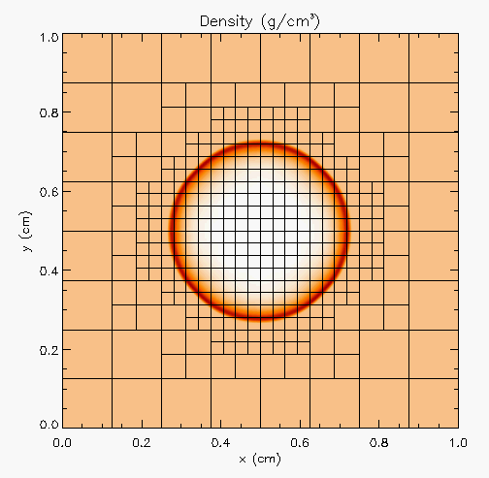
Scaffolding Example from FLASH
Hydro test
Unit test for Hydrodynamics
Sedov blast wave
High pressure at the center
Shock moves out spherically
FLASH with AMR and hydro
Known analytical solution
gc test
Eos test
Though it exercises mesh, hydro and eos, if mesh and eos are verified first, then this test verifies hydro
More testing needed for Grid using AMR
Flux correction and regridding

Slide 6
Scaffolding Example from FLASH
For AMR, correct behavior of flux conservation and regridding should also be verified.
Reason about correctness for testing Flux correction and regridding
IF Guardcell fill and EOS unit tests passed
Run Hydro without AMR
If failed fault is in Hydro
Run Hydro with AMR, but no dynamic refinement
If failed fault is in flux correction
Run Hydro with AMR and dynamic refinement
If failed fault is in regridding

Slide 7
Test Selection
First line of defense – code coverage tools
Code coverage tools necessary but not sufficient
Do not give any information about interoperability
Build a functionality matrix
Mark <i,j> if test covers corresponding features, and is a valid combination
Follow the order
All unit tests – including full module tests
Tests sensitive to perturbations
Most stringent tests for solvers
Least complex test to cover remaining spots

Slide 8
Takeaways
Testing at various granularities helps build confidence
Devise tests to enable quick pinpointing of errors through reasoning about their behavior
Same applies to ensuring coverage
Make sure that your tests fail when they should
…….Questions ?

