Slide 1

Summary
David E. Bernholdt, David Rogers Oak Ridge National Laboratory
Better Scientific Software Tutorial, SC20, November 2020
See slide 2 for license details

Slide 2
License, Citation and Acknowledgements
License and Citation
This work is licensed under a Creative Commons Attribution 4.0 International License (CC BY 4.0).
The requested citation the overall tutorial is: David E. Bernholdt, Anshu Dubey, Patricia A. Grubel, Rinku K. Gupta, Better Scientific Software tutorial, in SC ‘20: International Conference for High Performance Computing, Networking, Storage and Analysis, online, 2020. DOI: 10.6084/m9.figshare.12994376
Individual modules may be cited as Speaker, Module Title, in Better Scientific Software tutorial…
Acknowledgements
Additional contributors include: Mike Heroux, Alicia Klinvex, Mark Miller, Jared O’Neal, Katherine Riley, David Rogers, Deborah Stevens, James Willenbring
This work was supported by the U.S. Department of Energy Office of Science, Office of Advanced Scientific Computing Research (ASCR), and by the Exascale Computing Project (17-SC-20-SC), a collaborative effort of the U.S. Department of Energy Office of Science and the National Nuclear Security Administration.
This work was performed in part at the Argonne National Laboratory, which is managed by UChicago Argonne, LLC for the U.S. Department of Energy under Contract No. DE-AC02-06CH11357.
This work was performed in part at the Oak Ridge National Laboratory, which is managed by UT-Battelle, LLC for the U.S. Department of Energy under Contract No. DE-AC05-00OR22725.
This work was performed in part at the Lawrence Livermore National Laboratory, which is managed by Lawrence Livermore National Security, LLC for the U.S. Department of Energy under Contract No. DE-AC52-07NA27344.
This work was performed in part at the Los Alamos National Laboratory, which is managed by Triad National Security, LLC for the U.S. Department of Energy under Contract No.89233218CNA000001
This work was performed in part at Sandia National Laboratories. Sandia National Laboratories is a multi-mission laboratory managed and operated by National Technology and Engineering Solutions of Sandia, LLC., a wholly owned subsidiary of Honeywell International, Inc., for the U.S. Department of Energy’s National Nuclear Security Administration under contract DE-NA0003525.

Slide 3
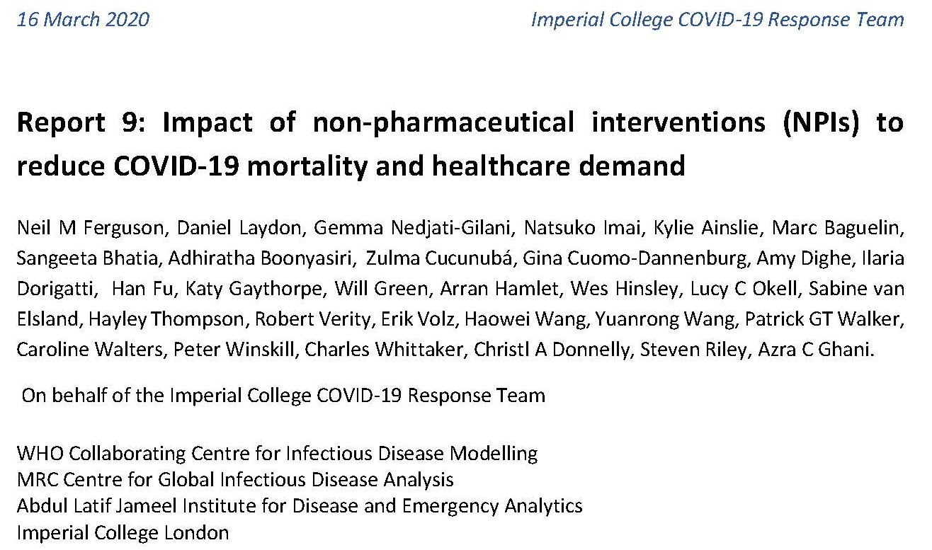
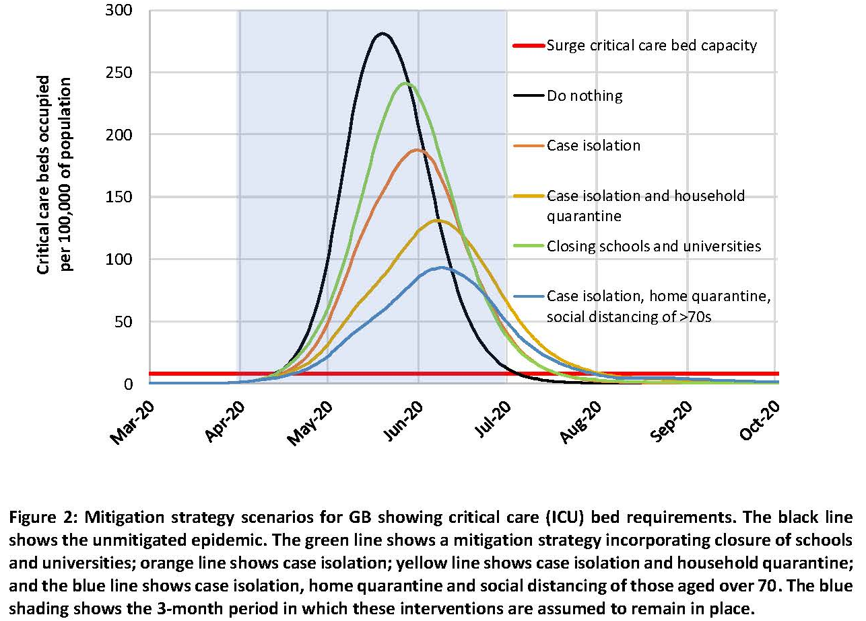
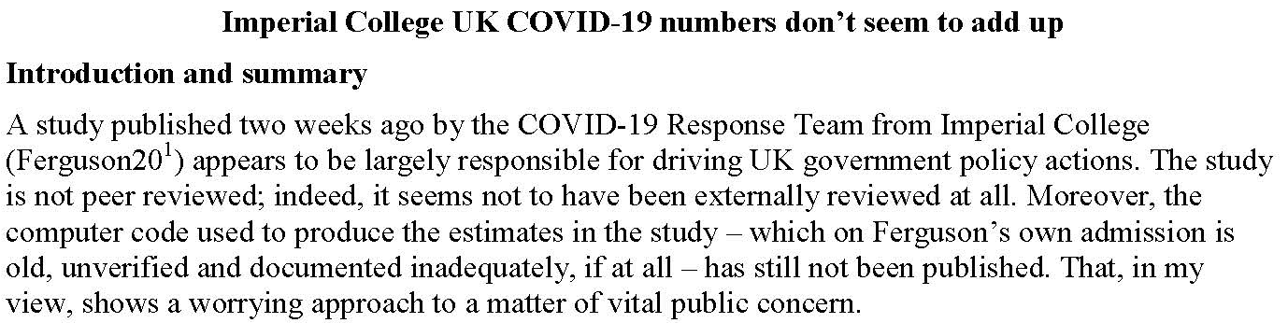
Software Under the Microscope
Mar. 16: Neil Ferguson (Imperial College) briefed UK Parliament on epidemiological modeling of COVID-19 pandemic
Epidemiological models like this helped prompt government action, but have lots of assumptions
April 1: Nicholas Lewis (independent climate science researcher in UK) can’t easily see where some of the assumptions come from – publishes a blog article
“Moreover, the computer code… is old, unverified, and documented inadequately, if at all…”
https://doi.org/10.25561/77482
https://www.nicholaslewis.org/imperial-college-uk-covid-19-numbers-dont-seem-to-add-up/
https://www.nature.com/articles/d41586-020-01003-6

Slide 4
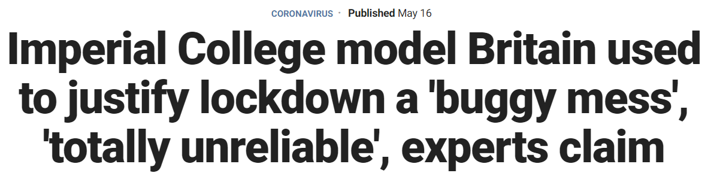
The Press Picks Up the Story
Headline and quotes from the Fox News article
“In our commercial reality, we would fire anyone for developing code like this and any business that relied on it to produce software for sale would likely go bust,” David Richards, co-founder of British data technology company WANdisco, told the Daily Telegraph.
Scientists from the University of Edinburgh have further claimed that it is impossible to reproduce the same results from the same data using the model. The team got different results when they used different machines, and even different results from the same machines.
“There appears to be a bug in either the creation or re-use of the network file. If we attempt two completely identical runs, only varying in that the second should use the network file produced by the first, the results are quite different,” the Edinburgh researchers wrote on the Github file.
A fix was provided, but it was the first of many bugs found within the program.
“Models must be capable of passing the basic scientific test of producing the same results given the same initial set of parameters…otherwise, there is simply no way of knowing whether they will be reliable,” said Michael Bonsall, Professor of Mathematical Biology at Oxford University.
https://www.foxnews.com/world/imperial-college-britain-coronavirus-lockdown-buggy-mess-unreliable
https://www.telegraph.co.uk/technology/2020/05/16/coding-led-lockdown-totally-unreliable-buggy-mess-say-experts/

Slide 5
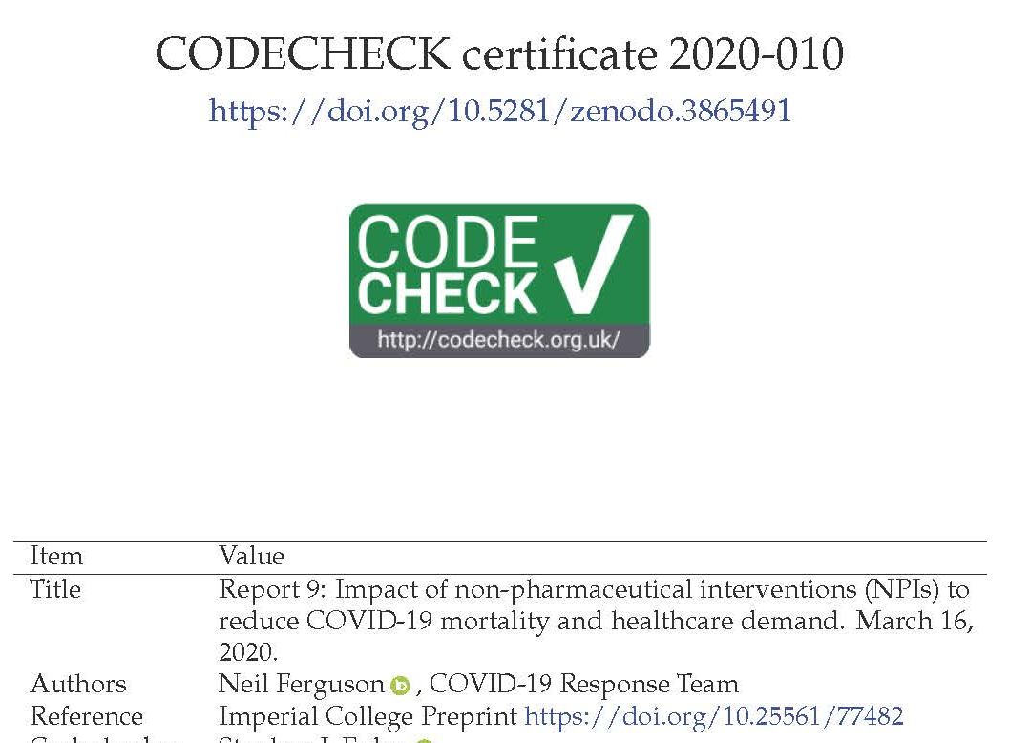
What you May Not Have Heard
tl;dr: Many scientists write code that is crappy stylistically, but which is nevertheless scientifically correct (following rigorous checking/validation of outputs etc). Professional commercial software developers are well-qualified to review code style, but most don’t have a clue about checking scientific validity or what counts as good scientific practice. Criticisms of the Imperial Covid-Sim model from some of the latter are overstated at best.
April 22: Imperial collaborates with Microsoft to refactor and clean up the code, which is released on GitHub
May 10: Phil Bull rebuts criticisms of the Imperial code
Which spurs further discussions within some groups focused on scientific software
May 29: CODECHECK independently reproduces results of Imperial’s Report 9
https://github.com/mrc-ide/covid-sim/
https://philbull.wordpress.com/2020/05/10/why-you-can-ignore-reviews-of-scientific-code-by-commercial-software-developers/amp/
http://doi.org/10.5281/zenodo.3865491

Slide 6
Some Observations
Your code is likely to live longer than you expect, and may be used in ways you don’t expect by people you don’t know – plan for it!
Increasingly, consequential decisions are made based on computational results
The codes generating those results may (justifiably) be subject to greater scrutiny
The scientific credibility of software is strongly connected to good software engineering practices
Documentation
Testing, verification, and (where possible) validation
Code readability and quality metrics
Question: Should we excuse scientific software for being “crappy stylistically”?
Hint: crappy code can hide bugs

Slide 7
Science through computing is, at best, as credible as the software that produces it!

Slide 8
Today, We Covered Many Topics…
Project management
Collaboration around software development
Designing software for flexibility and extensibility
Testing strategies for complex software systems
Systematic refactoring of large, complex software systems
Continuous integration testing
Reproducibility

Slide 9
And there are Many More We Didn’t Have Time For
Documentation
Licensing
Packaging and distribution
Issue tracking
Configuration and build
Debugging strategies
Building and sustaining communities around software
Software publication and citation
Requirements gathering
Understanding and debugging floating-point math
Performance and performance portability
…
Also important topics, but…
Less distinction between research software and other software
More informational resources available
Next-level concerns for starting researchers
There’s only so much time in the day!

Slide 10
But you’re a researcher. You can’t afford to spend “all” of your time on software engineering.

Slide 11

A Final Recommendation: Continual, Incremental Software Process Improvement
Target: your project should include “just enough” software engineering so that you can meet your short-term and longer-term scientific goals effectively
Identify your team’s “pain points” in your software development processes
Set a goal for something to improve
Target processes and behaviors, not just tasks
Pick something that you can address in a few months that will give you a noticeable benefit
Agree on a plan to address it, identify markers of progress and what is “done”
Write them down
Work your plan, track your progress
When you are done, celebrate…
…then pick a new pain point to address
Old Process
New Process
Cost
Start
Progress
Finish
The new process costs something to implement, but it pays off over time
Productivity and Sustainability Improvement Planning
https://bssw.io/psip
A goal of BSSw.io is to provide resources for improving your software processes. If you find useful resources that aren’t on BSSw.io, consider contributing. Its easy and quick.

Slide 12

Thanks, and Keep in Touch!
Please complete an evaluation of this tutorial
https://submissions.supercomputing.org/?page=Submit&id=TutorialEvaluation&site=sc20
Email comments and questions to bssw-tutorial@lists.mcs.anl.gov
We’ll provide feedback on pull requests in the hands-on repository
Follow us:
IDEAS Productivity project
Website: https://ideas-productivity.org/
Announcement list: http://eepurl.com/cQCyJ5
Better Scientific Software
Resources: https://bssw.io/
Monthly digest: https://bssw.io/pages/receive-our-email-digest
RSS feed: https://bssw.io/items.rss

