Slide 1

Scientific Software Design
Anshu Dubey Argonne National Laboratory
ATPESC 2020
See slide 2 for license details

Slide 2
License, Citation and Acknowledgements
License and Citation
This work is licensed under a Creative Commons Attribution 4.0 International License (CC BY 4.0).
The requested citation the overall tutorial
Individual modules may be cited as Speaker, Module Title, in ATPESC…
Acknowledgements
Additional contributors to this this track include: Anshu Dubey, David Bernholdt, Mike Heroux, Jared O’Neal, and Katherine Riley, James M. Willenbring
This work was supported by the U.S. Department of Energy Office of Science, Office of Advanced Scientific Computing Research (ASCR), and by the Exascale Computing Project (17-SC-20-SC), a collaborative effort of the U.S. Department of Energy Office of Science and the National Nuclear Security Administration.
This work was performed in part at the Argonne National Laboratory, which is managed managed by UChicago Argonne, LLC for the U.S. Department of Energy under Contract No. DE-AC02-06CH11357.
This work was performed in part at the Oak Ridge National Laboratory, which is managed by UT-Battelle, LLC for the U.S. Department of Energy under Contract No. DE-AC05-00OR22725.
This work was performed in part at Sandia National Laboratories. Sandia National Laboratories is a multi-mission laboratory managed and operated by National Technology and Engineering Solutions of Sandia, LLC., a wholly owned subsidiary of Honeywell International, Inc., for the U.S. Department of Energy’s National Nuclear Security Administration under contract DE-NA0003525. SAND NO SAND2017-5474 PE

Slide 3
Architecting scientific codes
Desirable Characteristics and Why They are Challenging
Extensibility
Performance
Well defined structure and modules
Encapsulation of functionalities
Spatial and temporal locality of data
Minimizing data movement
Maximizing scalability

Slide 4
Architecting scientific codes
Desirable Characteristics and Why They are Challenging
Extensibility
Performance
Well defined structure and modules
Encapsulation of functionalities
Spatial and temporal locality of data
Minimizing data movement
Maximizing scalability
Same data layout not good for all solvers. Many corner cases. Necessary lateral interactions
Low arithmetic intensity solvers with hard dependencies. Proximity and work distribution at cross purposes

Slide 5
Architecting scientific codes
Desirable Characteristics and Why They are Challenging
Portability
Verifiability and Maintainability
General solutions that work without significant manual intervention across platforms
Clean code
Documentation
Comprehensive testing

Slide 6
Architecting scientific codes
Desirable Characteristics and Why They are Challenging
Portability
Verifiability and Maintainability
General solutions that work without significant manual intervention across platforms
Clean code
Documentation
Comprehensive testing
Tremendous platform heterogeneity
A version for each class of device => combinatorial explosion
Wrong incentives
Designing good tests is hard

Slide 7
Architecting scientific codes
Taming the Complexity: Separation of Concerns
Subject of research
Model
Numerics
More Stable
Discretization
I/O
Parameters

Slide 8
Architecting scientific codes
Taming the Complexity: Separation of Concerns
Subject of research
Model
Numerics
Treat differently
More Stable
Discretization
I/O
Parameters

Slide 9
Architecting scientific codes
Taming the Complexity: Separation of Concerns
Subject of research
Model
Numerics
Client Code
Mathematically complex
Treat differently
More Stable
Discretization
I/O
Parameters
Infrastructure
Data structures and movement

Slide 10
Architecting scientific codes
Taming the Complexity: Separation of Concerns
Subject of research
Model
Numerics
Client Code
Mathematically complex
Treat differently
Hide from one another
More Stable
Discretization
I/O
Parameters
Infrastructure
Data structures and movement

Slide 11
Architecting scientific codes
Taming the Complexity: Separation of Concerns
Subject of research
Model
Numerics
Client Code
Mathematically complex
logically separable functional units of computation
Encode into framework
Treat differently
Hide from one another
Applies to both kind
Differentiate between private and public
More Stable
Discretization
I/O
Parameters
Infrastructure
Data structures and movement
Define interfaces

Slide 12
Architecting scientific codes
Taming the Complexity: Separation of Concerns
Subject of research
Model
Numerics
Client Code
Mathematically complex
Treat differently
Hide from one another
Applies to both kind
More Stable
Discretization
I/O
Parameters
Infrastructure
Data structures and movement

Slide 13
Architecting scientific codes
Taming the Complexity: Separation of Concerns
Subject of research
Model
Numerics
Client Code
Mathematically complex
logically separable functional units of computation
Encode into framework
Treat differently
Hide from one another
Applies to both kind
Differentiate between private and public
More Stable
Discretization
I/O
Parameters
Infrastructure
Data structures and movement
Define interfaces

Slide 14
A Successful Model in the Past
Infrastructure
Capabilities
Requirements
Model
Software Architecture API Design
API
Implement
Design
Develop
Test
Validate
Maintain
Augment
Integrate

Slide 15
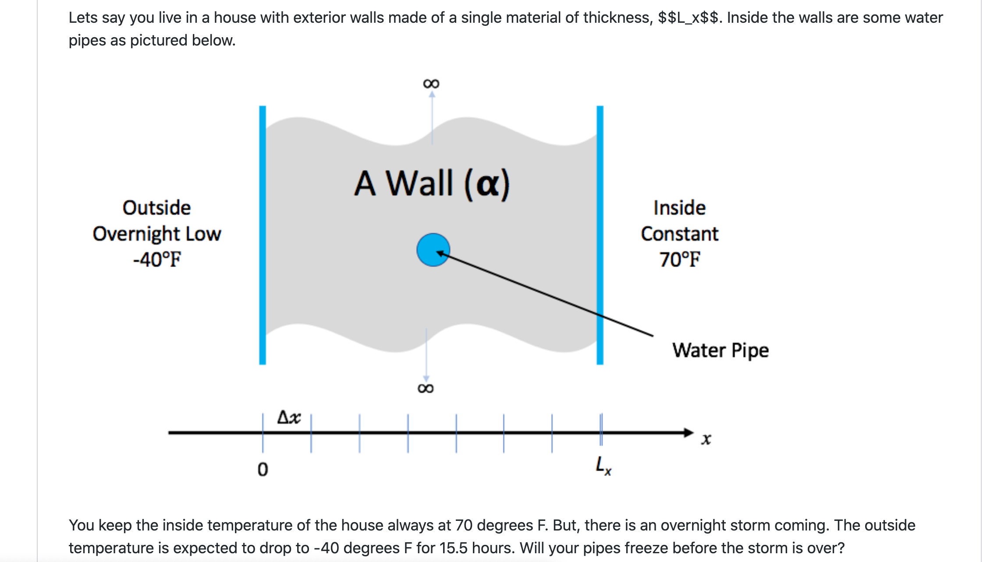

Slide 16
Problem Specification - Design Considerations
Specification
Solve heat equation with some initial and boundary conditions
Apply different integration methods
What is infrastructure here?
Discretization/ State
Verification
I/O
Application of initial conditions
Runtime parameters
Comparison
What is model here?
Initial conditions
Boundary conditions
Integration
Notes:
This is where one can switch to white board and ask questions.

Slide 17
Design Considerations
Infrastructure design
Take time to discuss, iterate over requirements and specification
Keep end users involved
Not doing so leaves possible options on the table
Simple is better
Flexibility Vs transparent to the user
Flexibility wins

Slide 18
Design Considerations
process_args(int argc, char **argv)
static void initialize(void)
void copy(int n, double *dst, double const *src)
void write_array(int t, int n, double dx, double const *a)
void set_initial_condition(int n, double *a, double dx, char const *ic)
Infrastructure design
Take time to discuss, iterate over requirements and specification
Keep end users involved
Not doing so leaves possible options on the table
Simple is better
Flexibility Vs transparent to the user
Flexibility wins

Slide 19
Design Considerations
Infrastructure design
Take time to discuss, iterate over requirements and specification
Keep end users involved
Not doing so leaves possible options on the table
Simple is better
Flexibility Vs transparent to the user
Flexibility wins
Configurability
Components or kernels
Levels of access (hierarchical)
Task orchestration
Mapping tasks to devices
CPU, accelerators, specialized devices
Managing data movement between devices

Slide 20
Design Considerations
process_args(int argc, char **argv)
static void initialize(void)
void copy(int n, double *dst, double const *src)
void write_array(int t, int n, double dx, double const *a)
void set_initial_condition(int n, double *a, double dx, char const *ic)
Infrastructure design
Take time to discuss, iterate over requirements and specification
Keep end users involved
Not doing so leaves possible options on the table
Simple is better
Flexibility Vs transparent to the user
Flexibility wins

Slide 21
Model Interfaces
double l2_norm(int n, double const *a, double const *b)
static void r83_np_fa(int n, double *a)
static void r83_np_sl ( int n, double const *a_lu, double const *b, double *x)
bool update_solution_crankn(int n, double *curr, double const *last, double const *cn_Amat, double bc_0, double bc_1)
bool update_solution_upwind15(int n, double *curr, double const *last, double alpha, double dx, double dt, double bc_0, double bc_1)
void compute_exact_solution(int n, double *a, double dx, char const *ic, double alpha, double t, double bc0, double bc1)
bool update_solution_ftcs( int n, double *uk1, double const *uk0, double alpha, double dx, double dt, double bc0, double bc1)

Slide 22
Interaction between infrastructure and model
infrastructure
model
Interfaces
Wrapper layer

Slide 23
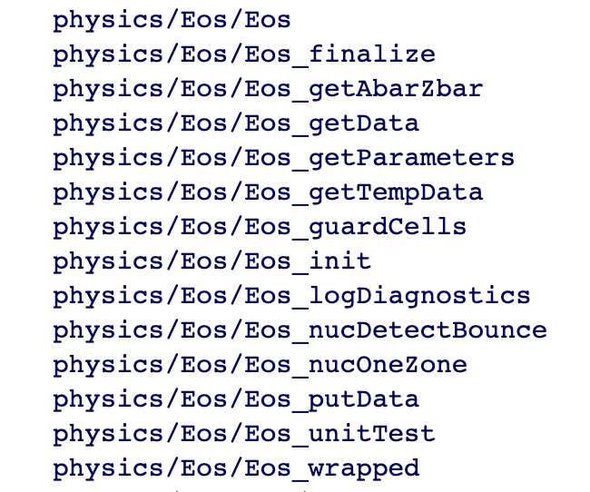
Example From FLASH: EOS interface Design
Hierarchy in complexity of interfaces
For collection of points
For sections of a block
Different levels in the hierarchy give different degrees of control to the client routines
Most of the complexity is completely hidden from casual users
More sophisticated users can bypass the wrappers for greater control
Done with elaborate machinery of masks and defined constants
Notes:
or full block vectorized input and output
wrappers to vectorize and configure the data
select derivative quantities to return with masking

Slide 24
Example: Multiphysics PDEs
Virtual view of functionalities
Decomposition into units and definition of interfaces
Spatial
decomposition
Virtual view :
domain sections
as stand-alone
computation unit
Parallelization
and scaling
optimization
Real view : A
whole domain
with many
operators
Functional
decomposition
Virtual view
collection of
components
Memory
access and
compute
optimization
Notes:
Example of changing the block size to adjust to the cache memory
And point-to-point Vs collectives depending upon the scale of the problem

Slide 25
Separation of Concerns, Tasks
Example: Multiphysics PDEs
Framework
Real view : A
whole domain
with many
operators
Spatial
Decomposition
Blocks/tiles
Virtual view :
domain sections
as stand-alone
computation unit
Load Distribution
Parallelization
and scaling
optimization
Dynamic
Scheduling
load balancing, work redistribution
Meta-information about domain sections
Possible asynchronization at block and operator level
No compute optimization here

Slide 26
composition
Example: Multiphysics PDEs
Framework
Abstractions for performance portability
Ability to express operations at a higher level
Real view : A
whole domain
with many
operators
Functional
decomposition
Virtual view
collection of
components
code
transformation
Toolchain to configure
compilers to optimize
Memory
access and
compute
optimization
Abstraction at
solver level
Fusing/inlining
Functions

Slide 27
Other Considerations
Leverage existing software
Libraries may have better solvers
Off-load expertise and maintenance
Examine the interoperability constraints
Many times the cost is justified even if there is more data movement
More available packages are attempting to achieve interoperability
See if a combination meets your requirements
May be worthwhile to let the library dictate data layout if the corresponding operations dominate
Institute a rigorous verification regime at the outset

Slide 28
Takeaways
Understand your needs
Do the cost-benefit analysis
Adopt what works for you without incurring technical debt
Design with portability, extensibility, reproducibility and maintainability in mind
Verify … verify … verify
…….Questions ?

Slide 29
Some available Options
Many efforts to provide tools to application developers
KoKKOs : Integrated Option with polymorphic arrays
Raja :
TiDA, HTA : managing tiling abstractions
GridTools : comprehensive solution from CSCS-ETH
Dash : managing multilevel locality
Task based processing – OCR, charm++, HPX, Quark etc
Language based solutions – Julia, Chapel, UPC++ etc
Domain specific languages

