Slide 1

Software Testing
Anshu Dubey Argonne National Laboratory
Software Productivity Track, ATPESC 2020
See slide 2 for license details

Slide 2
License, Citation and Acknowledgements
License and Citation
This work is licensed under a Creative Commons Attribution 4.0 International License (CC BY 4.0).
The requested citation the overall tutorial is: David E. Bernholdt, Anshu Dubey, Mark C. Miller, Katherine M. Riley, and James M. Willenbring, Software Productivity Track, in Argonne Training Program for Extreme Scale Computing (ATPESC), August 2020, online. DOI: 10.6084/m9.figshare.12719834
Individual modules may be cited as Speaker, Module Title, in Software Productivity Track…
Acknowledgements
Additional contributors include: Patricia Grubel, Rinku Gupta, Mike Heroux, Alicia Klinvex, Jared O’Neal, David Rogers, Deborah Stevens
This work was supported by the U.S. Department of Energy Office of Science, Office of Advanced Scientific Computing Research (ASCR), and by the Exascale Computing Project (17-SC-20-SC), a collaborative effort of the U.S. Department of Energy Office of Science and the National Nuclear Security Administration.
This work was performed in part at the Argonne National Laboratory, which is managed by UChicago Argonne, LLC for the U.S. Department of Energy under Contract No. DE-AC02-06CH11357.
This work was performed in part at the Oak Ridge National Laboratory, which is managed by UT-Battelle, LLC for the U.S. Department of Energy under Contract No. DE-AC05-00OR22725.
This work was performed in part at the Lawrence Livermore National Laboratory, which is managed by Lawrence Livermore National Security, LLC for the U.S. Department of Energy under Contract No. DE-AC52-07NA27344.
This work was performed in part at Sandia National Laboratories. Sandia National Laboratories is a multi-mission laboratory managed and operated by National Technology and Engineering Solutions of Sandia, LLC., a wholly owned subsidiary of Honeywell International, Inc., for the U.S. Department of Energy’s National Nuclear Security Administration under contract DE-NA0003525.

Slide 3
Verification
Code verification uses tests
It is much more than a collection of tests
It is the holistic process through which you ensure that
Your implementation shows expected behavior,
Your implementation is consistent with your model,
Science you are trying to do with the code can be done.
How do verification and validation differ?
Verification confirms that you have implemented what you meant to
Your method does what you wanted it to do
Validation tells you were right in implementing what you meant to
What you wanted your method to do is valid
Your model correctly captures the phenomenon you are trying to understand

Slide 4
Stages and types of verification
During initial code development
Accuracy and stability
Matching the algorithm to the model
Interoperability of algorithms
In later stages
While adding new major capabilities or modifying existing capabilities
Ongoing maintenance
Preparing for production

Slide 5
Verification Challenges
Functionality coverage
Particularly true of codes that allow composability in their configuration
Codes may incorporate some legacy components
Its own set of challenges
No existing tests at any granularity
Examples – multiphysics application codes that support multiple domains

Slide 6
Components of Verification
Testing at various granularity
Individual components
Interoperability of components
Convergence, stability and accuracy
Validation of individual components
Building diagnostics (e.g. ensure conservation of physical quantities)
Testing practices
Error bars
Necessary for differentiating between drift and round-off
Ensuring code and interoperability coverage

Slide 7
How to build your test suite ?
Two purposes
Regression testing
May be long running
Provide comprehensive coverage
Continuous integration
Quick diagnosis of error
A mix of different granularities works well
Unit tests for isolating component or sub-component level faults
Integration tests with simple to complex configuration and system level
Restart tests
Rules of thumb
Simple
Enable quick pin-pointing
Useful resources https://ideas-productivity.org/resources/howtos/

Slide 8
Why not always use the most stringent testing?
Effort spent in devising running and maintaining test suite is a tax on team resources
When the tax is too high…
Team cannot meet code-use objectives
When is the tax is too low…
Necessary oversight not provided
Defects in code sneak through
Evaluate project needs
Objectives: expected use of the code
Team: size and degree of heterogeneity
Lifecycle stage: new or production or refactoring
Lifetime: one off or ongoing production
Complexity: modules and their interactions
Balance is critical

Slide 9
Test Development For a New Code
Development of tests and diagnostics goes hand-in-hand with code development
Non-trivial to devise good tests, but extremely important
Compare against simpler analytical or semi-analytical solutions
Build granularity into testing
Use scaffolding ideas to build confidence
Always inject errors to verify that the test is working

Slide 10
How do you build a scaffolding of tests ?
Real dependency
Mocked up
dependency
Approach the problem sideways
Components can be exercised against known simpler applications
Same applies to combination of components
Build a scaffolding of verification tests to gain confidence
Unit test
Unit test
Unit test

Slide 11
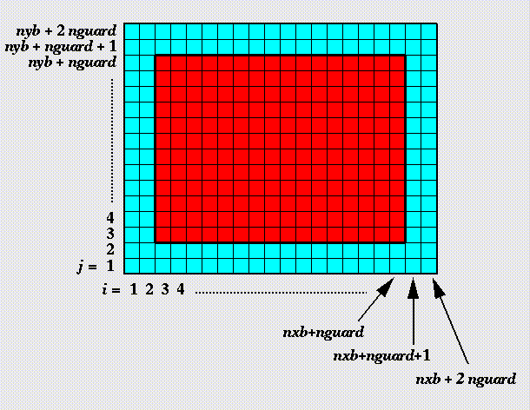
Scaffolding Example from FLASH
Unit test for Grid
Verification of guard/ghost/halo cell fill
Use two variables A & B
Initialize A in all cells and B only in the interior cells (red)
Apply guard cell fill to B
gc test

Slide 12
Scaffolding Example from FLASH
Eos test
Unit test for Equation of State (EOS)
Three modes for invoking EOS
MODE1: Pressure and density as input, internal energy and temperature as output
MODE2: Internal energy and density as input temperature and pressure as output
MODE3: Temperature and density as input pressure and internal energy as output
Use initial conditions from a known problem, initialize pressure and density
Apply EOS in MODE1
Using internal energy generated in the previous step apply EOS in MODE2
Using temperature generated in the previous step apply EOS in MODE3
At the end all variables should be consistent within tolerance

Slide 13
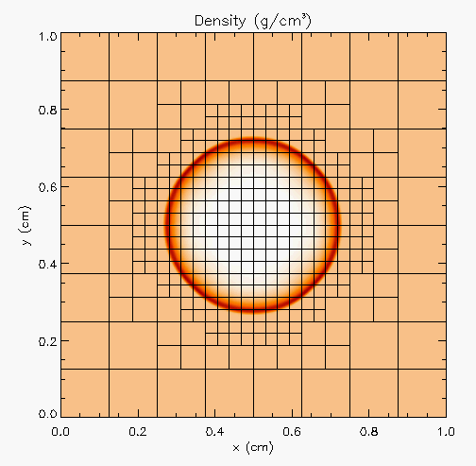
Scaffolding Example from FLASH
Hydro test
Unit test for Hydrodynamics
Sedov blast wave
High pressure at the center
Shock moves out spherically
FLASH with AMR and hydro
Known analytical solution
gc test
Eos test
Though it exercises mesh, hydro and eos, if mesh and eos are verified first, then this test verifies hydro
More testing needed for Grid using AMR
Flux correction and regridding

Slide 14
Scaffolding Example from FLASH
For AMR, correct behavior of flux conservation and regridding should also be verified.
Reason about correctness for testing Flux correction and regridding
IF Guardcell fill and EOS unit tests passed
Run Hydro without AMR
If failed fault is in Hydro
Run Hydro with AMR, but no dynamic refinement
If failed fault is in flux correction
Run Hydro with AMR and dynamic refinement
If failed fault is in regridding
Exercise: Devise a sequence of tests for heat_app.c to provide similar coverage

Slide 15
Test Development For a Legacy Code
There may not be existing tests
Isolate a small area of the code
Dump a useful state snapshot
Build a test driver
Start with only the files in the area
Link in dependencies
Copy if any customizations needed
Read in the state snapshot
Verify correctness
Always inject errors to verify that the test is working

Slide 16
Example from E3SM
Isolate a small area of the code
Dump a useful state snapshot
Build a test driver
Start with only the files in the area
Link in dependencies
Copy if any customizations needed
Read in the state snapshot
Restart from the saved state
state
driver
Exercise: From heat_app.c develop a test for l2_norm function using this method

Slide 17
Test Selection
First line of defense – code coverage tools (demo in refactoring module)
Code coverage tools necessary but not sufficient
Do not give any information about interoperability
Build a functionality matrix
Physics along rows
Infrastructure along columns
Alternative implementations, dimensions, geometry
Mark <i,j> if test covers corresponding features, and is a valid combination
Follow the order
All unit tests – including full module tests
Tests representing ongoing productions
Tests sensitive to perturbations
Most stringent tests for solvers
Least complex test to cover remaining spots

Slide 18
Example
A test on the same row indicates interoperability between corresponding physics
Similar logic would apply to tests on the same column for infrastructure
More goes on, but this is the primary methodology
Tests | Symbol
Sedov | SV
Cellular | CL
Poisson | PT
White Dwarf | WD

Slide 19
Good Testing Practices
Must have consistent policy on dealing with failed tests
Issue tracking
How quickly does it need to be fixed?
Who is responsible for fixing it?
Someone should be watching the test suite
When refactoring or adding new features, run a regression suite before check in
Add new regression tests or modify existing ones for the new features
Code review before releasing test suite is useful
Another person may spot issues you didn’t
Incredibly cost-effective

Slide 20
Takeaways
Your verification and testing regime should meet your project needs
No need to go overboard but make sure that you have confidence in the correct behavior of your code
Devise tests to enable quick pinpointing of errors
Make sure that your tests fail when they should
…….Questions ?

Slide 21
Agenda
Time (Central TZ) | Module | Topic | Speaker
9:30am-9:45am | 00 | Introduction | David E. Bernholdt, ORNL
9:45am-10:15am | 01 | Overview of Best Practices in HPC Software Development | Katherine M. Riley, ANL
10:15am-10:45am | 02 | Agile Methodologies | James M. Willenbring, SNL
10:45am-11:00am | 03 | Git Workflows | James M. Willenbring, SNL
11:00am-11:15am |  | Break (and Q&A with speakers)
11:15am-12:00pm | 04 | Software Design | Anshu Dubey, ANL
12:00pm-12:45pm | 05 | Software Testing | Anshu Dubey, ANL
12:45pm-1:45pm |  | Lunch (and Q&A with speakers)
1:45pm-2:00pm | 06 | Agile Methodologies Redux | James M. Willenbing, SNL
2:00pm-3:00pm | 07 | Refactoring | Anshu Dubey, ANL
3:00pm-3:15pm |  | Break (and Q&A with speakers)
3:15pm-3:45pm | 08 | Continuous Integration | Mark C. Miller, LLNL
3:45pm-4:30pm | 09 | Reproducibility | David E. Bernholdt, ORNL
4:30pm-4:45pm | 10 | Summary | David E. Bernholdt, ORNL

