Slide 1

An Introduction to Software Licensing
David E. Bernholdt Oak Ridge National Laboratory
James Willenbring, Michael A. Heroux Sandia National Laboratories
Better Scientific Software Tutorial SC19, Denver, Colorado
See slide 2 for license details

Slide 2
Disclaimer, License, Citation and Acknowledgements
Disclaimers
This is not legal advice (TINLA). Consult with true experts before making any consequential decisions
Copyright laws differ by country. Some info may be US-centric
License and Citation
This work is licensed under a Creative Commons Attribution 4.0 International License (CC BY 4.0).
The requested citation the overall tutorial is: David E. Bernholdt, Anshu Dubey, Michael A. Heroux, and Jared O’Neal, Better Scientific Software tutorial, in SC ‘19: International Conference for High Performance Computing, Networking, Storage and Analysis, Denver, Colorado, 2019. DOI: 10.6084/m9.figshare.10114880
Individual modules may be cited as Module Authors, Module Title, in Better Scientific Software Tutorial…
Acknowledgements
This work was supported by the U.S. Department of Energy Office of Science, Office of Advanced Scientific Computing Research (ASCR), and by the Exascale Computing Project (17-SC-20-SC), a collaborative effort of the U.S. Department of Energy Office of Science and the National Nuclear Security Administration.
This work was performed in part at the Oak Ridge National Laboratory, which is managed by UT-Battelle, LLC for the U.S. Department of Energy under Contract No. DE-AC05-00OR22725.
This work was performed in part at Sandia National Laboratories. Sandia National Laboratories is a multi-mission laboratory managed and operated by National Technology and Engineering Solutions of Sandia, LLC., a wholly owned subsidiary of Honeywell International, Inc., for the U.S. Department of Energy’s National Nuclear Security Administration under contract DE-NA0003525. SAND NO SAND2017-5474 PE

Slide 3
Bottom line up front
How you choose to license your software should be viewed as a tool to help accomplish your goals for that software.
There is no universal “right answer”!
The answer may not be your decision.
This tutorial will present common terminology, and examples of some of the considerations that might go into choosing a license.
The intent is to get you thinking, not to give you answers.

Slide 4
Some terminology and background

Slide 5
Copyright, patents, trademarks, and licenses
Copyright grants the creator of an original work exclusive rights to its use and distribution, including limits on derivative works
A patent grants the inventor of something new, useful, and non-obvious the rights to its production, use, and distribution
A trademark is a sign, design, or expression which identifies products or services from a particular source, as distinguished from other sources
Licenses are used to transfer (selected) rights in a work, invention, or mark from one party to another
Software licenses are mostly about copyright, but can contain clauses on patents and trademarks too

Slide 6
Your software starts out copyrighted
Under the law, the software you write is subject to copyright on creation
You don’t have to do anything special to claim copyright
Unless you specify some license, all rights are reserved to the owner of the copyright
The copyright owner may be you, or your employer
“Work for hire” (i.e. as part of your job) is probably owned by your employer. Employment contracts often make IP rights explicit.
Question 1: Who owns the rights in the work you create?
Homework: Find out!
If your employer owns the copyright, you probably have to get formal permission to license and distribute your software
Exception: Works created by the US government cannot be copyrighted
They are considered to be in the public domain
Comment: Originally to ensure public access to the US legal code

Slide 7
The licensing spectrum
Proprietary or Closed Licenses
Free or Open Licenses
Copyleft
Permissive
All Rights Reserved
Public Domain
Free vs Open Source?
“Free” in licensing discussions should refer strictly to “freedom” (to do certain things with the software)
Often gets conflated with “free as in beer”, muddling the discussion. Hence some prefer term “open source”
Major names in Free/Open Source Software:
Free Software Foundation (FSF) http://fsf.org/licensing
Open Source Initiative (OSI) http://opensource.org
Common misconception: Nothing in the definition of free or open source software prevents you from making money from it! (more later)

Slide 8
Defining free software: The four freedoms
From the Free Software Foundation
The freedom to run the program for any purpose
The freedom to study how the program works, and change it so it does your computing as you wish
Access to the source code is a precondition for this
The freedom to redistribute copies so you can help your neighbor
The freedom to distribute copies of your modified versions to others. By doing this you can give the whole community a chance to benefit from your changes
Access to the source code is a precondition for this
The OSI has a definition which amounts to the same thing, for most purposes

Slide 9
Permissive vs copyleft OS licenses
Permissive
Copyleft
Licensee can distribute derivative works as they see fit
Relicensing of derivatives is allowed
Including proprietary licenses
Examples
Apache License
MIT License
BSD License
Licensee must distribute derivative works as open source
Also referred to as “restrictive” or “viral”
Examples
GPL (v2 and v3)
LGPL
Note: Derived works may be held private and never released

Slide 10
What is a derivative work?
A derivative work is an expressive creation that includes major copyright-protected elements of a previously created first work (Wikipedia)
Basically: modifications to someone else’s software
But what about linking to a library? (Statically vs dynamically?) Interacting via pipes? Use as a component in a coupled multiphysics application?
Opinions differ
FSF (GPL) considers everything in a single executable to be a derived work (source of “viral” label)
LGPL created for libraries – says linking not considered derived work
Matters less for permissive licenses
Leads to concerns over “compatibility” in combining software under different licenses (more later)

Slide 11
Test: Is this an open source license? (A real-world example)
In order to acquire access to the code sources, the recipient agrees:
to compile/use the XYZZY source code AS IS without modification; users however are welcome to request changes, or to contribute modifications subject to approval of the authors;
if the copy of the XYZZY downloaded by the authorized user is made available to third parties, to ensure that the user agreement is followed by the third parties;
to send a one-time email to xyzzy@example.com describing planned research using that module
prior to publication, to email a draft of the article/letter/note to xyzzy@example.com
to include in published results or presentations the proper code name(s) and appropriate references.

Slide 12
Answer: Is this an open source license? No (A real-world example)
In order to acquire access to the code sources, the recipient agrees:
to compile/use the XYZZY source code AS IS without modification; users however are welcome to request changes, or to contribute modifications subject to approval of the authors;
if the copy of the XYZZY downloaded by the authorized user is made available to third parties, to ensure that the user agreement is followed by the third parties;
This violates the freedom of being able to distribute copies of your modified version of the code to others
Perhaps they want to impose some measure of “quality control” over modifications? Maybe they’ve had problems in the past with users distributing modified code with errors that are believed to reflect poorly on the original code?
Possible alternative: Some open source licenses include a requirement that derivatives must be clearly distinguished from the original (e.g., different name)

Slide 13
Choosing a license

Slide 14
Considerations in choosing a license
What rights do you want to retain or grant?
Who can use the program? (proprietary vs open)
Can users see the source code? (proprietary vs open)
Can users modify the source code? (proprietary vs open)
Can the users redistribute original or modified code? (proprietary vs open)
Can modified code be relicensed? (permissive vs copyleft)
Compatibility with software under other licenses
Permissive licenses have fewer issues
http://www.fsf.org/licensing/
Labeling of derived works
Derived works must be identified differently than original work
Patent grant/retaliation
Expectations of the community you want to engage?
Use an existing free/open source license rather than inventing a new one!
FSF and OSI certify many existing licenses (~80) as meeting their criteria

Slide 15
Popular OSI-approved licenses
License | Type | GPL-Compatible | Patent Grant
Apache License 2.0 | Permissive | v3,not v2 | yes
BSD 2-Clause and 3-Clause licenses | Permissive | yes | silent
GNU General Public License (GPL) v3 | Copyleft | yes | yes
GNU Library or "Lesser" General Public License (LGPL) v3 | Weak Copyleft | yes | yes
MIT license (MIT) | Permissive | yes | silent
Mozilla Public License 2.0 | Permissive | yes | yes
Common Development and Distribution License | Permissive | no | yes
Eclipse Public License 2.0 | Weak Copyleft | yes | yes
Affero General Public License v3 (network use == distribution) | Copyleft | yes | yes

Slide 16
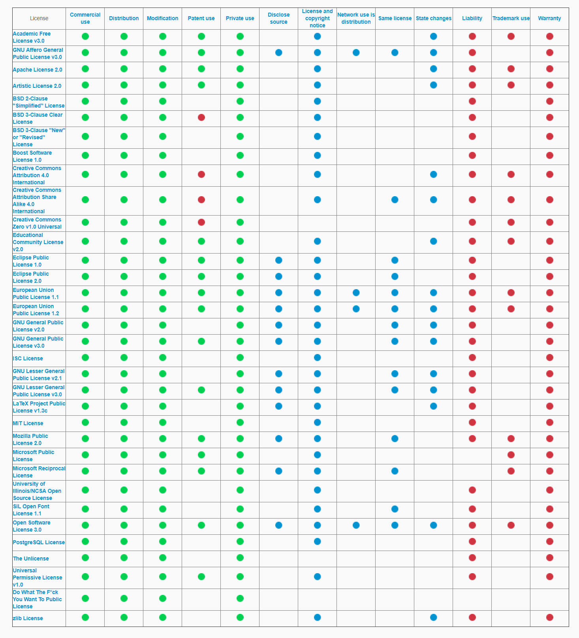
ChooseALicense.com (by GitHub)
Primarily a decision-tree approach to helping you choose a license
But backed by a repository with analysis of 30+ widely used licenses
The easiest way to access the whole list is to go to the “Appendix”
https://choosealicense.com/appendix/
A portion of the Appendix is shown at left
This is implemented in a GitHub repository with Jekyll, and open to pull requests!

Slide 17
Consideration: Software business models
Approach | Proprietary | Copyleft | Permissive
Sell the software | yes | yes | yes
“Fremium” or “dual licensing” allows free use by some, paid by others | yes | yes | yes
Relicense to proprietary | n/a | no | yes
Sell convenience, e.g., packaging, installation media, pre-compiled executables | yes | yes | yes
Sell professional services around the software, e.g., training, technical support, consulting | yes | yes | yes
Sell custom development services, e.g., proprietary extensions, accelerated development | yes | yes | yes
Sell software-as-a-service (SaaS) | yes | yes | yes
Sell the research | yes | yes | yes

Slide 18
Consideration: Don’t want others to profit from my open source software
A permissive license allows someone else to take derivatives proprietary
A copyleft license will prevent that
But there may be other considerations…
What if you do want a commercial entity to use your software?
Exposure, broader distribution
Copyleft is scary to many commercial entities
How far does the viral license reach into other parts of the product?
Legal opinions differ, no case law yet
Lawyers will tend toward a conservative answer: avoid copyleft software
Experience: some companies will not consider working with copyleft software
Experience: some companies consider staff working on copyleft software to be “contaminated” and will not allow them work on other software
Even in non-commercial environments, copyleft may raise compatibility concerns

Slide 19
The software-as-a-service conundrum
Many software-as-a-service (SaaS) products make extensive use of open source software
Some software developers don’t like the possibility that another company can trivially monetize (other people’s) software by turning it into a SaaS product
It may compete with their own SaaS offerings
The SaaS provider can keep enhancements proprietary and while making the benefits available in the SaaS product
Attempts to curb this via licensing result in licenses that are not open source
In some cases, key modules are changed to proprietary licenses, while others remain open
See: https://arstechnica.com/information-technology/2019/10/is-the-software-world-taking-too-much-from-the-open-source-community/

Slide 20
Consideration: Protecting my intellectual property
If I make my source code freely available, then others can use the novel ideas embodied in it to “scoop” me
Proprietary licenses (obviously) allow you to keep source private
Open source licenses don’t require that you make derived works public, only that if you do, you make the source available
Delay public release until you’ve had a reasonable chance to exploit the results of your work
Until initial papers are published
Fixed time period (e.g., one year)
A similar compromise is sometimes used in academic publishing: sponsor may want open access but allow publisher a proprietary exploitation period (often 1 year) before making it openly available

Slide 21
Patent clauses in software licenses
Software patents can be a serious consideration today
Regardless of philosophical arguments for or against, software patents are a reality
If you’re using a piece of software (even open source) that is covered by a patent and you don’t have a license for the patent, you’re infringing
Not being aware of a patent does not excuse the infringement
You can be sued for monetary damages
Many common software licenses are silent on patents
Especially older ones (e.g., BSD, GPLv2)
Some newer licenses do include patent clauses
Usually a royalty-free license to use patented content (e.g. Apache 2.0, GPLv3)
Some explicitly say that they do not grant any patent rights (e.g., BSD 3-Clause Clear)
Or retaliation clauses: “if you sue me for patent infringement, you can’t use this software”

Slide 22
License compatibility
In practice, most software is a combined work of some kind
Multiple packages with (potentially) different licenses (e.g. main package and dependencies)
Do the license terms allow the packages to be distributed (or even used) together?
Is the combined work considered a derived work?
Different licenses have different concepts of what constitutes a derived work and how derivatives may or must be licensed
Example: strong copyleft considers linking to produce a derived work, and requires derivatives be distributed under the same license as the original
There are different interpretations of what licenses are compatible
Little litigation so far
Most significant concerns tend to be about distribution of software
Larger projects starting to pay more attention to his

Slide 23
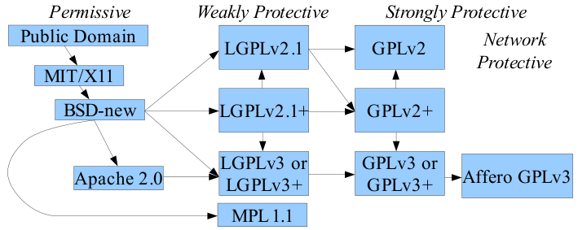
License compatibility in pictures
One view of license compatibility between common FOSS software licenses. The arrows denote a one directional compatibility, therefore better compatibility on the left side than on the right side. By David A. Wheeler - http://www.dwheeler.com/essays/floss-license-slide.html, CC BY-SA 3.0, https://commons.wikimedia.org/w/index.php?curid=41060008 via https://en.wikipedia.org/wiki/License_compatibility

Slide 24
Considerations favoring open source
Challenges of managing and archiving the paperwork associated with proprietary licenses
Explicit license agreements can inhibit (legal) use of software
I want to support peer review and reproducibility in science
My sponsor requires that I release my software as open source
I believe that the results of publicly-funded research should be publicly available
I want to build a self-sustaining community around my software

Slide 25
A few more points about our real-world example
In order to acquire access to the code sources, the recipient agrees:
to compile/use the XYZZY source code AS IS without modification; users however are welcome to request changes, or to contribute modifications subject to approval of the authors;
if the copy of the XYZZY downloaded by the authorized user is made available to third parties, to ensure that the user agreement is followed by the third parties;
to send a one-time email to xyzzy@example.com describing planned research using that module
prior to publication, to email a draft of the article/letter/note to xyzzy@example.com
to include in published results or presentations the proper code name(s) and appropriate references.

Slide 26
Why are these clauses included?
prior to publication, to email a draft of the article/letter/note to xyzzy@example.com
An attempt to address prior experience with users misusing the code and producing publications with erroneous results, thus reflecting poorly on the code used to obtain them.
Creates a burden on the code owners.
Not sure how strongly they attempt to enforce this.
to include in published results or presentations the proper code name(s) and appropriate references.
A natural desire for the software to be credited in papers where it is used.
Does not violate free/open source software principles.
Some licenses require attribution, but usually only in source code.
Creative Commons licenses can include an attribution clause (see later slide)
Possible alternative: CITATION file?

Slide 27
Some related matters

Slide 28
Software licenses can be changed
You may start out using one license for your code and later discover unanticipated problems
Or maybe your goals change
But changing licenses is not necessarily easy
(Generally) each and every contributor to a code holds a copyright interest in it
Each and every contributor must be contacted and agree to the relicensing
In practice, different institutions may have different ideas of “due diligence”
Keep good records of contributors; try to keep them current
Contributor license agreements (CLAs) and contribution transfer agreements (CTAs) can simplify this
But present different challenges (see upcoming slide)

Slide 29
Changing license example #1
Organization owns copyright for several software packages
Licensed LGPL
Authorship agreements were signed at time copyright was asserted
Several packages contained third-party source files
A variety of licenses
Many packages received contributions from other authors since initial copyright assertion
Many prospective (particularly industry) customers were wary of LGPL
Decision was made to relicense to BSD

Slide 30
Changing license example #1 (continued)
Contributions were deemed to be substantive or “bug fix”
This was a distinction suggested by a lawyer, every situation will be different
All third-party software was judged to have a compatible or incompatible license
Most packages were eventually relicensed, a few were not
A contributor agreement was adopted after this
Proved challenging in practice and is largely not used.
Considered building an agreement into pull-request template
Not clear if that is enforceable
Often people do not have the ability to agree on behalf of their employer

Slide 31
Changing license example #2
Another case of moving to a less restrictive license
Effort was made to obtain agreement from all 400+ contributors
This was successful, except one contributor had passed away
His contribution was removed from the code base
This was a more careful and exhaustive effort than the first example
Not implying it is better or worse

Slide 32
Accepting code contributions
Code contributions are implicitly offered under the current license
Some projects require a contributor agreement
Contributor license agreement (CLA) defines the terms between the contributor and the maintainers of the software
Contributor transfer agreement (CTA) transfers copyright ownership from contributor to maintainers
Why?
Clarify or make explicit terms of contribution (awareness by contributor)
Obtain additional rights, e.g., relicensing, patents, etc.
Ensure “clear title” to make the contribution
Why not?
Creates “barriers to entry” – may discourage potential contributors
Legal agreements that may require official review and signature
Experience: Lost funding for a project because lawyers wouldn’t agree to terms of a CLA
See Resources slide for several viewpoints

Slide 33
Managing copyright notices in software
All this does no good if you don’t make the license you’ve chosen clear to all
Need to assert copyright and make license terms explicit
Do these centrally or in every file?
Single COPYING or LICENSE file per package (or directory)
In comments at the top of the file
Advantages and disadvantages to each
Best practice: do both
Intelligently, to make it as easy to maintain as possible – script updates!
Authorship (separate, but related)
Version control is best way to maintain accurate records of authorship
See Managing Copyright Information within a Free Software Project for details
Also Software Package Data Exchange (SPDX, emerging standard)

Slide 34
Open licensing of non-software artifacts
Creative Commons is a family of licenses analogous to open source, but for things other than software
License variants
CC BY (Attribution)
CC BY-SA (Attribution-ShareAlike)
CC BY-ND (Attribution-NoDerivs)
CC BY-NC (Attribution-NonCommercial)
CC BY-NC-SA (Attribution-NonCommercial-ShareAlike)
CC BY-NC-ND (Attribution-NonCommercial-NoDerivs)
CC0 Public Domain Dedication
Indicates intent to place artifact in the public domain
Doesn’t satisfy legal requirements in all jurisdictions
See https://creativecommons.org

Slide 35
Resources
https://opensource.org (OSI)
http://www.fsf.org/licensing/ (FSF)
https://choosealicense.com, https://choosealicense.com/appendix/ (GitHub)
Software Freedom Law Center (SFLC)
https://en.wikipedia.org/wiki/License_compatibility
Managing Copyright Information within a Free Software Project
Software Package Data Exchange (SPDX, emerging standard)
http://contributoragreements.org/, https://developercertificate.org/ and http://ebb.org/bkuhn/blog/2014/06/09/do-not-need-cla.html
https://creativecommons.org (CC)
US DOE ASCR (open source) software policy
Your institution’s Technology Transfer Office (or equivalent)
An Intellectual Property Lawyer (knowledgeable in software)
Talk to colleagues and learn from their experiences

Slide 36
Additional resources recommended by others (1/3)
I have not yet studied these carefully myself, but I trust the people who recommend them.
Neil Chue Hong (Software Sustainability Institute) from his tutorial An Introduction to Software Licensing (yes, the same title as this presentation, but developed completely independently)
The Whys and Hows of Licensing Scientific Code
A Quick Guide to Software Licensing for the Scientist-Programmer
The Legal Side to Open Source
The International Free and Open Source Lawbook
qLegal: advice for tech start-ups + entrepreneurs
tl;dr legal: Software Licenses in Plain English
Open Source Software Watch

Slide 37
Additional resources recommended by others (2/3)
I have not yet studied these carefully myself, but I trust the people who recommend them.
Todd Gamblin (LLNL)
License compatibility resources
Open Source Licenses and their Compatibility
Which Licenses May Not be Included within Apache Products?
(Re-) Licensing considerations of various organizations
LLVM Contemplates Relicensing, LLVM Relicensing Effort
HEP Software Foundation licensing working group, particularly:
https://hepsoftwarefoundation.org/organization/2017/02/21/licensing.html
https://hepsoftwarefoundation.org/organization/2018/05/09/licensing.html included this Update on Software Licensing
EasyBuild: GPLv2 licensing is a big issue, consider relicensing to BSD
GEANT Intellectual Property Rights Policy

Slide 38
Additional resources recommended by others (3/3)
I have not yet studied these carefully myself, but I trust the people who recommend them
More from Todd Gamblin (LLNL)
Patents in software licenses
Why so little love for the patent grant in the MIT License?
React’s New MIT License: The Circus Enters Its Third Ring
GitLab freezes GraphQL project amid looming Facebook patent fears
Rust: Rust license changing (very slightly), Why dual MIT/ASL2 license?

Slide 39
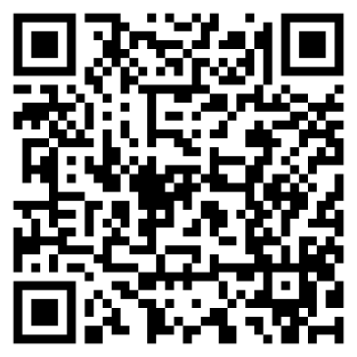
Agenda
Tutorial evaluation http://bit.ly/sc19-bssw-eval
Time | Module | Topic | Speaker
8:30am-8:40am | 00 | Introduction and Setup | David E. Bernholdt, ORNL
8:40am-9:15am | 01 | Overview of Best Practices in HPC Software Development | David E. Bernholdt, ORNL
9:15am-10:00am | 02 | An Introduction to Software Licensing | David E. Bernholdt, ORNL
10:00am-10:30am |  | Break
10:30am-11:30am | 03 | Agile Methodologies and Useful GitHub Tools | Michael A. Heroux, SNL
11:30am-12:00pm | 04 | Improving Reproducibility through Better Software Practices | Michael A. Heroux, SNL
12:00pm-1:30pm |  | Lunch
1:30pm-2:15pm | 05 | Software Design and Testing | Anshu Dubey, ANL
2:15pm-2:45pm | 06 | Git Workflows | Jared O’Neal, ANL
2:45pm-3:00pm | 07 | Code Coverage and Continuous Integration | Jared O’Neal, ANL
3:00-3:30pm |  | Break
3:30pm-3:50pm | 07 | Code Coverage and Continuous Integration (continued) | Jared O’Neal, ANL
3:50pm-5:00pm | 08 | Hands-on Activities and Additional Q&A | All

Slide 40
Additional Software-Related Events at SC19
Bold events (co-)organized by IDEAS
Day/Time | Event Type | Event Title
Sunday | Tutorial | Floating-Point Analysis and Reproducibility Tools for Scientific Software
Sunday | Workshop | The 2019 International Workshop on Software Engineering for HPC-Enabled Research (SE-HER 2019)
Monday | Tutorial | Better Scientific Software
Monday | Tutorial | Managing HPC Software Complexity with Spack
Monday | Workshop | 3nd International Workshop on Software Correctness for HPC Applications (Correctness 2019)
Monday | Students@SC | Students@SC: Modern Software Design, Tools, and Practices
Tuesday | BoF | Extreme-Scale Scientific Software Stack (E4S)
Tuesday | BoF | Exchanging Best Practices in Supporting Computational and Data-Intensive Research
Tuesday | Panel | Developing and Managing Research Software in Universities and National Labs
Wednesday | BoF | Software Engineering and Reuse in Modeling, Simulation, and Data Analytics for Science and Engineering
Thursday | BoF | Quality Assurance and Coding Standards for Parallel Software
Thursday | Panel | Sustainability of HPC Research Computing: Fostering Career Paths for Facilitators, Research Software Engineers, and Gateway Creators
Friday | Panel | The Road to Exascale and Beyond is Paved by Software: How Algorithms, Libraries and Tools Will Make Exascale Performance Real

