Slide 1

Scientific Software Design
Anshu Dubey Argonne National Laboratory
Software Productivity Track, ATPESC 2020
See slide 2 for license details

Slide 2
License, Citation and Acknowledgements
License and Citation
This work is licensed under a Creative Commons Attribution 4.0 International License (CC BY 4.0).
The requested citation the overall tutorial is: David E. Bernholdt, Anshu Dubey, Mark C. Miller, Katherine M. Riley, and James M. Willenbring, Software Productivity Track, in Argonne Training Program for Extreme Scale Computing (ATPESC), August 2020, online. DOI: 10.6084/m9.figshare.12719834
Individual modules may be cited as Speaker, Module Title, in Software Productivity Track…
Acknowledgements
Additional contributors include: Patricia Grubel, Rinku Gupta, Mike Heroux, Alicia Klinvex, Jared O’Neal, David Rogers, Deborah Stevens
This work was supported by the U.S. Department of Energy Office of Science, Office of Advanced Scientific Computing Research (ASCR), and by the Exascale Computing Project (17-SC-20-SC), a collaborative effort of the U.S. Department of Energy Office of Science and the National Nuclear Security Administration.
This work was performed in part at the Argonne National Laboratory, which is managed by UChicago Argonne, LLC for the U.S. Department of Energy under Contract No. DE-AC02-06CH11357.
This work was performed in part at the Oak Ridge National Laboratory, which is managed by UT-Battelle, LLC for the U.S. Department of Energy under Contract No. DE-AC05-00OR22725.
This work was performed in part at the Lawrence Livermore National Laboratory, which is managed by Lawrence Livermore National Security, LLC for the U.S. Department of Energy under Contract No. DE-AC52-07NA27344.
This work was performed in part at Sandia National Laboratories. Sandia National Laboratories is a multi-mission laboratory managed and operated by National Technology and Engineering Solutions of Sandia, LLC., a wholly owned subsidiary of Honeywell International, Inc., for the U.S. Department of Energy’s National Nuclear Security Administration under contract DE-NA0003525.

Slide 3
Architecting scientific codes
Desirable Characteristics and Why They are Challenging
Extensibility
Well defined structure and modules
Encapsulation of functionalities

Slide 4
Architecting scientific codes
Desirable Characteristics and Why They are Challenging
Extensibility
Well defined structure and modules
Encapsulation of functionalities
Same data layout not good for all solvers. Many corner cases. Necessary lateral interactions

Slide 5
Architecting scientific codes
Desirable Characteristics and Why They are Challenging
Extensibility
Performance
Well defined structure and modules
Encapsulation of functionalities
Spatial and temporal locality of data
Minimizing data movement
Maximizing scalability
Same data layout not good for all solvers. Many corner cases. Necessary lateral interactions

Slide 6
Architecting scientific codes
Desirable Characteristics and Why They are Challenging
Extensibility
Performance
Well defined structure and modules
Encapsulation of functionalities
Spatial and temporal locality of data
Minimizing data movement
Maximizing scalability
Same data layout not good for all solvers. Many corner cases. Necessary lateral interactions
Low arithmetic intensity solvers with hard dependencies. Proximity and work distribution at cross purposes

Slide 7
Architecting scientific codes
Desirable Characteristics and Why They are Challenging
Portability
General solutions that work without significant manual intervention across platforms

Slide 8
Architecting scientific codes
Desirable Characteristics and Why They are Challenging
Portability
General solutions that work without significant manual intervention across platforms
Tremendous platform heterogeneity
A version for each class of device => combinatorial explosion

Slide 9
Architecting scientific codes
Desirable Characteristics and Why They are Challenging
Portability
Verifiability and Maintainability
General solutions that work without significant manual intervention across platforms
Clean code
Documentation
Comprehensive testing
Tremendous platform heterogeneity
A version for each class of device => combinatorial explosion

Slide 10
Architecting scientific codes
Desirable Characteristics and Why They are Challenging
Portability
Verifiability and Maintainability
General solutions that work without significant manual intervention across platforms
Clean code
Documentation
Comprehensive testing
Tremendous platform heterogeneity
A version for each class of device => combinatorial explosion
Wrong incentives
Designing good tests is hard

Slide 11
Architecting scientific codes
Taming the Complexity: Separation of Concerns
Subject of research
Model
Numerics
More Stable
Discretization
I/O
Parameters

Slide 12
Architecting scientific codes
Taming the Complexity: Separation of Concerns
Subject of research
Model
Numerics
Treat differently
More Stable
Discretization
I/O
Parameters

Slide 13
Architecting scientific codes
Taming the Complexity: Separation of Concerns
Subject of research
Model
Numerics
Client Code
Mathematically complex
Treat differently
More Stable
Discretization
I/O
Parameters
Infrastructure
Data structures and movement

Slide 14
Architecting scientific codes
Taming the Complexity: Separation of Concerns
Subject of research
Model
Numerics
Client Code
Mathematically complex
Treat differently
Hide from one another
More Stable
Discretization
I/O
Parameters
Infrastructure
Data structures and movement

Slide 15
Architecting scientific codes
Taming the Complexity: Separation of Concerns
Subject of research
Model
Numerics
Client Code
Mathematically complex
logically separable functional units of computation
Encode into framework
Treat differently
Hide from one another
Applies to both kind
Differentiate between private and public
More Stable
Discretization
I/O
Parameters
Infrastructure
Data structures and movement
Define interfaces

Slide 16
A Design Model for Separation of Concerns
Infrastructure
Capabilities
Requirements
Model
Software Architecture API Design
API
Implement
Design
Develop
Test
Validate
Maintain
Augment
Integrate

Slide 17
Design Considerations
Infrastructure design
Take time to discuss, iterate over requirements and specification
Keep end users involved
Not doing so leaves possible options on the table
Simple is better
Flexibility Vs transparent to the user
Flexibility wins

Slide 18
Design Considerations
Infrastructure design
Take time to discuss, iterate over requirements and specification
Keep end users involved
Not doing so leaves possible options on the table
Keep API independent of numerics
Simple is better
Flexibility Vs transparent to the user
Flexibility wins
Model/numerics design
Abstract away the infrastructure knowledge as much as possible
Encapsulate
Let model needs guide API
Design flexible API to accommodate quick upgrades to methods
Simple is better
Flexibility Vs transparent to the user
Flexibility wins

Slide 19
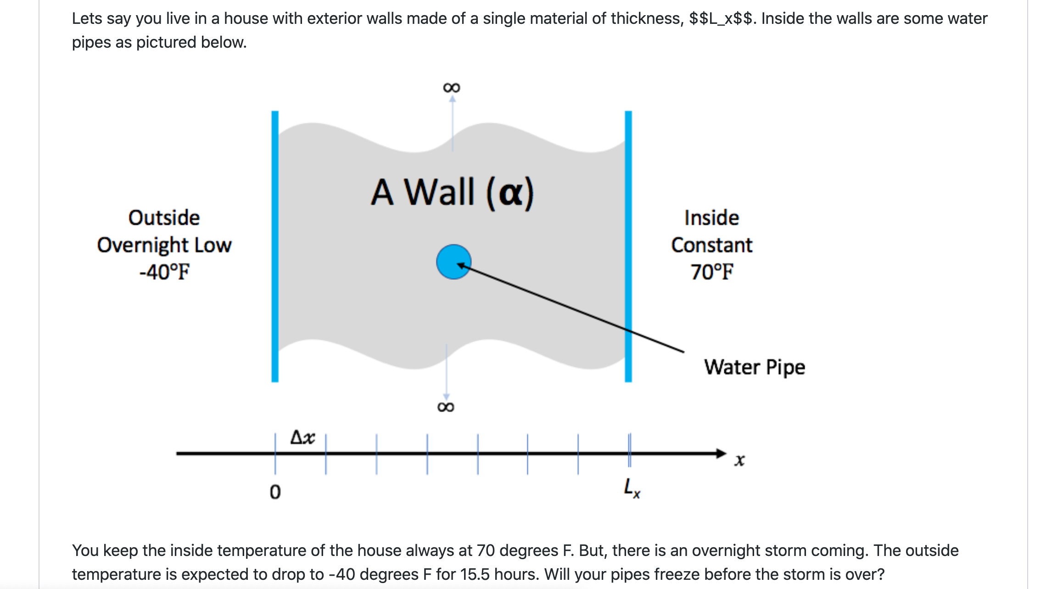
The Running Example
https://github.com/betterscientificsoftware/hello-numerical-world-atpesc-2020

Slide 20
Problem Specification - Design Considerations
Specification
Solve heat equation with some initial and boundary conditions
Apply different integration methods
What is infrastructure here?
Discretization/ State
Verification
I/O
Application of initial conditions
Runtime parameters
Comparison
What is model here?
Initial conditions
Boundary conditions
Integration
Notes:
This is where one can switch to white board and ask questions.

Slide 21
Infrastructure API
process_args(int argc, char **argv)
static void initialize(void)
void copy(int n, double *dst, double const *src)
void write_array(int t, int n, double dx, double const *a)
void set_initial_condition(int n, double *a, double dx, char const *ic)

Slide 22
Numerics API
double l2_norm(int n, double const *a, double const *b)
static void r83_np_fa(int n, double *a)
static void r83_np_sl ( int n, double const *a_lu, double const *b, double *x)
bool update_solution_crankn(int n, double *curr, double const *last, double const *cn_Amat, double bc_0, double bc_1)
bool update_solution_upwind15(int n, double *curr, double const *last, double alpha, double dx, double dt, double bc_0, double bc_1)
void compute_exact_solution(int n, double *a, double dx, char const *ic, double alpha, double t, double bc0, double bc1)
bool update_solution_ftcs( int n, double *uk1, double const *uk0, double alpha, double dx, double dt, double bc0, double bc1)

Slide 23
Example: Architecting Multiphysics PDEs
Virtual view of functionalities
Decomposition into units and definition of interfaces
Spatial
decomposition
Virtual view :
domain sections
as stand-alone
computation unit
Parallelization
and scaling
optimization
Real view : A
whole domain
with many
operators
Functional
decomposition
Virtual view
collection of
components
Memory
access and
compute
optimization
Notes:
Example of changing the block size to adjust to the cache memory
And point-to-point Vs collectives depending upon the scale of the problem

Slide 24
A Design Model for Separation of Concerns
Infrastructure
Capabilities
Requirements
Model
This worked with distributed memory parallelization model
No longer sufficient
needs refinement
Software Architecture API Design
API
Implement
Design
Develop
Test
Validate
Maintain
Augment
Integrate

Slide 25
Additional Considerations for Infrastructure
infrastructure
model
Configurability
Components or kernels
Levels of access (hierarchical)
Layered API
Task orchestration
Mapping tasks to devices
CPU, accelerators, specialized devices
Managing data movement between devices
Interfaces
Wrapper layer

Slide 26
Separation of Concerns, Tasks
Example: Architecting Multiphysics PDEs
Framework
Real view : A
whole domain
with many
operators
Spatial
Decomposition
Blocks/tiles
Virtual view :
domain sections
as stand-alone
computation unit
Load Distribution
Parallelization
and scaling
optimization
Dynamic
Scheduling
load balancing, work redistribution
Meta-information about domain sections
Possible asynchronization at block and operator level
No compute optimization here

Slide 27
composition
Example: Architecting Multiphysics PDEs
Framework
Abstractions for performance portability
Ability to express operations at a higher level
Real view : A
whole domain
with many
operators
Functional
decomposition
Virtual view
collection of
components
code
transformation
Toolchain to configure
compilers to optimize
Memory
access and
compute
optimization
Abstraction at
solver level
Fusing/inlining
Functions

Slide 28
Other Considerations
Leverage existing software
Libraries may have better solvers
Off-load expertise and maintenance
Examine the interoperability constraints
Many times the cost is justified even if there is more data movement
More available packages are attempting to achieve interoperability
See if a combination meets your requirements
May be worthwhile to let the library dictate data layout if the corresponding operations dominate
Institute a rigorous verification regime at the outset

Slide 29
Takeaways
Differentiate between slow changing and fast changing components of your code
Take your time to understand the requirements of your infrastructure
Implement separation of concerns
Design with portability, extensibility, reproducibility and maintainability in mind
Leverage existing capabilities where possible
…….Questions ?

Slide 30
Agenda
Time (Central TZ) | Module | Topic | Speaker
9:30am-9:45am | 00 | Introduction | David E. Bernholdt, ORNL
9:45am-10:15am | 01 | Overview of Best Practices in HPC Software Development | Katherine M. Riley, ANL
10:15am-10:45am | 02 | Agile Methodologies | James M. Willenbring, SNL
10:45am-11:00am | 03 | Git Workflows | James M. Willenbring, SNL
11:00am-11:15am |  | Break (and Q&A with speakers)
11:15am-12:00pm | 04 | Software Design | Anshu Dubey, ANL
12:00pm-12:45pm | 05 | Software Testing | Anshu Dubey, ANL
12:45pm-1:45pm |  | Lunch (and Q&A with speakers)
1:45pm-2:00pm | 06 | Agile Methodologies Redux | James M. Willenbing, SNL
2:00pm-3:00pm | 07 | Refactoring | Anshu Dubey, ANL
3:00pm-3:15pm |  | Break (and Q&A with speakers)
3:15pm-3:45pm | 08 | Continuous Integration | Mark C. Miller, LLNL
3:45pm-4:30pm | 09 | Reproducibility | David E. Bernholdt, ORNL
4:30pm-4:45pm | 10 | Summary | David E. Bernholdt, ORNL

