Slide 1

Continuous Integration
David E. Bernholdt Oak Ridge National Laboratory
Jared O’Neal Argonne National Laboratory
Mark C. Miller, Paul Bryant and the ECP CD/CI Team
Better Scientific Software Tutorial RF SciDAC 2020 Workshop
See slide 2 for license details
Notes:
Designed to be 15 Minute Talk + 20 minutes for the live Travis CI demo

Slide 2
License, Citation and Acknowledgements
License and Citation
This work is licensed under a Creative Commons Attribution 4.0 International License (CC BY 4.0).
The requested citation the overall tutorial is: David E. Bernholdt, Better Scientific Software tutorial, in RF SciDAC 2020 Workshop, Knoxville, Tennessee. DOI: 10.6084/m9.figshare.11918397
Individual modules may be cited as Speaker, Module Title, in Better Scientific Software Tutorial…
Acknowledgements
Additional contributors to this this tutorial include: Anshu Dubey, Mike Heroux, Alicia Klinvex, Jared O’Neal, and Katherine Riley, James M. Willenbring
This work was supported by the U.S. Department of Energy Office of Science, Office of Advanced Scientific Computing Research (ASCR), and by the Exascale Computing Project (17-SC-20-SC), a collaborative effort of the U.S. Department of Energy Office of Science and the National Nuclear Security Administration.
This work was performed in part at the Argonne National Laboratory, which is managed managed by UChicago Argonne, LLC for the U.S. Department of Energy under Contract No. DE-AC02-06CH11357.
This work was performed in part at the Oak Ridge National Laboratory, which is managed by UT-Battelle, LLC for the U.S. Department of Energy under Contract No. DE-AC05-00OR22725.
This work was performed in part at Sandia National Laboratories. Sandia National Laboratories is a multi-mission laboratory managed and operated by National Technology and Engineering Solutions of Sandia, LLC., a wholly owned subsidiary of Honeywell International, Inc., for the U.S. Department of Energy’s National Nuclear Security Administration under contract DE-NA0003525. SAND NO SAND2017-5474 PE

Slide 3
What is Continuous Integration (CI) Testing
Testing
Focused, critical functionality (infrastructure), fast, independent, orthogonal, complete, …
Existing tests often require re-design/refactoring for CI
Integration
Changes across key branches automatically merged to ensure the “whole” still works
Develop, develop, develop, merge, merge, merge, test, test, test…NO!
Develop, merge, test, develop, merge, test, develop, merge, test…YES!
Merge & test typically handled automatically
Continuous
Changes tested ever commit and/or pull-request. Like auto-correct in Word (every keystroke)
CI is currently a popular term (buzz word)
Tiers of testing…? users are on more exotic platforms higher tolerance for breakage)
First change to code…don’t follow procedure…bad way to introduce yourself
automation needs to be a key part here, small chunks,

Slide 4
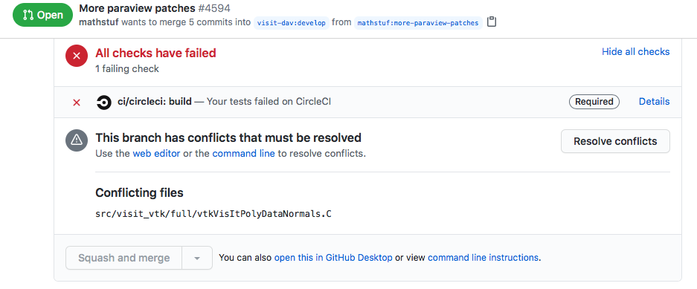
Automated Testing vs. Continuous Integration (CI) Testing
Automated Testing: Software that automatically performs tests and reliably detects and reports anomalous behaviors/outcomes.
Examples: Auto-test, Ctest/CDash, nightly testing, deployment testing, release testing
Potential issues: change attribution, timeliness of results, multiple branches of development
Continuous Integration (CI): automated testing performed at high frequency and fine granularity aimed at preventing code changes from breaking key branches of development (e.g. master)
Example: Disabled/enabled “Merge Pull Request” button on GitHub
Potential issues: extreme automation, test granularity, coverage, 3rd-party services/resources

Slide 5
CI Testing is one part of the “Shift Left” movement in DevOps

Slide 6
What can make CI Difficult
Common situations
Advanced situations
Just getting started
Many technologies/choices; often in the ”cloud”
Solution: start small, simple, build up
Developing suitable tests
Many project’s existing tests not suitable for CI
Solution: Simplify/refactor and/or sub-setting test suite
Ensuring sufficient coverage
Some changes to code never get tested
Solution: tools to measure it, enforce always increasing
Defining failure for many configurations
Bit-for-bit (exact) match vs. fuzzy match
Solution: absolute/relative tolerances → AI/ML
Numerous 3rd party libraries (TPLs)
Compiling takes too long
Solution: cache pre-built TPLs, containers
Performance testing
Avoid time-, space-, scaling-performance degredation
Solution: Perf. instrumentation and scheduled testing

Slide 7
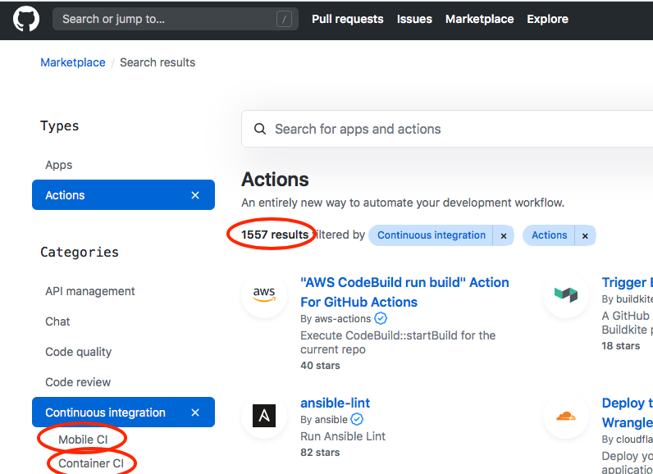
CI Resources (Where do jobs run?)
Free Cloud Resources (many free on GitHub, BitBucket, GitLab, etc.)
Travis-CI, Circle-CI, AppVeyor, Azure Pipelines,…
All launch a VM (Linux variants, Windows and OSX)
Constrained in time/size, config. (e.g. GPU type/count)
Not always suitable for large, HPC projects
Site-local Resources
Examples: Bamboo @ LLNL, Jenkins @ ANL, Travis+CDash @ NERSC, etc.
ECP Program: GitLab-CI @ ANL, LANL, LLNL, NERSC, ORNL, SNL
Roll your own by setting up resources and services

Slide 8





Examples…
travis-ci.com
github.com
Your code repository
Your CI Resources
LLNL
NERSC
bitbucket.llnl.gov
gitlab.nersc.gov
You

Slide 9
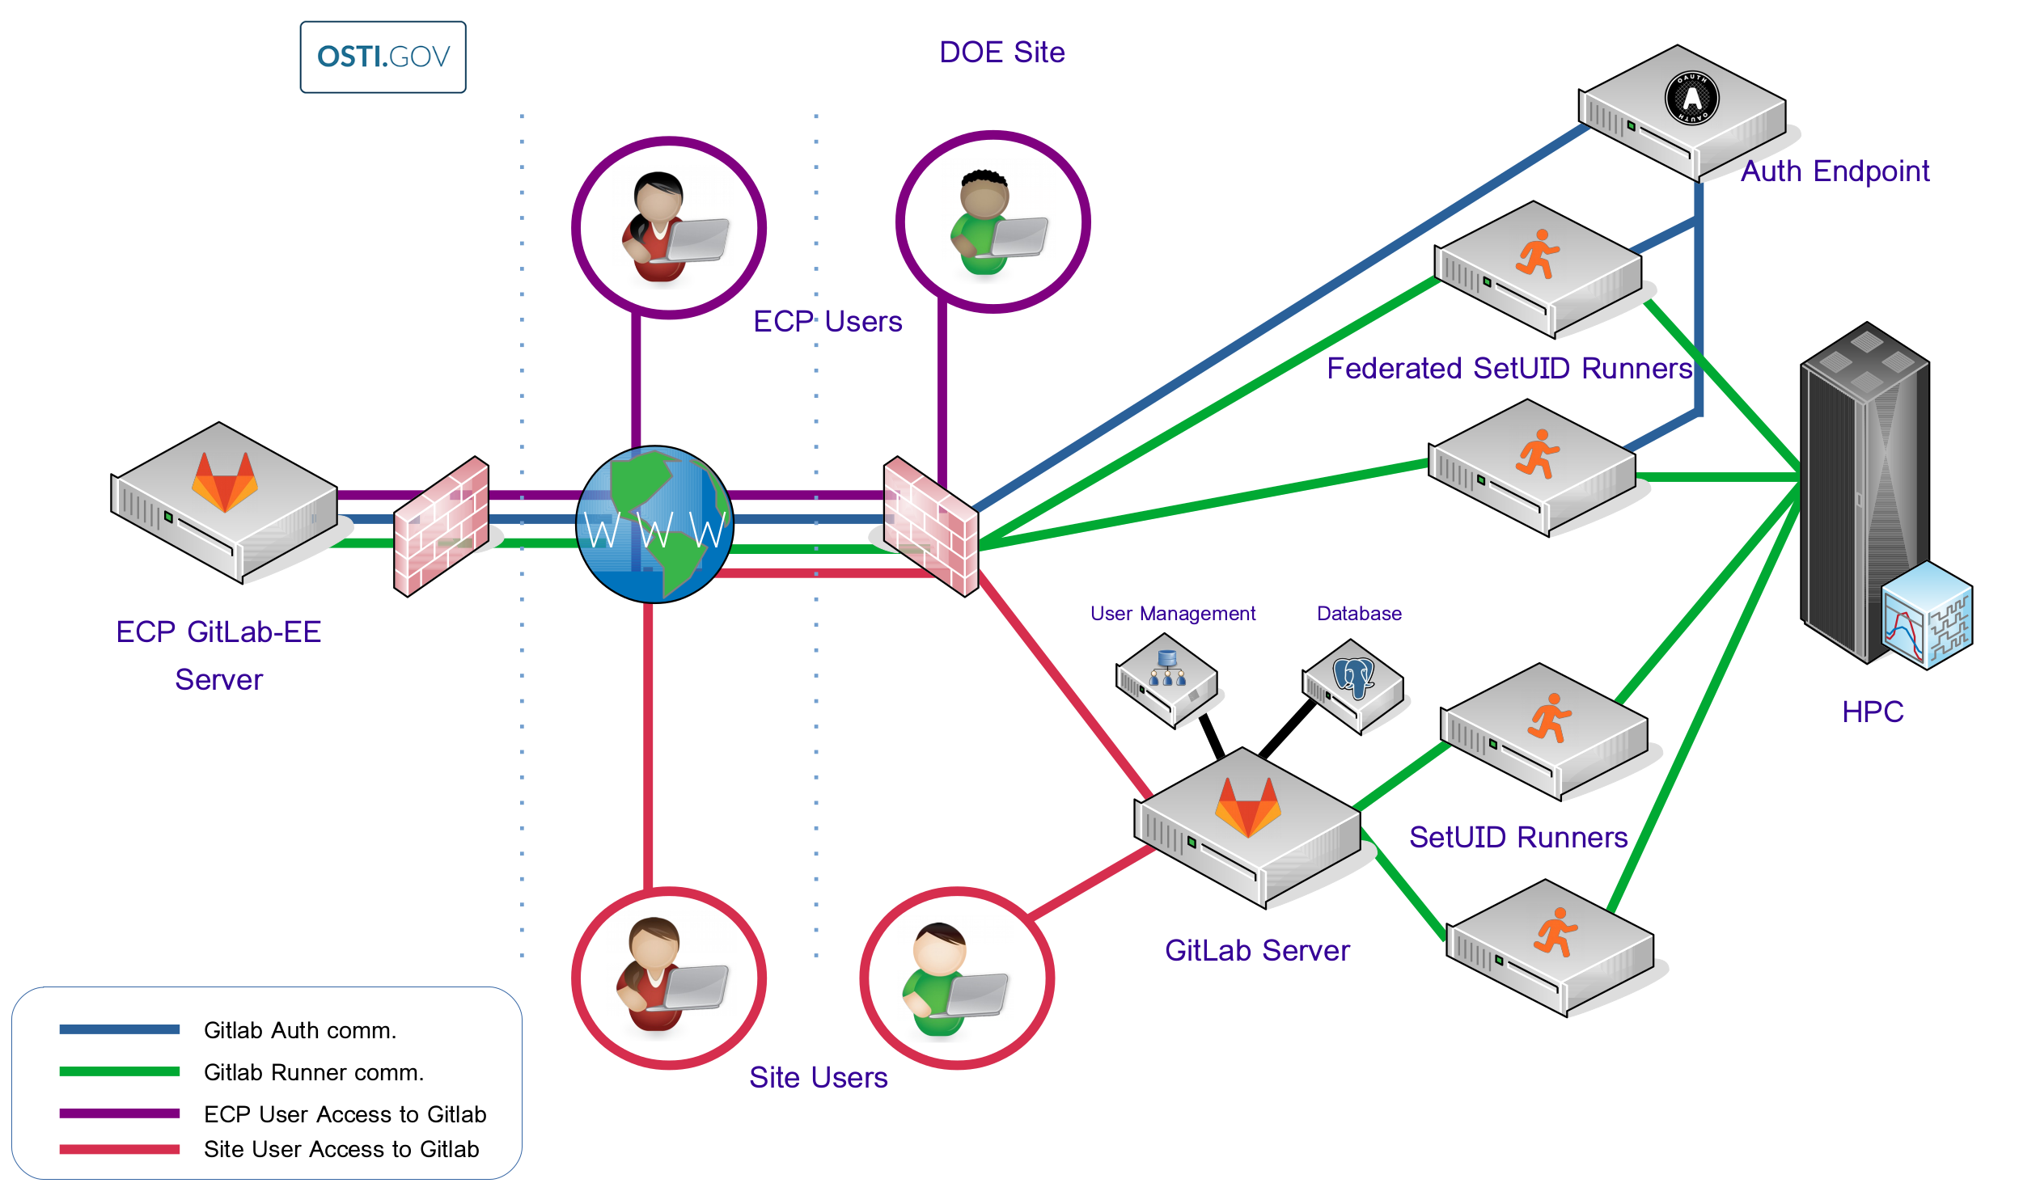
ECP CI Resources
ECP invested in GitLab for complex-wide CI
Non-GitLab projects mirror into GitLab
Complex-wide Federation via OSTI is goal.
Many hurdles still to overcome.
Manual federation possible…but non-trivial!
Documentation and on-boarding help
https://ecp-ci.gitlab.io
email me, miller86@llnl.gov for on-boarding contacts

Slide 10
Getting started with CI
In terms of configuration, what are your project’s highest priorities?
Which compiler and version?
What third party library version(s) if any?
What functionality is most important?
Good candidates to use as starting points for CI
A “hello world” example for your project
Any existing test with no/minimal dependencies and fastest to compile and run
Once you’ve got the basics working, its easy to add more

Slide 11
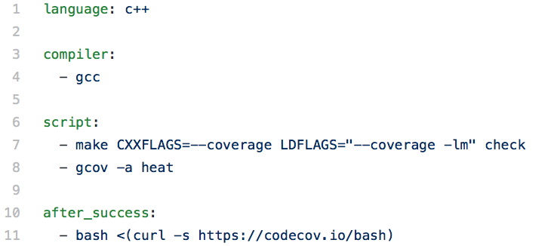
Getting started with CI:
Configuring CI
Example .travis.yml file (also doing coverage analysis)
Service | Config Interface
Travis | repo YAML file [& scripts] | /.travis.yml in root of repo
GitLab | Web page configurator + repo YAML file [& scripts] | /.gitlab-ci.yml in root of repo
Bamboo | Web page configurator + repo scripts
. . .

Slide 12
Getting started with CI:
Keywords specific to Travis-CI YML
Example .travis.yml file (also doing coverage analysis)
Specify environment
Commands to run

Slide 13
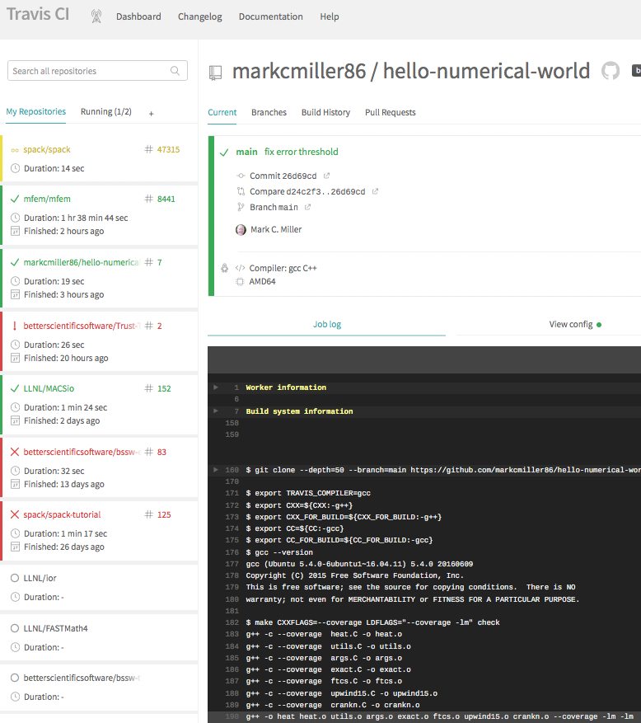
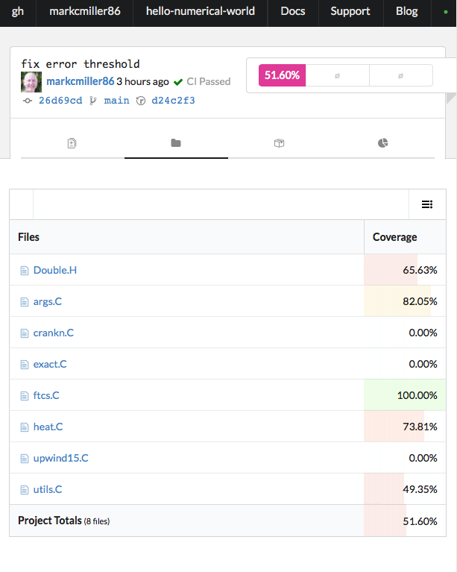

Slide 14
After Hours Hands-on Lesson (Video demo to be uploaded to YouTube)
Create GitHub account
Create Travis-CI account
Create Codecov account
Fork repo
Config repo integrations
Change ‘check’ to “check_all”

