Slide 1
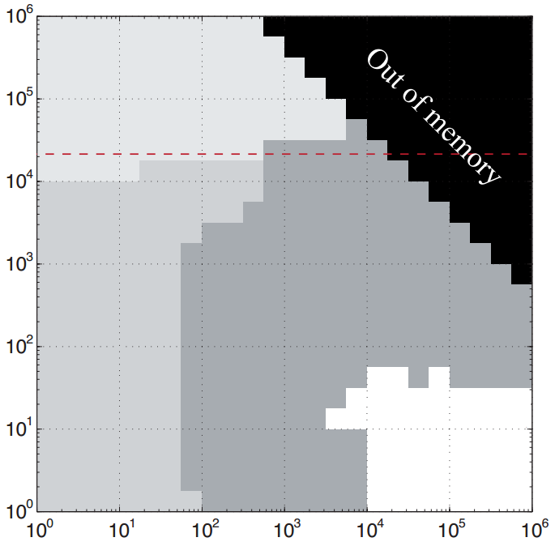
kernel 1: reduce_y__big_x_small_y
bx=0
bx=1
bx=2
output vector
Each thread is responsible for a single column of the matrix.
bdx=tune{32,64,128,192,256}
bdy=1
wdx=1
wdy=y
gdx=divup(x,bdx)
gdy=1
x
1 thread per column
y

Slide 2
kernel 2: reduce_y__huge_x_small_y
bx=0
bx=1
bx=2
wx = 0
wx = 1
wx = 0
wx = 1
wx = 0
wx = 1
wdx columns
per thread
Each thread is responsible for p columns of the matrix.
bdx=tune{32,64,128,192,256}
bdy=1
wdx=tune({1,2,3,4,5,6,7,8})
wdy=y
gdx=divup(x,bdx*wdx)
gdy=1
x
y

Slide 3
kernel 3: reduce_y__big_x_big_y
bx=0,by=0
bx=1,by=0
bx=0,by=1
bx=1,by=1
wy = 0
Each thread is responsible for a single column of the block.
bdx=tune{32,64,128,192,256}
bdy=1
wdx=1
wdy=tune{1,2,3,4,5,6,7,8}
gdx=divup(x,bdx)
gdy=divup(y,bdx*wdy) // each thread handles bdx*wdy elements
wy = 1
wy = 0
special kernel
that checks < y
x
1 thread per column
gdy blocks per column
intermediate memory of size (x,gdy)
then recursively call reduce_y on this temp array
y

Slide 4
kernel 4: reduce_y__small_x_any_y
by=0
by=1
wy = 0
(bdx % x) threads have their values discarded, effectively idle
Each thread is responsible for a single column of the matrix.
bdx=tune{32,64,128,192,256}
bdy=1
wdx=1
wdy=tune{1,2,3,4,5,6,7,8}
gdx=1
gdy=divup(y,bdx*wdy) // each thread handles bdx*wdy elements
wy = 1
wy = 0
special kernel
that checks < y
x
bdx/x threads per col
gdy blocks per col
intermediate memory of size (x,gdy)
then recursively call reduce_y on this temp array
y

Slide 5
