Slide 1
Features and Performance of Sarsa Reinforcement Learning Algorithm with Eligibility Traces and Local Environment Analysis for Bots in First Person Shooter Games
AY2019 Master Thesis Defense
Bundik Bettina Vivien (ブンディク ベッティーナ ヴィヴィエン)
5118FG13-8
Department of Computer Science and Communications Engineering Graduate School of Fundamental Science and Engineering Waseda University
2020.02.05.

Slide 2
Contents
Introduction
Background
Related Work
Purpose of Research
Methodology
Analysis of Local Environment
Experimental Setup
Experimentation and Discussion
Conclusion

Slide 3
Introduction
Reinforcement learning agents in first person shooter (FPS) games – good test bed for applying AI to complex environments
This field shares common features with robotics and multi-agent systems
FPS game: human player equipped with a gun in a 2D or 3D video game engages in combat with computer-controlled bots or other human players
FPS bots require basic skills for playing the game
Navigating through the environment
Collecting items (if available)
Initiating combat
Aspects of survival
Notes:
FPS agents can be applied to real-life situations as well

Slide 4
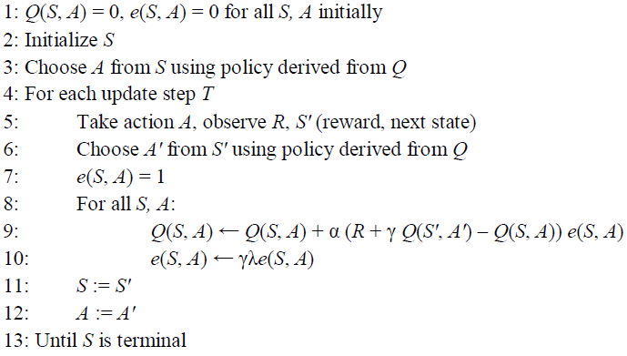
Background
FPS bots train by reinforcement learning and learn from experience
They use tabular Sarsa(λ) algorithm with eligibility traces
Agent learns a value based on the current action A derived from the current policy Q
With eligibility traces, agents can learn sequences of actions and past actions can benefit from the current reward
Policy of Sarsa(λ) derived from Q: choose highest Q-value with ε-greedy selection
ε-greedy creates balance between exploration and exploitation
Pseudocode of Sarsa(λ)
Notes:
Tabular: lookup table to map numerical values to state-action pairs
Eligibility traces: important for an effective combat strategy
epsilongreedy – random action is chosen (ε) of the time, action of the policy (1 – ε) of the time

Slide 5
Related Work
Sarsa(λ) applied to agents of FPS games is proven to be effective and well-working
One method [1] for dividing tasks of agents and training them separately
Navigation: path-finding and collecting items
Combat: bots’ shooting skills and combat strategies
Combinations of controllers [2] was done by either training or rule-based systems
Decent navigational skills were developed
Stealth and aggressive style combat was learned by agents
Another paper [3] achieved adaptive shooting skills for FPS bots
Applied a dynamic reward scheme for shooting
Resulted in good combat strategies and unpredictable, adaptive behaviour

Slide 6
Purpose of Research
Increase quality of game-play and performance of agents according to general goals
Improved navigation and item-collecting skills by
Minimalize the count of collisions with obstacles
Maximalize the distance travelled and items picked up
Better combat strategy by
A higher hit and kill count and lower death count
Adaptive combat behaviour (stealth and aggressive styles)
Proposed method: reach goals by combining Navigation and Combat Controllers with data abstraction method and compare to previous methods
After training Navigation and Combat Controllers
An analysis of local environments of agents is carried out where a preferred controller is chosen considering the result

Slide 7
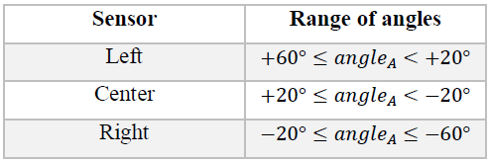
Methodology I
Environment and Maps
Environment contains the bots, predefined maps, walls, items and shooting mechanism
There are 4 maps (50 x 50, 2D-layout) with a variety of design
Arena map, Maze map – Navigation Controller
Combat map – Combat Controller
Ultimate map – trains all tasks with proposed method
Agents
An FPS bot has its own data fields
Position, direction, health points etc.
View range
+60° to –60° relatively to direction
Equipped with 3 sensors for obstacles and items
Angle ranges shown in table
Angle ranges for sensors of agents
Notes:
Variety of design is needed if agents train for multiple tasks, each layout is responsible for a group of actions

Slide 8
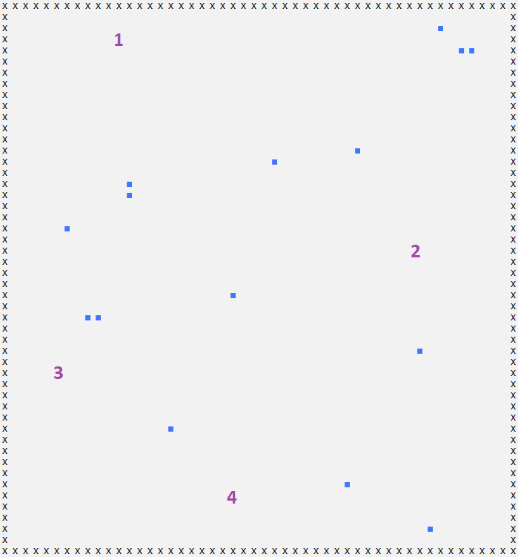
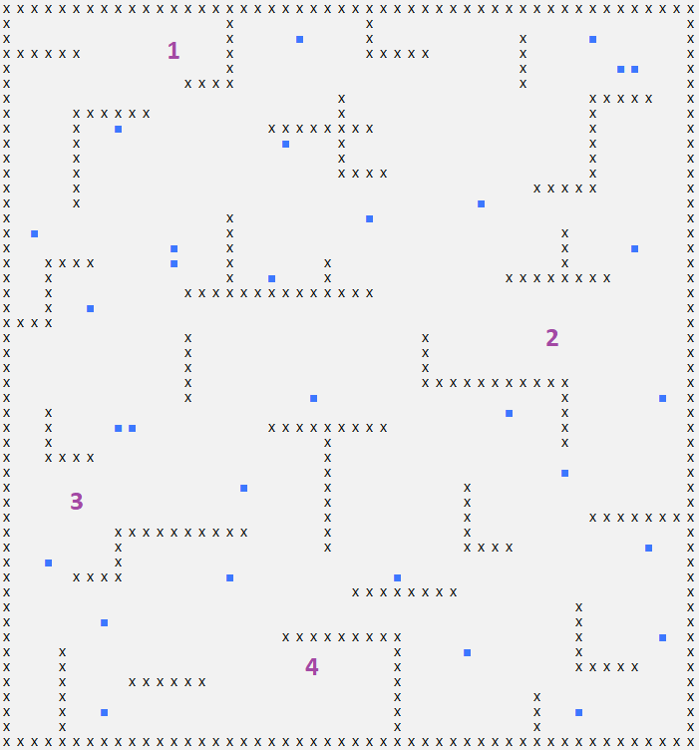
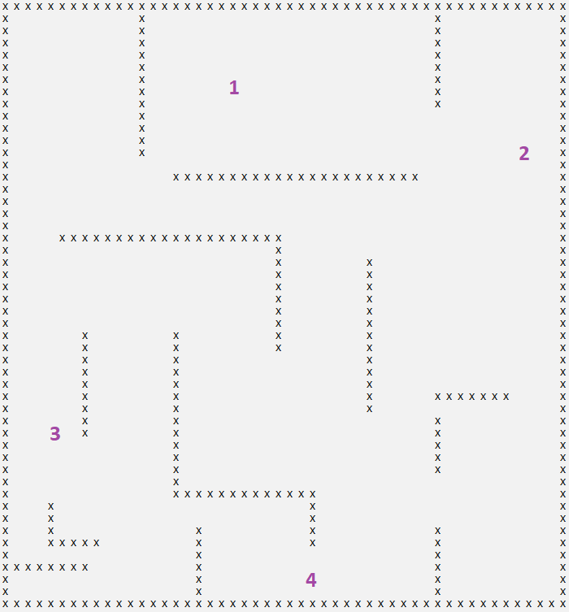
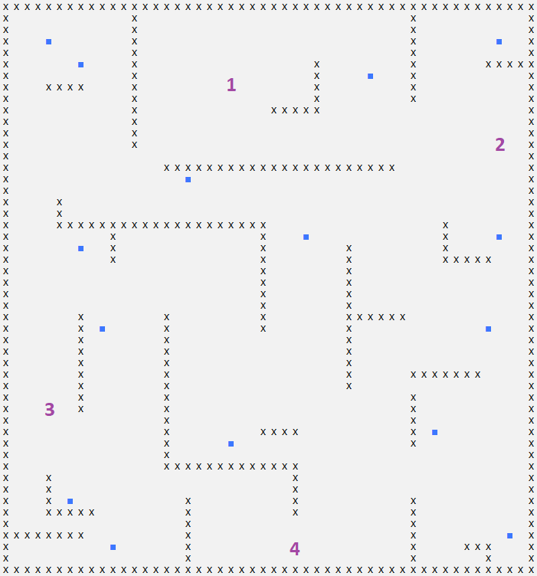
The Arena map
The Maze map
The Combat map
The Ultimate map

Slide 9
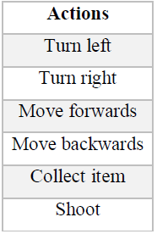
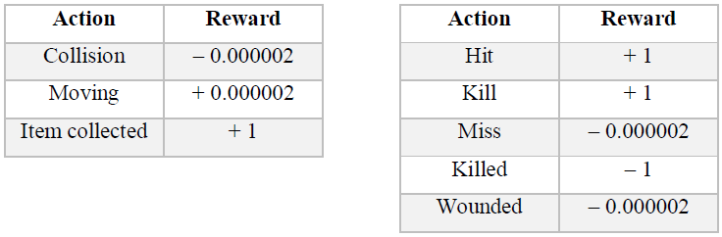
Methodology II
State for Navigation Controller
Has 6 values returned from 3 sensors
One value for items and one for obstacles for each sensor
These are either far, close on non-existent
State for Combat Controller
Considers the closest visible enemy
If there is one
Its estimated distance
Whether the agent’s weapon is on cooldown (1 second)
Agent’s current health points
Available actions for agents
Navigation Reward Scheme
Combat Reward Scheme
Notes:
Actions include turning, moving, picking up an item and shooting
And there are two separate reward schemes for the controllers

Slide 10
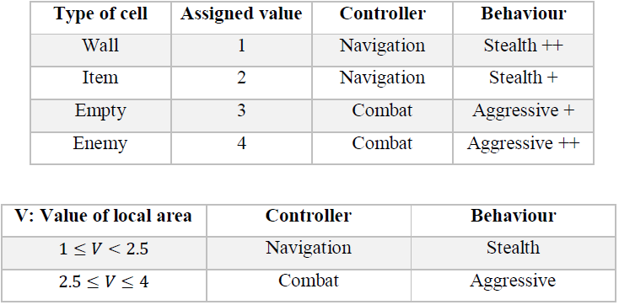
Analysis of Local Environment
Proposed method
To train Navigation and Combat Controllers
To conduct an Ultimate training with following data abstraction method
Analysing process of local surroundings of agents
Features of local areas are considered because a large map contains open areas, as well as parts that have higher density of obstacles
Value is assigned to each cell according to its type and their average is taken (V)
Intervals for V decide on which controller to use in a given state
According to observations of agents’ behaviours: stealth = navigation, aggressive = combat controller in this scheme
Assigned values and behaviour types
Value intervals
Notes:
Stealth = navigation = they prioritize exploration of the map, and would rather run away from combat
Aggressive = combat = bots go after opponents, engage in lots of combat

Slide 11
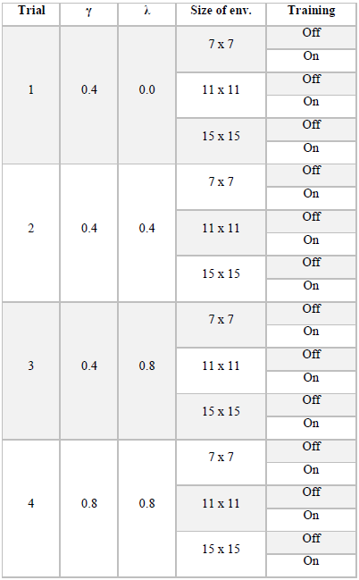
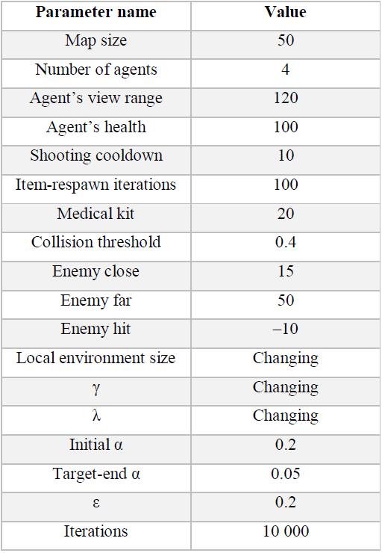
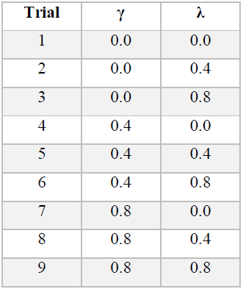
Experimental Setup
Trials (Ultimate)
Simulation parameters
Trials (Navigation, Combat)

Slide 12
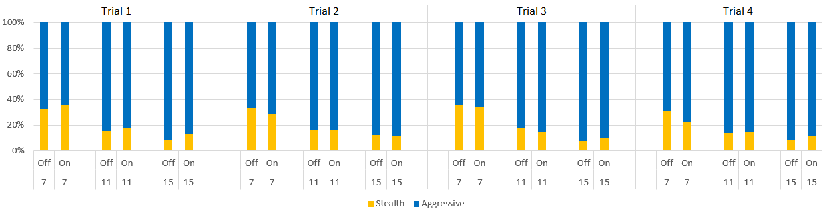
Experimentation and Discussion – Chosen Behaviour
Percentages of chosen behaviours on Ultimate map
There is correspondence between chosen behaviours and local area sizes: agents choose aggressive style more often as size grows
With smaller local area and training turned on, choices between controllers seem to be more balanced which is more optimal in the long run
Fair adaptiveness is achievable

Slide 13
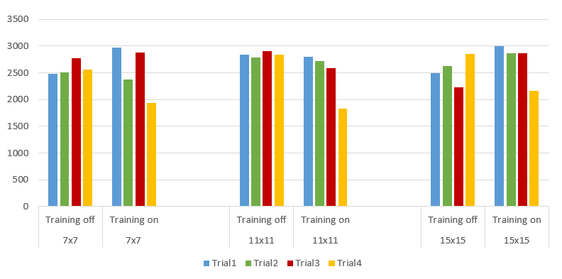
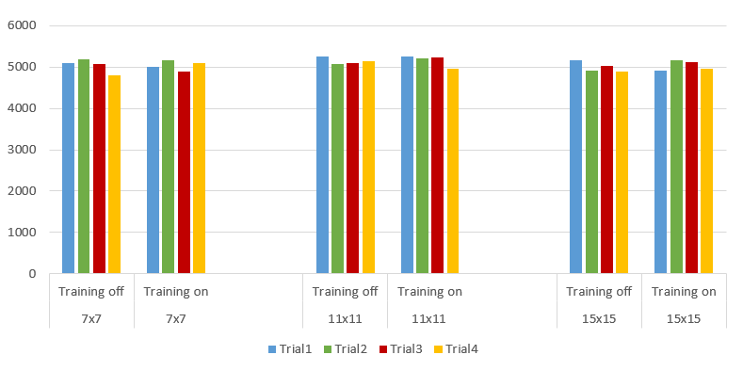
Experimentation and Discussion – Collisions and Distances
Collision counts of Ultimate map
Distances travelled on Ultimate map
Correlations to Sarsa training parameters can be observed, but no relation to proposed method
Higher γ and λ creates aggressive behaviour (less colliding, less distance)
Lower γ and λ creates stealth behaviour (more colliding, more distance)
Collision counts stay lower when agents are still in training
Overall distance is ~1.5 times more than that of a simple Navigation Controller
Notes:
Lowest collision is at trial 4, training turned on with local area size 7 and 11

Slide 14
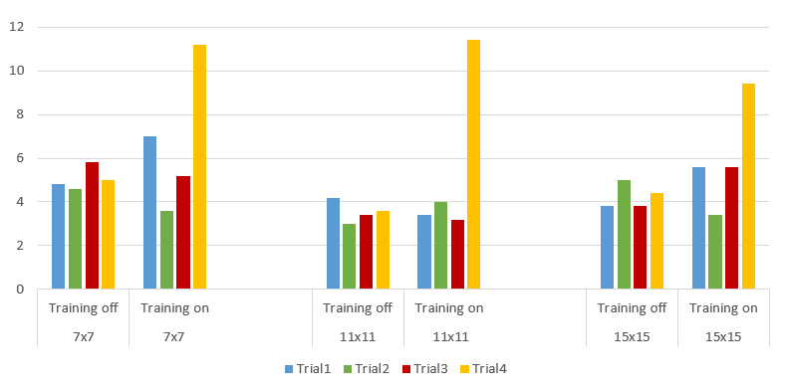
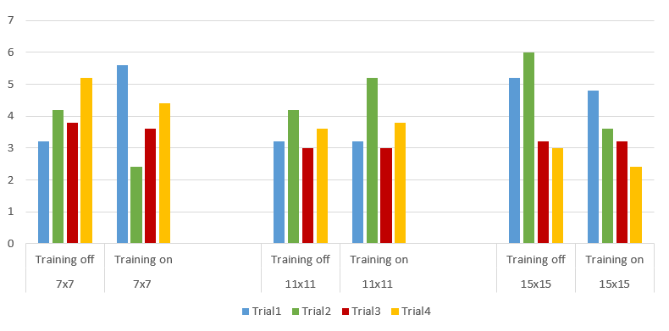
Experimentation and Discussion – Items and Kills/Deaths
Items collected on Ultimate map
Numbers of kills and deaths of Ultimate map
No clear pattern or convergence here either, item counts are slightly higher when training stays on
Trial 4 has a high peak in item counts (γ and λ both high) implying that a new combat strategy is found: agents realize the healing ability of items, thus collecting more and surviving longer during combat – effective and useful
Also counts of kills and deaths are slightly lower in this case

Slide 15
Conclusion
Successfully trained Navigation and Combat controllers are combined in an FPS game as ultimate training with local environment analysis
A choice is made at every step on preferred behaviour (selected controller)
Similar level of performance is achieved compared to related work, but not better
One of the trials (4) develops a new and effective strategy where FPS bots make use of healing collectibe items in order to survive longer
References
[1] Michelle McPartland and Marcus Gallagher, “Learning to be a Bot: Reinforcement Learning in Shooter Games,” Artificial Intelligence Interactive Digital Entertainment, Stanford, CA, 2008.
[2] Michelle McPartland and Marcus Gallagher, “Reinforcement Learning in First Person Shooter Games,” IEEE Transactions on Computational Intelligence and AI in Games, Vol. 3, No. 1, 2011.
[3] Frank G. Glavin and Michael G. Madden, “Adaptive Shooting for Bots in First Person Shooter Games Using Reinforcement Learning,” IEEE Transactions on Computational Intelligence and AI in Games, Vol. 7, No. 2, 2015.

