Slide 1

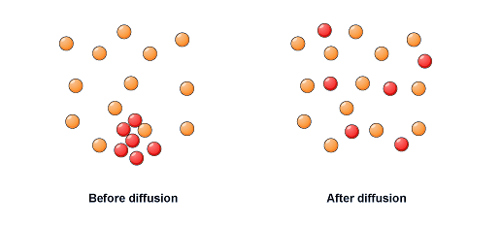
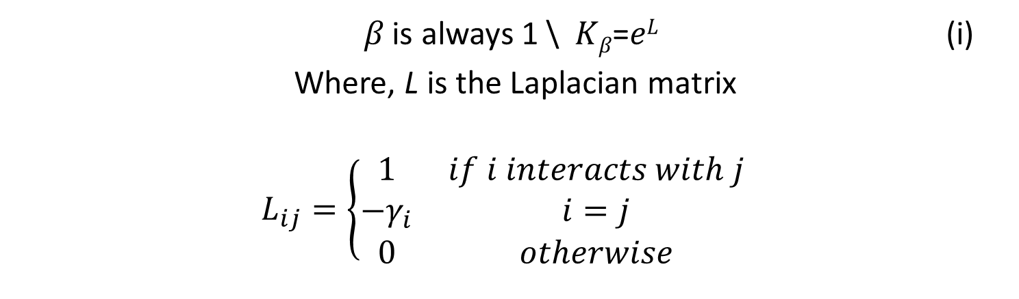


Identifying Probable Protein-Protein Interactions Related to Asthma and Allergy Using the Diffusion Kernel
Bett, Dominic K.*, Mondal, Ananda M.
Department of Mathematics and Computer Science, Claflin University, Orangeburg, SC 29115
* Corresponding Author, Email: dbett@claflin.edu
ABSTRACT
Many diseases occur due to over-expression or suppression of certain proteins. These proteins come to physical contact with each other due to biochemical events in a process called Protein-Protein Interaction (PPI). Studies have been done on how the PPI networks directly influence the development and progression of diseases. In this study, we focus on neighborhood proteins in the PPI network that do not physically interact with each other but have a likelihood to interact with the actual PPIs in the network. We predicted the probable missing PPIs related to asthma and allergy using the diffusion kernel. Identifying these missing PPIs would complete the network biomarker for a disease.
INTRODUCTION
Diagnosis of some chorionic diseases such as cancer, diabetes, and asthma is based on certain PPI network biomarkers. Studies have also been done on how these network biomarkers dynamically affect disease progression. Identifying missing links in the network is therefore important for better representation of the network.
MATERIALS AND METHODS
Dataset
PPI network for asthma and allergy used for present analysis is developed by overlaying the differentially expressed proteins on genome-wide PPI network. The PPI network for asthma and allergy is composed of 1,425 PPIs with 84 proteins. Genome-wide PPI data are obtained from STRING database and differentially expressed proteins are obtained from SABiosciences of Qiagen. A sample of the dataset is as shown on Table 1 below:
Sub-networks
The PPI scores represent the confidence of the interaction. Higher PPI scores indicate higher confidence. The data was sorted in order of their PPI scores and six sub-networks generated for the purpose of this investigation. Network-500 through network-950 as shown on Table 2 below represent PPI networks with threshold PPI scores of through 950 respectively. The average degree of interaction is calculated as:
$Average degree=$ $\frac{Number of PPIs in the network}{Number of proteins in the network}$
The number of Non-PPIs represents the number of PPI combinations, given the particular proteins in the network, that do not belong to the actual set of PPIs. That is, they are non-existent.
Method
The idea of diffusion kernel came from the physical phenomenon of diffusion of heat or gas.
Diffusion kernel, K on a graph corresponds to random walk on a graph and could be modeled as:
Protein interactions for asthma and allergy are represented in a two dimensional space called a Laplacian matrix, L. In this study, Laplacian matrix is a square matrix, where an element is 1 if two proteins interact, otherwise 0. The diagonal value for a protein is the negative of number of interactions with the protein as shown on Table 3 below.
The Laplacian matrix is then used to evaluate the diffusion kernel, which assigns similarity weights to all possible PPIs for each unique proteins associated with asthma and allergy in the network. The diffusion kernel is computed using equation (i) above as shown in Table 4 below. Just like in the Laplacian matrix, values of corresponding PPIs in the diffusion kernel are the same.
In this study, probable PPIs for each Asthma and Allergy sub-networks are predicted as the non-existing PPIs that have higher average diffusion kernel values(K-val) than those of the actual PPIs.
Results and Discussion
Technique
The approach taken in this research was in favor of average diffusion kernel threshold value as opposed to minimum diffusion kernel threshold value. There is an inverse relationship between the average degree of interaction and the diffusion kernel values as shown in Figure-2 below
We considered results from Network-500 through Network 950 as possible missing PPIs. As an experiment to verify our results, we appended the probable missing PPIs to the existing ones in each network and re-evaluated the diffusion kernel. In accordance with our hypothesis, 95.95% of the Missing PPI had diffusion kernel values higher than their initial values. Table 5 below shows a sample of the predicted missing PPIs.
Conclusion and Future WORK
There exists some missing PPIs in the Asthma and Allergy PPI network
These missing PPIs enables us to have a complete network biomarker for the disease
Diffusion kernel can be used to predict these probable missing PPI
In future, other prediction methodologies will be used to validate the results
AcknOWledgmenT
This work is partially supported by the HBCU-UP grant.
References
C. von Mering, L. J. Jensen, B. Snel, S. D. Hooper, M. Krupp, M. Foglierini, et al., "STRING: known and predicted protein-protein associations, integrated and transferred across organisms," Nucleic Acids Res, vol. 33, pp. D433-7, Jan 1 2005.
A. Mondal and J. Hu, "Network based prediction of protein localisation using diffusion Kernel," International Journal of Data Mining and Bioinformatics, vol. 9, pp. 386-400, 2014.
P. Timalsina, K. Charles, and A. M. Mondal, “STRING PPI Score to Characterize Protein Subnetwork Biomarkers for Human Diseases and Pathways,” IEEE 14th International Conference on Bioinformatics and Bioengineering. Nov 10-12, 2014. (Accepted)
Figure-1: Visualization of the diffusion process
𝛽 is always 1 \ 𝐾_{𝛽}=𝑒^{𝐿} (i)
Where, L is the Laplacian matrix
$$L_{ij}=\left\{\begin{matrix}1 & if i interacts with j \\ {−γ}_{i} & i=j \\ 0 & otherwise\end{matrix}\right.$$
Figure-2: Relationship between the average interaction and average diffusion kernel values for Asthma and Allergy PPI networks
Table 3: Sample Laplacian Matrix Data produced by the Allergy and Asthma PPI dataset
Table 1: Sample list of Allergy and Asthma PPIs and their scores.
 | ADAM33 | ADRB2 | ALOX5 | AREG | … | TNFSF4 | TPSAB1 | TSLP
ADAM33 | -29 | 1 | 0 | 0 | … | 0 | 0 | 0
ADRB2 | 1 | -27 | 0 | 0 | … | 0 | 0 | 1
ALOX5 | 0 | 0 | -22 | 0 | … | 0 | 0 | 0
AREG | 0 | 0 | 0 | -15 | … | 0 | 0 | 0
… | … | … | … | … | … | … | … | …
TNFSF4 | 0 | 0 | 0 | 0 | … | -25 | 0 | 1
TPSAB1 | 0 | 0 | 0 | 0 | … | 0 | -12 | 0
TSLP | 0 | 1 | 0 | 0 | … | 1 | 0 | -40
Number | PPI | Score
1 | CCL11 CCR3 | 999
2 | CCL17 CCR4 | 999
3 | CCL22 CCR4 | 999
4 | CCL24 CCR3 | 999
5 | CCL26 CCR3 | 999
… | … | …
1421 | MRC1 PPARG | 152
1422 | ADRB2 EPX | 151
1423 | CHIA IL4 | 151
1424 | CER1A PPARG | 151
1425 | IL2RA RNASE2 | 151
Table 5: Sample of the resulting Missing PPI
 | Missing PPIs
1 | CYSLTR1 KITLG
2 | RNASE2 RNASE3
3 | CCL24 CCL8
4 | CPA3 KIT
5 | ALOX5 KITLG
6 | CCL24 GPR44
… | …
46 | IL12A MS4A2
47 | KIT MS4A2
48 | PDCD1 TNFRSF4
*The standard protein names herein are as provided by the HUGO Gene Nomenclature Committee (HGNC).
Table 4: Sample Diffusion Kernel values for Allergy and Asthma PPI Network
 | ADAM33 | ALOX5 | AREG | ARG1 | … | TNFSF4 | TSLP | Total
ADAM33 | 0.171820 | 0.008344 | 0.004183 | 0.001545 | … | 0.009716 | 0.011132 | 1.000000
ALOX5 | 0.008344 | 0.048186 | 0.005586 | 0.001414 | … | 0.010738 | 0.012012 | 1.000000
AREG | 0.004183 | 0.005586 | 0.403810 | 0.000598 | … | 0.007024 | 0.007806 | 1.000000
ARG1 | 0.001545 | 0.001414 | 0.000598 | 0.331460 | … | 0.001887 | 0.002118 | 1.000000
… | … | … | … | … | … | … | … | …
TBX21 | 0.011385 | 0.011936 | 0.008111 | 0.002929 | … | 0.014623 | 0.014210 | 1.000000
TGFB1 | 0.011298 | 0.012559 | 0.012080 | 0.002204 | … | 0.014154 | 0.014082 | 1.000000
TNFRSF4 | 0.010257 | 0.010965 | 0.007297 | 0.002087 | … | 0.022140 | 0.014852 | 1.000000
TNFSF4 | 0.009716 | 0.010738 | 0.007024 | 0.001887 | … | 0.027408 | 0.015446 | 1.000000
TSLP | 0.011132 | 0.012012 | 0.007806 | 0.002118 | … | 0.015446 | 0.014657 | 1.000000
Total | 1.000000 | 1.000000 | 1.000000 | 1.000000 | … | 1.000000 | 1.000000
$$\text{e}L=\sum_{k=0}^{∞}{\frac{Ak}{k!}}$$
Table 2: Topology of Allergy and Asthma PPI network
Table 5: Summary of probable missing PPI evaluated by using average K-val and minimum K-val as threshold values.
 | # of PPI | # Protein | Avg. Deg. | # of Non-PPI
Original | 1425 | 84 | 16.96 | 2061
N_500 | 610 | 83 | 7.35 | 2793
N_600 | 540 | 82 | 6.59 | 2781
N_700 | 468 | 77 | 6.08 | 2458
N_800 | 346 | 73 | 4.74 | 2282
N_900 | 240 | 68 | 3.53 | 2038
N_950 | 183 | 61 | 3.00 | 1647
 | Diffusion Kernel |  | # of Non-existing PPI larger than
PPI | Avg. D.K. Value | Min. D.K. Value | Avg. D.K. Value | Min. D.K. Value
Original | 0.011926 | 0.011891 | 1252 | 1846
N_500 | 0.013495 | 0.011349 | 18 | 1816
N_600 | 0.014591 | 0.011783 | 15 | 1481
N_700 | 0.017008 | 0.012946 | 5 | 1308
N_800 | 0.022212 | 0.013661 | 11 | 1110
N_900 | 0.028909 | 0.015859 | 15 | 547
N_950 | 0.033594 | 0.016331 | 10 | 543
The Emerging Researchers National (ERN) Conference in STEM, Washington DC, February 19-21, 2015

