Slide 1
One-Way ANOVA

Slide 2
About the Project
The goal in this project is to analyze if test whether there are significant differences among the group means.
Iris dataset used, the most famous and widely used dataset in machine learning and statistics.
It was introduced by the British statistician and biologist Ronald Fisher in 1936 as an example for discriminant analysis.
It has 150 samples (rows), 4 features (petal and sepal dimensions), and target variable with three categories (iris: setosa, versicolor and virginica, 50 samples each).

Slide 3
Data Cleaning and Exploration
ggplot2, car, dplyr and DescTools libraries were used.
There are no missing values , all 150 observations are complete.
No handling is required, as the data is clean and complete.

Slide 4
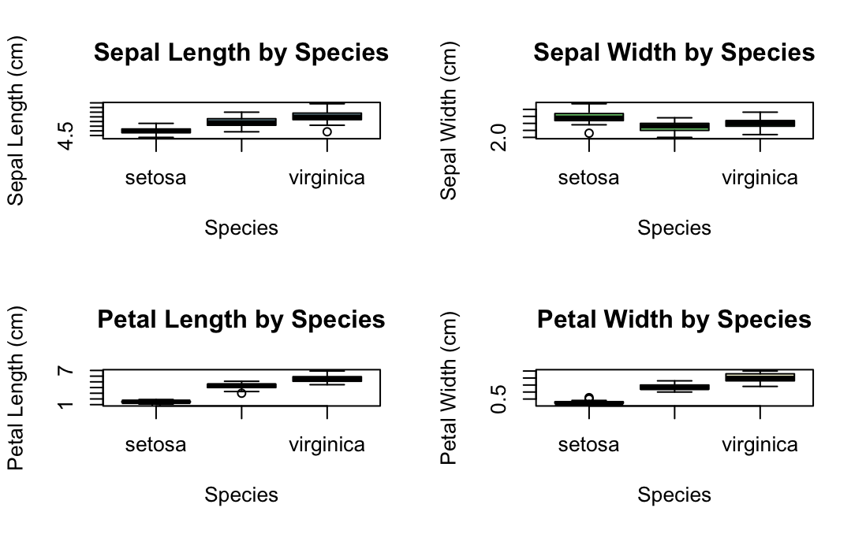
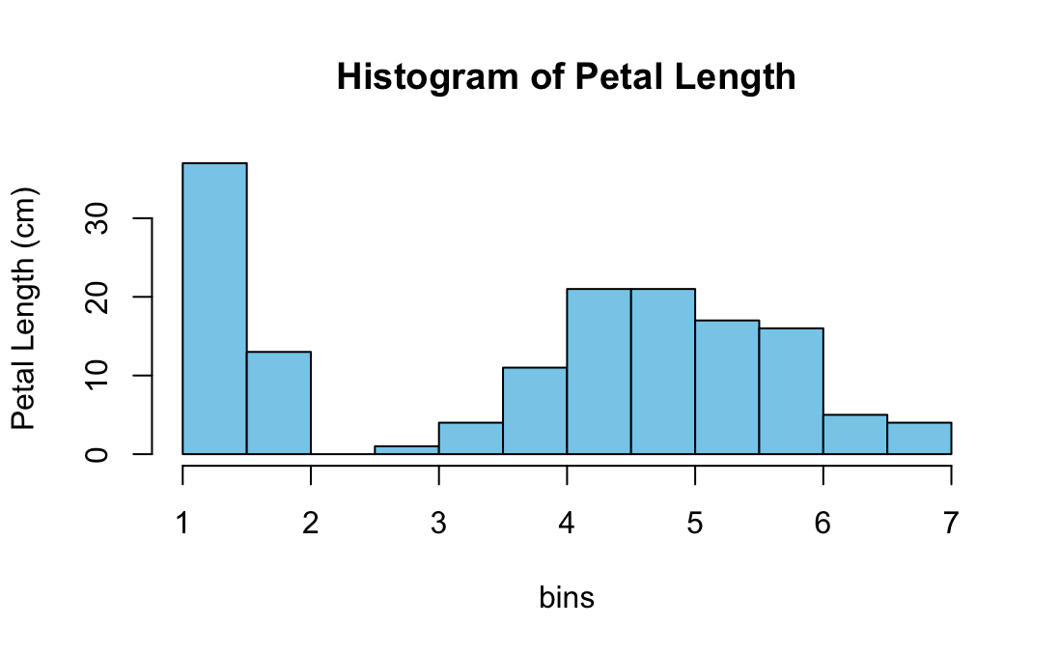
Summary Statistics Plots and Exploration Analysis

Slide 5
Assumptions Checking
Before conducting ANOVA, we have to check for the following assumptions:
  Normality: Are the response variable values within each group approximately normally distributed?
  Homogeneity of Variances: Are the group variances approximately equal? Use Levene’s test or Bartlett’s test.

Slide 6
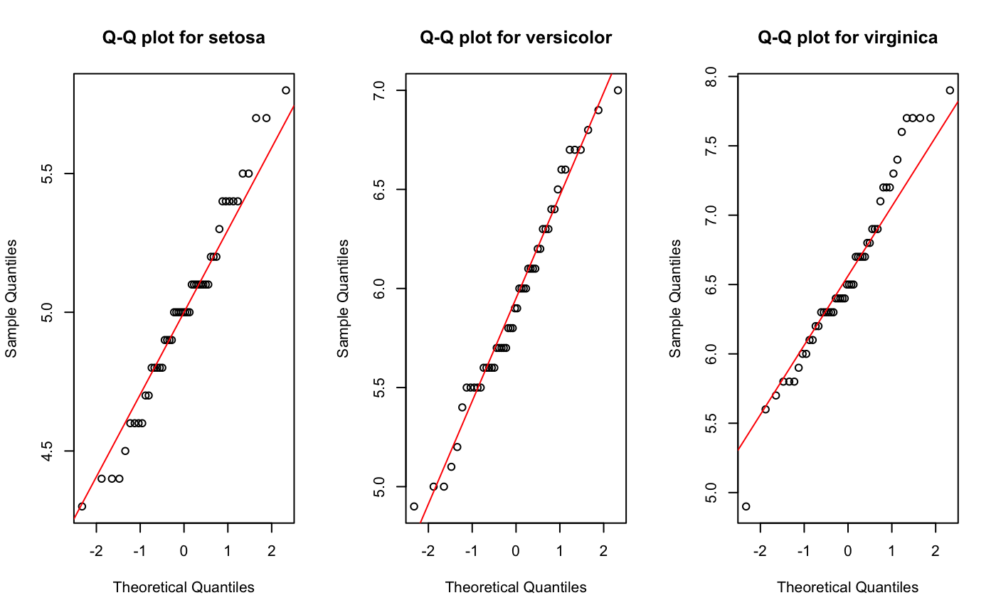
Assumptions Results
From the plots, distributions of sepal length and sepal width generally adhere to normality across all three species (setosa, versicolor, and virginica), although for setosa and virginica, there is a slight deviation at the 1-2 quantiles.

Slide 7
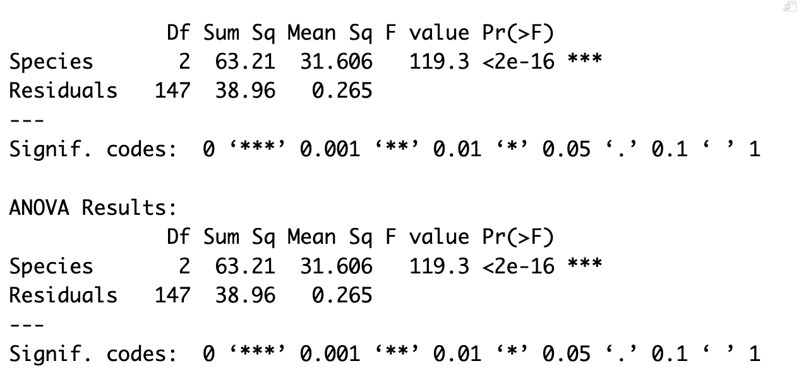
ANOVA Analysis
The F-statistic of approximately 119.3 is very large, indicating substantial variation between group means (species) relative to within-group variation.
The p-value (2×10^16) is less than 0 '***', inferring there is strong evidence to reject the null hypothesis that the mean sepal length is equal across all three species.
The between-group sum of squares (63.21) accounts for most of the total variation, underscoring the species effect.
While ANOVA confirms at least one pairwise difference exists, it does not specify which pairs differ—follow-up post-hoc tests, such as the Tukey's HSD, would reveal whether all three pairwise comparisons are significant.

Slide 8
Post-Hoc Analysis and Interpretation
Iris virginica has the longest mean sepal length, significantly longer than both versicolor (by 0.652 cm) and setosa (by 1.582 cm).
Iris versicolor has intermediate sepal length, significantly longer than setosa (by 0.930 cm).
Iris setosa has the shortest mean sepal length.
The 95% confidence intervals for all differences do not include zero, confirming that none of the pairwise differences could reasonably be due to chance.
Tukey's HSD confirms that all three Iris species have statistically distinct mean sepal lengths, with a clear ordering: setosa < versicolor < virginica.

Slide 9
Conclusion
All three pairwise comparisons show highly significant differences (adjusted p = 0.0000).
This supports the strong discriminatory power of sepal length for distinguishing among the species, consistent with the extremely significant ANOVA result (F = 119.3, p < 2e-16).
Although petal measurements typically separate the species even more clearly, sepal length alone is sufficient to detect highly significant differences between all pairs.

