Slide 1
Assistance with choosing a location where to Relocate to
Applied Data Science Capstone

Slide 2
Introduction
- a help with picking up the right location where to move to in Prague
- used by someone who needs basic overview of areas in Prague
- situated on the Vltava River
- capital city of the Czech Republic
- 1.3 million people

Slide 3
Data
GeoLocations – for 57 city districts
- 112 cadastral territories
- Nominatim (latitude,longtitude)
- OSMNX (POINTS,POLYGONS)
Venues - Foursquare API – top venues in each cadastral
Rents and extras – csv files of recycling bins and trans. Stops added to venues
- rents – averages per m² in CZK

Slide 4
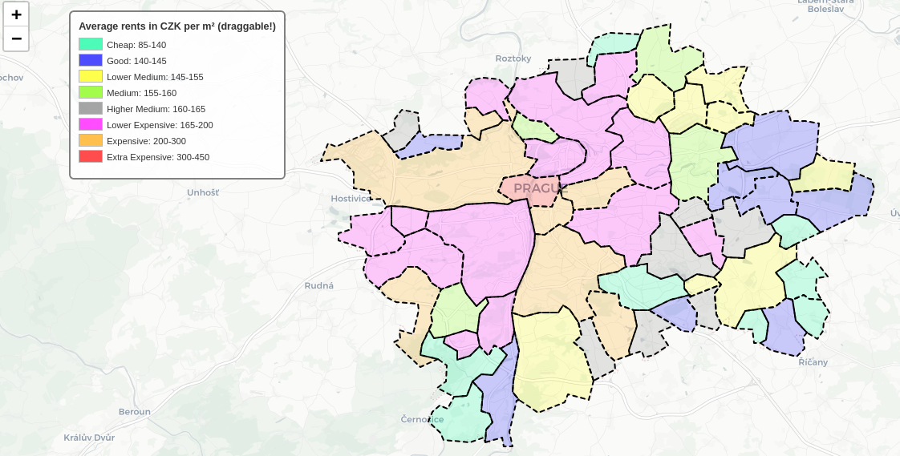
Main
The basic map with rents

Slide 5
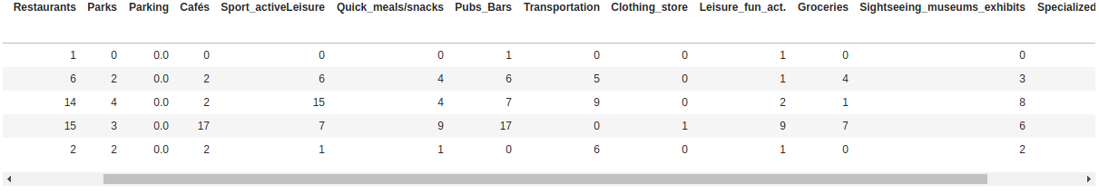
Foursquare dataset
Top venue categories for each of 112 cadastral districts
All categories are grouped and generalized

Slide 6
Recycling and buses
density of available waste bins for recycling in each cadastral
density of bus and tram stops in neighborhoods
- FourSquare category Transportation is more like transportation hub

Slide 7
Normalizing and clustering
main dataframe consists of several generalized groups of venues – each large scale of values
using sklearn.MinMaxScaler – value 0 – 1
Using clustering algorythm AffinityPropagation from sklearn

Slide 8
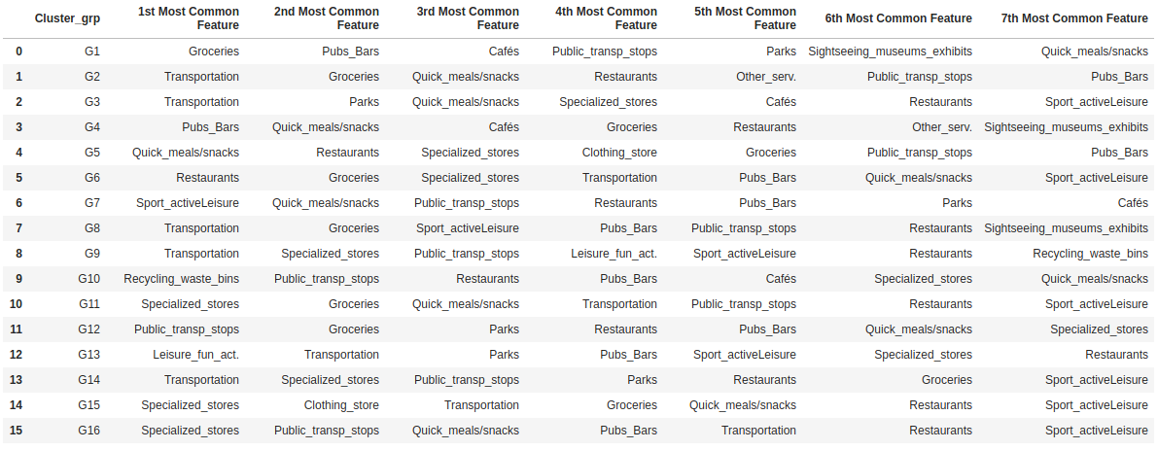
Main Article
- 16 cluster groupes with 7 most common venues

Slide 9
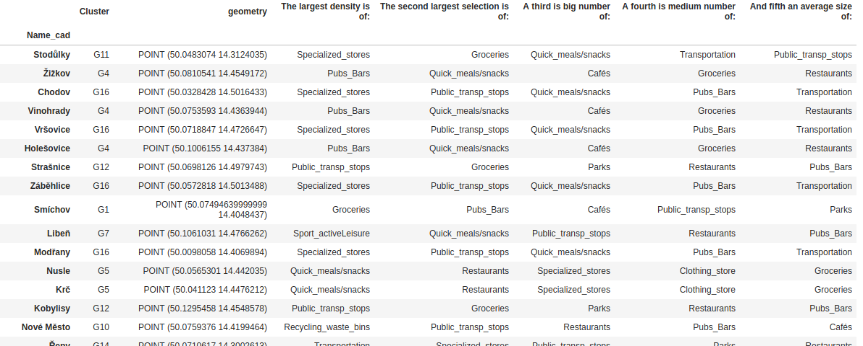
Main Article
- the main dataframe with cadastral names, its locations, cluster groups and five density based features

Slide 10
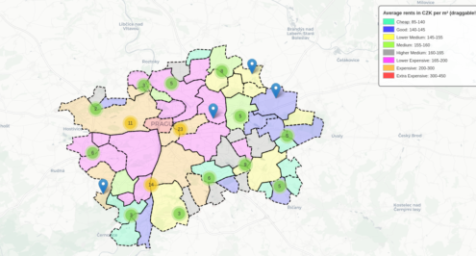
Completing and summarizing

Slide 11
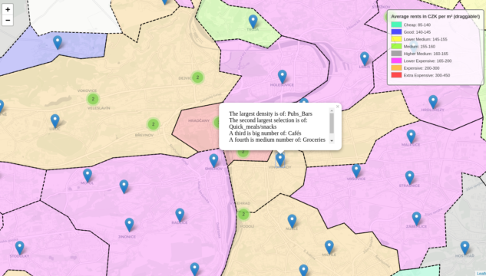
Completing and summarizing

Slide 12
Completing and summarizing
- merging dataframe with the main map helped us when trying to pick one of neighborhoods where to relocate
- choices here are really individual and everything depends on everyone's preferences
- the map tells us the average costs of living and top five categories of venues in specific area

Slide 13
References
[1] https://www.welcometoprague.eu/basic-information-about-prague
[2] http://opendata.praha.eu/dataset/ipr-mestske_casti
[3] https://foursquare.com/
[4] https://realitymix.centrum.cz/statistika-nemovitosti/byty-pronajem-prumerna-cena-pronajmu-1m2-mesic.html http://www.cenovamapa.eu/
[5] http://opendata.iprpraha.cz/CUR/DOP/DOP_PID_ZASTAVKY_B/WGS_84/DOP_PID_ZASTAVKY_B.json
[6] http://opendata.iprpraha.cz/CUR/ZPK/ZPK_O_Kont_TOitem_b/S_JTSK/ZPK_O_Kont_TOitem_b.json
[7] https://mapshaper.org/
[8] https://nbviewer.jupyter.org/gist/talbertc-usgs/18f8901fc98f109f2b71156cf3ac81cd
[9] https://cs.wikipedia.org/wiki/Seznam_katastr%C3%A1ln%C3%ADch_%C3%BAzem%C3%AD_Prahy_podle_po%C4%8Dtu_obyvatel
[10] https://github.com/gboeing/urban-data-science
[11] https://www.toptal.com/machine-learning/clustering-algorithms

