Slide 1
Influence of Tiered Starting Positioning: Formula 1 British Grand Prix (Silverstone)
Presented by
Betty He
CMSE 201

Slide 2
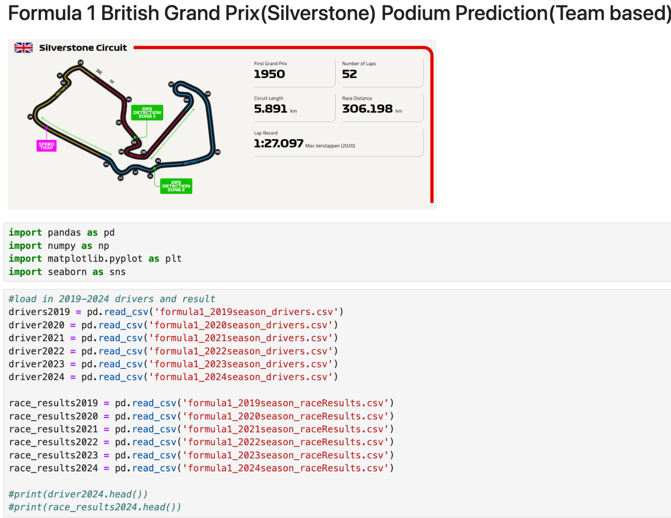
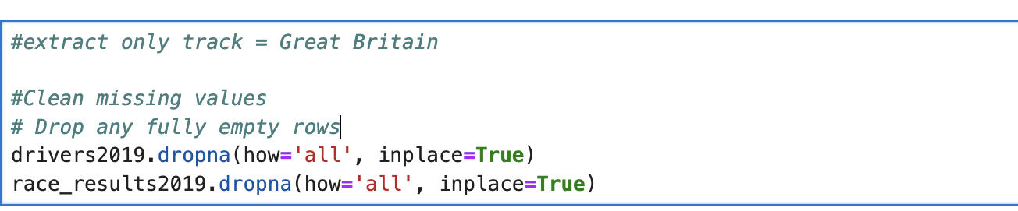
Workflow
Import, clean and merge data
Calculations
Visualization Ideas
Conclusion
Assumptions
Historical trends are reliable indicators.
Crashes, mechanical failures, and weather unpredictability are not modeled.
Data assumes team stability per race (no mid-season driver switches unless tracked).
1 .
2 .
Final Data Format

Slide 3
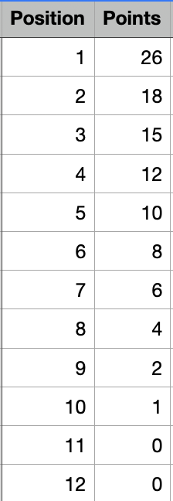
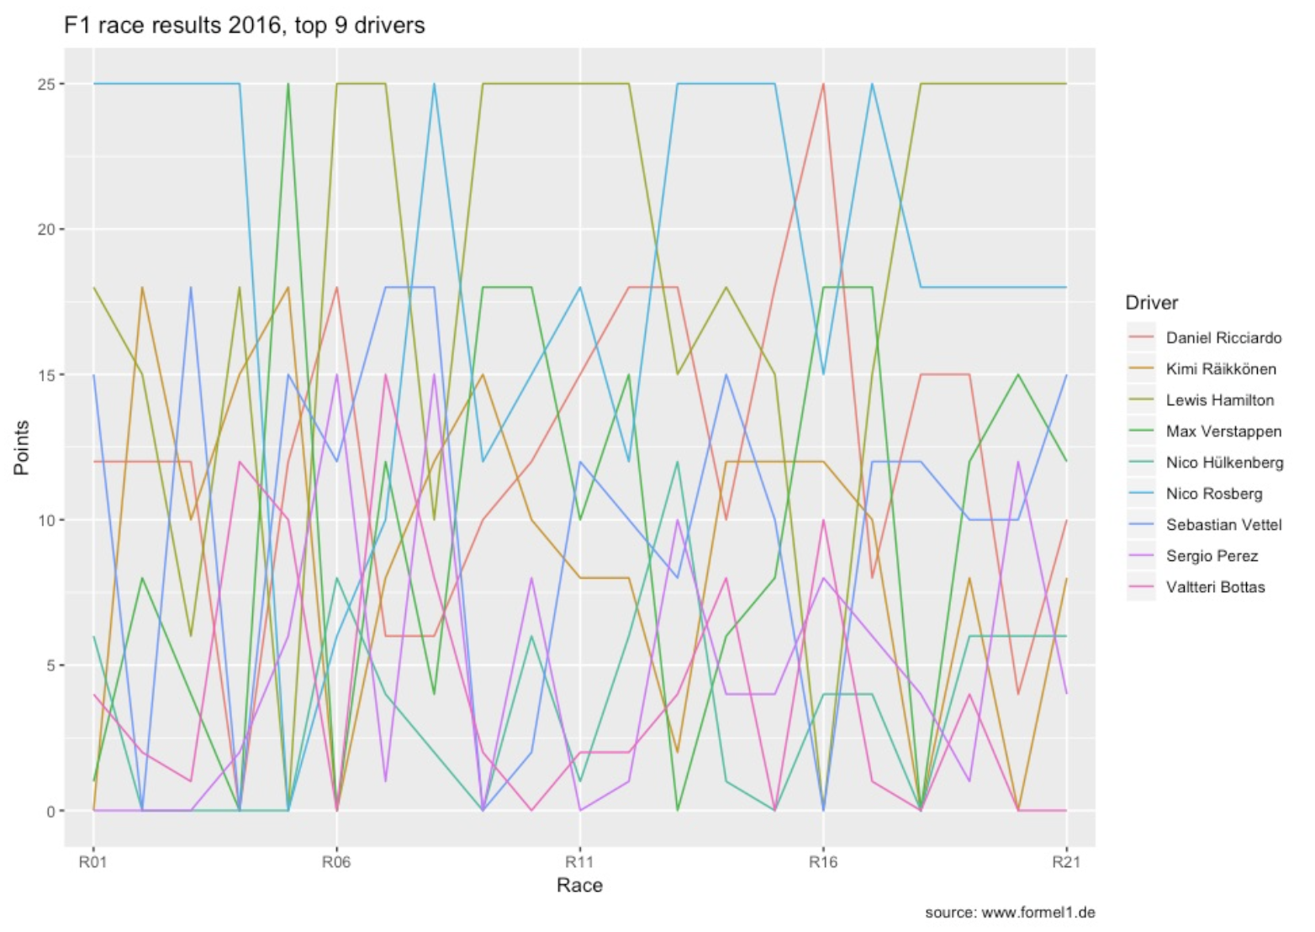
Research Questions: Does a driver’s starting position impact race results?
Additional questions:
Which team improved their position the most?
Which team accumulated points most steadily?
Was the driver who set the fastest lap one of the drivers (team) on the podium?
Features:
Avg Start, Avg Finish, Fastest Laps, and Rolling Points
Visualizations
Compare Average Start and Finish Positions (Per Team)
Points Progression Across Races
Scatter plot: Start position vs. Finish position, change in position.
Point - Position relationship
Example points progression plot
3 .

