Slide 1


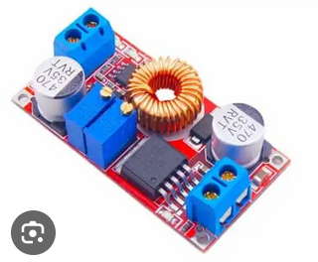
Buck Regulators / buck converters
Betty Simpson
Intro to robotics

Slide 2
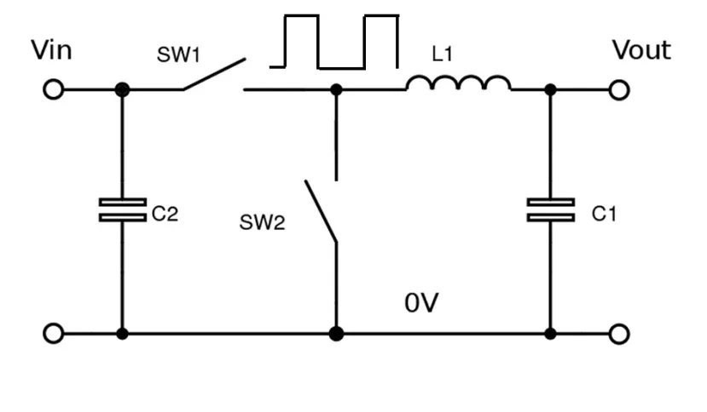
What is a buck regulator (buck converter)
Buck Regulators: provide a stable DC-DC conversion at point of load by lowering voltage and stepping up current. Load or voltage can be varied or changing. This form of regulation is more efficient than an linear power supply.
-“Buck”: to reduce or get rid of. “Boost” to increase
-Also known as a step down regulator or switching regulator. Step down regulators are an umbrella category in which all buck regulators are step down regulators but not all step down regulators are buck regulators
-Previously we used transformers to transform from AC to desired DC voltage which is large and inefficient. Increased access to microcontrollers and cheap components from China made buck regulators/converters extremely popular.
-These circuits play well with PWM, or plays similarly as PWM.
Overview of circuit in order of component:
Input V – BR takes power (battery or supply etc.)
Switch – Rapid switches on and off
Inductor – Stores energy that in turns lowers voltage
Diode – Provides path/”cleans up”
Output V – Regulator maintains with duty cycles (similar concept to PWM)

Slide 3
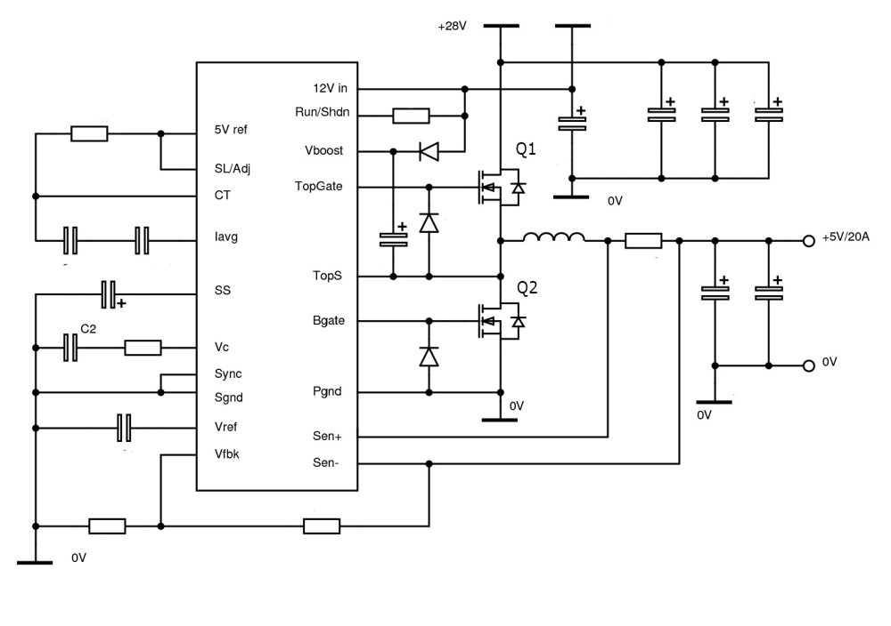
Development
Early ICs introduced (linear)
Fixed Frequency Controllers created
Current Mode control (measuring and controlling with PWM)
Added second control loop for stability
Digital devices rather than analog
The largest change to BR/BC’s is the addition of digital controls and microcontrollers. The microcontrollers are an important communication system when maintaining voltage output when other variables change or for disabling certain phases to save energy. The same job could be done at a very noisy and mechanical level that now extremely small BR/BC’s can do at a high performance level without outputting heat.

Slide 4
Where Br/BC is used
Buck Regulators/Converters are useful in almost an infinite amount of applications and circumstances such as:
DC power supplies
Battery powered devices/uninterruptable supplies: Power-tools, mobile device, electric vehicles and devices that cannot be “unplugged” from power
Sensitive equipment: medical, scientific, aviation equipment that either need stability, reliability or minimal interference
Computer memory/GPUs: components that require specific voltage
Devices that are always connected to the internet (IoT): to regulate voltage so the user can save energy

Slide 5
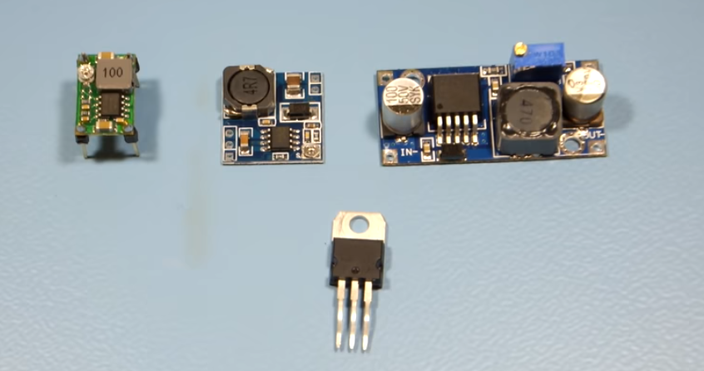
advantages
High efficiency – stores and releases energy without high loss or high heat
Versatile – anywhere there is a need for power management
Size – can be made extremely small yet still powerful unlike linear systems
Fast – respond quickly to changes
Inexpensive – simple components are cheap and available to make and distribute
The largest advantage of a buck regulator/converter is the efficiency. The top three photos are buck converters, and the bottom is a commonly used linear power supply. The linear supply creates an extreme amount of heat. Buck regulators are extremely necessary to the modern computing world because higher efficiency and lower heat mean one can squeeze much more computing power into one place. Many linear power supplies will shut off if they reach heat limits and consume almost up to 90% more power. Buck regulators can even regulate overheating in some applications by turning on and off again to cool off.

Slide 6
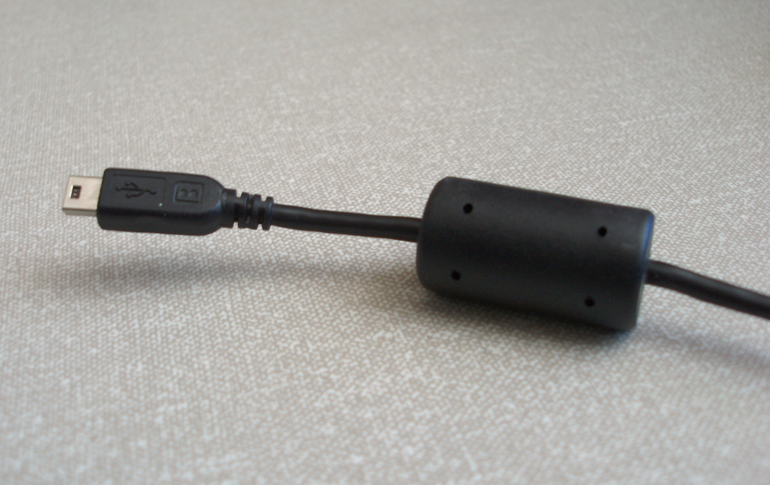
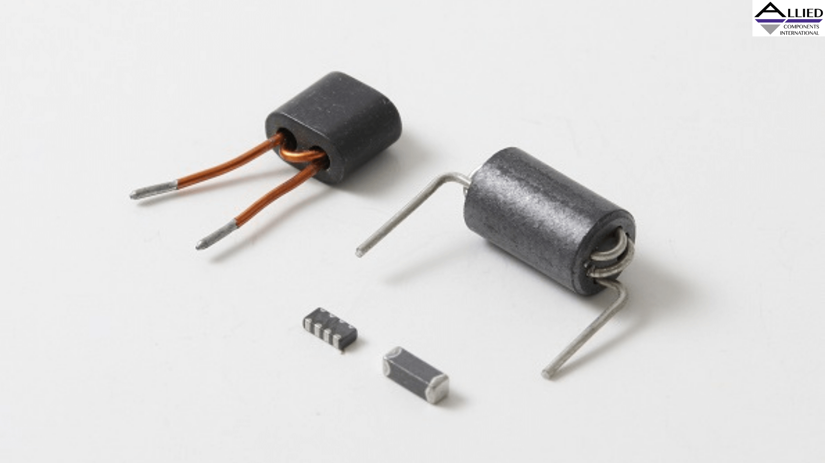
disadvantages
Only one function
Complex: controlling BR/BC requires high level circuitry which can actually raise prices of design or ability to fix. The components involved within the circuitry undergo a lot of stress and rely on perfect design to preform correctly.
High frequency noise, EMI and rippling: These circuits produce a lot of interference that require filtering or else it will damage components with unwanted voltage. Voltage ripple can be possible when using Buck Regulators – usually these surges cause distortion but can also make circuits malfunction.
The disadvantages of a buck regulator/converter fundamentally come down to one thing: noise. Though these circuits are designed only to do high to low conversion (unless using a buck/boost), most electronics designers know that what you are getting is a modern and application specific.
Noise comes in ripples and high frequency ringing. High frequency ringing from these circuits is mitigated by the addition of ferrite beads or ceramic bypass capacitors. (ferrite beads shown above)
-note: this noise is also a disadvantage when working with radio frequencies and one would be better off with linear power.

Slide 7
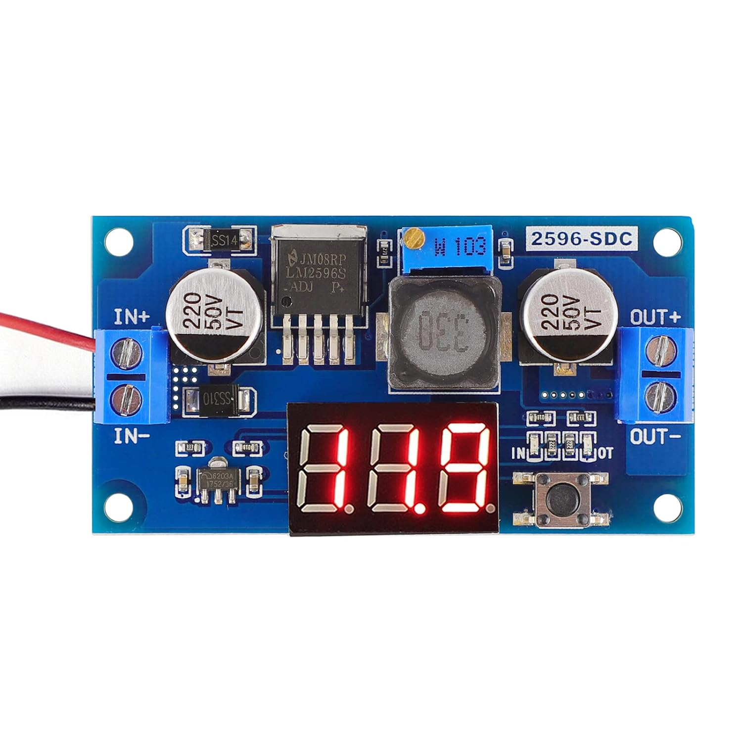
Variations of the buck regulator/buck converter
Synchronous and Non-Synchronous:
Synchronous buck converters do not use diodes whereas non-synchronous do.
Multiphase and Current sharing
A method to mitigate interference and increase reliability, many buck converters are used in parallel.
Current and Voltage
Both of these kinds of regulators are based on the kind of output. Current output is considered better for transient responses and voltage is considered simpler. Peak current mode control is another variation that regulates peak inductor current rather than output.
Digital Buck Converter
These are the most modern of buck regulators and can be programmed for maximum efficiency.
Fixed and Variable Frequency
*Very little information on this: I could only seem to gather that fixed frequency can handle small loads with little noise, and variable can handle “more variable” conditions and are noisier?
Burst Mode/Soft Start/Wide Input:
These are more specialized regulators that are situation and circumstance specific to design, application and project.
As previously listed there are many variations of buck regulators. This particular one is found on Amazon for aprox $8. The converter itself is analog and you can use a small screwdriver to regulate the step down voltage. A simple pushdown button is included with an LED that activates a voltmeter to accurately test output. These small converters can be used for household items (ex. Installing USB ports or other power conversion needs) or hobbyist projects (audio, 3d printing, rc cars etc)

Slide 8
Working bibliography
DC-DC converter design basics (part 1): Buck Converters. (n.d.-a). https://www.electronicdesign.com/technologies/power/article/21270572/renesas-electronics-dcdc-converter-design-basics-part-1-buck-converters
Home. RECOM. (n.d.). https://recom-power.com/en/rec-n-an-introduction-to-buck,-boost,-and-buck!sboost-converters-131.html?0
How the buck converter has evolved. (n.d.). https://www.rs-online.com/designspark/how-the-buck-converter-has-evolved
Megha Jain, content writer. (n.d.). An introduction to buck converter: Working Principle, Advantages and Applications. siliconindia. https://www.siliconindia.com/news/business/an-introduction-to-buck-converter-working-principle-advantages-and-applications-nid-222605-cid-3.html
PDF, D. (2022, November 18). Input and output noise in Buck Converters explained. Analog Devices. https://www.analog.com/en/technical-articles/input-and-output-noise-in-buck-converters-explained.html
Switching regulator fundamentals (rev. C) - texas instruments india. (n.d.-b). https://www.ti.com/lit/an/snva559c/snva559c.pdf?ts=1640446005688&ref_url=https%253A%252F%252Fwww.google.com.hk%252F

