Slide 1

Exploratory Data Analysis
GM2 Cab Investment
14/10/2021

Slide 2
Agenda
Executive Summary
Problem Statement
Approach
EDA
EDA Summary
Recommendations

Slide 3
Background
XYZ is a private firm in US. Due to remarkable growth in the Cab Industry in last few years and multiple key players in the market, it is planning for an investment in Cab industry and as per their Go-to-Market(G2M) strategy they want to understand the market before taking final decision.
Objective: Finding a sustainable market for cab investment.

Slide 4
Data Preparation and Properties
The data consists of 4 sub-datasets that contain information on 2 cab companies.
In order to get a unified dataset to work with, the 4 sub-datasets were combined to come up with one main dataset that consisted of:
-16 features
-Time: 2016-01-31 to 2018-12-31
- 359392 entries
Users are seen as the cab users in the dataset. The Profits were calculated from the difference of Price charged and the cost of trip.
Detection of outliers is present in the Price charged. However this is not treated as a barrier in calculating the profit.

Slide 5
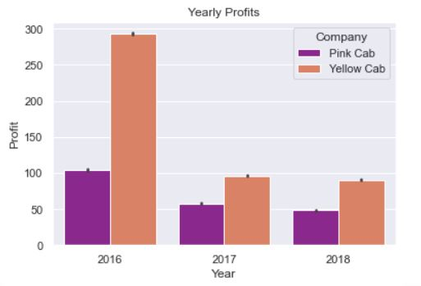
Yearly Profit

Slide 6
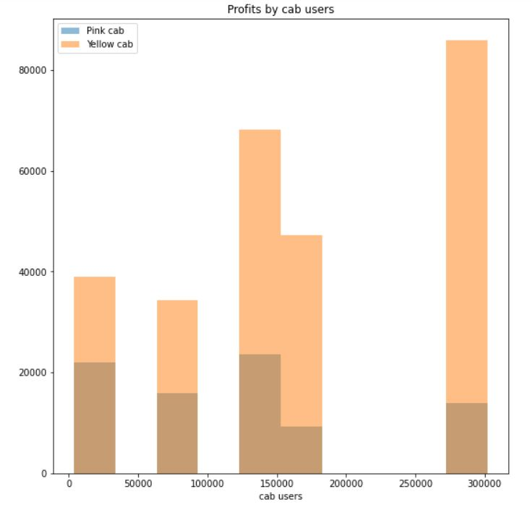
Profits(Users)
Yellow cab records the highest number of users and profits.

Slide 7
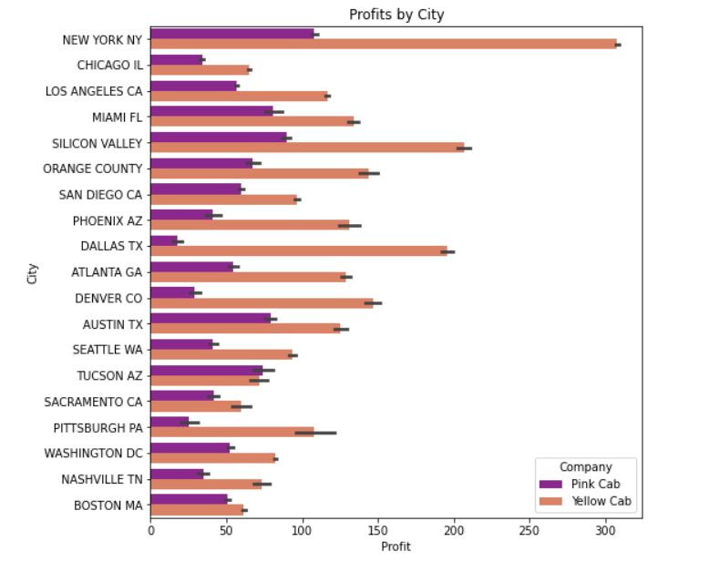
Profits(Cities and the cabs)
New York has the highest yellow cab users but generally the yellow cab has many users distributed in the cities.
Which also means that New York records the highest profits for the yellow cab.

Slide 8
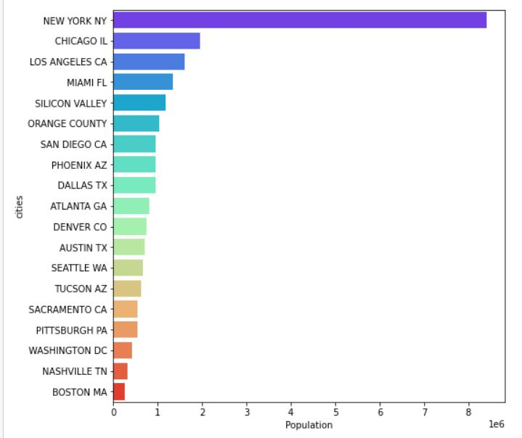
Population Segmentation
New York has the highest population which is the reason why it has many cab users.
Boston has the lowest population

Slide 9
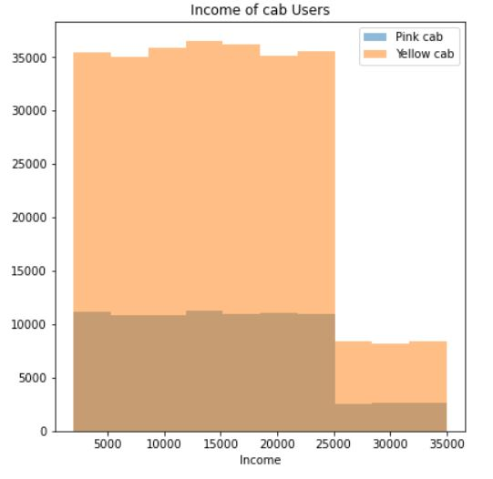
Income of cab users
Many cab users earn a low-medium income which concludes many are from a low- middle class.
People earning low-medium income mainly use the Yellow cab.

Slide 10
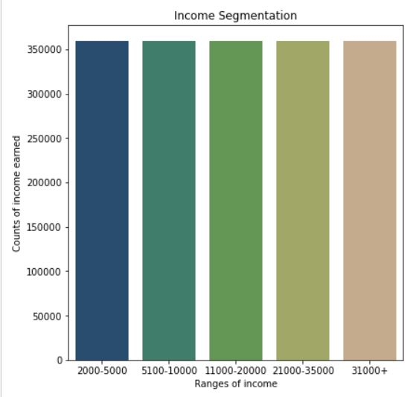
Income segementation

Slide 11
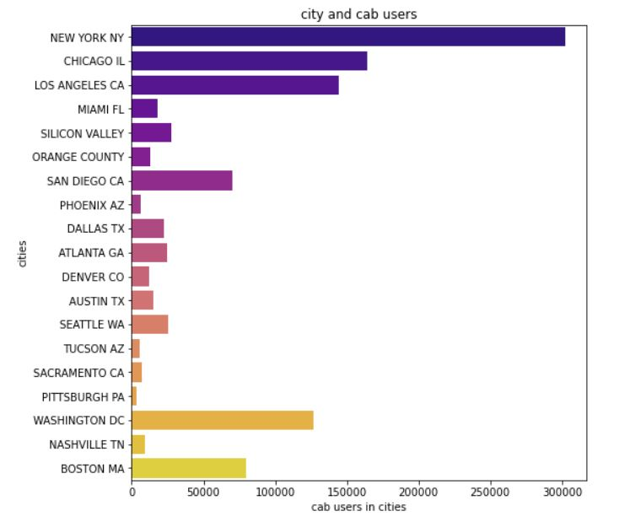
Customer segementation
These cities have lowest cab users
Pittsburgh
Sacramento
Tucson, Arizona
Nashville
Phoenix
It is striking to notice that Boston has the lowest population but has a high number of cab users compared to the cities above.

Slide 12
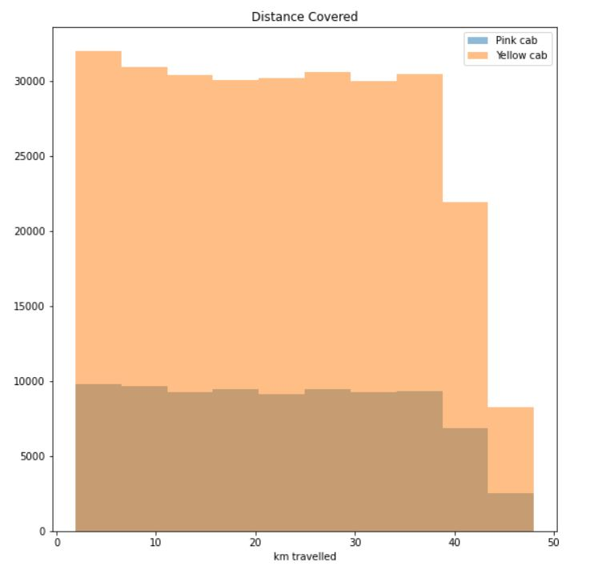
Distance covered by the two cabs
Yellow cab travels more then the pink cab and this could be because the yellow cab has many users.

Slide 13
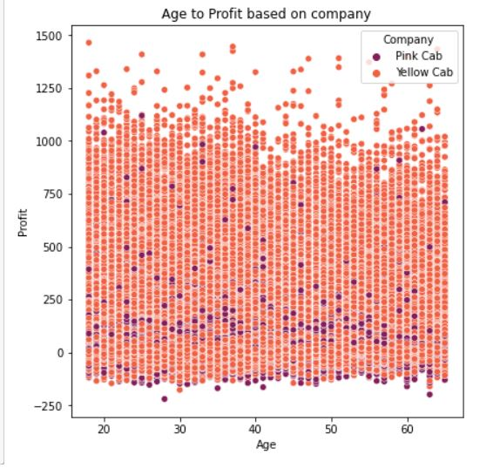
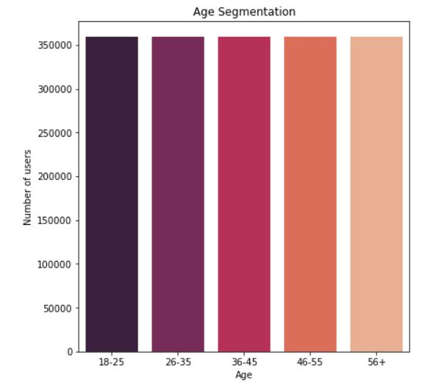
Age segmentation & cab profits per age

Slide 14
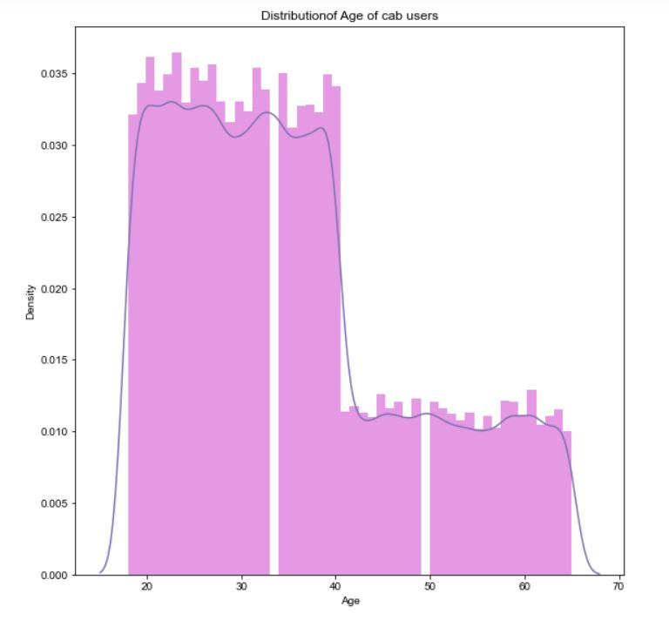
Distribution of Age
Most cab users are young adults aged between 18-40.

Slide 15
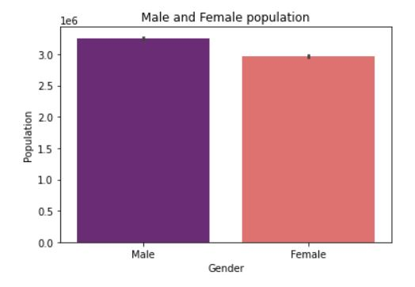
Male and Female population

Slide 16
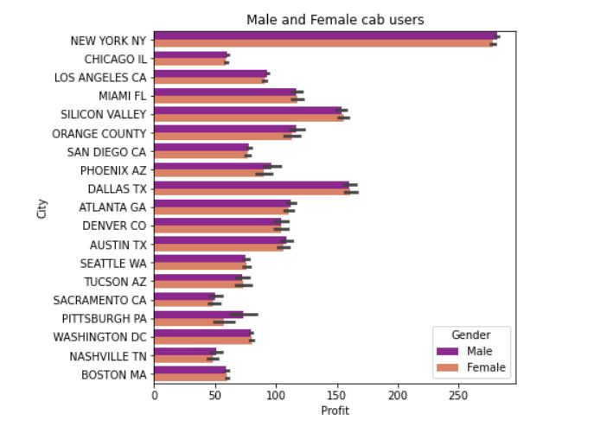
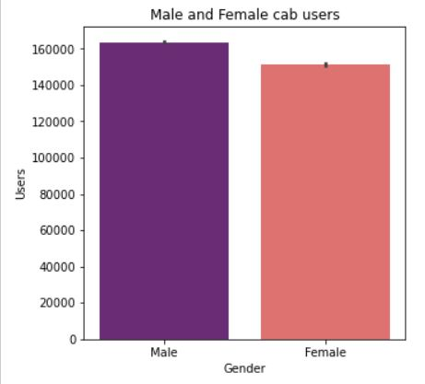
Male and Female cab users

Slide 17
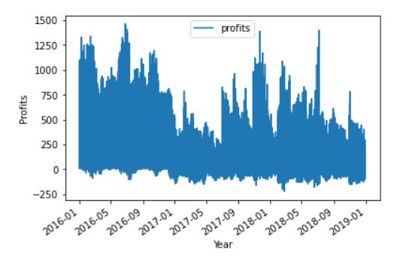
Seasonality demand by year
Seasonality demand for the cabs is steady with a flowing increase and decrease throughout the year.
However 2017 had the lowest demand especially on the first six months and then picked up in 2018

Slide 18
Recommendations
Customer-reach- Yellow cab has generally outperformed the pink cab and has a great customer reach because it is very popular.
Number of trips- Yellow cab has made the highest overall number of trips according to the high distance covered by the cabs.
Affordability- Most of the population is low-medium income earners and the yellow cab and pink cab are affordable but still the yellow cab takes the lead.
Accessibility- since the yellow cab seems to be most popular, it is easy to access it especially in big cities like New York and California.
Age-groups- The yellow cab has great fondness among young people considering also a lot of young people live in the cities as well.

Slide 19
Thank You

